Slide 1
INFO 6105 Assignment 2
Vignesh Gunasekaran
Neuid: 001029530
Feb 02, 2022

Slide 2
Linear Regression on Boston Housing Dataset Problem:
Linear Regression between the dependent variable ‘MV’ and independent variables from final dataset with reduced number of columns, utilizing p-value, correlation coefficient, and multiple R-squared statistics.
For Linear regression, out of statsmodels & sklearn – python libraries, I used both.
Other libraries: pandas, matplotlib, scipy.

Slide 3
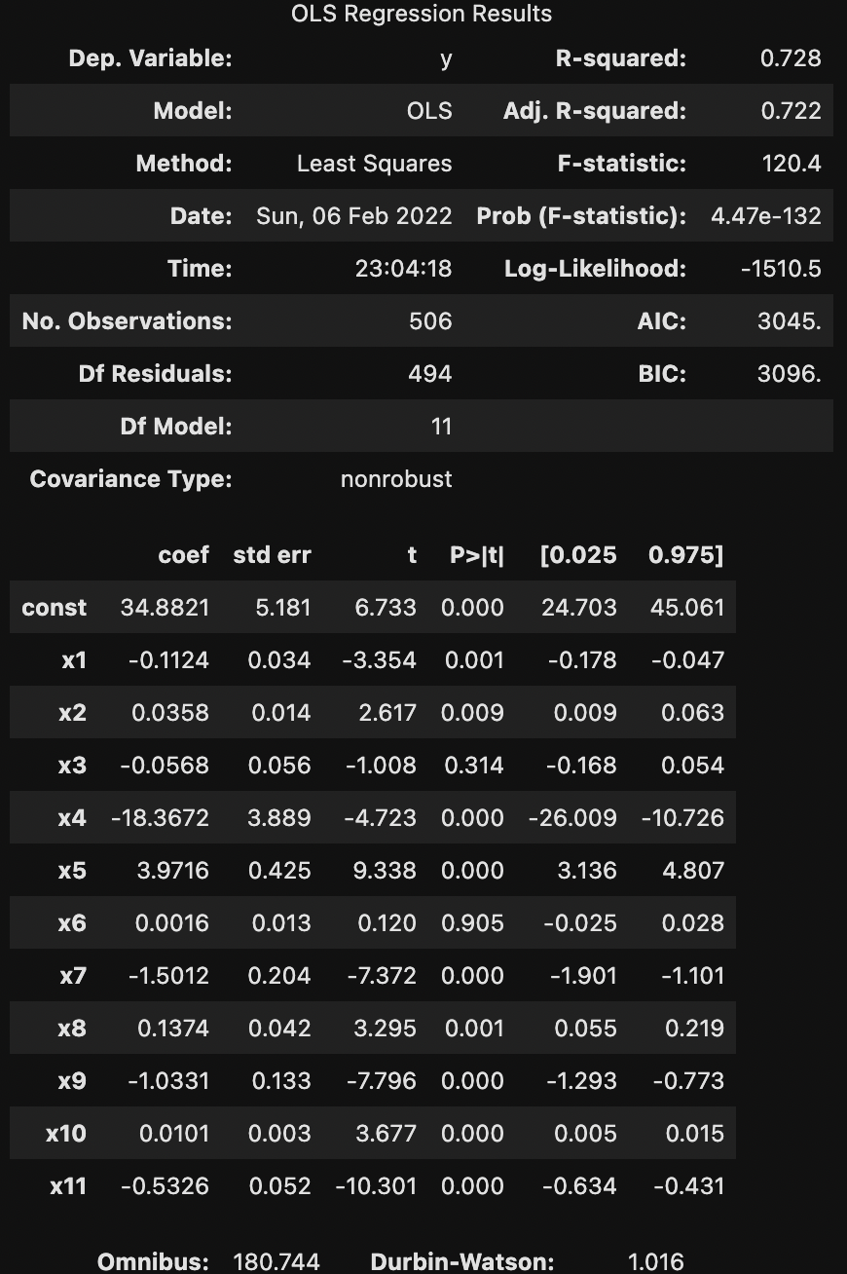
Linear Regression on Boston Housing Dataset Results:

Slide 4
Logistic Regression on Loan Dataset Problem:
Logistic Regression between dependent variable ‘Decision’ and independent variables that are of categorical values with irrelevant variables removed. Performed the one-hot encoding.
For Logistic regression, I have used sklearn python libraries.
Other libraries: pandas, matplotlib, scipy.

Slide 5
Logistic Regression on Loan Dataset Results:

