Slide 1
Prediction Accuracy Comparison on Loan Dataset over Decision Tree & Random Forest INFO 6105 Assignment 3
Vignesh Gunasekaran, COE @ NEU
Feb 09, 2022

Slide 2
Problem Description & Approach
Decision Tree construction on the Loan Dataset and accuracy calculation.
Used sklearn library.
Used LabelEncoder, DecisionTreeClassifier, StandardScaler, accuracy_score routines.
Using Random Forest algorithm, calculating the accuracy.
Used sklearn library.
Used RandomForestClassifier routine.
Comparing both accuracies and concluding.

Slide 3
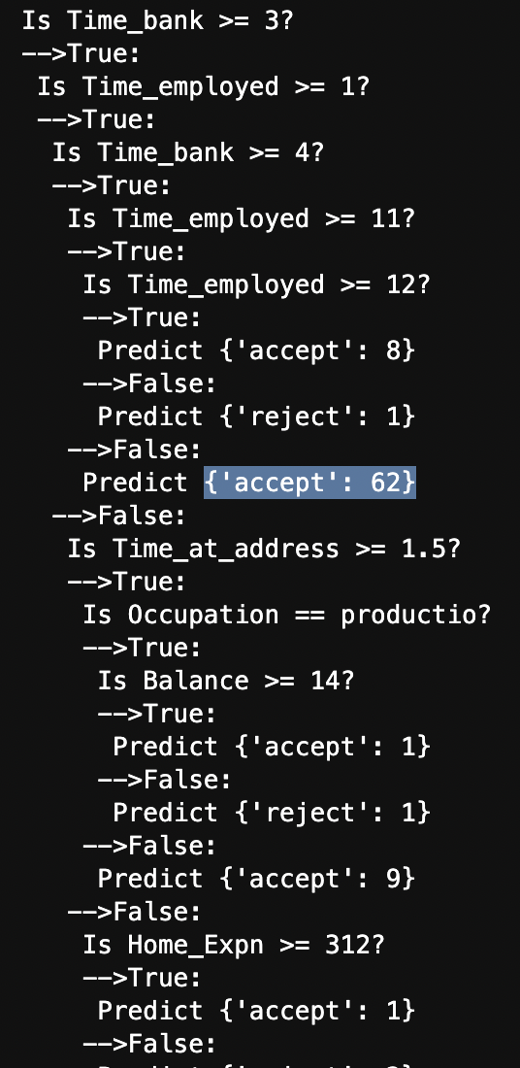
Results
Part of Decision Tree
Initially,
After dropping further columns,

Slide 4
Conclusion
Evidently, we can see that Random Forest algorithm provides much better accuracy than Decision Tree algorithm.
Hence, it is advisable to consider Random Forest algorithm on Loan Dataset for accurate result predictions.

