Slide 1
Silhouette analysis using GMM & K-Means on Boston Housing Dataset INFO 6105 Assignment 5
Vignesh Gunasekaran, MSIS @ NEU
Feb 23, 2022

Slide 2
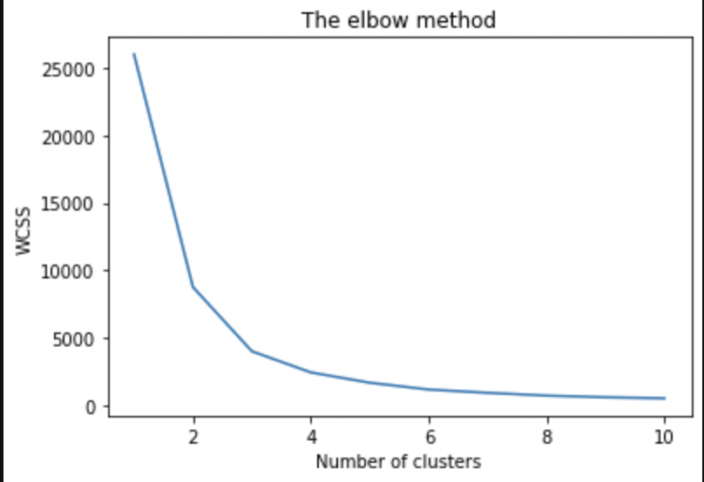
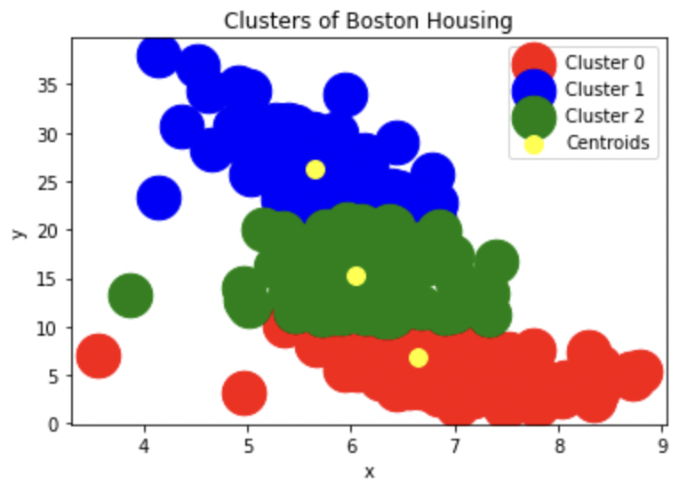
K-Means Procedure & Result
Obtain dataset and identify independent variables.
Compute WCSS arrays and find K (3), number of cluster, by the Elbow method.
Plot clusters.
Find silhouette score for k = 2,3,4,5.
Justify with those scores, the k value considered is the apt one for our dataset.

Slide 3
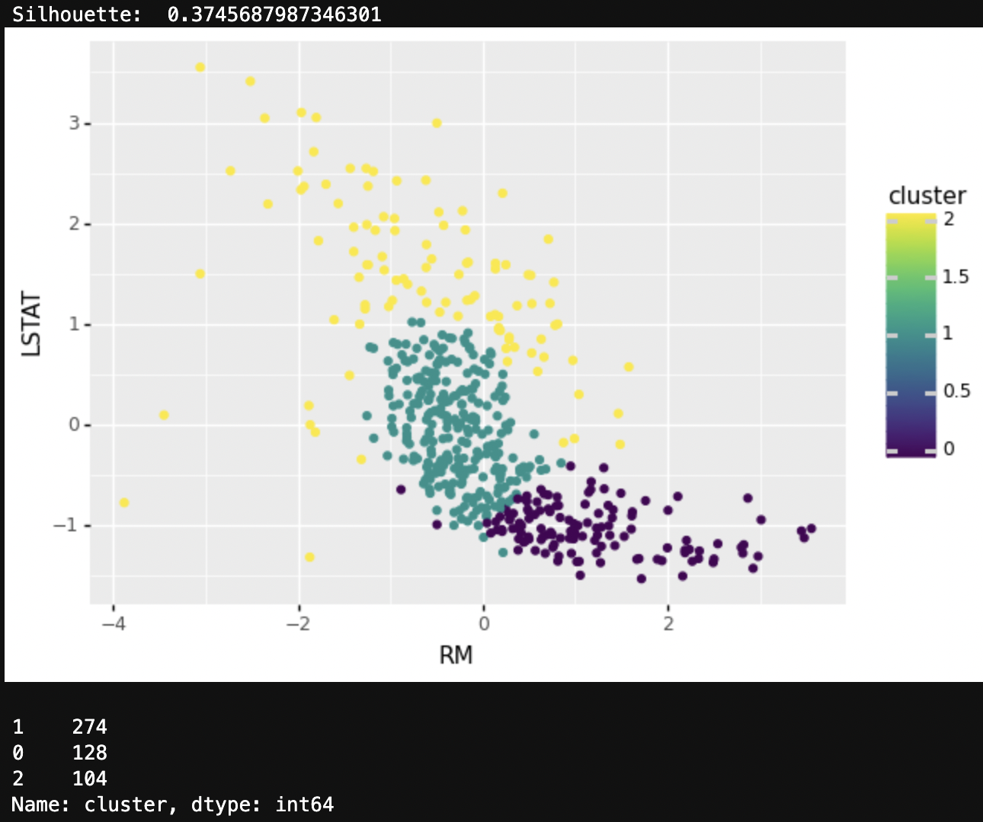
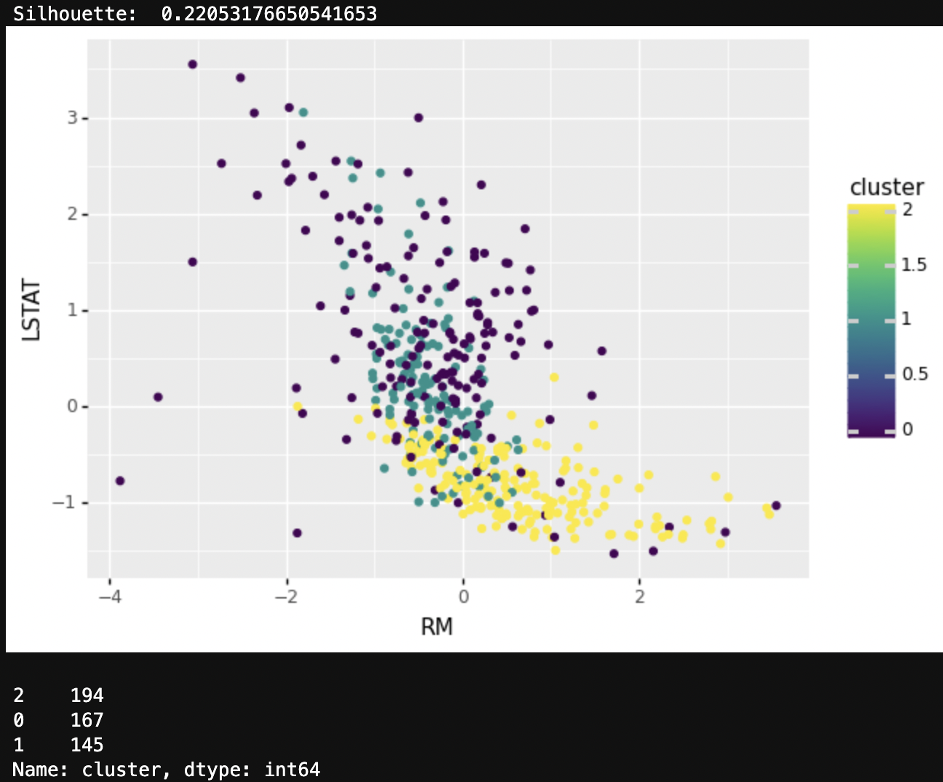
GMM - Gaussian Mixture Model Procedure & Result
when considering independent variables:
'RM’, 'LSTAT’: 'RM’, 'LSTAT’, 'INDUS’, 'NOX’, 'TAX’, ‘PT’:

Slide 4
Conclusion
Silhouette coefﬁcient:
- Values near 0 denote overlapping clusters.
For both K-Means & GMM, the silhouette values are near to 0. The overlapping of clusters is visible plots drawn.

