Slide 1
SVM Classification Analysis using Kernel types on Loan Dataset INFO 6105 Assignment 6
Vignesh Gunasekaran, MSIS @ NEU
MAR 2, 2022

Slide 2
Introduction
“Support Vector Machine” (SVM) is a supervised machine learning algorithm that can be used for both classification or regression challenges. The idea of SVM is simple: The algorithm creates a line or a hyperplane which separates the data into classes.
Some popular kernels: Linear, Polynomial, Radial – rbf, Sigmoid
Libraries used: pandas, numpy, matplotlib, and sklearn (svm, model_selection, preprocessing, metrics).
Training:Testing set ratio = 80:20
Resolved categorical data via get_dummies()

Slide 3
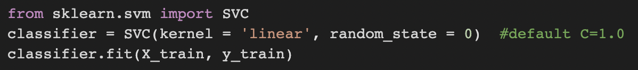
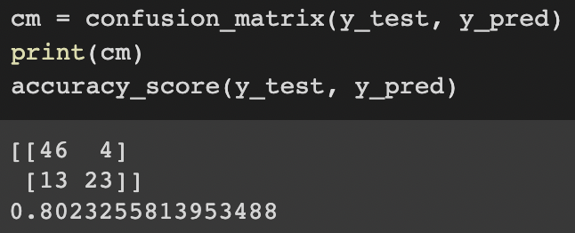
SVM - Linear Procedure & Result

Slide 4
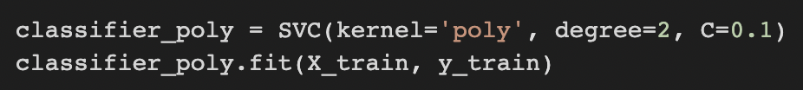
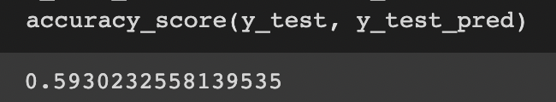
SVM - Poly Procedure & Result

Slide 5
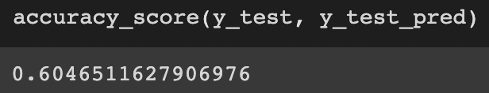
SVM - Radial Procedure & Result

Slide 6
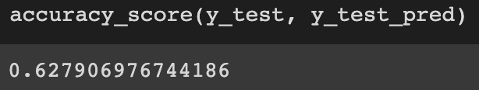
SVM - Sigmoid Procedure & Result

Slide 7
Conclusion & Future Expansions
Accuracy scores: for C=0.5
Linear: 0.79
Poly: 0.66
Radial: 0.60
Sigmoid: 0.62
It is evident that: Linear Kernel of SVM provides better accuracy score for our Loan dataset. In fact, this is much better score than Linear Regression.

