Slide 1


Department of CSE
CRESIGNITE - PROJECT EXPO 2K26
TITLE PAGE
Project Title- GoScheme
Theme- PS 13 — Government Scheme Discovery Assistant
Team Name- Techies
Team Member Names- Vignesh A, Musthaba S, Mohammed AlHameed

Slide 2
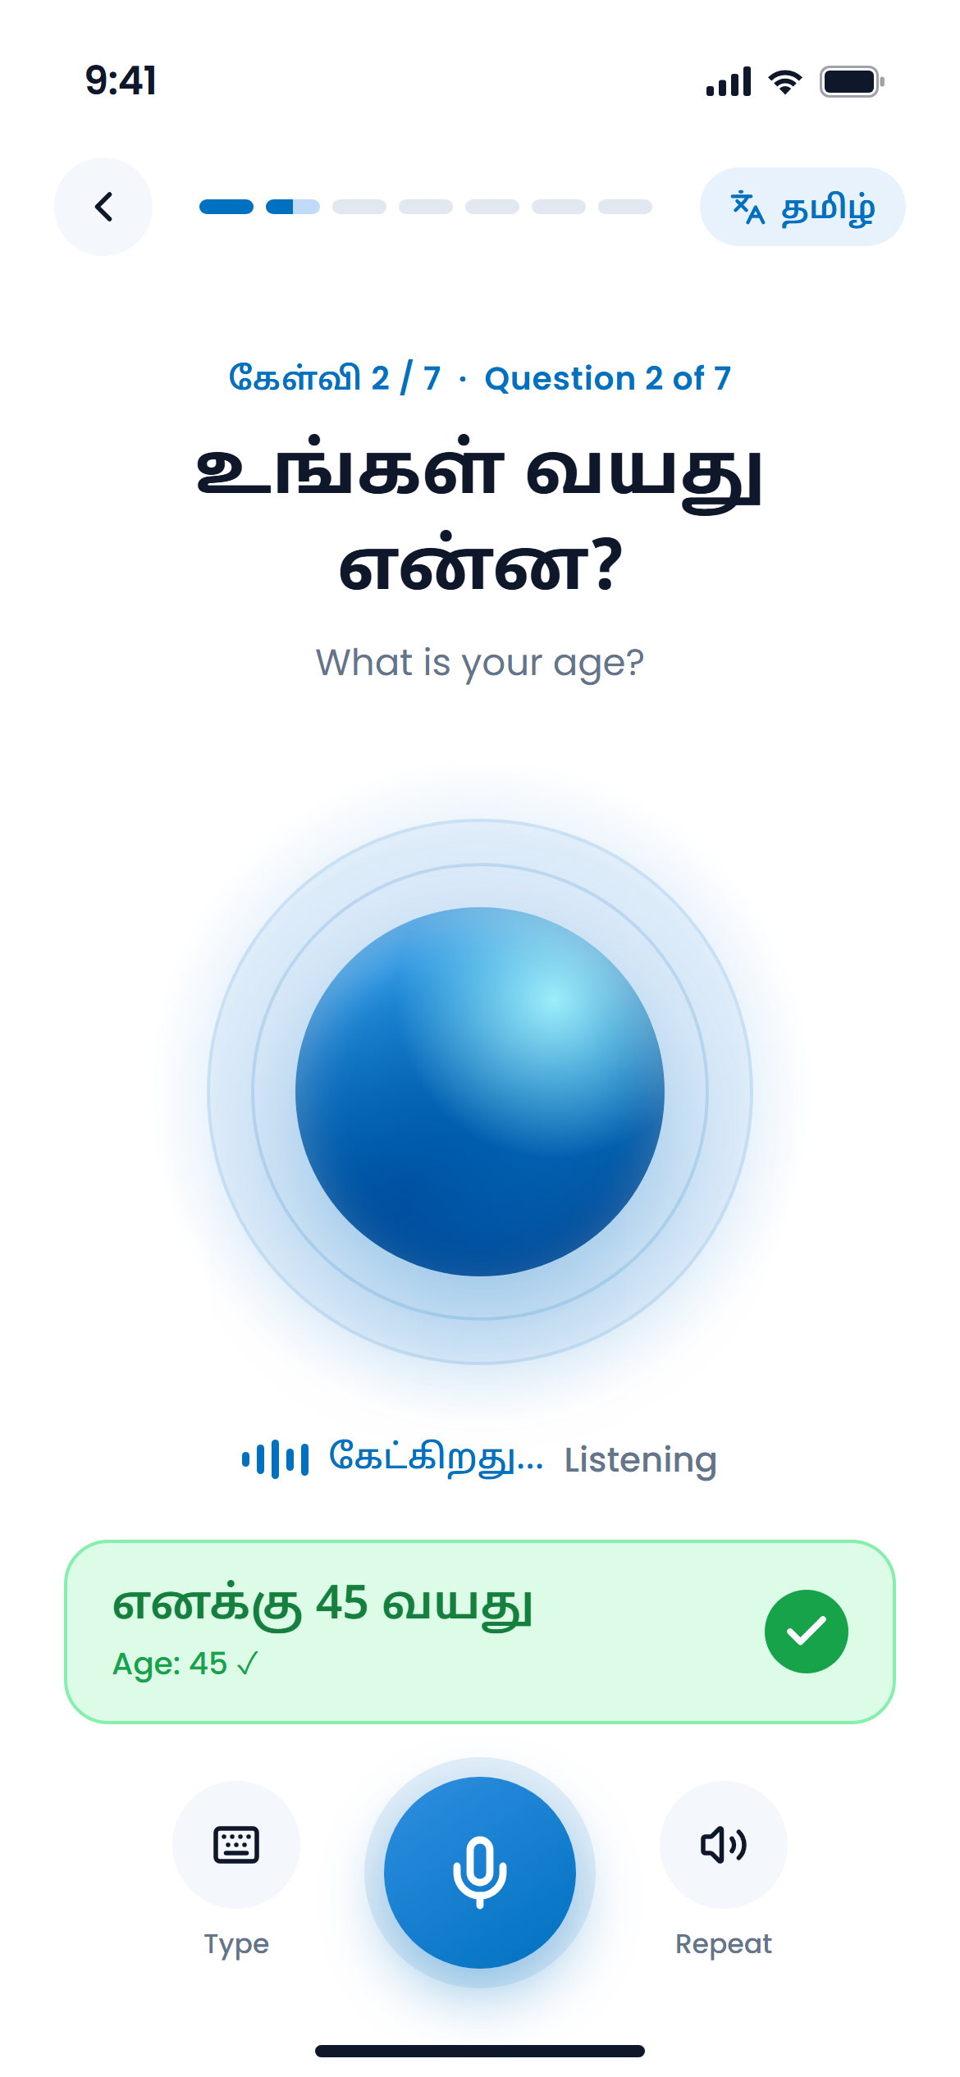
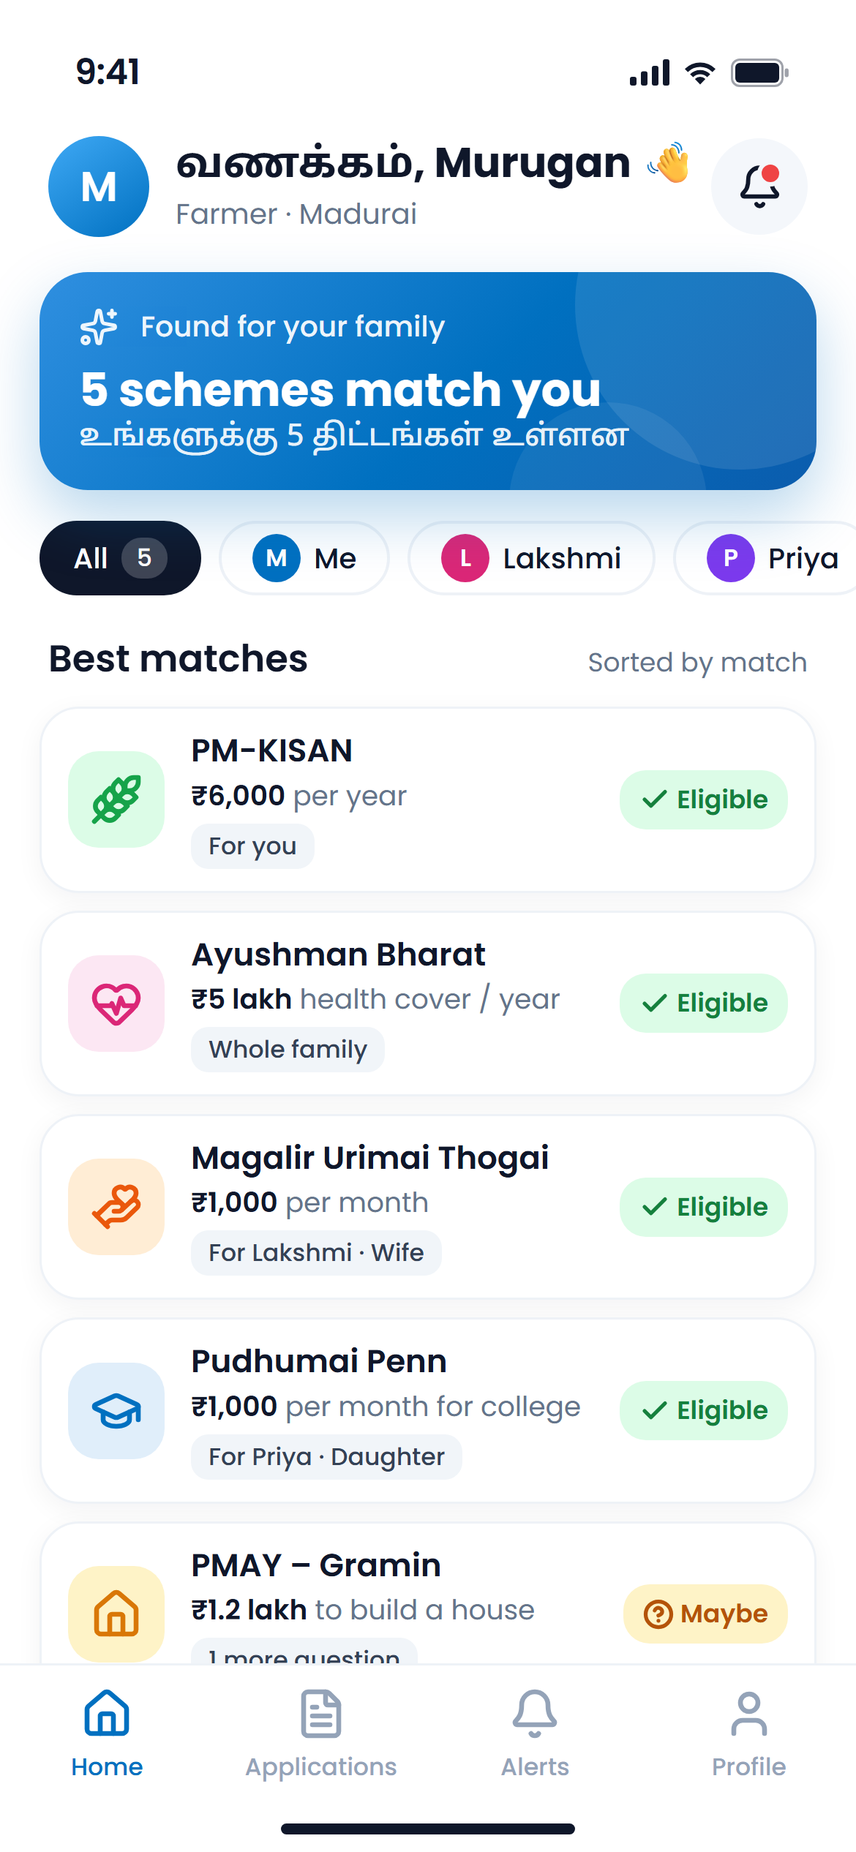




Proposed Solution/Idea Abstract
GoScheme
Find and apply for government schemes just by speaking in Tamil or English — free, with no middleman.
Speak
Answer simple questions by voice, one at a time
Match
See every scheme your family qualifies for, and why
Auto-fill
Profile + document photo (OCR) fill the form
Apply
Review, then get the ready-filled official form
“myScheme tells you, Haqdarshak does it for a fee — we do it free with AI.”

Slide 3
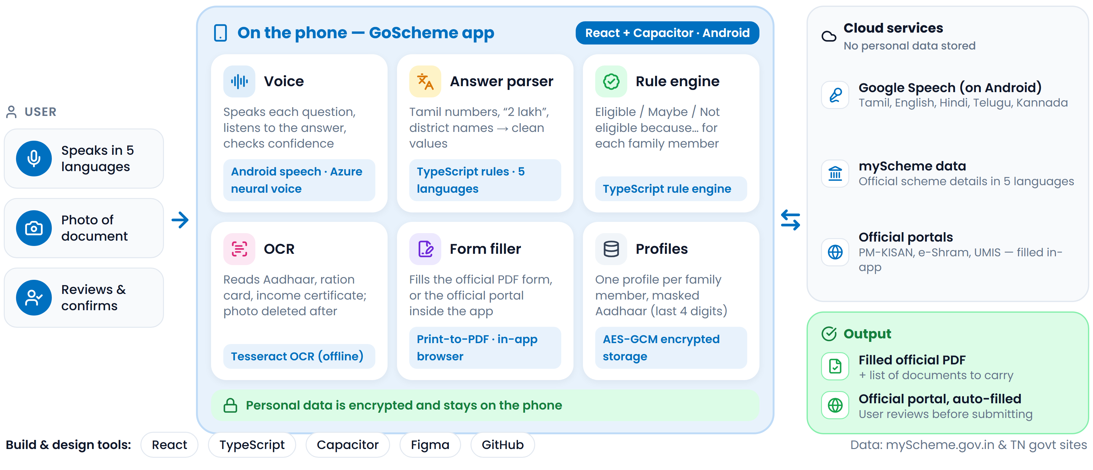
Technology/Tools Planned

Slide 4
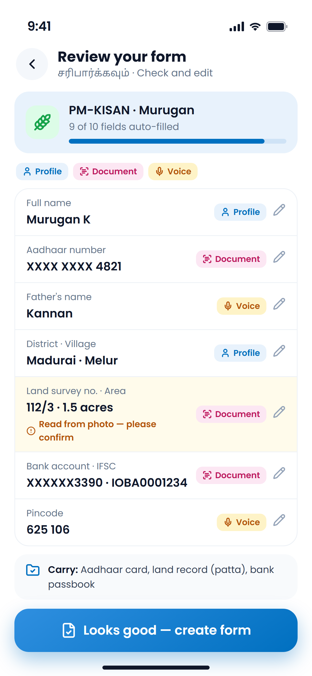
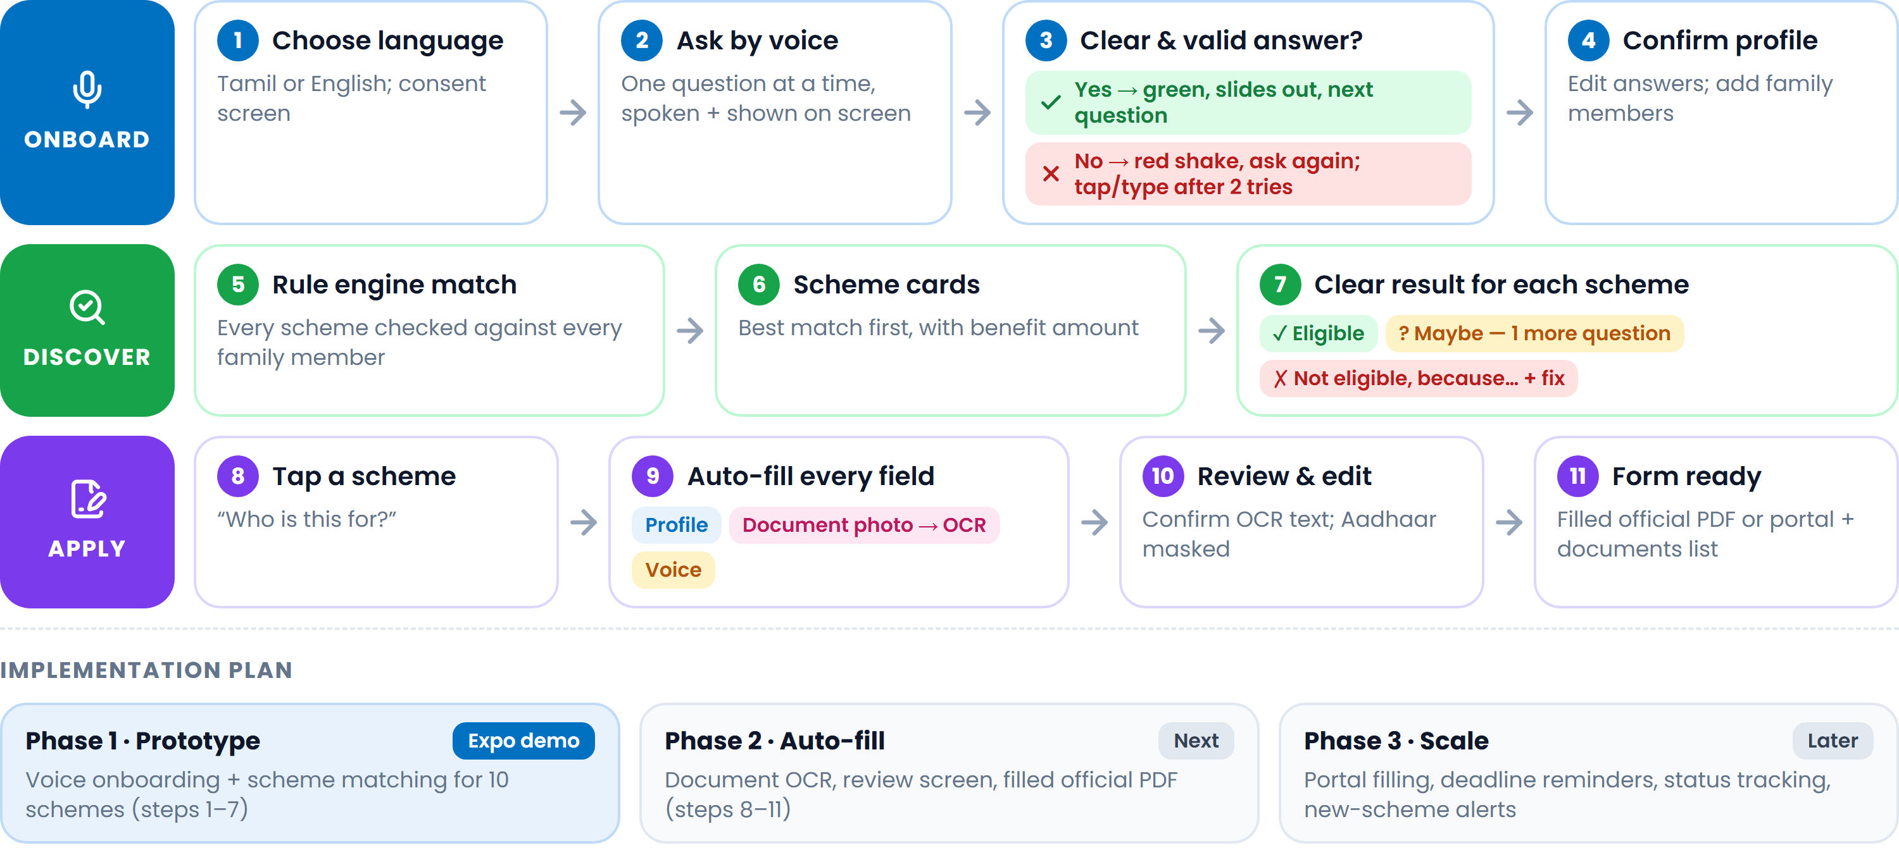
Expected Outcome
Methodology: how the app works
Expected outcome: anyone can find the schemes their family is eligible for just by speaking, and get a ready-filled official form — free, with no agent.

Slide 5
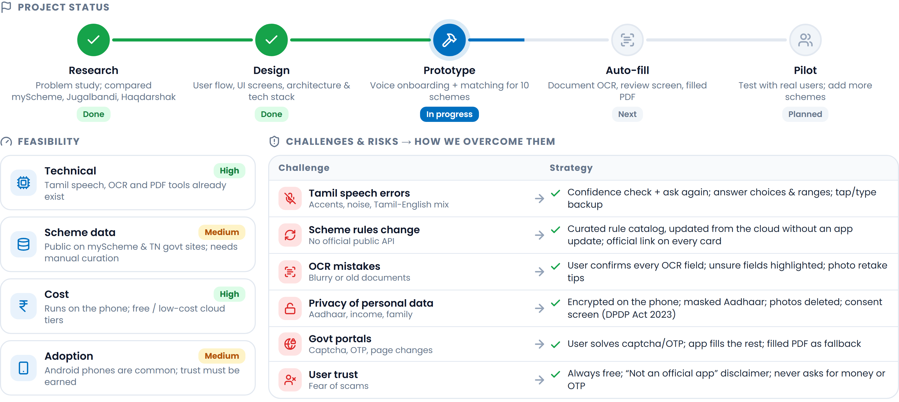
Project Status

Slide 6
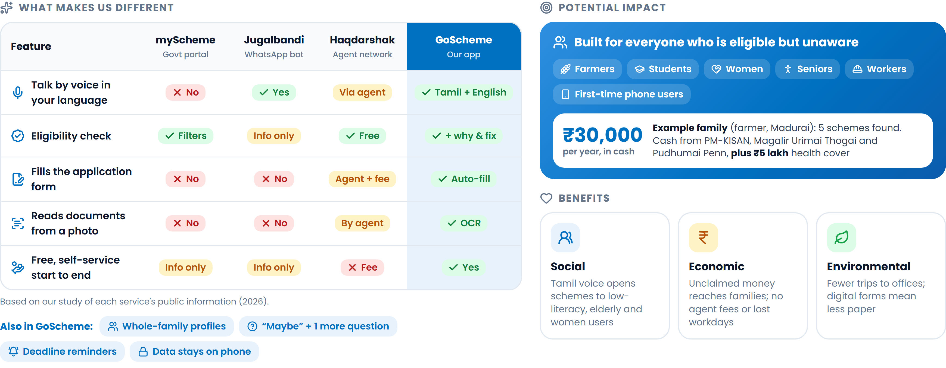
Novelty / Uniqueness

Slide 7




RESEARCH AND REFERENCES
Existing solutions studied
Government scheme sources
myScheme — National scheme platform myscheme.gov.in
Jugalbandi — Microsoft + AI4Bharat chatbot news.microsoft.com
Haqdarshak — Welfare access via agents haqdarshak.com
PM-KISAN pmkisan.gov.in
Ayushman Bharat PM-JAY pmjay.gov.in
Kalaignar Magalir Urimai Thogai (TN) kmut.tn.gov.in
Pudhumai Penn (TN) pudhumaipenn.tn.gov.in
PMAY – Gramin pmayg.nic.in
Language AI & technology
Law, privacy & data access
Bhashini — Govt Indian-language AI bhashini.gov.in
AI4Bharat — Indic speech models ai4bharat.iitm.ac.in
Capacitor — Android app framework capacitorjs.com
React — App interface react.dev
Tesseract OCR — Tamil support github.com/tesseract-ocr
Digital Personal Data Protection Act, 2023 meity.gov.in
API Setu — Govt API platform apisetu.gov.in
DigiLocker partner onboarding SOP api-setu.in (PDF)
Sources as of September 2026. Scheme benefit amounts on our slides come from these official sites.

