Slide 1


X-Fusion: Tri-Modal Cross-Attention Fusion
with Contrastive Feature Extraction
for Interpretable Chest X-Ray Diagnosis
Under the Guidance of Dr. K Vishal Reddy
PROJECT TEAM
24BD1A055E — P. Deepesh Reddy
24BD1A055G — R Vignesh
24BD1A055H — R. Sidhardh Reddy
24BD1A055J — Saharsh Machendra
24BD1A055Y — V. Surya Venkat
Project Review Presentation

Slide 2
Abstract
Problem Statement
In hospitals, diagnosis uses more than the X-ray: doctors also consider clinical notes, age, symptoms, laboratory results and patient history. Most current AI systems focus mainly on the image, struggle with multiple co-occurring diseases, and provide limited explanations of their decisions.
Project Objective
X-Fusion aims to build an intelligent multimodal diagnostic framework that jointly processes chest X-rays, clinical text and structured patient information to support reliable multi-disease prediction and explanations that are easier for clinicians to understand.
Proposed Approach
Three specialized encoders process the modalities: BiomedCLIP for X-rays, CXR-BERT for clinical notes and an MLP for structured data. Multi-head cross-attention learns relationships between modalities, while contrastive learning aligns their representations.
Expected Contribution
The system is designed to provide multi-label thoracic disease predictions together with LayerCAM visual explanations, SHAP-based structured-feature attribution and cross-modal evidence, aggregated into an interpretable clinical report.
Overview of the project — detailed implementation is explained in later slides.

Slide 3
Base Paper
DAViT: A Domain-Adapted Vision Transformer for Automated Pneumonia Detection and Explanation Using Chest X-Ray Images
Research Problem
CNN-based methods capture strong local patterns but may miss global relationships. Models pretrained on natural-image datasets can also have a domain mismatch when applied directly to medical X-rays.
DAViT Core Idea
DAViT combines a Vision Transformer for global feature learning with a shallow CNN for local feature extraction, and uses domain adaptation to make representations more suitable for chest X-rays.
Explainability
Grad-CAM is applied to generate heatmaps showing regions of the X-ray that contributed to the prediction, improving interpretability.
Base-Paper Results
Dataset: 5,856 chest X-rays.
Pneumonia detection: 97% F1, 96% AUC.
Pneumonia type classification: 81% F1, 84% AUC.
Ablation study showed the importance of domain adaptation, ViT and CNN components.
Relevance to X-Fusion
DAViT forms the visual foundation of our project. X-Fusion extends the single-image approach by adding clinical text and structured patient information, deeper cross-modal fusion and explanations across multiple input types.
Base-paper results shown here belong to DAViT, not to the X-Fusion project.

Slide 4
Literature Survey
Selected approaches discussed in the DAViT research paper and their relevance to X-Fusion
Work / Approach | Method | Key Contribution | Limitation / Relevance
Kermany et al. | Inception V3 / CNN | Demonstrated strong automated pneumonia detection and subtype identification from chest X-rays. | CNN-centric feature learning motivates the need for stronger global/contextual representations.
Rajpurkar et al. (CheXNet) | 121-layer DenseNet CNN | Showed that deep learning can achieve radiologist-level pneumonia detection on chest X-rays. | Primarily image-based; does not provide the multimodal clinical reasoning targeted by X-Fusion.
Hosen et al. | CNN + LIME / SHAP | Focused on improving interpretability for pneumonia detection. | Explanation remains centered on model features rather than joint image-text-patient reasoning.
DAViT (Fu et al.) | ViT + shallow CNN + domain adaptation | Combines global and local visual features and achieves strong pneumonia performance with Grad-CAM explanations. | Still centered on chest X-ray images; X-Fusion extends the idea to tri-modal diagnosis.
Research Direction
Move from isolated image analysis → multimodal clinical reasoning → multimodal explainability.
Survey is derived from approaches and discussion in the DAViT paper.

Slide 5
Existing System
Typical Input
Chest X-ray image is the primary input. Patient history, clinical notes and structured information are generally not integrated into the same diagnostic representation.
Typical Processing
CNNs, Vision Transformers or hybrid CNN–ViT architectures extract visual features and feed them to a disease-classification head.
Typical Explanation
Grad-CAM and related XAI methods highlight image regions associated with a prediction, helping users see where the model focused.
What existing systems do well
• Strong visual representation learning is already possible for chest X-rays.
• Vision Transformers improve global feature modelling through self-attention.
• Hybrid approaches can combine global ViT features with local CNN features.
• Domain adaptation can reduce the mismatch between natural-image pretraining and medical X-ray data.
Where the gap remains
• Most systems remain image-centric.
• Clinical notes and patient metadata are not deeply connected to image evidence.
• Simple feature concatenation cannot capture rich cross-modal relationships.
• Image-only heatmaps do not explain contributions from text or structured patient information.
Existing-system discussion is the motivation for the X-Fusion design.

Slide 6
Advantages of Existing System
1. Strong Image Feature Extraction
CNNs capture local patterns while ViTs use self-attention to model long-range relationships within the X-ray.
2. Better Visual Context with Hybrid Models
DAViT combines ViT and shallow CNN features so both global and local visual information can contribute to diagnosis.
3. Domain Adaptation
DAViT adapts representations toward chest X-ray characteristics, addressing the mismatch between natural-image pretraining and medical images.
4. Explainable Visual Predictions
Grad-CAM produces heatmaps that show important X-ray regions, making the model's visual focus more interpretable.
Why These Strengths Matter
X-Fusion keeps these useful visual ideas but adds clinical context, cross-modal reasoning and multimodal explanations.
These strengths are inherited as design motivation, not claimed as X-Fusion results.

Slide 7
Disadvantages of Existing System
1. Lack of Patient Context
An X-ray can be ambiguous without age, symptoms, previous notes or laboratory information. Image-only systems cannot use these complementary clues.
2. Modality Overpowering
If multiple data types are simply combined, high-dimensional image features may dominate smaller but clinically meaningful text or tabular signals.
3. Shallow Fusion
Basic concatenation or addition does not explicitly learn relationships such as linking a specific image region with a relevant clinical phrase.
4. Single-Image Explainability
Grad-CAM can show where the model looked in the image, but it does not explain how patient vitals or clinical notes affected the final prediction.
5. Deployment Considerations
The DAViT paper also notes generalization and computational-cost challenges that must be considered when moving medical AI toward different clinical settings.
Limitations are grounded in the project gap analysis and DAViT discussion.

Slide 8
Proposed System
Input 1 — Chest X-Ray
Medical image → preprocessing → BiomedCLIP visual representation → shallow CNN refinement.
Input 2 — Clinical Notes
Clinical text → cleaning/tokenization → CXR-BERT / clinical-language representation.
Input 3 — Patient Data
Age, sex, vitals and structured metadata → normalization/encoding → MLP representation.
Cross-Attention Fusion
Multi-head cross-attention dynamically connects image features with clinical text and structured patient features.
Contrastive Feature Alignment
InfoNCE-style contrastive learning aligns related modality representations in a shared space and reduces modality imbalance.
Multi-Disease Classification
Multi-label prediction head with asymmetric loss targets simultaneous co-occurring thoracic conditions.
Multimodal Explainability
LayerCAM + SHAP + attribution aggregation explain visual and structured contributions.
Clinical Output
Predictions + confidence + visual/text/structured evidence → interpretable report.
The proposed system is an architectural design; implementation results are not yet claimed.

Slide 9
Advantages of Proposed System
Holistic Diagnosis
Uses X-rays together with clinical notes and structured patient information instead of relying on a single image.
Balanced Multimodal Learning
Contrastive learning encourages aligned representations so image features do not overwhelm other clinically useful signals.
Deep Cross-Modal Connections
Cross-attention can learn relationships between image regions, clinical phrases and patient attributes.
Multi-Disease Detection
The multi-label classification design is intended to identify multiple co-occurring thoracic conditions simultaneously.
Multimodal Explainability
Explanation is not limited to the X-ray: visual saliency and feature attribution can be combined into one report.
Scalable Architecture
Modular encoders make it possible to extend the framework to additional modalities or medical-imaging domains in future work.
Core Contribution
Move from image-only prediction toward multimodal, explainable clinical decision support.
Advantages describe the intended design benefits, not experimentally verified X-Fusion performance.

Slide 10
Disadvantages of Proposed System
Higher Computational Cost
Three encoders, cross-attention, contrastive training and multiple explanation methods increase training and inference requirements.
Complex Data Requirements
The framework depends on reliable synchronization between images, clinical text and structured patient information; missing or inconsistent fields can complicate training.
Model & Pipeline Complexity
Multimodal preprocessing, alignment, loss balancing and explanation aggregation create more engineering complexity than a single-image classifier.
Clinical Validation Still Needed
The current project describes a proposed framework. Robust evaluation across institutions, populations and imaging protocols is necessary before clinical deployment.
Important Constraint
No actual X-Fusion accuracy or deployment result is presented until implementation and evaluation are completed.
This slide separates project design challenges from actual measured results.

Slide 11
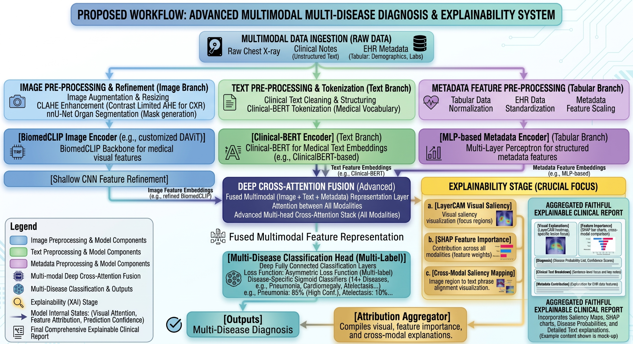
Architecture or Flow Diagram
Actual project architecture diagram from Untitled document — preserved for explanation.

Slide 12
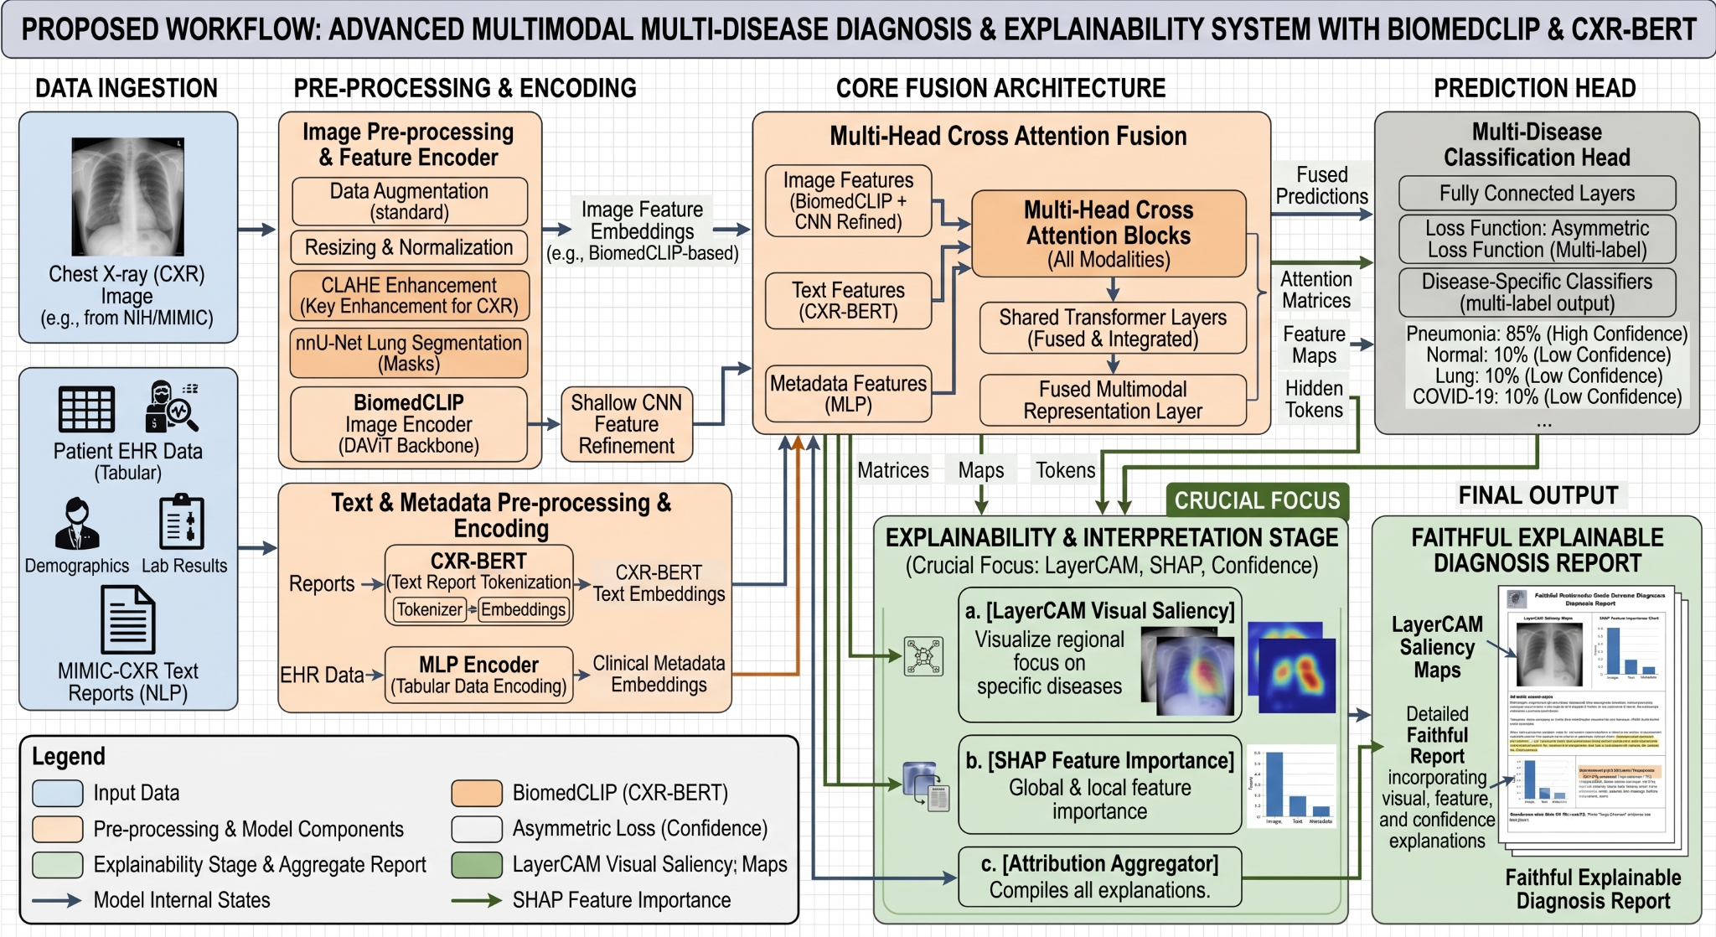
Architecture Diagram Explanation
1. Data Ingestion
X-ray + clinical notes + EHR/metadata.
2. Pre-processing & Encoding
Image enhancement; text tokenization; metadata normalization.
3. Feature Extraction
BiomedCLIP/CNN, clinical text encoder and MLP representations.
4. Cross-Attention + Alignment
Learn cross-modal relationships and align representations with contrastive learning.
5. Prediction
Multi-label classification of co-occurring thoracic diseases.
6. Explainability + Report
LayerCAM, SHAP and attribution aggregation produce an interpretable clinical report.
Workflow and module explanation are based on the actual project document.

