Slide 1
URBANI
Proactive Observability & AI Troubleshooting Assistant
Custom Web Dashboard · AI Log Chatbot · Live Logs · AWS CDK — v3.0 Proposal

Slide 2
What We Propose
Custom web dashboard (React + Node) — NOT Grafana / NOT CloudWatch dashboards
AI Log Chatbot — ask questions about logs in natural language, evidence-grounded
Urbani log integration via API Gateway with clear data-provenance labels
Amazon Bedrock analysis (Claude 3.5 Sonnet v2) behind a provider abstraction
DynamoDB alert persistence · KMS · CloudTrail · IAM least-privilege · Budgets
Full infrastructure as AWS CDK (TypeScript)

Slide 3
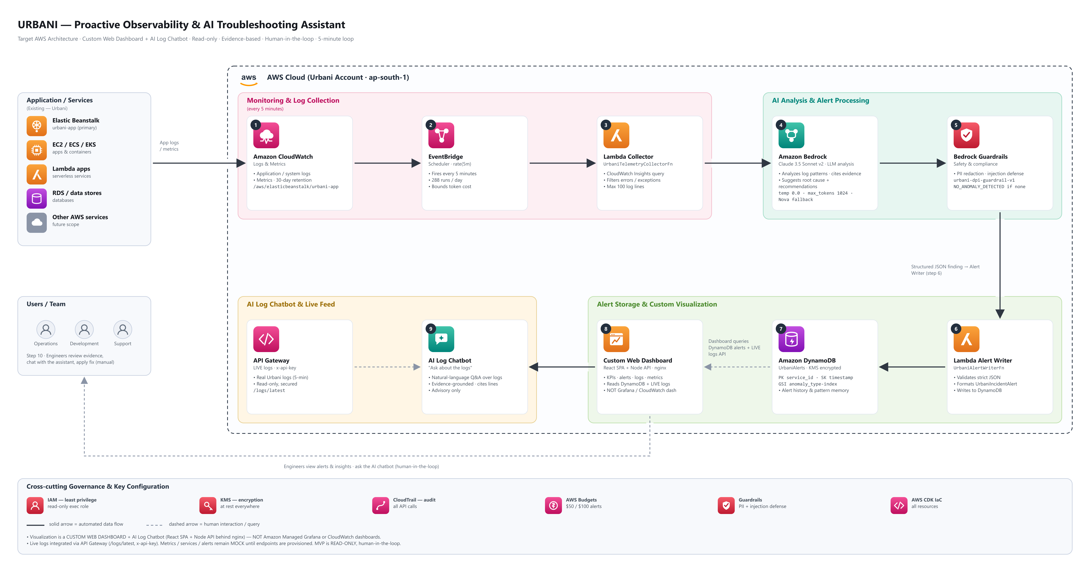
Target AWS Architecture
Custom web dashboard + AI log chatbot · read-only · human-in-the-loop · 5-min loop

Slide 4
AI Design & Safeguards
Aspect | Specification
Primary model | Claude 3.5 Sonnet v2 (anthropic.claude-3-5-sonnet-20241022-v2:0)
Fallback | Amazon Nova Pro / Nova Lite
Inference | temperature 0.0 · max_tokens 1024 · top_p 1.0
Guardrails | urbani-dpi-guardrail-v1 — PII redaction, injection defense
Grounding | No evidence → NO_ANOMALY_DETECTED; chatbot never speculates
Remediation | None — advisory only, human-in-the-loop

Slide 5
Delivery Plan & Prerequisites
Proposed Phases
Prerequisites from Client / AWS
Custom dashboard + all pages
Production hardening + Docker
Logs API integration
AI Log Chatbot
AWS CDK stack
Bedrock enablement + full deploy
Bedrock model + guardrail access
Metrics/services API endpoints
AWS account + IAM to deploy CDK
Real log activity (or history endpoint)
Secure handling of logs API key

