Slide 1
Stock Price Prediction Using Machine Learning: An Ensemble Approach
Guided by,
Dr. Shenbaga Velu P (53640)
SMEC
VIT CHENNAI
Presented by,
Nuka Nandan Vignesh (21BRS1473)
SCOPE VIT CHENNAI

Slide 2
INTRODUCTION
Stock market prediction has been a subject of interest for decades, with the aim of predicting future price movements. Traditional methods, such as technical and fundamental analysis, have been widely used but often fall short in accurately capturing the complex dynamics of the market. In recent years, machine learning has emerged as a powerful tool for analyzing large datasets and making accurate predictions.
Ensemble learning is a technique that combines multiple machine learning models to improve predictive performance. By leveraging the strengths of different algorithms, ensemble methods can enhance accuracy, reduce bias, and improve generalization.
In the context of stock price prediction, ensemble learning can effectively capture complex patterns and trends in the market data.

Slide 3
This presentation will explore the application of ensemble learning techniques, specifically focusing on Decision Trees, Support Vector Machines, and K-Nearest Neighbors, to predict stock prices.
We will discuss the methodology employed, including data collection, preprocessing, feature engineering, model training, and evaluation. Additionally, we will delve into the implementation of different ensemble techniques, such as averaging, weighted averaging, and gradient boosting.
The goal of this presentation is to demonstrate the effectiveness of ensemble learning in improving the accuracy of stock price predictions. By combining the strengths of multiple machine learning algorithms, we aim to develop a robust and reliable model that can outperform individual models.

Slide 4
The ensemble approach, which combines multiple algorithms, further enhances predictive performance. By leveraging the strengths of various models, the ensemble method can mitigate the weaknesses of individual algorithms.
This presentation aims to explore the effectiveness of using an ensemble approach that incorporates Decision Tree, K-nearest neighbour, and SVM for stock price prediction. We will examine the methodology for collecting data, training the models, and evaluating their performance.

Slide 5
S.No. | Paper Title & Year | Methods Used (Individual Learners) | Ensemble Learning Algorithms | Inferences
1 | Construction of an Ensemble Scheme for Stock Price Prediction Using Deep Learning Techniques (2019) | LSTM | Stacking | - Ensemble models outperform individual models (LSTM) in terms of prediction accuracy (lower MSE). - Combining different deep learning architectures can lead to better generalization.
2 | Can Ensemble Machine Learning Methods Predict Stock Returns for Indian Banks Using Technical Indicators? (2018) | XGBoost, Gradient Boosting, AdaBoost | Bagging | - Ensemble methods (XGBoost in this case) achieve higher accuracy compared to individual models like Random Forest for predicting stock returns. - Combining multiple boosting algorithms can lead to robust predictions.
3 | A Hybrid Approach for Stock Price Prediction Using Machine Learning and Ensemble Techniques (2020) | Linear Regression, KNN, SVM, Decision Tree | Bagging | - Ensemble techniques like Bagging can improve prediction accuracy compared to individual models, especially for KNN. - Combining simpler models with ensemble methods can lead to better generalization.

Slide 6
4 | Stock Price Prediction Using Stacked Ensemble Learning (2022) | XGBoost, Random Forest, Support Vector Regression (SVR) | Stacking | - Stacked ensemble learning can outperform individual models and simple ensembles (e.g., averaging) by combining their strengths. - This approach can be computationally expensive but can lead to more accurate predictions.
5 | Ensemble Learning for Stock Price Prediction: A Comparative Study (2023) | LSTM, ARIMA | Weighted Averaging | - Combining statistical models (ARIMA) with deep learning models (LSTM) through ensemble methods can improve prediction accuracy. - This approach leverages the strengths of both time-series forecasting and deep learning for stock price prediction.
6 | Improving Stock Price Prediction Using Hybrid Ensemble Learning (2021) | LSTM, GRU, RNN | Stacking | - Hybrid ensemble models that combine different deep learning architectures can significantly improve prediction accuracy compared to individual models. - Stacking can effectively combine the strengths of multiple base models.

Slide 7
7 | Stock Price Prediction Using Stacked Ensemble Learning (2022) | XGBoost, Random Forest, Support Vector Regression (SVR) | Stacking | - Stacked ensemble learning can outperform individual models and simple ensembles (e.g., averaging) by combining their strengths. - This approach can be computationally expensive but can lead to more accurate predictions.
8 | Stock Price Prediction Using a Hybrid Ensemble Model (2020) | LSTM, GRU, CNN | Stacking | - Hybrid ensemble models that combine different deep learning architectures (LSTM, GRU, CNN) can capture complex patterns in stock price data. - Stacking can effectively combine the strengths of multiple base models.
9 | A Hybrid Deep Learning and Ensemble Learning Model for Stock Price Prediction (2023) | LSTM, GRU, CNN | Stacking | - Hybrid ensemble models that combine different deep learning architectures (LSTM, GRU, CNN) can capture complex patterns in stock price data. - Stacking can effectively combine the strengths of multiple base models.

Slide 8
10 | Predicting Stock Price Movements Using Machine Learning (2018) | KNN, SVM, Decision Tree | - KNN was sensitive to the choice of distance metric and the number of neighbors. - SVM was found to be effective in high-dimensional spaces and non-linear relationships. - Decision trees were interpretable but prone to overfitting.

Slide 9
RESEARCH GAP
While ensemble learning has shown promise in various fields, its application to stock price prediction is still relatively limited. Many studies rely on individual models without fully leveraging the benefits of combining multiple models.
Feature engineering plays a crucial role in the performance of machine learning models. However, many studies rely on a limited set of features, such as historical price data and technical indicators. Exploring a wider range of features, including fundamental factors and sentiment analysis, could improve prediction accuracy.
Traditional performance metrics, such as Mean Squared Error (MSE) and Mean Absolute Error (MAE), may not fully capture the nuances of stock price prediction. More sophisticated metrics, such as directional accuracy and Sharpe ratio, could provide a more comprehensive evaluation of model performance.

Slide 10
Stock markets are inherently volatile, and sudden events can significantly impact price movements. Developing robust models that can adapt to changing market conditions is a key challenge. Ensemble learning techniques, such as bagging and boosting, can help improve model robustness.
Stock price data is often non-stationary, meaning that statistical properties like mean and variance change over time. This can pose challenges for machine learning models. To address this issue, techniques like differencing and stationarity tests can be employed.
While ensemble models can improve predictive accuracy, they often lack interpretability. Understanding the underlying reasons for a prediction can be crucial for decision-making. Techniques like feature importance analysis and SHAP values can help shed light on the factors driving predictions.

Slide 11
OBJECTIVE
The primary objective of this project is to develop a robust ensemble learning model for accurate stock price prediction. By combining the strengths of multiple machine learning algorithms, we aim to improve the predictive accuracy and reduce the impact of noise and uncertainty in the stock market.
Specifically, this project focuses on the following objectives:
Data Acquisition and Preprocessing: To collect historical stock price data from reliable sources and preprocess it to ensure data quality and consistency.
Feature Engineering: To extract relevant features from the raw data, including technical indicators, fundamental ratios, and sentiment analysis features.
Model Development: To train individual machine learning models (Decision Tree, SVM, KNN) and ensemble models (averaging, weighted averaging, gradient boosting) on the preprocessed data.

Slide 12
Model Evaluation: To evaluate the performance of the models using appropriate metrics, such as Mean Absolute Error (MAE), Mean Squared Error (MSE), Root Mean Squared Error (RMSE), and R-squared.
Model Deployment: To deploy the best-performing model to make real-time predictions and provide valuable insights for investors and traders.
By achieving these objectives, we aim to contribute to the advancement of stock price prediction techniques and provide a valuable tool for informed decision-making in the financial markets.

Slide 13
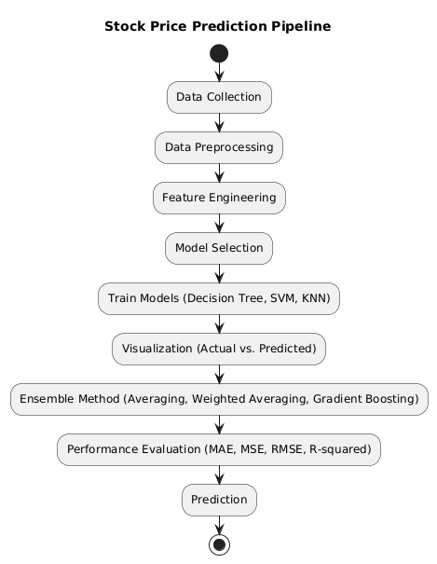
FLOWCHART

Slide 14
METHODOLOGY
Data Collection:
Gather historical stock price data from reliable sources like Yahoo Finance.
Collect relevant financial and economic indicators that may influence stock prices.
Data Preprocessing:
Clean the data by handling missing values, outliers, and inconsistencies.
Normalize the data to a common scale.
Split the data into training and testing sets.
Feature Engineering:
Create relevant features from the raw data, such as:
Technical indicators (SMA, EMA, UpperBand, LowerBand, RSI, ATR, MACD)
Model Development:
Individual Models:
Train Decision Tree, SVM, and KNN models on the preprocessed data.
Averaging: Calculate the average prediction of the individual models.
Weighted Averaging: Assign weights to each model based on their performance and calculate the weighted average prediction.
Gradient Boosting: Sequentially train weak learners to correct the errors of previous models.

Slide 15
Model Evaluation:
Mean Absolute Error (MAE)
Mean Squared Error (MSE)
R-squared
Accuracy
Model Optimization:
Fine-tune the hyperparameters of the individual models and ensemble methods using techniques like grid search or random search.
Experiment with different feature combinations and model architectures to improve performance.
Model Deployment:
Deploy the best-performing model to make real-time predictions.
Integrate the model into a web application or trading platform for practical use.

Slide 16
DECISION TREE
A Decision Tree is a supervised learning algorithm that uses a tree-like model of decisions and their consequences. In stock price prediction, it helps by splitting historical data based on different features (e.g., moving averages, RSI) to identify patterns in stock movements. Each "branch" of the tree represents a decision rule that leads to an outcome, allowing it to model the non-linear dependencies that often exist in financial data.
Advantages:
Decision Trees provide clear decision paths, making it easy to understand the reasoning behind predictions.
They handle non-linear relationships well, which is common in stock prices.
Automatically selects important features, making it efficient in complex datasets.
Disadvantages:
Without pruning, it can easily overfit, especially with high-depth trees.
Small changes in the data can result in large differences in the structure of the tree.
Decision Trees are better for classification tasks, making regression predictions less accurate in continuous data like stock prices.

Slide 17
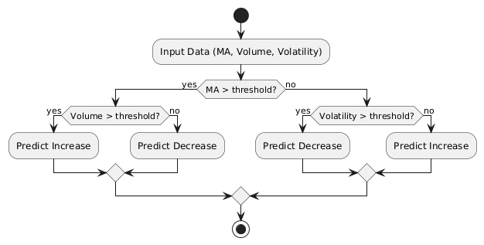
This Decision Tree flow starts by checking each feature in sequence, creating paths for different conditions. For example, if the Moving Average is high, the algorithm goes down one branch; if it’s low, it goes down another. The process leads to a prediction outcome based on a set of conditions that match past stock performance, aiding in price trend predictions.

Slide 18
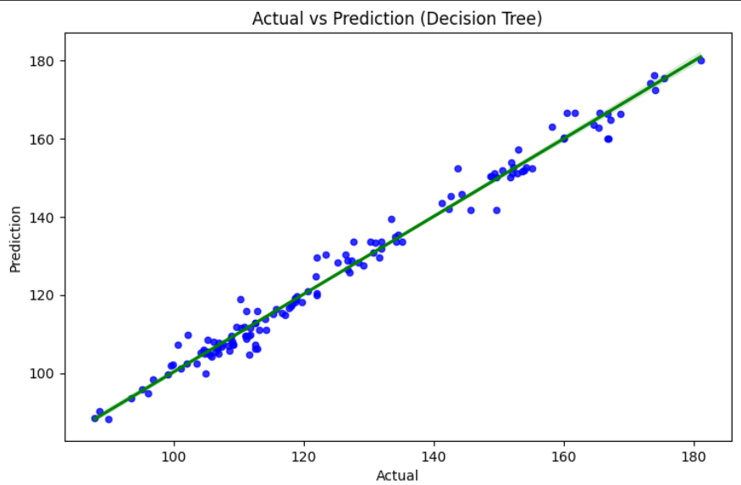

Slide 19
K-NEAREST NEIGHBOUR
KNN is a simple, non-parametric algorithm that classifies data points based on the "k" nearest data points in feature space. In stock price prediction, KNN finds the closest historical data points to the current stock data and assumes that the price trend of the closest matches will reflect the future movement. KNN works effectively for pattern recognition and can help detect trends based on previous, similar behavior.
Advantages:
KNN is easy to implement and understand.
Effective for pattern recognition, which is useful in stock trends and price movements.
Since KNN is a lazy learner, it does not require a training phase, saving time on model preparation.
Disadvantages:
Requires comparing all points to each query, which becomes slow with large datasets.
Sensitive to irrelevant features, making feature scaling important.
KNN may not perform well if there is an imbalance in the number of data points in each class.

Slide 20
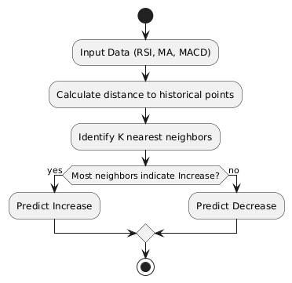
In this KNN flow, we use similarity measurements to find the most similar historical days (neighbors) to today. Based on the predominant trend (increase or decrease) among those neighbors, KNN makes a prediction. This approach works well for stock patterns that frequently repeat in similar market conditions.

Slide 21
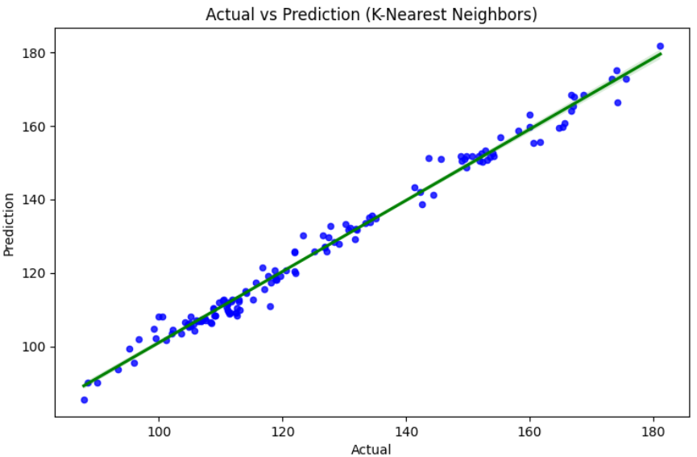

Slide 22
SUPPORT VECTOR MACHINE
SVM is a supervised learning algorithm that finds an optimal hyperplane to separate data into classes. In stock prediction, SVM can classify historical stock price data to identify different market conditions, such as "bullish" or "bearish." SVM works well in complex financial data, especially when applying kernel functions to handle non-linearities.
Advantages:
SVM performs well in high-dimensional spaces, making it suitable for stock prediction with multiple features.
Kernel tricks allow SVM to handle non-linear relationships well.
SVM uses regularization, which helps prevent overfitting in prediction tasks.
Disadvantages:
Requires significant memory, especially with larger datasets.
Selecting an appropriate kernel and tuning its parameters can be challenging.
SVM can be slow with large datasets, which can be limiting in stock analysis.

Slide 23
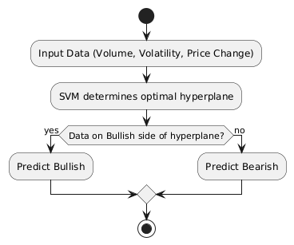
SVM tries to create a clear boundary (hyperplane) between Bullish and Bearish market data. The prediction is based on which side of the hyperplane today's data point lies on. This approach is particularly useful in stock markets to differentiate positive and negative sentiment effectively.

Slide 24
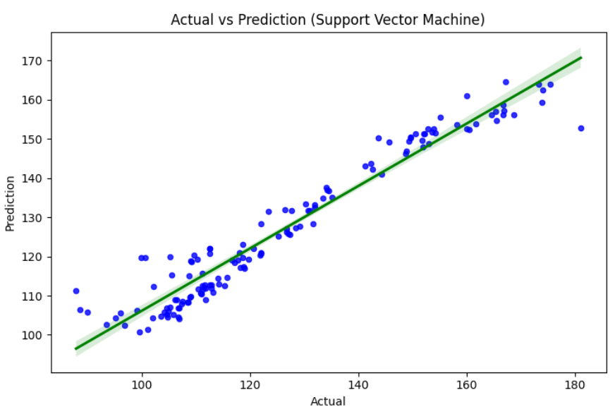

Slide 25
ENSEMBLE APPROACH
In stock price prediction, an ensemble approach involves combining predictions from multiple machine learning models to get a final prediction. Instead of relying on a single algorithm, which may have its weaknesses, ensemble methods use the strengths of several algorithms to improve accuracy and robustness. This approach can capture different aspects of the data and provide a more reliable forecast of stock prices.
Ensemble methods are, therefore, well-suited for minimizing errors and increasing predictive accuracy, making them an ideal choice for high-stakes fields like stock market forecasting.
Moreover, ensemble approaches are adaptable and can be tailored based on specific project needs, enhancing their applicability across different contexts within finance.
For instance, in our project, simple and weighted averaging allow for efficient, fast predictions when speed is crucial, while gradient boosting enables a deeper learning process that can capture complex patterns in the data. This flexibility makes ensemble methods versatile and effective in producing high-quality results.
By integrating predictions from multiple models, we can capture not only immediate stock trends but also underlying factors that a single algorithm might miss, providing a robust, holistic view of future stock prices. This adaptability and effectiveness underscore the significance of ensemble approaches in delivering reliable forecasts, helping investors make informed decisions with reduced risk.

Slide 26
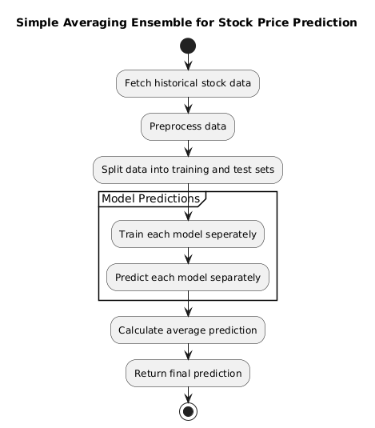
SIMPLE AVERAGING
In simple averaging, predictions from multiple models (like SVM, Decision Tree, and KNN) are averaged equally to form a final prediction.
Historical stock data is fetched and preprocessed.
The data is split into training and test sets.
Multiple models (e.g., Linear Regression, Decision Tree, and KNN) are trained on the training set.
Each model independently makes a prediction on the test set.
The final prediction is the average of the individual model predictions.

Slide 27
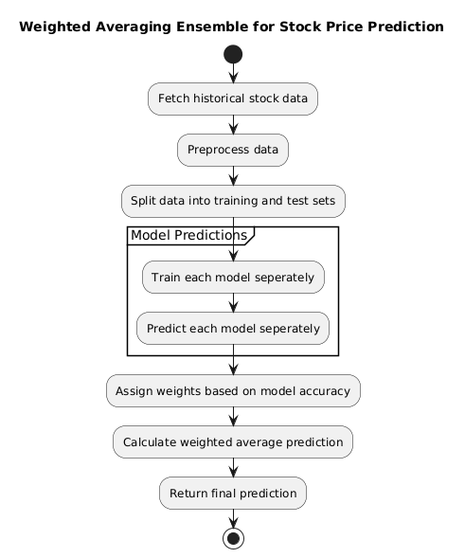
WEIGHTED AVERAGING
Weighted averaging assigns different weights to each model’s prediction based on the model's performance or importance, which can yield more accurate results than simple averaging.
Historical data is fetched and preprocessed.
Data is split into training and test sets.
The Linear Regression, Decision Tree, and KNN models are trained.
Each model generates predictions, which are then weighted based on their performance.
The weighted predictions are combined to produce a final prediction, accounting for the relative accuracy of each model.

Slide 28
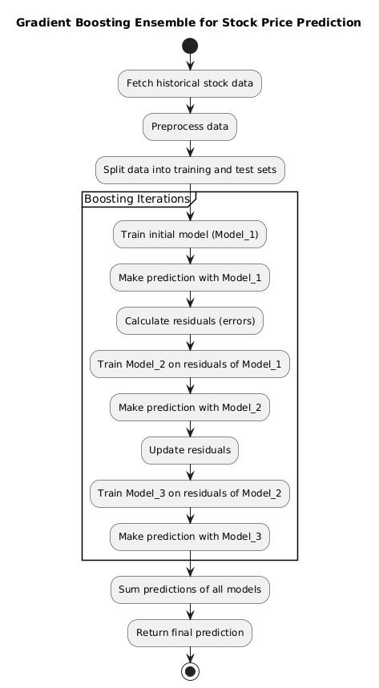
GRADIENT BOOSTING
Gradient boosting builds an ensemble by training models sequentially, where each new model corrects the errors of the previous ones, improving the final prediction iteratively.
Data is fetched, preprocessed, and split.
A base model (Model_1) is trained to make an initial prediction.
The residual errors from Model_1’s predictions are calculated.
A new model (Model_2) is trained on these residuals to correct the errors from Model_1.
This process is repeated with additional models to iteratively improve the prediction.
The final prediction is the cumulative result of all models, creating an accurate, fine-tuned prediction.

Slide 29
CONCLUSION
In this project, we developed a robust stock price prediction model using an ensemble approach that combined various machine learning algorithms such as SVM, Decision Tree, KNN. By experimenting with ensemble methods like simple averaging, weighted averaging, and gradient boosting, we aimed to capture the inherent complexities of stock price movements and improve prediction accuracy.
Results and Discussion
Among the different ensemble approaches, the Gradient Boosting Machine yielded the highest accuracy in terms of Mean Absolute Error (MAE), Mean Squared Error (MSE), and R-squared values, proving to be a highly effective method in minimizing error rates and improving model performance. Weighted averaging also performed better than simple averaging, indicating that assigning weights based on model performance enhances accuracy.
Comparison of Ensemble Methods:
Simple Averaging: Provided a stable yet basic aggregation of predictions, showing moderate performance. Although it improved upon individual model performance, it lacked the precision of other methods.

Slide 30
Weighted Averaging: Improved accuracy by prioritizing the predictions of better-performing models, which yielded more reliable results, especially when different models captured distinct patterns in the data.
Gradient Boosting: Outperformed the other two approaches by iteratively reducing errors, proving to be the most efficient in capturing stock price fluctuations in this dataset.
Ensemble methods provided a way to use the strengths of different algorithms, reducing individual model weaknesses. This resulted in a more accurate, stable model for predicting stock prices.
Ensemble methods tend to be computationally expensive, especially when using complex techniques like gradient boosting. They also require careful selection of models and tuning of hyperparameters to achieve optimal results.
Utilizing a larger dataset from yfinance with more diverse features, such as macroeconomic indicators like Gross Domestic Project(GDP), Interest rates, Consumer Price Index(CPI), could further improve prediction accuracy.
This ensemble approach, demonstrated a strong predictive capability in stock price forecasting. The project underscores the importance of combining machine learning algorithms and integrating external data sources for more accurate, real-world financial predictions.

Slide 31
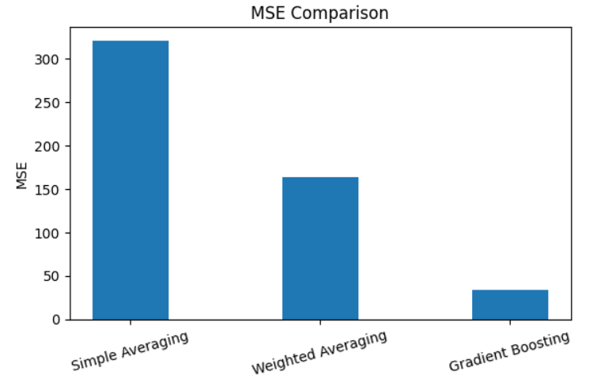
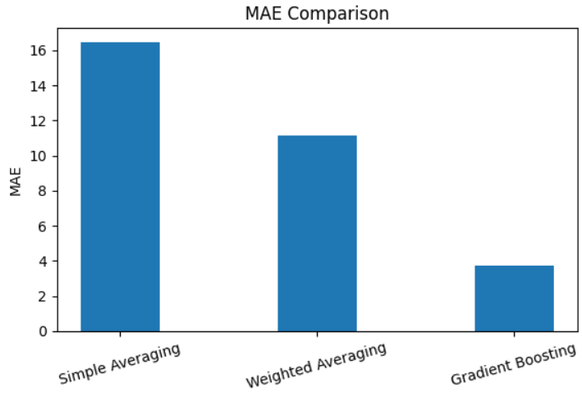
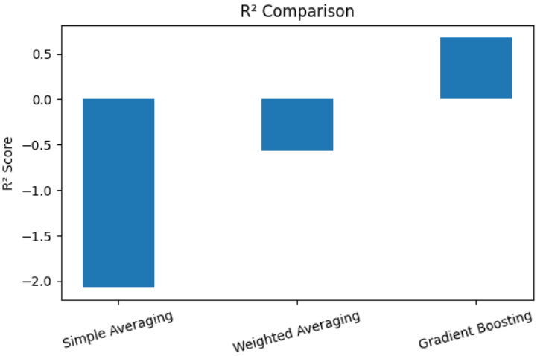
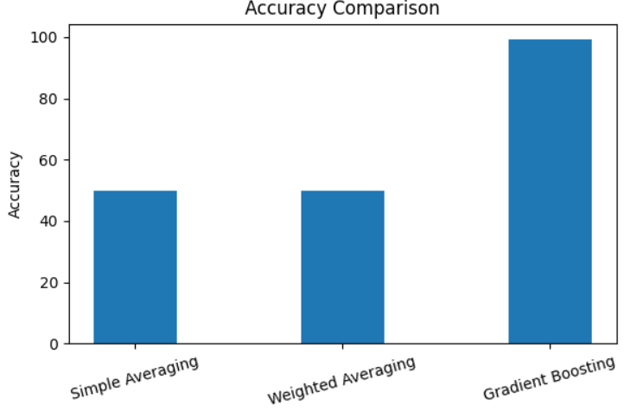

Slide 32
In the realm of stock price prediction, evaluation metrics play a crucial role in assessing the accuracy and reliability of our models. They help us understand how well our predictions align with the actual market movements.
The evaluation metrics are like scorecards that tell us about how the model is working and according to it we can make the assumptions.
MSE quantifies the average squared difference between the predicted and actual stock prices.
MAE calculates the average absolute difference between the predicted and actual stock prices. It gives us a sense of the magnitude of prediction errors.
R² measures the proportion of variance in the dependent variable (stock price) that is explained by the independent variables (features used in the model).
Accuracy is the percentage of correct predictions made by the model.
The best case scenarios of evaluation metrics for a best model are as follows
Mean Squared Error(MSE) - 0.0
Mean Absolute Error(MAE) - 0.0
R² - 1.0
Accuracy - 100%

