Slide 1

Course | Mini Project | Course Code | CSEP23506
Student Name | Vignesh P | USN | 1GA23CS193
 | Shakthi Vel K |  | 1GA23CS151
Domain | Full Stack | Group No: | G62
Project Title | “BookMates”
Guide Name | Prof. P Sushmita Singh

Slide 2
Agenda
Introduction
Problem Statement
Literature Survey
Objectives
Architecture
Data Flow Diagram
Modules and Description
Results(screen shots)
Conclusion
References
Dept of CSE,GAT 2025-26

Slide 3
Introduction and Problem Statement
📚 Readers, especially students, face high costs in accessing books.
🚫 Limited availability of diverse books in existing systems.
📖 Many books remain unused on shelves, while others lack access.
⚠️ limited centralized and user-friendly platform for effective book exchange.
📊 Lack of tracking or analysis of book usage
🔍 Difficulty in finding specific books
💬 Inefficient communication between contributors and readers
Dept of CSE,GAT 2025-26

Slide 4
Literature Survey
S. Yoshida, M. Takahara, I. Tanev & K. Shimohara, “Reading Notes as Media to Enrich Communications between Reader and Book,” IEEE CSDE, 2020.
S. A. Jebamani, R. Punitha, N. Rajesh, T. Kavin & K. U. A. Abdul Kalam, “Books Tracking and Review Application,” Sri Sai Ram Engineering College, 2022.
K. Sudharson, H. A. Prasad & S. Smriti, “A Survey on Reader’s Society: New Social Network of Book Swapping Platform,” IEEE SCEECS, 2023.
A. Jobst, D. Atzberger, R. Henker, W. Scheibel & J. Döllner,“OrderBookVis: A Visualization Approach for Comparing Order Books,” IEEE ICBC, 2023.
Y. Cui, P. Zhou, K. Li, B. Seng & H. Cao, “Extracting Aspect Sentiment from Users’ Book Reviews for Recommendation,” CLNLP, 2024.
Dept of CSE,GAT 2025-26

Slide 5
Objectives of the Project
📚 To design a Centralized online platform for book exchange.
🔄 To enable users to list, request, and swap books seamlessly.
📊 To provide tracking and management of book exchanges.
👥 To build a Community-driven platform that promotes
collaboration and sharing.
🌱 To encourage reuse and sustainability through book swapping.
Dept of CSE,GAT 2025-26

Slide 6
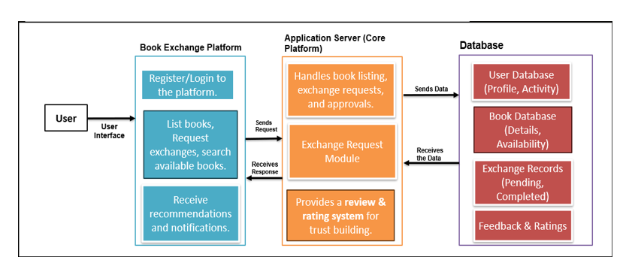
System Architecture / Block Diagram
FIG 1 Architecture of Book Exchange Platform
Dept of CSE,GAT 2025-26

Slide 7
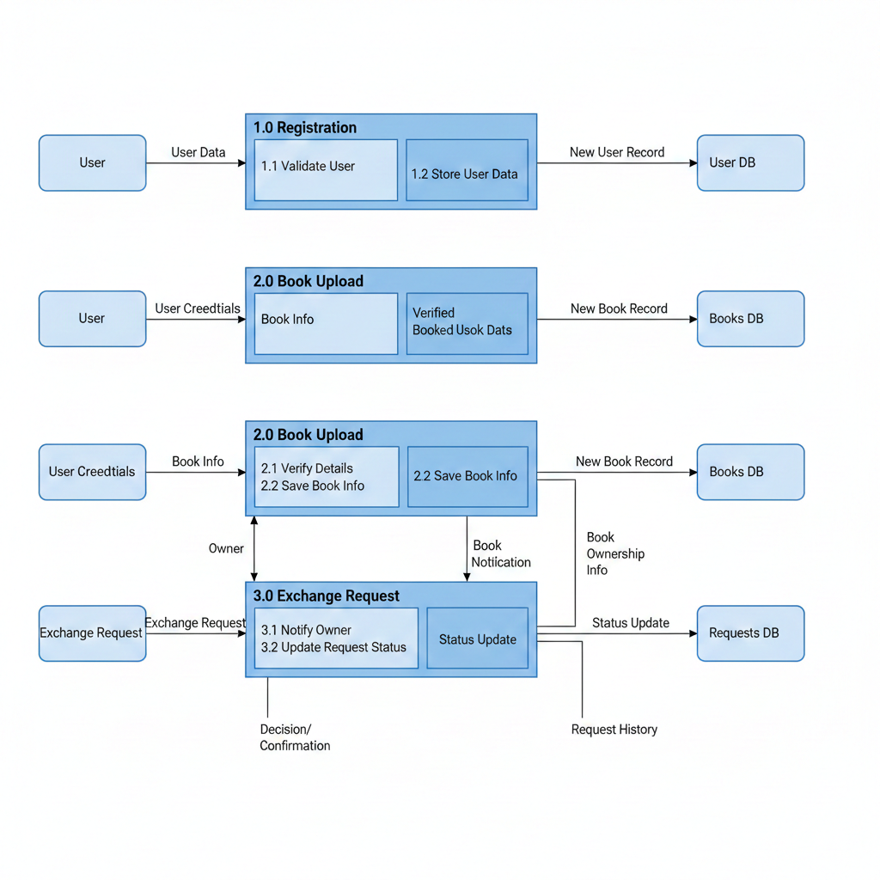
Data Flow Diagram
FIG 2 Data Flow Diagram
Dept of CSE,GAT 2025-26

Slide 8
Modules and Description
🔹 User (Interface Layer)
Interacts via web/mobile app.
Can register, login, search, request exchanges, and receive notifications.
🔹 Book Exchange Platform (Front-End)
Register/Login to platform.
Request exchanges & search books.
Get recommendations & notifications.
🔹 Application Server (Core Platform)
Handles book listing, exchange requests & approvals.
Exchange Request Module for managing transactions.
Review & Rating system for trust building.
🔹 Database (Storage Layer)
User Database – profile & activity.
Book Database – details & availability.
Exchange Records – pending & completed.
Feedback & Ratings – trust management.
Dept of CSE,GAT 2025-26

Slide 9

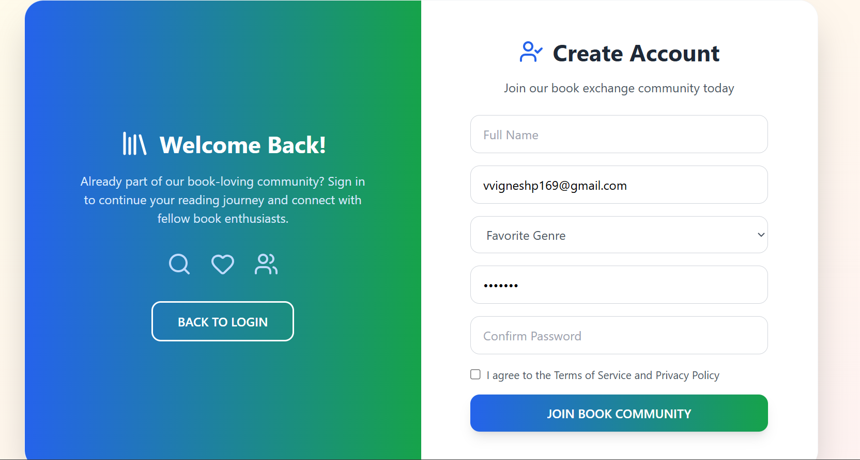
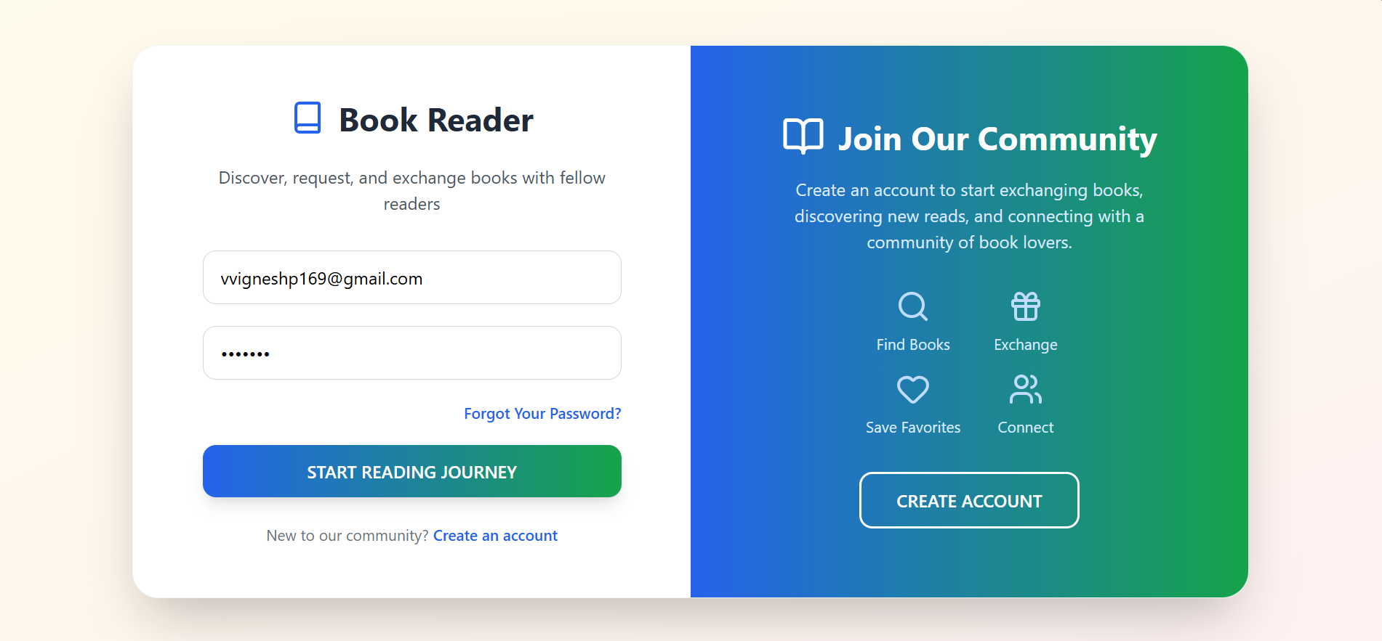
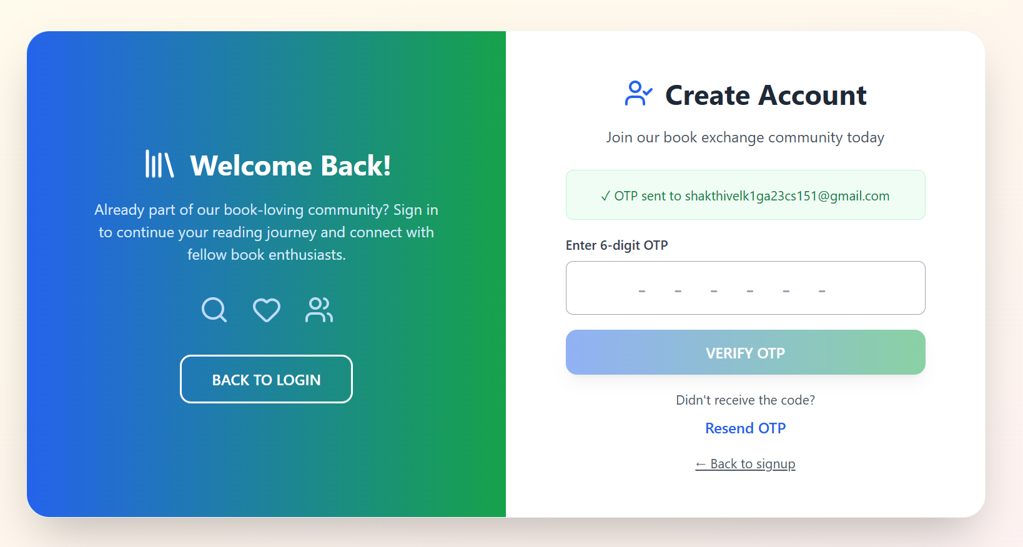
Results
Dept of CSE,GAT 2025-26

Slide 10
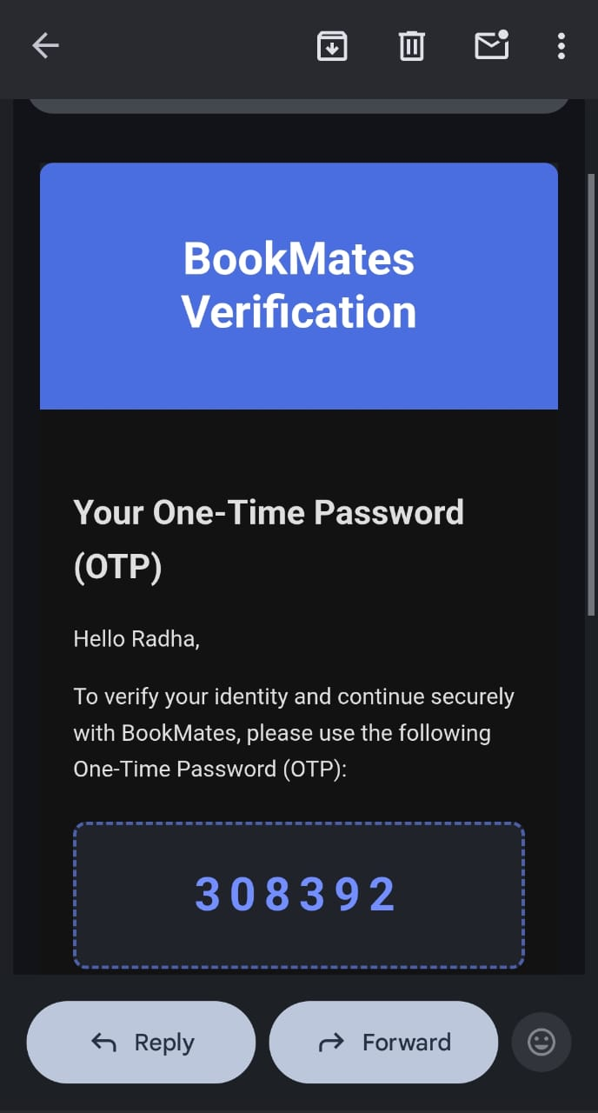
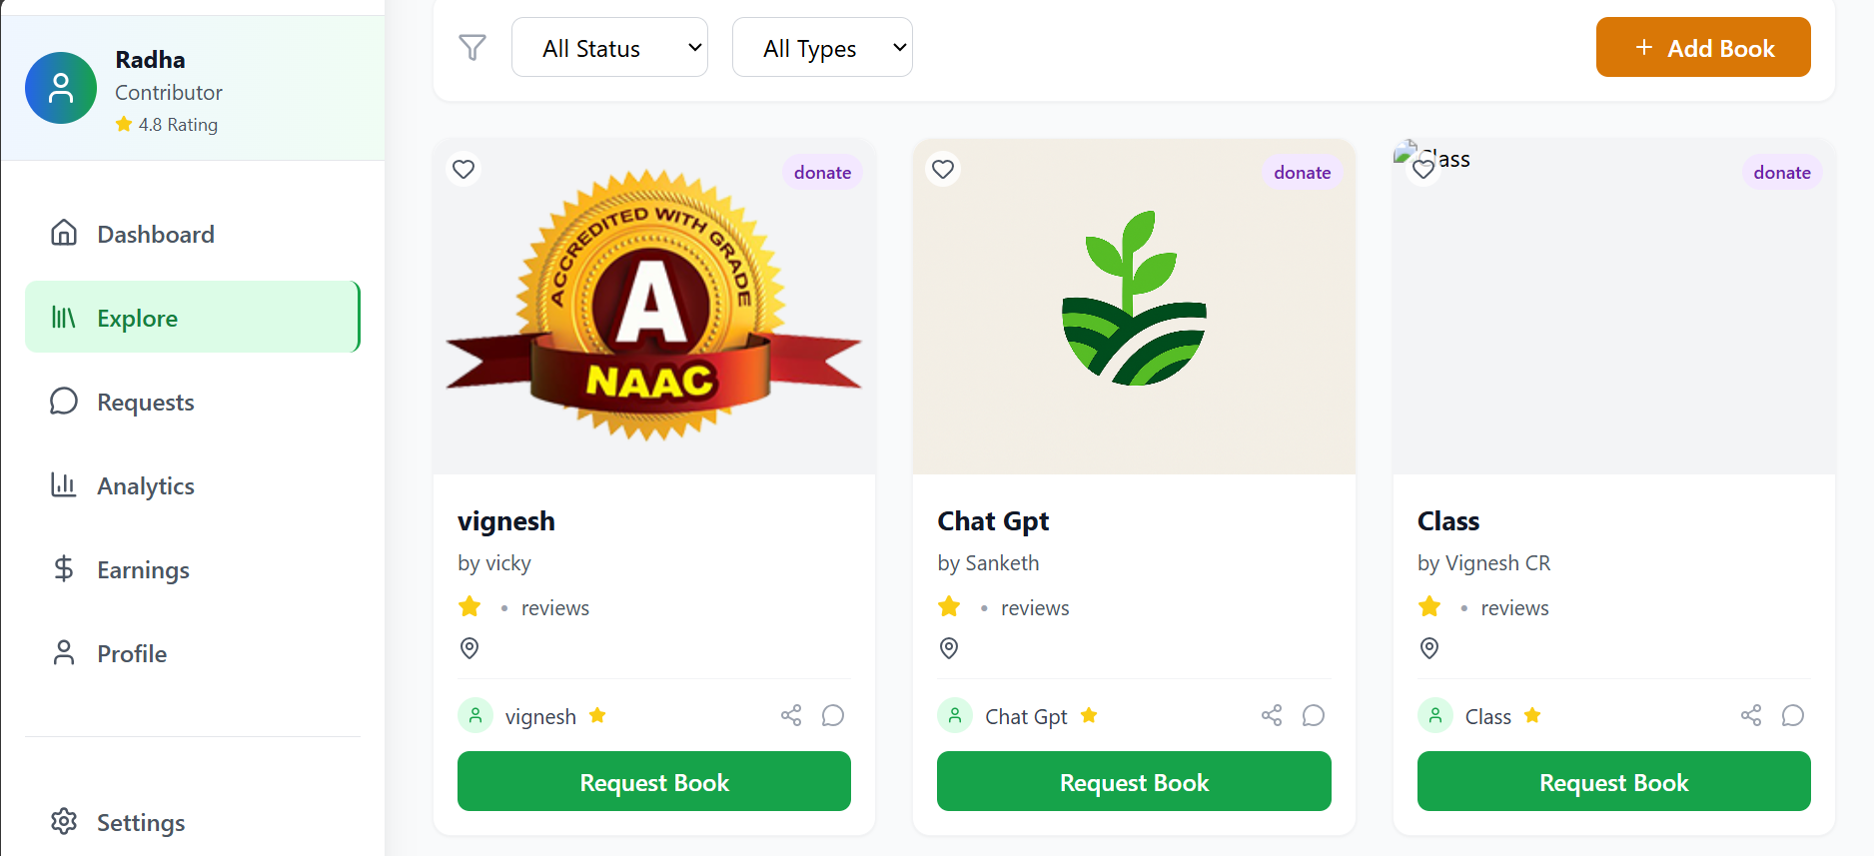
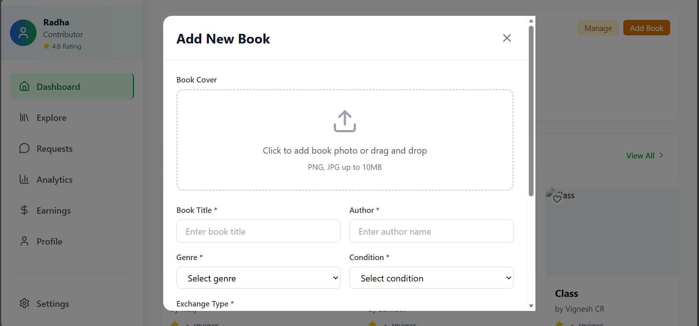
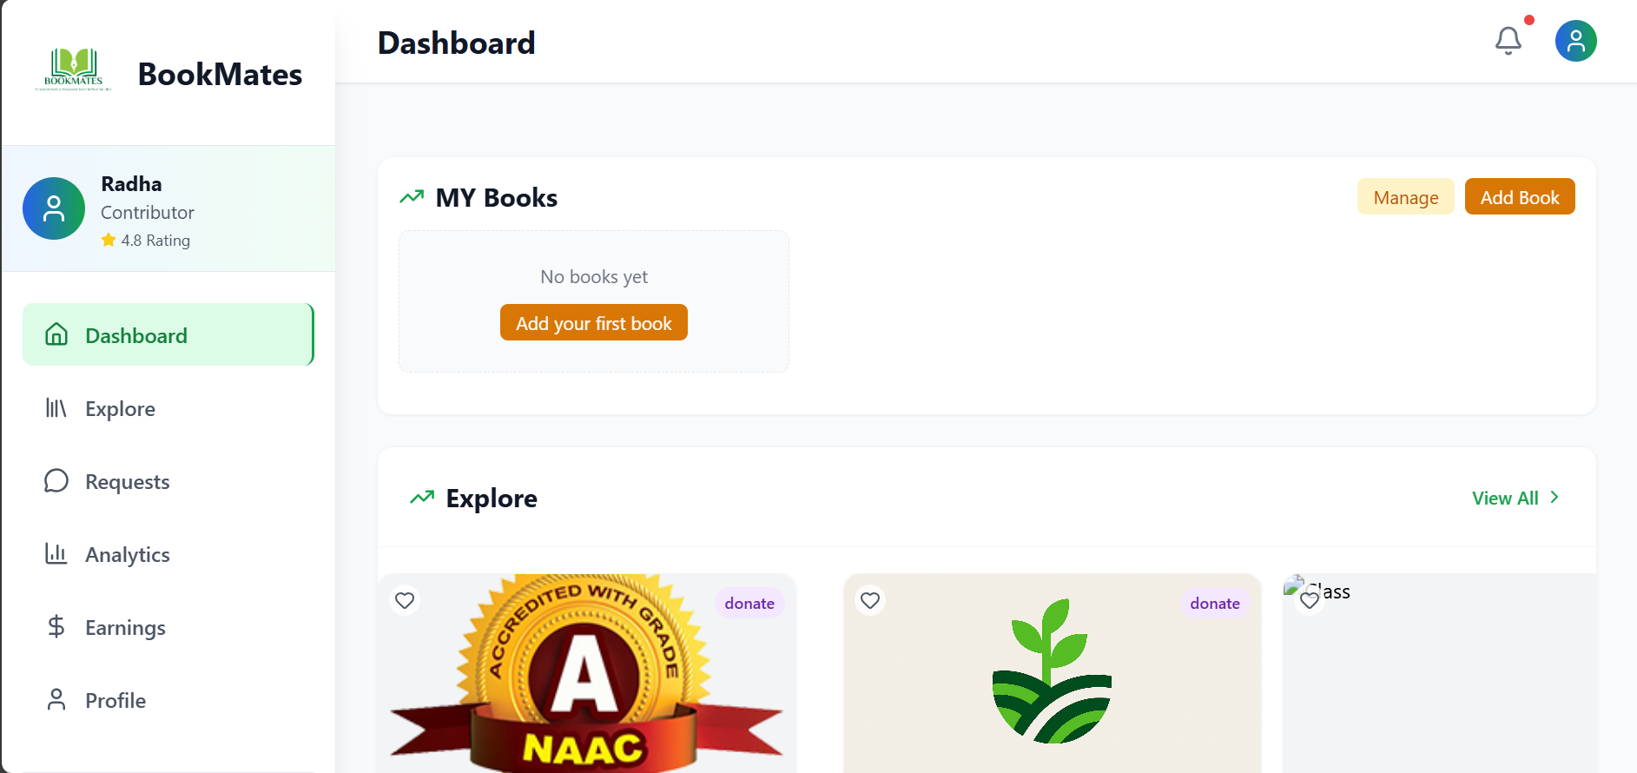
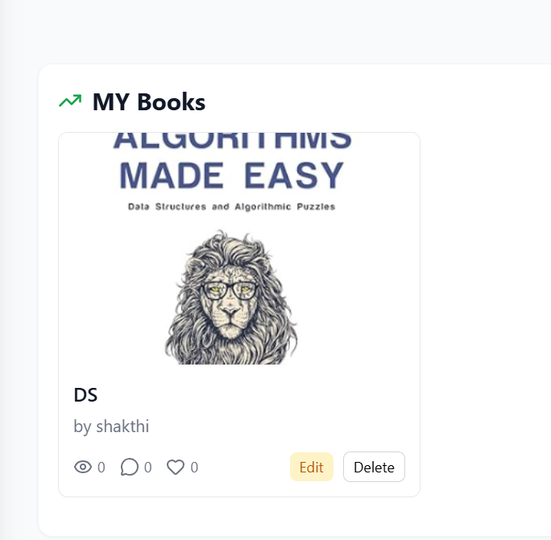
Results
Dept of CSE,GAT 2025-26

Slide 11
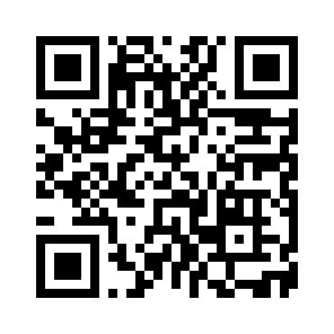
Scan to Explore the Website
BookMates

Slide 12
Conclusion
📚 Easy-to-use digital platform for book lovers to exchange, donate, and explore
books.
🔐 Secure login with OTP, ensuring safe user authentication.
🧭 Personalized dashboard for managing books and user activities effortlessly.
📘 Simple book management tools for adding, editing, and organizing books.
🔍 Interactive Explore section to discover books shared by the community.
🌱 Promotes sustainable reading habits by encouraging book reuse and sharing.
🤝 Connects readers and fosters meaningful interactions among book enthusiasts.
🌟 Builds a vibrant reading community centered around sharing knowledge and
stories.
Dept of CSE,GAT 2025-26

Slide 13
References
S. Yoshida, M. Takahara, I. Tanev & K. Shimohara, “Reading Notes as Media to Enrich Communications between Reader and Book,” IEEE CSDE, 2020.
S. A. Jebamani, R. Punitha, N. Rajesh, T. Kavin & K. U. A. Abdul Kalam, “Books Tracking and Review Application,” Sri Sai Ram Engineering College, 2022.
K. Sudharson, H. A. Prasad & S. Smriti, “A Survey on Reader’s Society: New Social Network of Book Swapping Platform,” IEEE SCEECS, 2023.
A. Jobst, D. Atzberger, R. Henker, W. Scheibel & J. Döllner, “OrderBookVis: A Visualization Approach for Comparing Order Books,” IEEE ICBC, 2023.
Y. Cui, P. Zhou, K. Li, B. Seng & H. Cao, “Extracting Aspect Sentiment from Users’ Book Reviews for Recommendation,” CLNLP, 2024.
BookCrossing – Book sharing community. Available at: https://www.bookcrossing.com/
NearBook – Platform to buy, sell, and donate used books locally.
Dept of CSE,GAT 2025-26

