Slide 1

Course | Mini Project | Course Code | CSEP23506
Student Name | Shakthi Vel K | USN | 1GA23CS151
 | Vignesh P |  | 1GA23CS193
Domain | Full Stack | Group No: | G62
Project Title | “BookMates”
Guide Name | Prof. P Sushmita Singh

Slide 2
Problem Statement
📚 Readers, especially students, face high costs in accessing books.
🚫 Limited availability of diverse books in existing systems.
📖 Many books remain unused on shelves, while others lack access.
⚠️ limited centralized and user-friendly platform for effective book exchange.
📊 Lack of tracking or analysis of book usage
🔍 Difficulty in finding specific books
💬 Inefficient communication between contributors and readers
Dept of CSE,GAT 2025-26

Slide 3
Objectives of the Project
📚 To design a Centralized online platform for book exchange.
🔄 To enable users to list, request, and swap books seamlessly.
📊 To provide tracking and management of book exchanges.
👥 To build a Community-driven platform that promotes
collaboration and sharing.
🌱 To encourage reuse and sustainability through book swapping.
Dept of CSE,GAT 2025-26

Slide 4
Existing System
Current System
NearBook allows users to buy, sell, or donate used books through a mobile app by uploading book details and connecting directly with nearby buyers or sellers for in-person exchanges. Link :NearBook - Buy, sell, donate used books nearby
Limitations
📊 No dashboard for book readers or contributors.
📈 For book contributors, no analysis is available on exchanges, views, or
engagement.
⭐ No rating or review system for sellers or contributors, affecting trust.
📱 Limited platform support—may be only mobile app, no web version
Dept of CSE,GAT 2025-26

Slide 5
Proposed System
📚 Centralized platform accessible across devices.
🧑‍🏫Separate dashboards for readers and contributors.
📊 Analytics for contributors to monitor exchanges, views, and engagement.
👥 Reviews, ratings, and community interactions to build trust
🌱 Encourages continuous sharing and reuse of books
Dept of CSE,GAT 2025-26

Slide 6
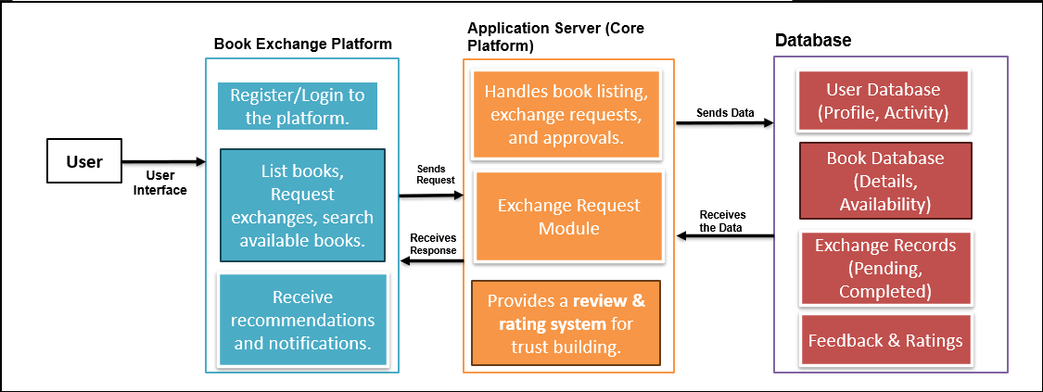
System Architecture
Architecture of Book Exchange Platform
Dept of CSE,GAT 2025-26

Slide 7
Modules and Description
🔹 User (Interface Layer)
Interacts via web/mobile app.
Can register, login, search, request exchanges, and receive notifications.
🔹 Book Exchange Platform (Front-End)
Register/Login to platform.
Request exchanges & search books.
Get recommendations & notifications.
🔹 Application Server (Core Platform)
Handles book listing, exchange requests & approvals.
Exchange Request Module for managing transactions.
Review & Rating system for trust building.
🔹 Database (Storage Layer)
User Database – profile & activity.
Book Database – details & availability.
Exchange Records – pending & completed.
Feedback & Ratings – trust management.
Dept of CSE,GAT 2025-26

Slide 8
Technology Stack
Hardware:
PC or Laptop for development and server hosting.
Software:
Frontend: React.js + Tailwind CSS
Backend: Node.js + Express.js
Database: MongoDB
Version Control & Collaboration: Git (local version control), GitHub (remote repository & team collaboration)
Dept of CSE,GAT 2025-26

Slide 9
Implementation Status (50%)
✅ Landing Page: Completed and functional
✅ Authentication Page: User login/signup implemented
✅ Book Reader Dashboard: Fully connected with authentication
✅ Book Contributor Dashboard: Fully connected with authentication
🔗 Integration: Authentication Process successfully linked with both
dashboards.
Dept of CSE,GAT 2025-26

Slide 10
Demonstration
🖥️ User Interface (UI): Show landing page, authentication page, and
dashboards
📚 Reader Dashboard: Display book search, view, and request features
✍️ Contributor Dashboard: Demonstrate adding, managing, and tracking
books
🔗 Integration: Show authentication flow connecting readers and
contributors
📊 Module Outputs: Display analytics, requests, and book exchange updates
Dept of CSE,GAT 2025-26

Slide 11
Work Plan
📝 Design remaining modules for full functionality
☁️ Upload book details to the backend
📩 Manage book requests efficiently
🛠️ Test all modules for bugs and smooth functionality
📈 Add analytics/dashboard for book usage and exchanges
Dept of CSE,GAT 2025-26

Slide 12
Conclusions
Current Status:
✅ Landing page, authentication page, reader & contributor dashboards designed and integrated
🔗 Authentication connected with dashboards
🖥️ Basic UI and module flows functional
Expected Outcome by Next Review:
☁️ Upload book details to backend
📩 Manage requests and approvals
🔍 Implement book search
📊 Track books and monitor exchanges
🎨 Enhance UI/UX and add notifications for smoother experience
Dept of CSE,GAT 2025-26

Slide 13
References
S. Yoshida, M. Takahara, I. Tanev & K. Shimohara, “Reading Notes as Media to Enrich Communications between Reader and Book,” IEEE CSDE, 2020.
S. A. Jebamani, R. Punitha, N. Rajesh, T. Kavin & K. U. A. Abdul Kalam, “Books Tracking and Review Application,” Sri Sai Ram Engineering College, 2022.
K. Sudharson, H. A. Prasad & S. Smriti, “A Survey on Reader’s Society: New Social Network of Book Swapping Platform,” IEEE SCEECS, 2023.
A. Jobst, D. Atzberger, R. Henker, W. Scheibel & J. Döllner,“OrderBookVis: A Visualization Approach for Comparing Order Books,” IEEE ICBC, 2023.
Y. Cui, P. Zhou, K. Li, B. Seng & H. Cao, “Extracting Aspect Sentiment from Users’ Book Reviews for Recommendation,” CLNLP, 2024.
Dept of CSE,GAT 2025-26

