Slide 1
Task 2: RAG+LLM System Design

Slide 2
System Architecture
Document Ingestion: Extract text from PDFs using PyMuPDF.
Chunking: Split text into overlapping chunks (350 words per chunk with 150-word overlap) to retain context.
Embedding: Encode chunks into vector representations using a Sentence Transformer model.
Indexing: Store embeddings in FAISS for efficient similarity search.
Retrieval & Reranking: Retrieve top-k candidate chunks (e.g., k=3) from FAISS. Re-rank candidates using a Cross-Encoder model to select the most relevant context.
LLM Answer Generation: Generate answers with Flan-T5 using only the retrieved and re-ranked context. Guardrails (prompt constraints and context restriction) prevent hallucinations.
Evaluation: Assess answer quality via semantic similarity between generated answers and retrieved chunks. Compute grounding precision at a defined threshold (e.g., 0.7) and retrieval recall to measure how well the LLM is supported by the source content.

Slide 3
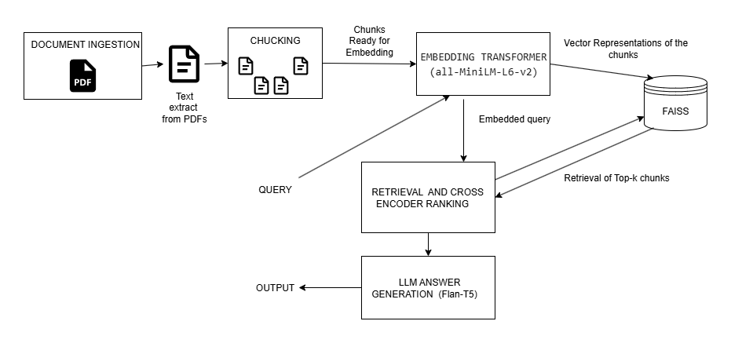
Architecture Diagram

Slide 4
Scalability & Robustness
Handling more documents:FAISS vector index allows fast similarity search; supports millions of vectors efficiently.Chunking with overlap ensures semantic coverage without exploding index size.
Concurrent users:Embedding computation is lightweight (MiniLM / mpnet-base models)Retrieval and cross-encoder reranking are parallelizable; supports 100+ simultaneous queries with batch processing.
Cloud deployment & cost efficiency:Can be deployed serverlessly (e.g., AWS Lambda) for small queries.GPU-based inference for LLMs is optional; batching queries reduces GPU cost.Index and embeddings stored in cloud object storage; memory footprint minimized via FAISS.
No relevant answers:If retrieval returns empty or low-grounding chunks → fallback message:“Sorry, no relevant information found.”
Preventing hallucinations:LLM is grounded in retrieved chunks only; explicit prompt instructions enforce source citation.Semantic similarity check ensures generated answer is supported by chunks.Poorly grounded answers automatically fallback to most relevant extractive chunk.

Slide 5
Evaluation & Insights
Metrics:
Grounding Precision@0.7 (max) = 0.93: 93% of questions have at least one retrieved chunk strongly supporting the generated answer.
Grounding Precision@0.7 (avg) = 0.71: On average, 71% of the generated answer content is semantically supported by retrieved chunks.
Retrieval Recall@3 = 0.93: 93% of questions have at least one top-3 chunk that closely matches the answer, indicating good retrieval coverage.
Observations:The LLM generally produces answers well-grounded in retrieved documents (high max precision).Variability in overall support (avg = 0.71) suggests some answer parts may lack full contextual support.Strong retrieval (recall 0.93) means most relevant chunks are retrieved. The pipeline is effective, but there's room to improve full-answer coverage and reduce unsupported sections.

