Slide 1

Pretty Good Privacy
Developed almost entirely by Phil Zimmerman.
Functions:
    Authentication
    Confidentiality
    Confidentiality & Authentication
    Compression
    E-mail Compatibility
    Segmentation & Reassembly

Slide 2
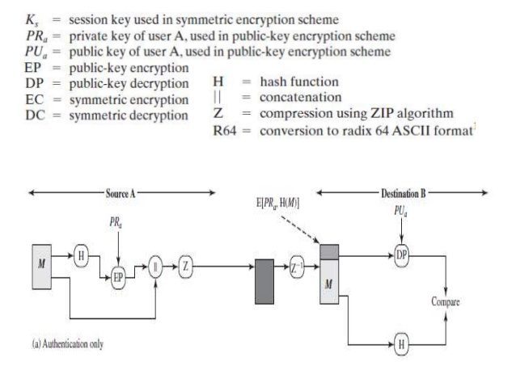
Authentication

Slide 3
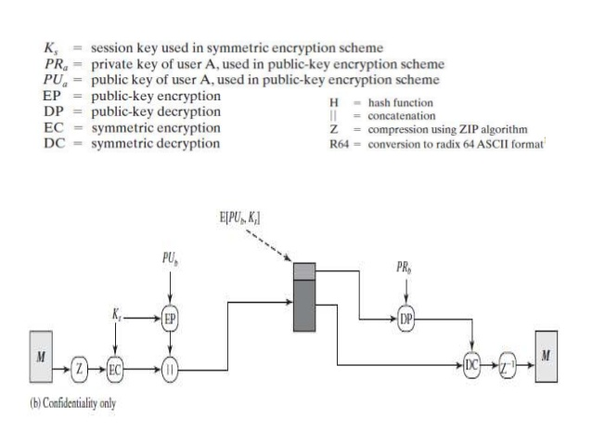
Confidentiality

Slide 4
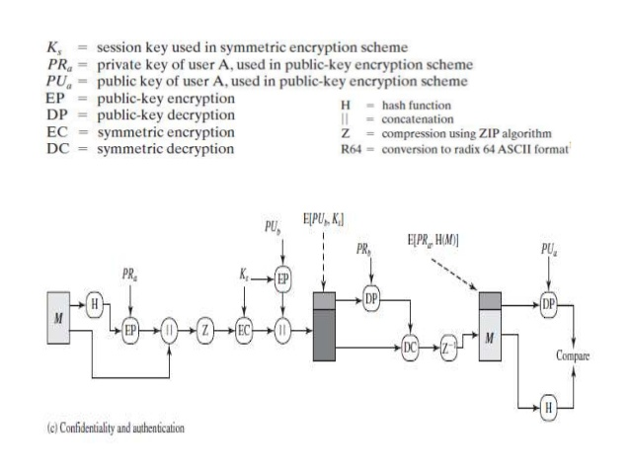
Confidentiality & Authentication

Slide 5
Compression
PGP compresses files using a ZIP algorithm
  The signature is generated before compression
  Message encryption is after compression
    To strengthen cryptographic security, as it reduces redundancy

Slide 6
E-Mail Compatibility
Many electronic mail systems can only transmit blocks of ASCII text. This can cause a problem when sending encrypted data since ciphertext blocks might not correspond to ASCII characters which can be transmitted.
PGP overcomes this problem by using radix-64 conversion.

Slide 7
Radix-64 conversion
Suppose the text to be encrypted has been converted into binary using ASCII coding and encrypted to give a ciphertext stream of binary.
Radix-64 conversion maps arbitrary binary into printable characters.

Slide 8
6 bit value | Character encoding | 6 bit value | Character encoding | 6 bit value | Character encoding | 6 bit value | Character encoding
0 1 2 3 4 5 6 7 8 9 10 11 12 13 14 15 | A B C D E F G H I J K L M N O P | 16 17 18 19 20 21 22 23 24 25 26 27 28 29 30 31 | Q R S T U V W X Y Z a b c d e f | 32 33 34 35 36 37 38 39 40 41 42 43 44 45 46 47 | g h i j k l m n o p q r s t u v | 48 49 50 51 52 53 54 55 56 57 58 59 60 61 62 63 (pad) | w x y z 0 1 2 3 4 5 6 7 8 9 + / =

Slide 9
Segmentation & Reassembly
Another constraint of e-mail is that there is usually a maximum message length.
PGP automatically blocks an encrypted message into segments of an appropriate length.
On receipt, the segments must be re-assembled before the decryption process.

