Slide 1

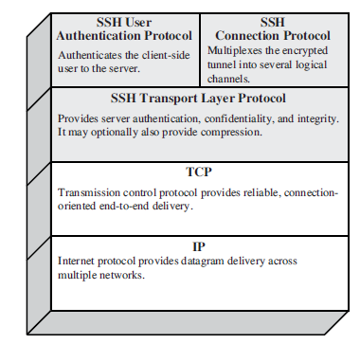
Secure Shell (SSH)
- is a protocol for secure network communications designed to be
relatively simple and inexpensive.
-SSH is organized as three protocols that typically run on top of TCP.
SSH Protocol Stack

Slide 2
SSH components
SSH Transport Layer Protocol
  provides server authentication, confidentiality, and integrity services
  it may provide compression too
  runs on top of any reliable transport layer (e.g., TCP)
SSH User Authentication Protocol
  provides client-side user authentication
  runs on top of the SSH Transport Layer Protocol
SSH Connection Protocol
  multiplexes the secure tunnel provided by the SSH Transport Layer and User Authentication Protocols into several logical channels
  these logical channels can be used for a wide range of purposes
    secure interactive shell sessions
    TCP port forwarding

Slide 3
SSH TLP – Overview
client
server
TCP connection setup
SSH version string exchange
SSH key exchange
(includes algorithm negotiation)
SSH data exchange
termination of the TCP connection

Slide 4
Connection setup and version string exchange
TCP connection setup
  the server listens on port 22
  the client initiates the connection
SSH version string exchange
  both side must send a version string of the following form:
  “SSH-protoversion-softwareversion comments”
  used to indicate the capabilities of an implementation
  triggers compatibility extensions
  current protocol version is 2.0
  all packets that follow the version string exchange is sent using the Binary Packet Protocol

Slide 5
Binary Packet Protocol
  packet length:
    length of the packet not including the MAC and the packet length field
  padding length:
    length of padding
  payload:
    useful contents
    might be compressed
    max payload size is 32768
  random padding:
    4 – 255 bytes
    total length of packet not including the MAC must be multiple of max(8, cipher block size)
    even if a stream cipher is used
  MAC:
    message authentication code
    computed over the clear packet and an implicit sequence number
packet length (4)
padding length (1)
payload
(may be compressed)
random padding
MAC
encryption
compression

Slide 6
Encryption
Encryption algorithm is negotiated during the key exchange
supported algorithms
  3DES-CBC (required) (168 bit key)
  BLOWFIS H(recommended)
  Twofish256-CBC (opt) / twofish192-CBC (opt) / twofish128-CBC (recomm)
  AES256-CBC (opt) / AES192-CBC (opt) / AES128-CBC(recomm)
  Serpent256-cbc (opt) / serpent192-cbc (opt) / serpent128-cbc (opt)
  IDEA-CBC (opt) / CAST128-CBC (opt)
Key and IV are also established during the key exchange
All packets sent in one direction is considered a single data stream
  IV is passed from the end of one packet to the beginning of the next one
encryption algorithm can be different in each direction

Slide 7
MAC
MAC algorithm and key are negotiated during the key exchange
supported algorithms
  HMAC-SHA1 (required) [MAC length = key length = 160 bits]
  HMAC SHA 1-96(recomm) [MAC length = 96, key length = 160 bits]
  HMAC-MD5 (opt) [MAC length = key length = 128 bits]
  HMAC-MD5-96 (opt) [MAC length = 96, key length = 128 bits]
MAC algorithms used in each direction can be different
MAC = MAC( key, seq. number | clear packet )
  sequence number is implicit, not sent with the packet
  sequence number is represented on 4 bytes
  sequence number initialized to 0 and incremented after each packet
  it is never reset (even if keys and algs are renegotiated later)

Slide 8
Key exchange - Overview
client
server
SSH_MSG_KEXINIT
execution of the selected
key exchange protocol
SSH_MSG_NEWKEYS
uses new keys
and algorithms
for sending
uses new keys
and algorithms
for receiving

Slide 9
Algorithm negotiation
SSH_MSG_KEXINIT
  kex_algorithms (comma separated list of names)
  server_host_key_algorithms
  encryption_algorithms_client_to_server
  encryption_algorithms_server_to_client
  mac_algorithms_client_to_server
  mac_algorithms_server_to_client
  compression_algorithms_client_to_server
  compression_algorithms_server_to_client
  first_kex_packet_follows (boolean)
  random cookie (16 bytes)
algorithm lists
  the server list the algorithms it supports
  the client lists the algorithms that it is willing to accept
  algorithms are listed in order of preference
  selection: first algorithm on the client’s list that is also on the server’s list

Slide 10
Service request
after key exchange the client requests a service
services
  ssh-userauth
  ssh-connection
when the service starts, it has access to the session ID established during the first key exchange

Slide 11
SSH – User Authentication Protocol
the protocol assumes that the underlying transport protocol provides integrity and confidentiality (e.g., SSH Transport Layer Protocol)
the protocol has access to the session ID
the server should have a timeout for authentication and disconnect if the authentication has not been accepted within the timeout period
  recommended value is 10 minutes
the server should limit the number of failed authentication attempts a client may perform in a single session
  recommended value is 20 attempts
three authentication methods are supported
  publickey
  password
  hostbased

Slide 12
User authentication overview
USERAUTH_REQUEST
  user name
  service name
  method name
  … method specific fields …
USERAUTH_FAILURE
  list of authentication methods that can continue
  partial success flag
    TRUE: previous request was successful, but further authentication is needed
    FALSE: previous request was not successful
USERAUTH_SUCCESS
  (authentication is complete, the server starts the requested service)
client
server
SSH_MSG_USERAUTH_REQUEST
SSH_MSG_USERAUTH_FAILURE
(further authentication needed)
SSH_MSG_USERAUTH_REQUEST
SSH_MSG_USERAUTH_FAILURE
(further authentication needed)
…
SSH_MSG_USERAUTH_REQUEST
SSH_MSG_USERAUTH_SUCCESS

Slide 13
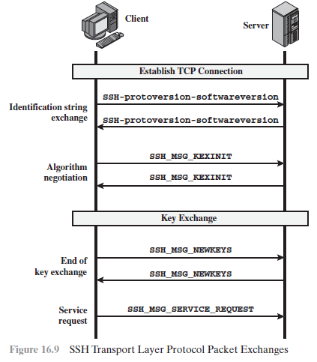

Slide 14
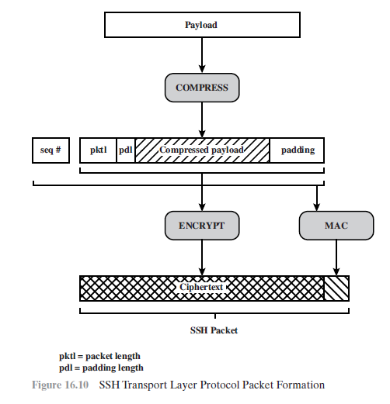

Slide 15
