Slide 1

Secure Socket Layer (SSL)

Slide 2
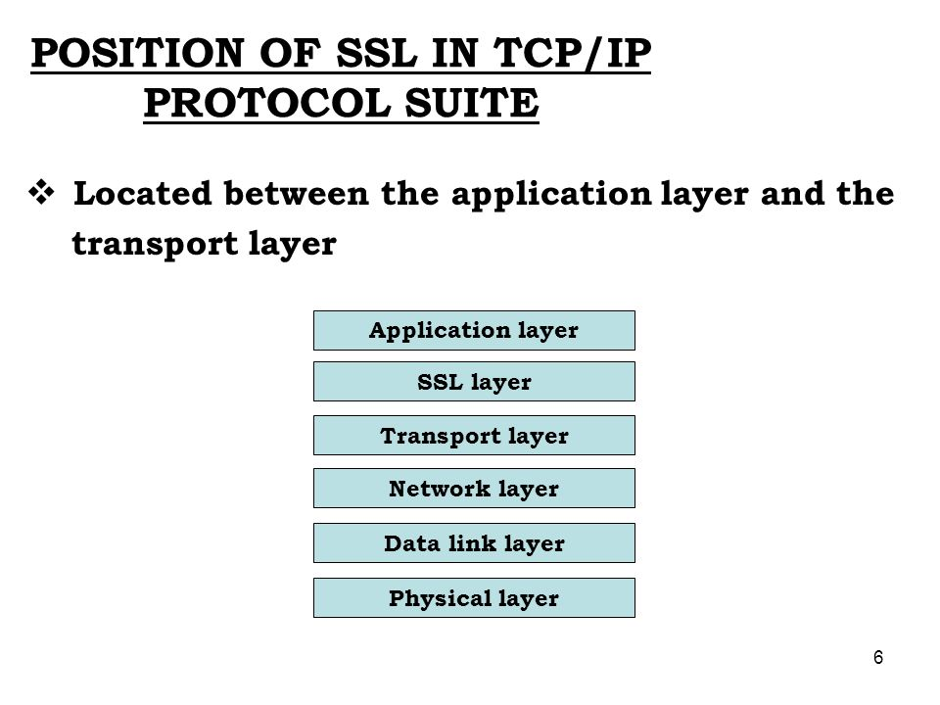

Slide 3
SECURE SOCKET LAYER
    Handshake Protocol
    Record Protocol
    Alert Protocol

Slide 4
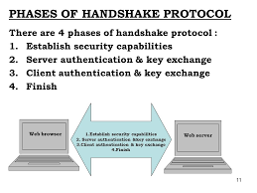

Slide 5
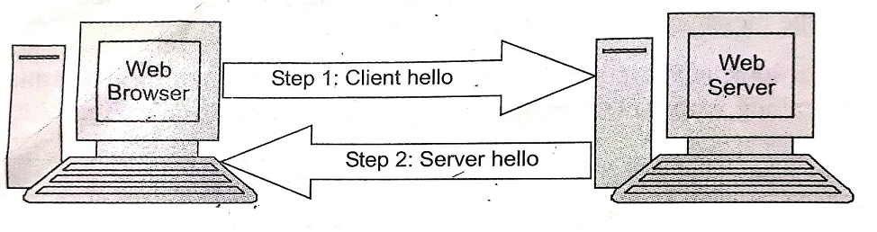
Establish Security Capabilities

Slide 6
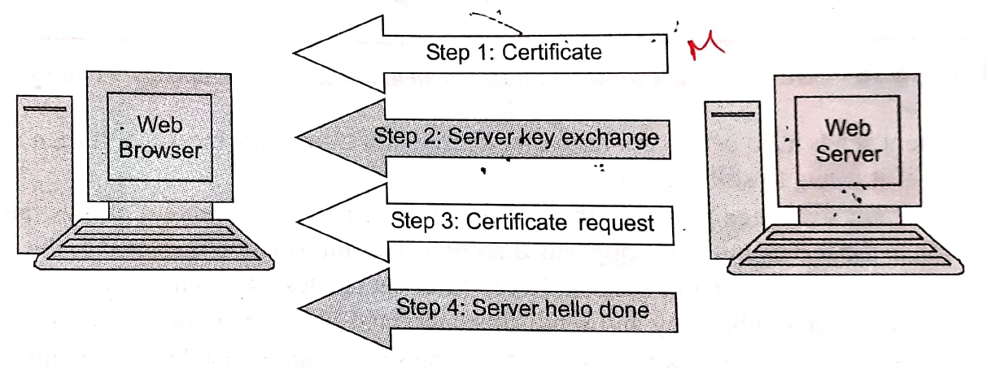
Server Authentication & Key Exchange

Slide 7
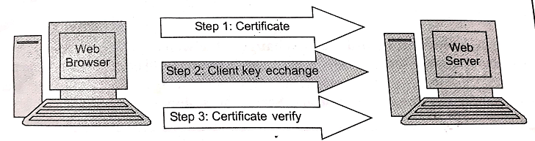
Client Authentication & Key Exchange

Slide 8
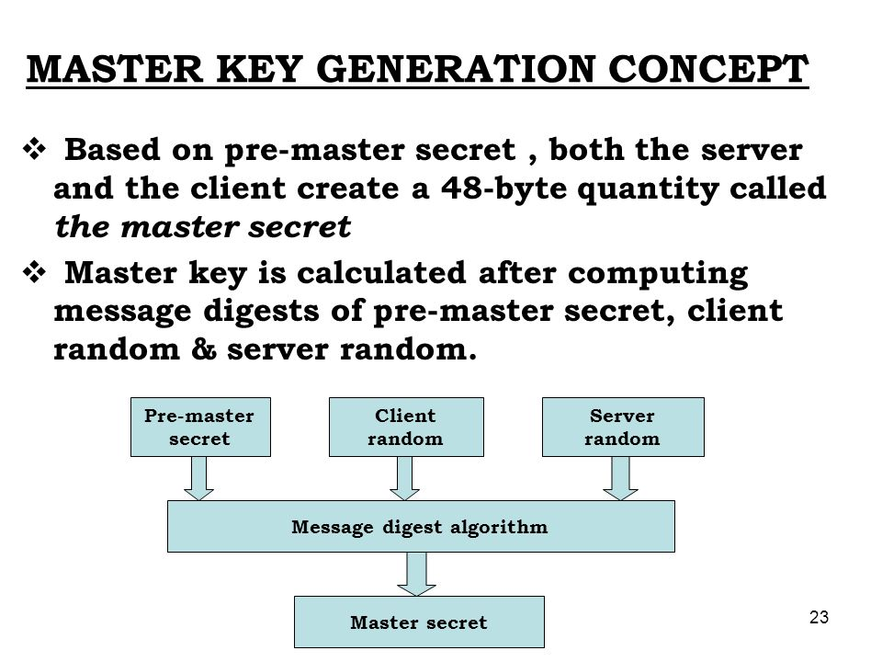

Slide 9
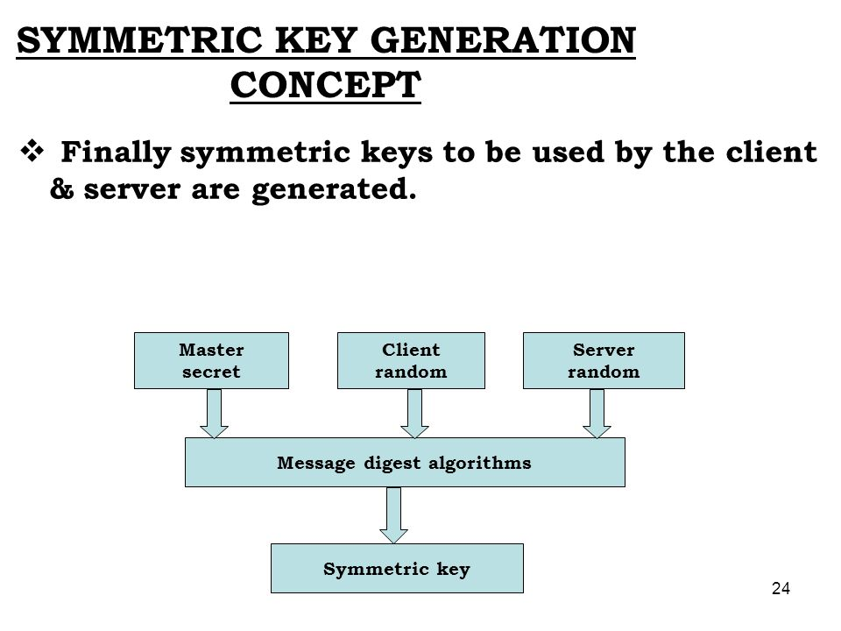

Slide 10
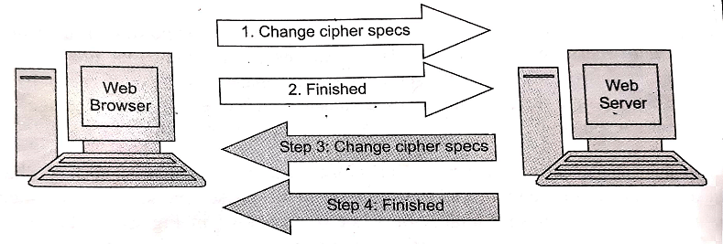
Finish

Slide 11
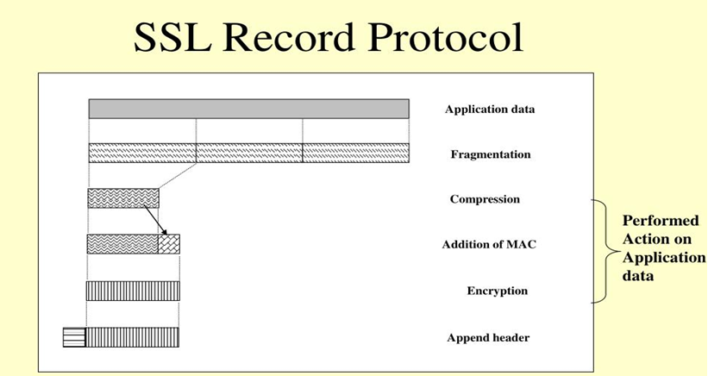

Slide 12
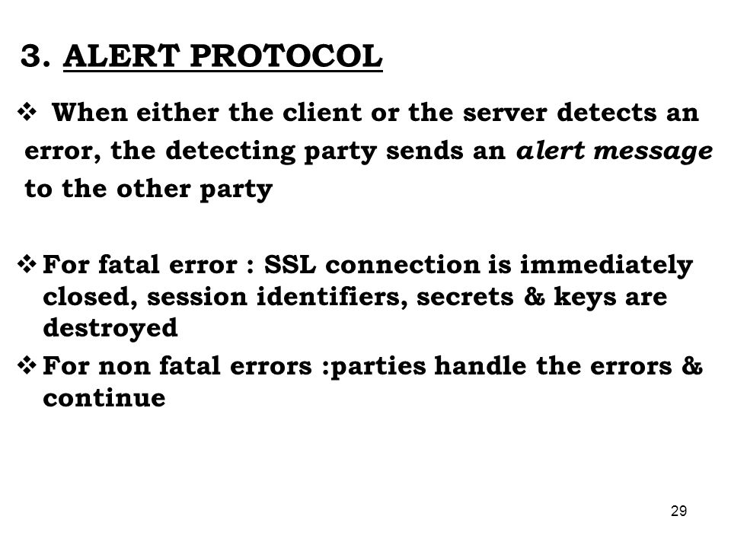

Slide 13
