Slide 1

ADHIPARASAKTHI COLLEGE OF ENGINEERING
G.B. NAGAR, KALAVAI, RANIPET DIST - 632 516.
PROJECT FINAL REVIEW
AI-Powered Text Analyzer
Summarization | Emotion Detection |Title Generation
GUIDED BY :
TEAM MEMBERS :
Mr.B.Sukkrivan,M.Tech,(Ph.D)
SURYA S (510121104047)
VIGNESH S (510121104053)
SUDHARSAN V (510121104043)
SIDDIQ S (510121104039)

Slide 2
Abstract
A web-based application built with Streamlit that combines summarization, emotion classification, and title generation using transformer models (BART, DistilRoBERTa, T5). The goal is to help users analyze large texts efficiently and generate emotionally resonant, context-aware summaries and titles.

Slide 3
Problem Statement
Manual summarization, title writing, and sentiment analysis are time-consuming and error-prone. Existing tools often lack integration, emotional depth, and user-friendliness.

Slide 4
Objectives
- Summarize content using BART
- Detect emotion using DistilRoBERTa
- Generate titles using T5
- Build UI in Streamlit

Slide 5
Literature Survey
- Transformer models (BERT, RoBERTa, GPT)
- Sentiment lexicons and embeddings
- Pretrained datasets like Kaggle, Semeval

Slide 6
Existing System
- Manual summarization
- No emotion insight
- No integration
- No title generation

Slide 7
Proposed System
- BART for summarization
- DistilRoBERTa for emotion
- T5 for title
- Integrated in Streamlit UI

Slide 8
System Architecture
[User Input] → [Preprocessing] → [BART Summary]
→ [RoBERTa Emotion]
→ [T5 Title]
→ [Display in UI]

Slide 9
Module 1 – Input Handling
- Preprocess input
- Lowercase
- Limit to 750 words
- Trigger on Analyze

Slide 10
Module 2 – Title Generation
- Model: T5
- Input: summarization prompt
- Output: 2–5 word titles

Slide 11
Module 3 – Summarization
- Model: BART-large
- Abstractive summarization
- Outputs concise summary

Slide 12
Module 4 – Emotion Detection
- Model: DistilRoBERTa
- Outputs emotion probabilities
- Shows top 3 with emojis

Slide 13
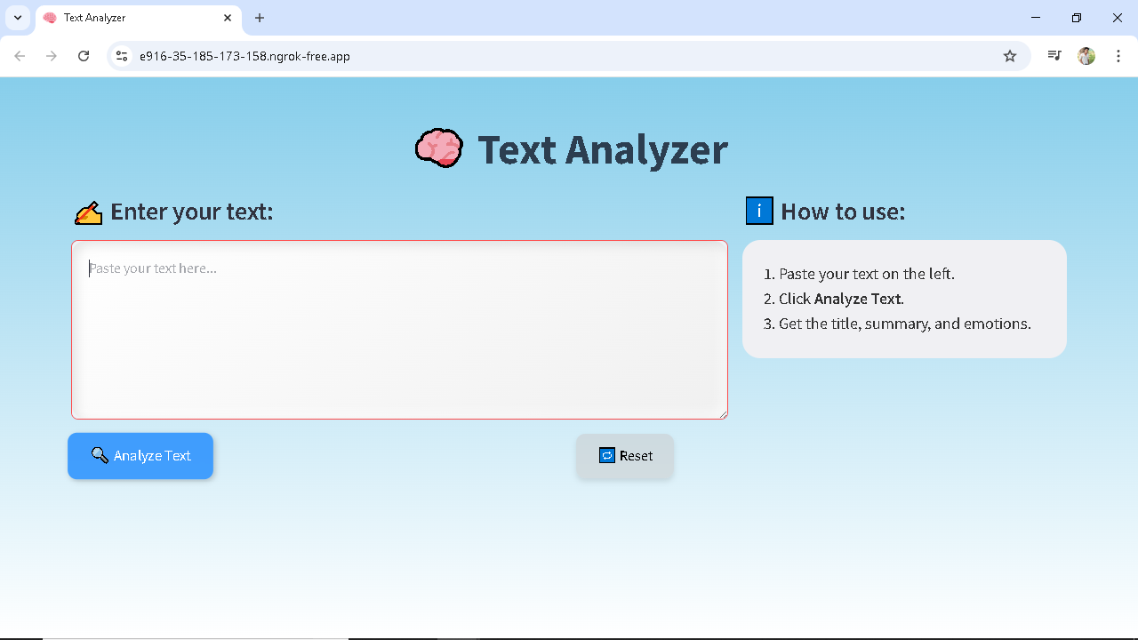
Streamlit UI Design

Slide 14
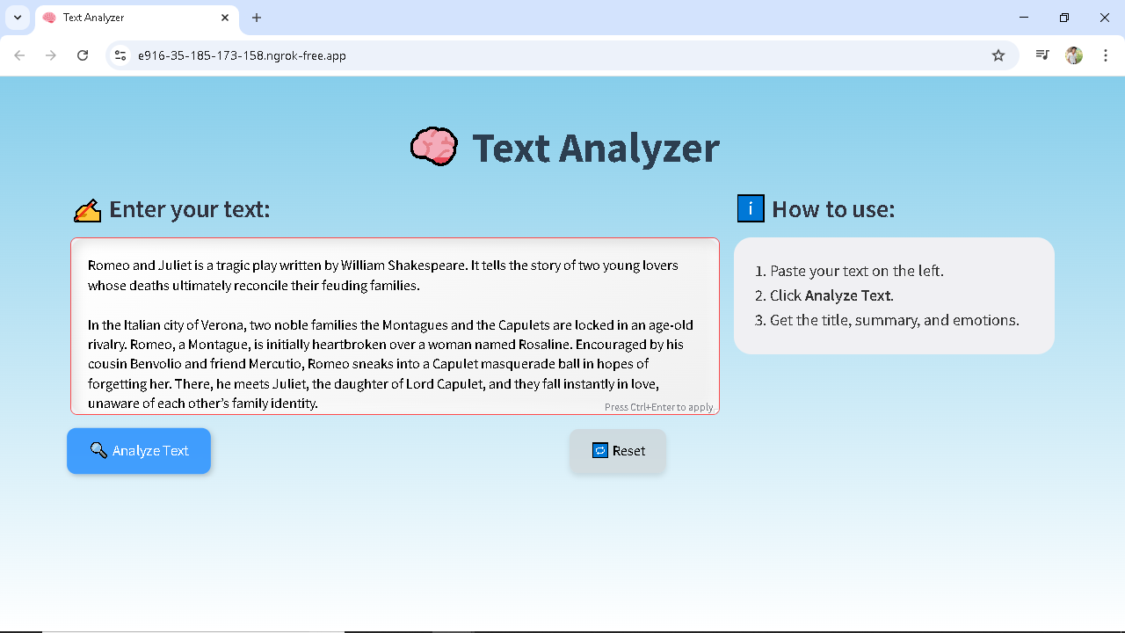
Output Screenshot 1: Input Given

Slide 15
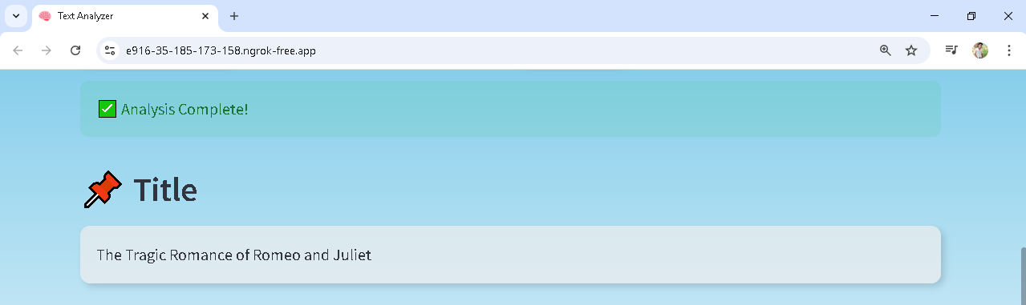
Output Screenshot 2: Title Output

Slide 16
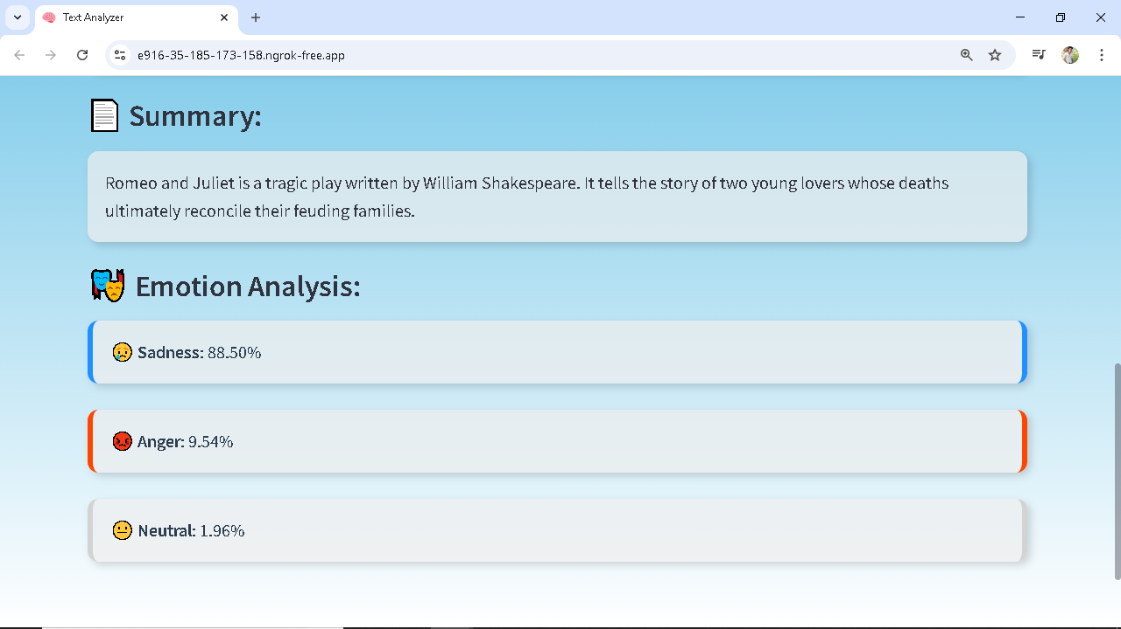
Output Screenshot 3: Summary & Emotion

Slide 17
Conclusion & Future Scope
- Successfully integrated transformer models for summarization, title generation, and emotion detection.
- Future improvements include voice input, larger input support, and public deployment.

