Slide 1
Introduction to Graph Neural Networks
Vignesh Kumar Thangarajan
CMPE-258 San Jose State University

Slide 2
Data Representation
Data in most machine learning algorithms are typically represented in the Euclidean space.
we often have an embedding layer to represent text and flattening layer for image data.
These representations have ruled out any inherent relationship between the data for the processing layers to consider.

Slide 3
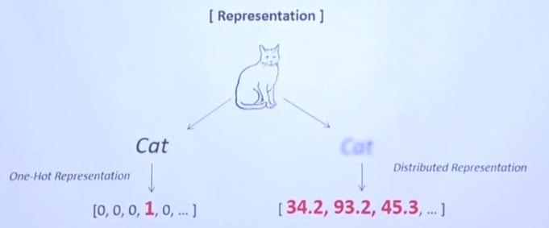
Distributed Vector Representation

Slide 4
Graph Representation
The graphs can be either directed or undirected graph and it is purely based on the application design consideration.
Once we have a graph representation of data it is fed to the processing layers of GNN.
The output of which will then be used per application need and it can be fed to a loss computation layer and back propagate it to the Graph for each node to adjust the weights to improve the accuracy.

Slide 5
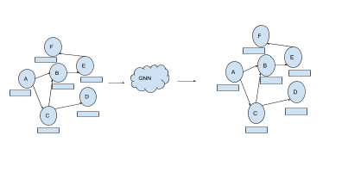
Graph

Slide 6
Message Passing
In our example, the node B has two neighbors — A and C. So, it will receive updates from both A and C in every clock time. The updates are called messages.
The messages are then prepared using Mathematical functions applied on both the messages independently. A bias term can also be added to keep track of the number of nodes the updates coming from.
Prepared messages are then summarized. A new function applied over the Union of all messages from all the neighbor nodes.
Output of step 3 and current state of node C (at time t-1) is then combined and fed to either a recurrent network layer or convolution layer based on the application need.
Output of step 4 is now the new state of node C at time t.

Slide 7
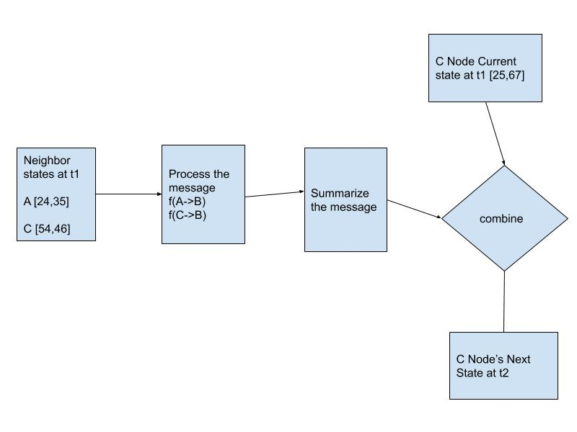
Flow diagram

Slide 8
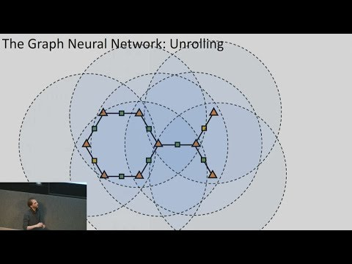
Message passing to all nodes

Slide 9
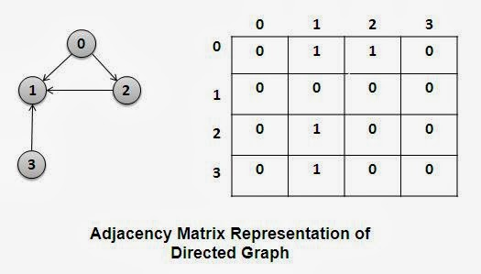
Adjacency Matrix

Slide 10
Variants of GNN
We can use several variants of GNN and it is completely based on the problem we want to solve and the design considerations we take.
If we use a RNN for back propagation, it is called Gated GNN (GRU) and Graph Convolution Network (GCN) if we instead use convolution layer.

Slide 11
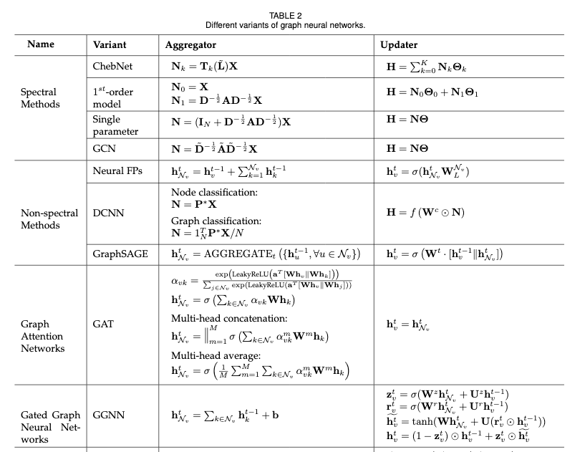
Comparison of functions in GNN

Slide 12
Applications
Calculating Molecular Fingerprints. For example, to study a complex protein structure, we can represent that in graph like each atom as a separate node and their connections as edges.
Self healing computer programs.
Bayesian Neural Network and Bayesian based GNN. The plain vanilla Bayesian Networks are also represented as graphs. These networks are pivotal in measuring the confidence of classification or prediction accuracy that the network is doing — which is, very relevant in almost all real world applications.

Slide 13
References
Microsoft Research
https://arxiv.org/pdf/1901.00596.pdf
https://www.youtube.com/watch?v=lDRb3CjESmM
https://arxiv.org/pdf/1812.08434.pdf
https://theaisummer.com/Graph_Neural_Networks/
Special Thanks to Professor - Vijay Eranti

