Slide 1
Unprocessing Images for learned raw denoising
Vignesh Kumar Thangarajan

Slide 2
Motivation
Single Image de-noising is one of the important aspects of computer vision and image processing.
Previous algorithms did a good job, but they still failed to take important aspects of camera into consideration like digital gain, color correction and tone mapping.
The assumption made by previous algorithms was wrong and we explore a new state of art method which tries to reverse engineer lot of aspects.

Slide 3
Solution Design
In unprocess stage, we sequentially invert image processing transformations. This consists of inverting and in order tone mapping , applying gamma decompression, converting sRGB to Device RGB, inverting white balance and digital gain.
The resultant image is the raw image which is equivalent to the image captured by a raw camera sensor.
Shot and Read noise are the two primary attributes to Sensor noise. Shot noise indicates the photon arrival statistics and Read noise indicates the imprecision in the readout circuitry.
The former is a Poisson random variable while the later is Gaussian random variable. With this information, a neural network which we will see later gets trained to denoise raw images.

Slide 4
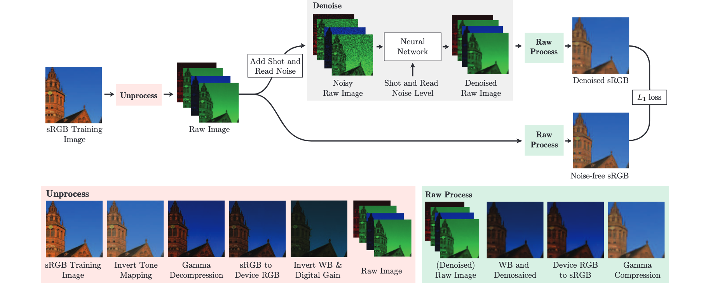
Solution Design

Slide 5
Demosaicing
Each pixel in a camera sensor is covered by a single red, green, or blue color filter, arranged in a Bayer pattern, such as R-G-G-B.
Demosaicing is a process of recovering all three-color measurements for each pixel in the image. Here, we adopt bi-linear interpolation to recover the colors.

Slide 6
Digital Gain
Every camera does auto adjustment in terms of image lighting and intensity.
This algorithm is different from every camera vendors out there. We cannot reverse engineer this unknown algorithm to invert this step.
So, a reasonable heuristic is to assume a single global scaling factor. The assumption here is the images from real and synthetics datasets follows different exponential distribution.

Slide 7
White Balance
Like Digital Gain, one of the goals of a camera is to neutralize the effect of illumination thereby producing an image that appears to be lit under natural illumination.
This adjustment is done by white balance algorithm that estimates a per channel gain of an image using a heuristic approach.
Since, the logic is black box, inverting this WB algorithm is difficult. However, raw image datasets record the white balance metadata of their images, so we can synthesize somewhat realistic data by simply sampling from the empirical distribution of white balance gains in that dataset.

Slide 8
Color Correction
In general, the color filters of a camera sensor do not match the spectra of sRGB color space.
To address this, a camera will apply a 3×3 color correction matrix (CCM) to convert it to sRGB values. Raw image datasets typically consists of four cameras, each of which uses its own CCM to perform color correction.
To invert this step in synthetic images, we sample random convex combinations of these four CCMs, and for each image, we apply the inverse of a sampled CCM to neutralize the effect of color correction.

Slide 9
Gamma Compression
Humans are sensitive to gradations in the dark areas of images, gamma compression is typically used to allocate more bits of dynamic range to those pixels.
We use the standard gamma curve, while taking care to clamp the input to the gamma curve to prevent numerical instability during training.
we use inverse of this function while generating synthetic data.

Slide 10
Tone Mapping
While high dynamic range images require extreme tone mapping, even standard low-dynamic-range images are often processed with an S-shaped curve which are designed to match the “characteristic curve” of image.
More complex edge-aware local tone mapping may be performed, though reverse-engineering such an operation is difficult.
We therefore assume that tone mapping is performed with a simple S-shaped curve and inverse of that curve is applied to generate synthetic image.

Slide 11
Model
Above are the common steps that are involved in an image processing pipeline and after inverting the image processing steps, we placed the denoising neural network model.
The synthetic data is corrupted by the noise. The goal of the neural network is to effectively denoise this input. Therefore, the input to the neural network is images that are unprocessed and before calculating the loss of the neural network we re-process the images.
By doing this way the neural network is also taking into the consideration of parameters that are applied during the image processing pipeline.

Slide 12
Model Architecture
Here we used a U-Net architecture with skip connections between encoder and decoder blocks at the same scale, with box down sampling while encoding whereas bilinear up sampling while decoding. PReLU is the activation function.

Slide 13
Model Evaluation
Two different models are trained one on sRGB error metrics and one on the raw image error metrics. The models produce a 14% and 25% reduction in error on the raw metrics compared to the next best performing technique, and a 21% and 38% reduction in error on the sRGB metrics compared to the two next best performing techniques — N3Net and CBDNet.

Slide 14
Conclusion
The proposed unprocessing methods helped converting the generic images into raw images that resembles images captured by camera sensors. Following that, we trained a Convolution neural network for the task of denoising raw image data. The proposed model thus achieved lower error rates and also recorded significant improvement in training time.

