Slide 1


CSA1402 – Compiler Design
Technical Presentation
“How Modern Programming Languages Are Compiled”
PRESENTED BY
Vigneshvar S (192424187)
GUIDED BY
Dr. N Deepa

Slide 2
Introduction
A compiler is a software program that translates high-level source code into machine code.
It enables programmers to write code in languages like C, C++, Java, and Python, which computers cannot execute directly. Compilation is performed through multiple phases such as Lexical Analysis, Syntax Analysis, Semantic Analysis, Intermediate Code Generation, Optimization, and Code Generation.
Each phase performs a specific task to improve the correctness and efficiency of the program.
Understanding these phases helps us learn how modern programming languages are compiled and executed efficiently.

Slide 3
Compiler Basics
Compiler Basics
Source Code
Program written by the programmer in a high-level language (e.g., C, Java, Python).
Compiler
Translates source code into machine code before execution.
Interpreter
Executes source code line by line without generating a separate executable.
Compilation Process
Converts source code into executable machine code through multiple compiler phases.

Slide 4
Compilation Pipeline
The compilation process transforms source code through a well-defined sequence of phases:
Source Code
Lexical Analysis
Syntax Analysis
Semantic Analysis
Execution
Machine Code
Optimization
Intermediate Code
Compilation begins with the source code written by the programmer.
The compiler processes the code through multiple phases, each performing a specific task.
Errors are detected and corrected during the early phases of compilation.
The program is optimized to improve performance and reduce unnecessary operations. Finally, machine code is generated and executed by the computer.

Slide 5
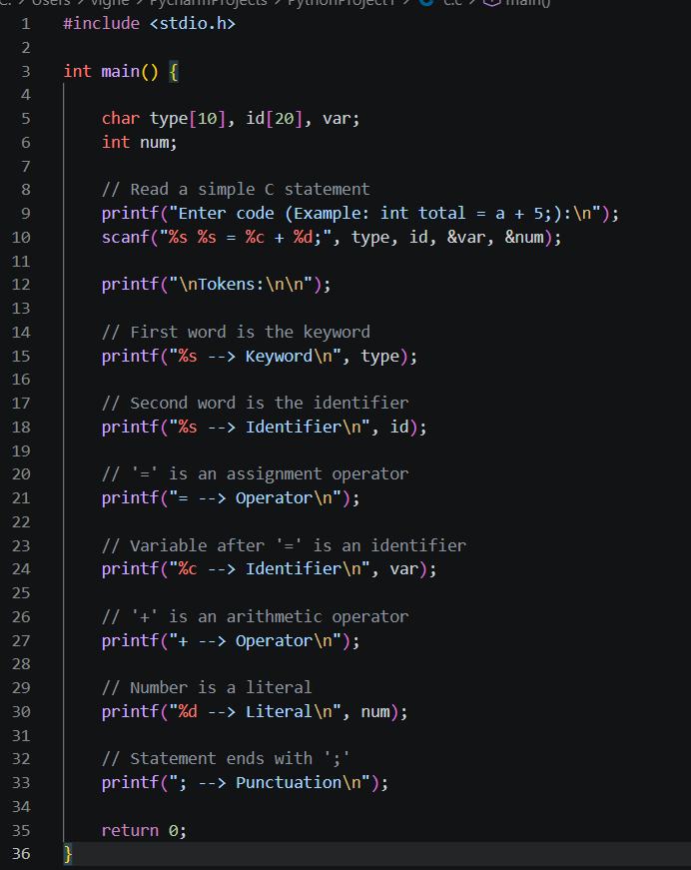
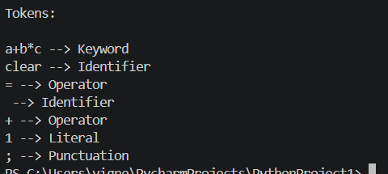

Lexical Analysis
First phase of the compiler that scans the source code. Breaks the program into tokens (Keyword, Identifier, Operator, Literal, Punctuation).
Ignores unnecessary spaces and comments during scanning.
Passes the generated tokens to the Syntax Analysis phase.

Slide 6
Syntax Analysis
Checks whether the sequence of tokens follows the language grammar.
Detects syntax errors such as missing symbols or incorrect statement structure.
Builds a Parse Tree to represent the grammatical structure of the program.
Passes the validated structure to the Semantic Analysis phase.
Assign (=)
total
Expr (+)
a
5

Slide 7
Semantic Analysis
Checks whether the program is logically correct after syntax analysis.
Verifies data types to ensure operations are valid.
Checks that variables and functions are declared before use.
Detects semantic errors such as type mismatches, undeclared variables, and invalid function calls.

Slide 8
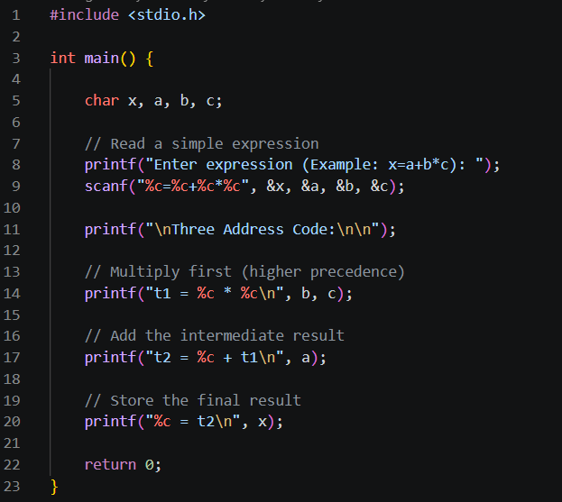
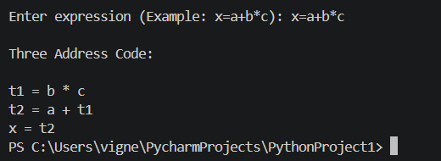
Intermediate Representation (IR)
Converts the source program into an intermediate representation (IR).
Breaks complex expressions into simple three-address instructions.
Uses temporary variables (t1, t2, ...) to store intermediate results.
Simplifies code optimization and target code generation.

Slide 9
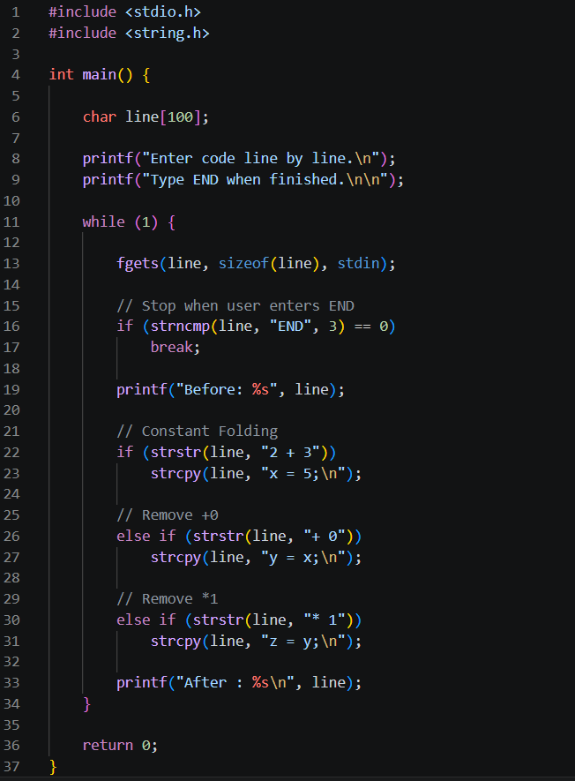
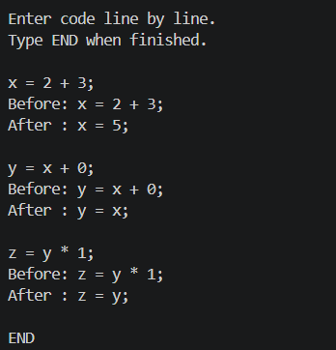
Compiler Optimizations
Improves code efficiency without changing the program output.
Evaluates constant expressions at compile time (Constant Folding).
Removes unnecessary operations such as + 0 and * 1. Produces faster and more optimized code for execution.

Slide 10
Code Generation
Intermediate Representation (IR): Serves as the input for the code generation phase.
Instruction Selection: Converts IR operations into equivalent machine instructions. ‘
Register Allocation: Assigns CPU registers to variables for efficient execution.
Assembly/Machine Code: Produces the final executable code that the processor can run.
IR
Instruction
Selection
Register
Allocation
Assembly /
Machine Code

Slide 11
Conclusion
A compiler transforms high-level source code into executable machine code through a series of well-defined phases.
Each compiler phase—Lexical Analysis, Syntax Analysis, Semantic Analysis, Intermediate Code Generation, Optimization, and Code Generation—plays a vital role in producing correct and efficient programs.
Compiler optimization techniques improve execution speed, reduce resource usage, and generate high-quality machine code.
Modern compiler technologies continue to evolve by supporting new programming languages, advanced hardware, and AI-assisted optimization.
Understanding compiler design provides a strong foundation for programming languages, software development, and system-level computing.

Slide 12
References
Aho, A. V., Lam, M. S., Sethi, R., & Ullman, J. D. (2006). Compilers: Principles, Techniques, and Tools (2nd ed.). Pearson.
Lattner, C., & Adve, V. (2004). LLVM: A Compilation Framework for Lifelong Program Analysis & Transformation. Proceedings of CGO.
LLVM Project. (2026). LLVM Language Reference Manual. https://llvm.org/docs
GNU Project. (2026). GCC Online Documentation. https://gcc.gnu.org/onlinedocs
Haas, A., et al. (2017). Bringing the Web up to Speed with WebAssembly. Proceedings of ACM SIGPLAN PLDI.
Python Software Foundation. (2026). CPython Developer's Guide. https://devguide.python.org
Oracle. (2026). The Java Virtual Machine Specification. https://docs.oracle.com/javase/specs

Slide 13


Slide 14
THANK YOU!

