Slide 1

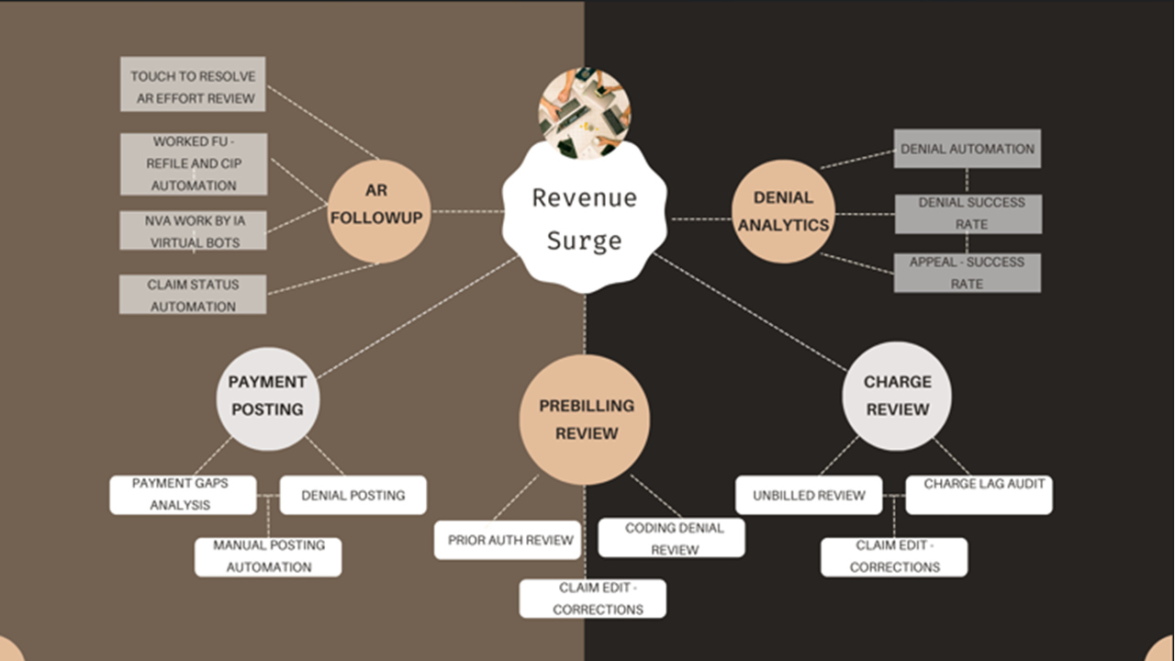

Revenue Surge

Slide 2
Better $ impact by Effective Work flow Structure

Slide 3
AR Work Flow Prioritization
TFL
Timely filing by Payer plan
calculations : Lag: Today - DOS
Claim $ Value
Average OSAR +100% above
Average OSAR +50 % Above
Average OSAR
Lesser than Average OSAR
AFL
Appeal filing limit by Payer plan
Calculations: Today - Denial poste date
Adjudication timeline:
Time taken for the payer to pay claim
Calcualtion: Paid date - DOS
Unbilled
Insurance type P,S,T, self
Insurance type based on Primary , Secondary and Tertiary and Self pay
Rejection
Denial resolution - Category
Denied resolution by Category
Denial posted date - payment posted date after denial date
Historical payment /No
Denial resolution - Payer
Denied resolution by Payer
Denial posted date - payment posted date after denial date
Similar Type of issues – Project level addressing
Recommended action Category
Corrected claim /New claim
Appeal
Client Assistance Success rate & AR collections

Slide 4
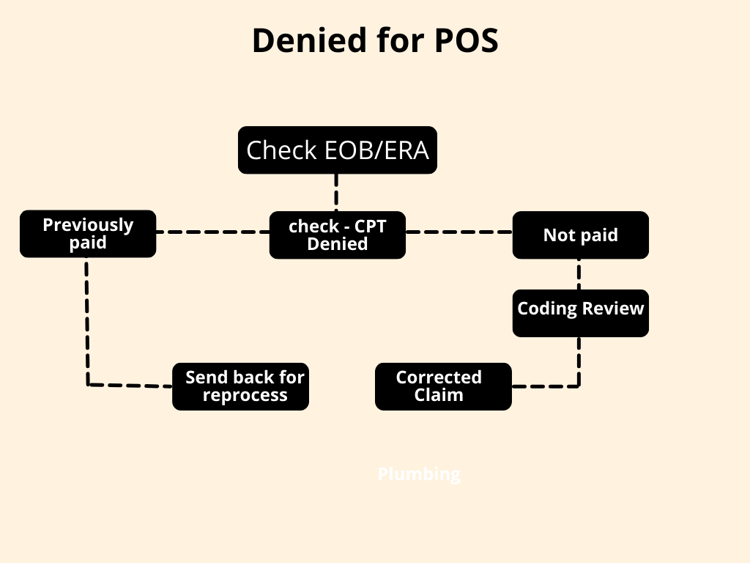
AR Work Flow by Decision Tree model
Sample
Denial for POS
Decision tree based on Industry standards
Give context why should send to reprocess with sample encounters
Give context based on SOP update and guidelines
More accurate resolutions which can be automated /mapped based on SOP/Specialty recommendations

Slide 5
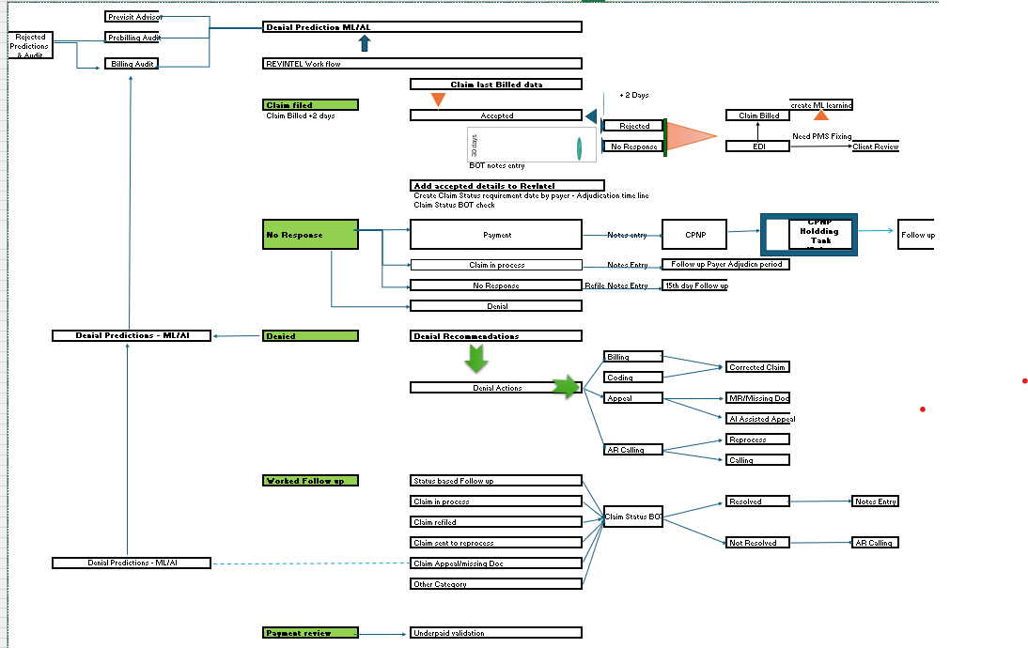
Fully loaded Automation and work flow

