Slide 1
Abbott – ITSM PRESENTATION

Slide 2

Impact Classifications
Extensive / Widespread
The entire enterprise site or more than 1,000 users could be affected.
Significant / Large
Either an entire division or 100 to 1,000 users could be affected.
Moderate Limited
Either an entire business unit or 2 to 100 users could be affected.
Minor Localized
One person could be affected.

Slide 3

Urgency Classifications
Critical
User is unable to work. System is non-functional. Critical Systems or business functions are adversely affected.
High
User is able to work but significant functionality is unavailable. Non-critical System missing prior functionality.
Medium
User is able to work, but minor functionality is unavailable. Non-critical System missing minor functionality. Reasonable Workaround has been employed successfully.
Low
Incidents/Service Requests logged by Abbott’s Service Desk, which are a result of request for increased functionality for New Services, not a failure in the IT infrastructure. System enhancement request.

Slide 4
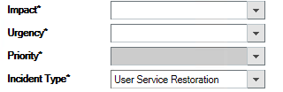
Priority Levels (P1 through P4) & Support Coverage
Impact / Urgency | Extensive/Widespread | Significant/Large | Moderate Limited | Minor Localized
Critical | P1 | P1 | P2 | P2
High | P1 | P2 | P2 | P3
Medium | P2 | P3 | P3 | P3
Low | P4 | P4 | P4 | P4
P1
- Severe business Impact
P2
- Major business Impact
P3
- Minor business Impact
P4
- Minimal or no business Impact

Slide 5
SLA
A service level agreement (SLA) is a contract between a service provider (either internal or external) and the end user that defines the level of service expected from the service provider.
This Agreement represents a Service Level Agreement between Cognizant and Abbott for the provisioning of IT services required to support and sustain the Product or service.
SLA Types
Response SLA
Resolution SLA

Slide 6
Incident & Service Request Response Targets for All Systems
Impact / | Extensive / Widespread | Significant/ | Moderate Limited | Minor
Urgency |  | Large |  | Localized
Critical | P1 - 15 min | P1 - 15 min | P2 - 15 min | P2 – 15 min
High | P1 - 15 min | P2 - 15 min | P2 - 15 min | P3 - 2 hrs
Medium | P2 - 15 min | P3 - 2 hrs | P3 - 2 hrs | P3 - 2 hrs
Low | P4 – 4 hrs | P4 - 4 hrs | P4 - 4 hrs | P4 - 4 hrs

Slide 7
Incident & Service Request Resolution Targets
Business Critical Systems
Impact / Urgency | Extensive / Widespread | Significant/ Large | Moderate Limited | Minor Localized
Resolution time (in Workdays unless otherwise noted)
Critical | P1 – 2 hrs | P1 – 2 hrs | P2 – 8 hrs | P2 – 8 hrs
High | P1 – 2 hrs | P2 – 8 hrs | P2 – 8 hrs | P3 - 2 days
Medium | P2 – 8 hrs | P3 - 2 days | P3 - 2 days | P3 - 2 days
Low | P4 - 10 days | P4 - 10 days | P4 - 10 days | P4 - 10 days
Business Non-Critical Systems
Impact / Urgency | Extensive / Widespread | Significant/ Large | Moderate Limited | Minor Localized
Resolution time (in Workdays unless otherwise noted)
Critical | P1 – 8 hrs | P1 – 8 hrs | P2 - 2 days | P3 - 6 days
High | P1 – 8 hrs | P2 - 2 days | P2 - 2 days | P3 - 6 days
Medium | P2 - 2 days | P3 - 6 days | P3 - 6 days | P3 - 6 days
Low | P4 - 10 days | P4 - 10 days | P4 - 10 days | P4 - 10 days

Slide 8
SLA Clock
SLA Event | Description | SLA Clock | Event recorded
First Response | You have acknowledged a request for service | Running | SLA First Response Date/Time
Resolution Plan | A plan to resolve the issue is in place | Running | SLA Resolution Plan Date/Time
Waiting Customer | You are awaiting action or information from a customer | Paused | N/A
Resolved | The customer's service need has been met and the issue can be resolved | Stopped | SLA Resolved Date/Time

Slide 9
P1 & P2 (SMO - IM process)
For P1 and P2, SMO IM will pitch in for the efficiency and effectiveness of the incident management process.
Support team will have to validate and provide the details to the IM within 15 minutes.
Once the P1/P2 incident has been confirmed – SMO IM will send out email communication with the bridge details within 30 minutes of its occurrence.
A bridge call allows a group of people to participate in phone call. The most common form of bridge allows participants dial into a virtual meeting room from their own phone.
Periodic Technical Communications will be sent by SMO IM as per SLA.

Slide 10
Root Cause Analyses
The scheduled completion time for each Root Cause Analysis will be agreed by the Parties for each occurrence within 5 days and recorded in the ITSM Tool.
RCAs shall be conducted for each P1 and P2 “Extensive/Widespread Impact” Incident and recurring Incidents for which a Problem record has been opened by Abbott. The Parties shall agree to the scheduled completion date for each Problem and document it within the applicable Problem record of the ITSM Tool.

Slide 11
What is a CAPA
An acronym for Corrective Actions & Preventative Actions
The systematic investigation of non-conformities in order to prevent their recurrence
CAPA is part of our quality management system (GQMS)
The IT Quality Impact Evaluation Procedure, BTSQC03.01.001
The Evaluation Process is segregated by type of incident. The incident evaluations should be performed based on the incident type:
Documentation or Process
Infrastructure
Application
Security related incidents
If the evaluation determines that a nonconformity or potential nonconformity exists, the incident must be communicated to GIS CAPA Program Management via email or assignment of the ITSM incident ticket.
If the incident is a nonconformity or potential nonconformity, it is documented via an Exception Report (ER). The ER must be initiated within seven (7) calendar days from the recognition date. If this requirement is not met, justification must be documented within the report.

Slide 12
BTSQC03.01.001(IT Quality Impact Evaluation Procedure )
BTSQC03.01.001, IT Quality Impact Evaluation Procedure
Defines how you are to identify non-conformities when resolving Incidents and completing the Incident Management record in ITSM.
Incidents Requiring Evaluation
Applies to all Level 2 or higher Incident tickets for quality applications, infrastructure supporting quality applications, quality data or security incidents require a CAPA evaluation to be performed and documented
Incidents Not Requiring Evaluation
Incidents resolved by the Help Desk
Service Requests (but make sure they are identified correctly as Service Requests)
Incidents involving systems which are not part of the Quality System
Responsibility
All personnel that troubleshoot and resolve Level 2 or higher Incident tickets
Incident Evaluation Criteria
Must be evaluated against current rev of the procedure and must be documented in Incident ticket Work Detail
NOTE: Refer BTSQC03.01.001 document for more info.

Slide 13
Why IT Nonconformity Evaluation is Important
It is an input to the CAPA Input process
Required by regulation, for example
FDA under 21 CFR Part 820 Subparts I, J for all nonconformance relating to product, manufacturing processes, and quality systems
Failure to do the evaluation could result in (examples)
A negative affect on Abbott’s good reputation
Abbott producing a poor quality product
Affect the safety of Abbott’s products
Cause harm, or even death, to a patient or a manufacturing line operator
Cause inaccurate data to be reported to a regulatory body
Cause a regulatory agency to close our operations

Slide 14
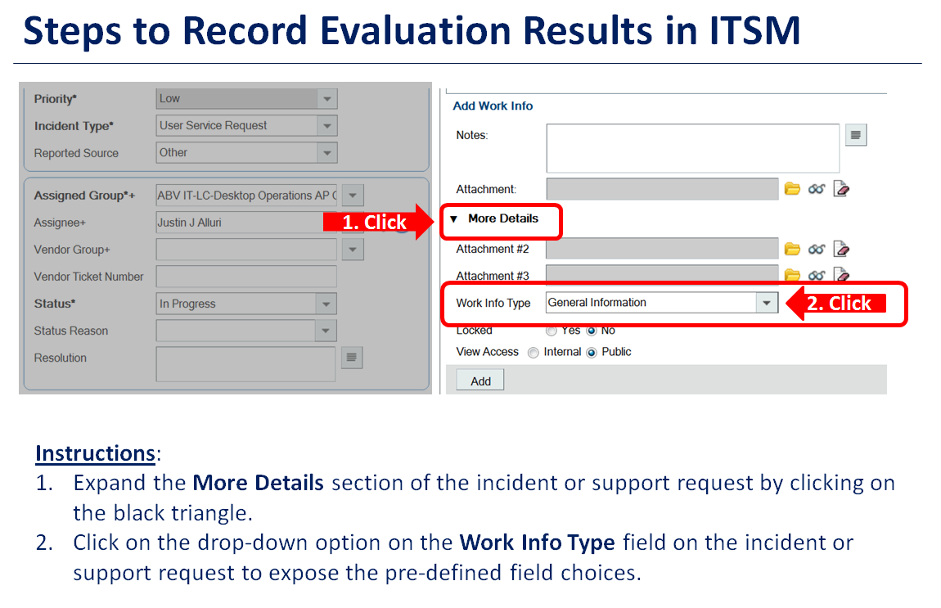
How to document a CAPA Evaluation

Slide 15
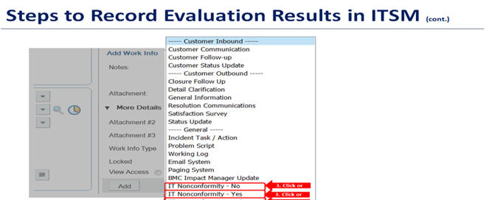
3. Select the appropriate evaluation results from the exposed field options(select only one option).

Slide 16
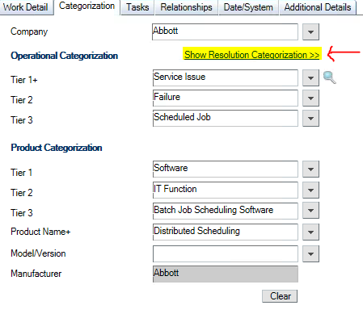
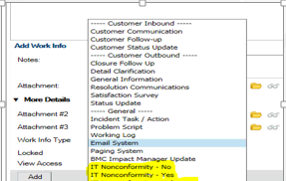
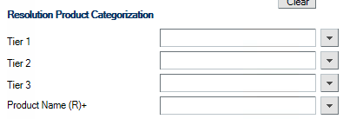
Mandatory Fields
Resolution Categorization & Product Name
Impact/Urgency
IT Non Conformity

Slide 17
3 Strike Rule
Contact the user at 3 different times using at least two methods of communication on different days. Failure to make contact and IT will resolve the service request/incident.
The first attempt is made by calling the user.
The next business day, make a second attempt by sending an email.
The following day, make the third and final attempt by contacting the user in different time zone.
The incident/service request is then resolved with a status/action indicating that the request was closed under this policy (e.g. resolved no Response). This provides an important metric which can be presented to the business when discussing SLA performance.
Use this rule only when the issue is resolved.
Note: This is not applicable for P1 and P2.

Slide 18
Audit Parameters
Was ticket marked In Progress by the assignee and when active work effort began?
Was ticket Impact/Urgency/Priority reclassified?
Is Ticket a P1 or P2? was Abbott SME notification documented?
Was CAPA Analysis documented prior to Resolution (See QC10.21) OR SR confirmation documented?
If IT Nonconformity Yes, was CAPA process followed?
Was Product captured upon creation of ticket? If no and created by MS, no point. If no and created by others, point. If Yes, point and point column N
If ticket was not categorized when created, was Product captured before Resolution? If yes, point. If No, no point
If additional information was required, before moving ticket to Pending Status?
Was Knowledge Article Documented?
If no Knowledge Article was used, was QC10.23 followed to crated or update the Knowledge DB?
Client follow up for Resolution (Client followup/ communication -Client Confirmation or 3 attempts)
Was ticket updated during the life of the ticket (Initial Analysis, progress, 10 days min)?

Slide 19

Thank You

