Slide 1
CATCH’24
TEAM NAME : DATA PIRATES
team leader : vigneshwar p.s
topic name : chatbot ai

Slide 2
IDEA:
Acknowledging the importance of effective communication across languages in our interconnected world.
Introducing the concept of multilingual chatbots as a solution to bridge language gaps and foster inclusive communication.
Exploring the role of emojis in enriching textual conversations and conveying emotions universally.
Previewing the presentation's focus on the development and implementation of multilingual chatbots with integrated emoji support to enhance user engagement and satisfaction.

Slide 3
OBJECTIVES:
Develop chatbots capable of understanding and responding in multiple languages.
Integrate emoji support for enhanced user engagement and emotional expression.
Improve accessibility and engagement among diverse user groups.
DATA STACK:
Frontend: Html,CSS
Backend: Javascript,JSON
Offline Data Handling:IndexedDB
Synchronization: Gpt3 APIs
User Interface: Material-UI or Ant Design

Slide 4
PROJECT DESCRIPTION:
Introduction and Aim:
Development and implementation of multilingual chatbots for inclusive communication.
Emphasizes the importance of effective cross-language communication in today's globalized world.
Target Audience and Benefits:
Businesses with international clientele, travelers, and multicultural communities.
Highlights benefits such as improved communication efficiency and fostering connections across linguistic barriers.

Slide 5
Technical Implementation: Utilize Natural Language Processing (NLP) for language detection and translation. Manage multilingual content and responses through database integration. Integrate emoji libraries and algorithms for accurate interpretation and display. Testing and Validation: Validate effectiveness and accuracy of multilingual functionalities. Test language translations, emoji interpretations, and overall user experience. Ensure optimal performance and user satisfaction.

Slide 6
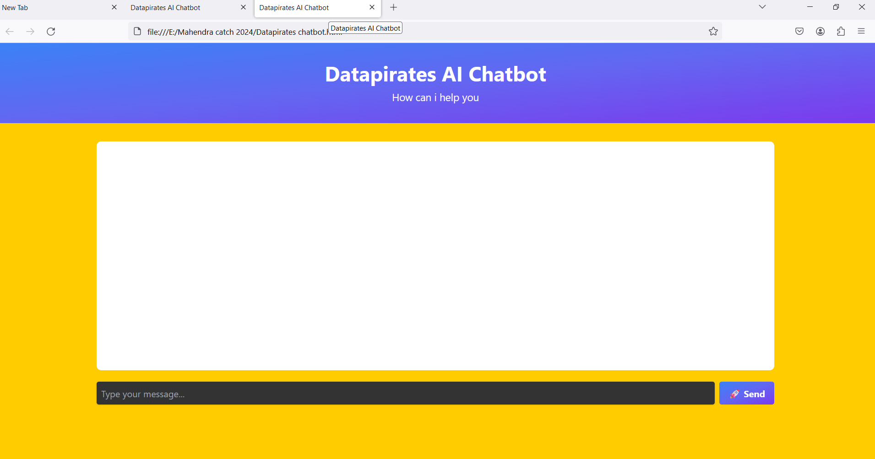
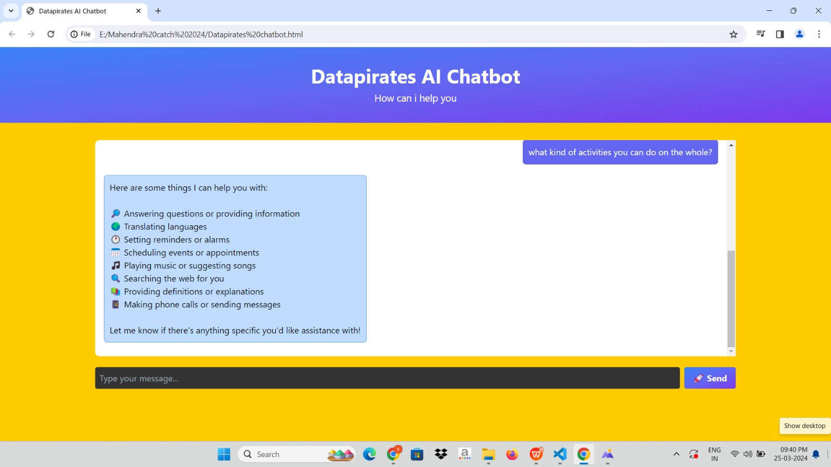
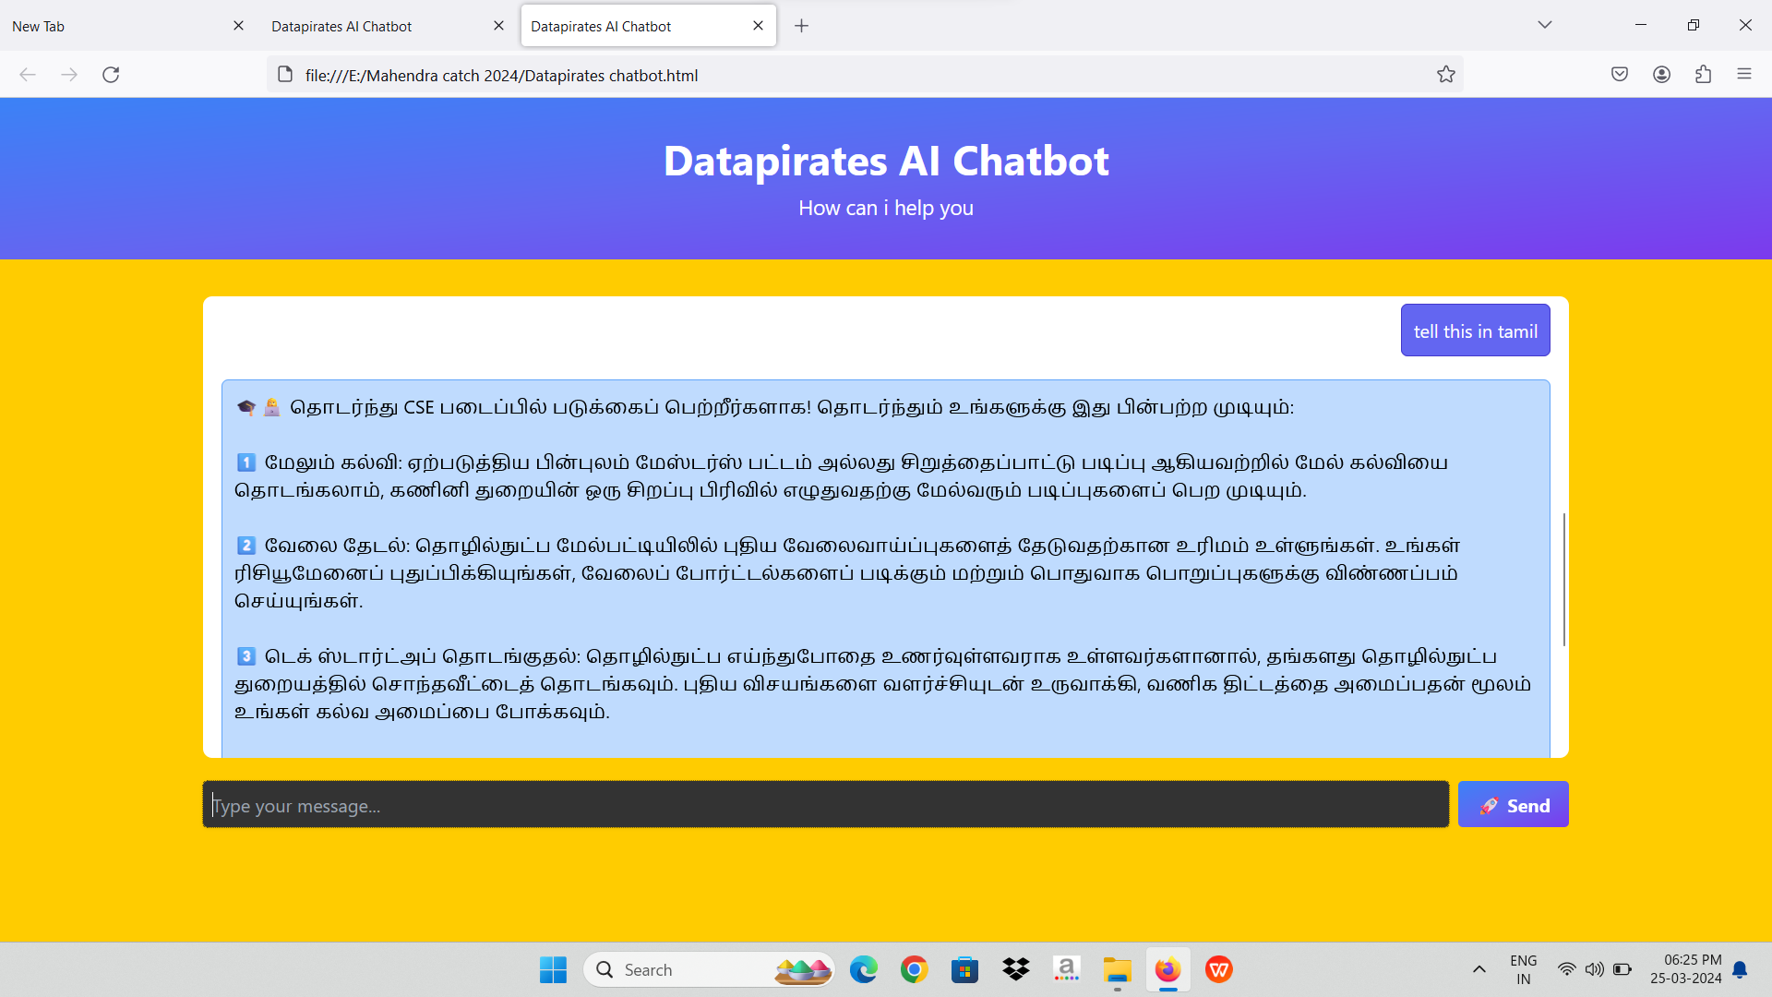
CHATBOT AI:

Slide 7
Dependencies/Stoppers in Creating Multilingual Chatbots: 1. Language Resources: - Availability of comprehensive language resources. - Limited availability of high-quality data, especially for less common languages. 2. Emoji Support: - Utilization of emoji libraries. - Compatibility issues across platforms. 3. Technical Infrastructure: - Need for scalable infrastructure. - Resource constraints, especially in areas with unreliable connectivity.

Slide 8
4. User Interface Design: - Design complexity for language selection. - Intuitive interfaces for diverse language preferences. 5. Linguistic Nuances: - Consideration of cultural sensitivities. - Difficulty in accurately interpreting nuances. 6. Data Privacy: - Implementation of robust privacy measures. - Compliance challenges across regions. 7. Resource Constraints: - Access to skilled professionals. - Talent shortages may hinder development efforts.

Slide 9
Conclusion:
Breaking Barriers: Our chatbot bridges languages, promoting seamless communication worldwide. Inclusivity: Supporting multiple languages ensures accessibility for all users. Emotional Connection: Emojis enhance expression, fostering deeper engagement. Global Vision: Our chatbot fosters connectivity in a diverse world, where language is no barrier to communication.

