Slide 1
CHICAGO CRIME
SQL AGENT
Schema-Augmented Retrieval for Text-to-SQL
Vignesh · Rupesh

Slide 2
The Problem
Data is locked behind SQL — most people can't access it
The Gap
"
• Databases hold critical insights
• Non-technical users can't write SQL
• Engineers become a bottleneck
• Insights are delayed or never surfaced
The problem isn't just generating SQL. It's reliably generating correct SQL and turning the results into a real answer - for a real user.
Why existing tools fail
• LLMs hallucinate column names
• Generated queries often break on real DBs
• Most tools stop at SQL — users still get raw tables

Slide 3
Our Solution
A self-correcting Text-to-SQL agent built with LangGraph
Plain English Question
Generate SQL
Validate SQL
Run Query
Natural Language Answer
→
→
→
→
↺ retry up to 3×
Example
Q: "Which district had the most domestic crime in 2022?"
SQL:
SELECT "DISTRICT", COUNT(*) FROM crimes WHERE "DOMESTIC" = TRUE AND "YEAR" = 2022 GROUP BY 1 ORDER BY 2 DESC LIMIT 1
A: "District 11 had the highest number of domestic crimes in 2022 with 4,312 incidents."

Slide 4
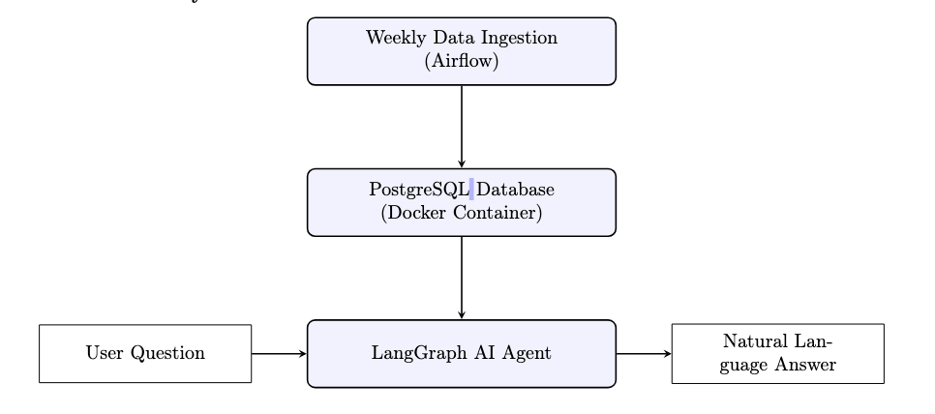
System Architecture
Data Layer
Apache Airflow ingests ~1.4M crime records weekly into PostgreSQL
Inference Layer
LangGraph agent + Groq (ChatGPT OSS 120B) orchestrates the pipeline
User Layer
Next.js chat UI, Docker container, exposed via Cloudflare Tunnel

Slide 5
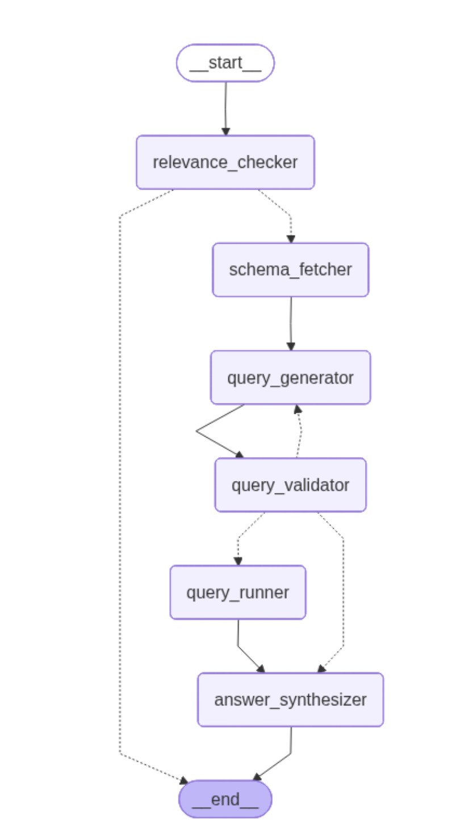
Agent Pipeline
6-node LangGraph StateGraph
1
Relevance Checker
Regex filter rejects off-topic questions in <5ms - no LLM cost
2
Schema Fetcher
Reads live DB column names and types - no hardcoded schema
3
Query Generator
LLM writes a PostgreSQL SELECT with strict quoting rules
4
Query Validator
Runs EXPLAIN to catch syntax errors; blocks DML; retries up to 3×
5
Query Runner
Executes the validated SQL and captures results
6
Answer Synthesizer
LLM turns rows into a clear, plain-English summary

Slide 6
Prompt Engineering
4 iterations - no model fine-tuning
Phase | Change Made | Outcome
1 Baseline | Generic "write SQL" prompt | High syntax errors, DML leakage
2 PostgreSQL Rules | Double-quote identifiers, block DML explicitly | Syntax errors dropped significantly
3 Rules + Schema | Schema of the database along with the rules with previous step | JOIN accuracy improved
4 Retry + Validator | EXPLAIN loop, expanded relevance keywords | Final system (V2) — SQ 4.34
Key insight: explicit constraints + a validation loop outperform a single LLM call.

Slide 7
Evaluation Setup
100 hand-crafted questions with ground-truth SQL
Easy
Medium
Hard
30 questions
40 questions
30 questions
Single-table counts, filters, basic aggregations
JOINs, GROUP BY, year-over-year comparisons
Window functions, CTEs, rolling averages
Three Metrics
VSR - Valid SQL Rate
Did the query execute without syntax errors or DML violations?
EX - Execution Accuracy
Did it return the correct result set? (hybrid relational match)
SQ - Synthesis Quality
Was the natural-language answer accurate and clear? (1–5 scale)

Slide 8
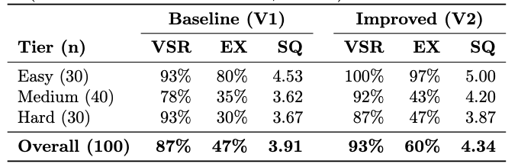
Results
V2 exceeds the SQ target of ≥ 4.0 across all tiers
+6pp VSR
+13pp EX
+0.43 SQ
Fewer broken queries
More correct result sets
Clearer natural language answers

Slide 9
Key Findings
✓ What drove improvement
✗ Remaining failures
Removing LIMIT 10 from the prompt was the single biggest fix - Hard EX: 7% → 17%
Ambiguous questions
"Average crimes on the same block" → global vs. per-block interpretation
Expanding relevance keywords cut false rejections by 70% (10 → 3 failures)
API rate limits
4 Hard queries failed - free tier 8k TPM cap, not a system bug
When SQL is correct, LLM narrates it well: SQ ≥ 4 in 85 of 100 V2 cases
Derived metric gaps
Synthesis is not the bottleneck - SQL generation quality is
"Night vs daytime" - LLM must guess unstated hour cutoffs

Slide 10
Future Work & Takeaway
All improvements point to RAG
01 Semantic Relevance
02 Selective Schema
Replace keyword filter with embedding similarity → eliminates false rejections on paraphrased questions
Inject only top-k relevant columns per query → 70–80% token reduction, fits within rate limits
03 Few-Shot Retrieval
04 Domain Knowledge Store
Retrieve similar (question, SQL) pairs as examples → +10–20% EX expected on Hard tier
Embed domain conventions (e.g. night = 22:00–05:59) → fixes ambiguous derived-metric failures
Takeaway
A structured agentic loop with good prompt engineering outperforms a single LLM call — and closes the gap between raw data and non-technical users.

