Slide 1
Machine Learning-Based Network Intrusion Detection System (NIDS)
CAPSTONE PROJECT
Presented By:
Vignesshwaran Kumaresan – SIES Graduate School of Technology – Computer Engineering

Slide 2
OUTLINE
Problem Statement (Should not include solution)
Proposed System/Solution
System Development Approach (Technology Used)
Algorithm & Deployment
Result (Output Image)
Conclusion
Future Scope
References

Slide 3
Problem Statement
In today’s digital age, communication networks are constantly under threat from various cyber-attacks such as Denial of Service (DoS), Probe, Remote to Local (R2L), and User to Root (U2R). Traditional rule-based intrusion detection systems are often inefficient in detecting novel or evolving threats. Therefore, there is a critical need for an intelligent and adaptive system that can analyze network traffic and distinguish between normal behavior and malicious activities in real-time.

Slide 4
Proposed Solution
The proposed NIDS uses a supervised machine learning approach to analyze labeled network traffic data and detect anomalies. Key components of the system include:
Data Collection: Use the Kaggle NIDS dataset
Preprocessing: Handle missing values, normalization, label encoding
Model Training: Train ML models (e.g., Random Forest, XGBoost)
Evaluation: Validate using accuracy, precision, recall, F1-score
Deployment: Deploy on IBM Cloud using Watson Studio and Cloud Object Storage for secure access and scalability

Slide 5
System Approach
Technologies Used:
IBM Watson Studio (AutoAI pipeline for ML)
IBM Cloud Object Storage (dataset storage)
Streamlit (for front-end interface)
Snap Decision Tree Classifier (AutoAI model)
IBM Watson Machine Learning (deployment platform)
Workflow:
Uploaded and preprocessed NIDS dataset in IBM Watson Studio.
Used AutoAI with Snap Decision Tree Classifier and enabled HPO-1 (Hyperparameter Optimization).
Best pipeline selected with optimized accuracy and minimal log loss.
Model deployed as REST API on IBM Cloud.
Created a simple Streamlit UI to send inputs and receive predictions from deployed model.

Slide 6
IBM Watson Studio Setup Steps – Part 1
Remove any old projects/resources from your IBM Cloud dashboard.
In IBM Cloud dashboard, search for "watsonx.ai Studio".
Choose London region and select Lite (free) plan.
Click Launch to enter Watson Studio environment.

Slide 7
IBM Watson Studio Setup Steps – Part 2
Click “New Project” → choose Create an empty project.
Enter project name, description, and attach free storage.
Navigate to Manage tab > Services and Integrations.
Click Associate Service + → Select watsonx.ai Runtime.
Go to Assets tab, click on New asset and add your training data file.
Go to the Overview tab and click:
➤ “Build Machine Learning Models Automatically” (AutoAI)

Slide 8
Algorithm & Deployment
Model Used:
Snap Decision Tree Classifier (AutoAI)
Key Points:
Number of Features: 39
Evaluation Instances: 2520
Deployed using IBM Watson Machine Learning (WML)
Authentication via IBM IAM Token Service
Important Features (by importance):
src_bytes – 73.14%
service – 9.61%
dst_host_srv_count, hot, dst_bytes, duration, protocol_type
Frontend Workflow:
Streamlit accepts key features like duration, protocol_type, src_bytes, etc.
Sends a POST request with dummy padding to WML endpoint
Receives class (normal / anomaly) and confidence level

Slide 9
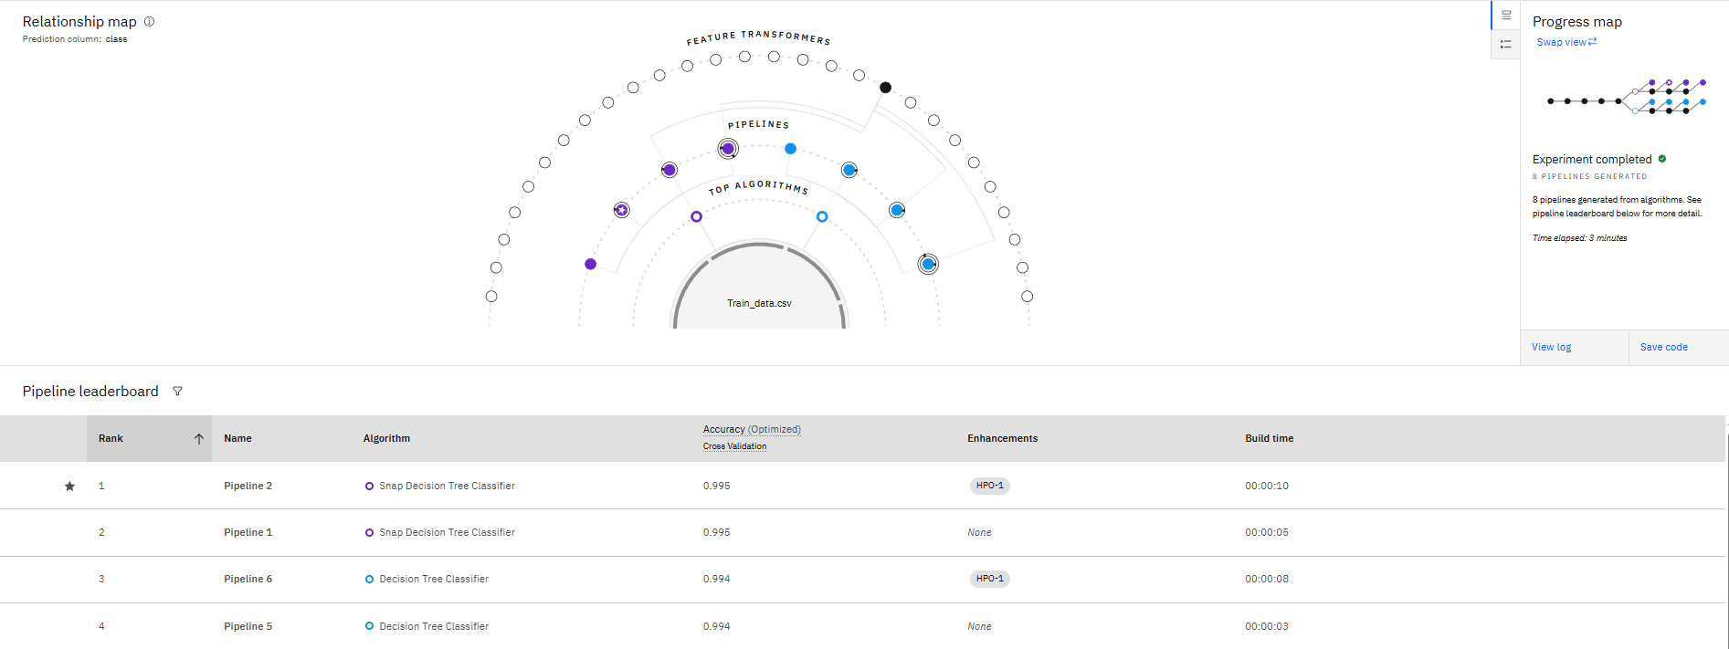
Algorithm & Deployment

Slide 10
Result
Model Performance Overview:
The Snap Decision Tree Classifier achieved exceptionally high performance, indicating it is well-suited for binary classification tasks like detecting “normal” vs “anomaly” traffic.
Holdout Accuracy of 99.8% shows the model performed extremely well on unseen data.
Cross-validation Accuracy of 99.5% confirms the model’s consistency and generalization.

Slide 11
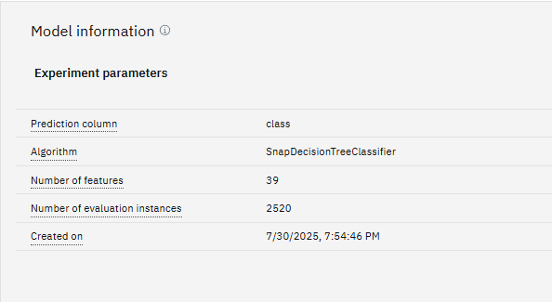
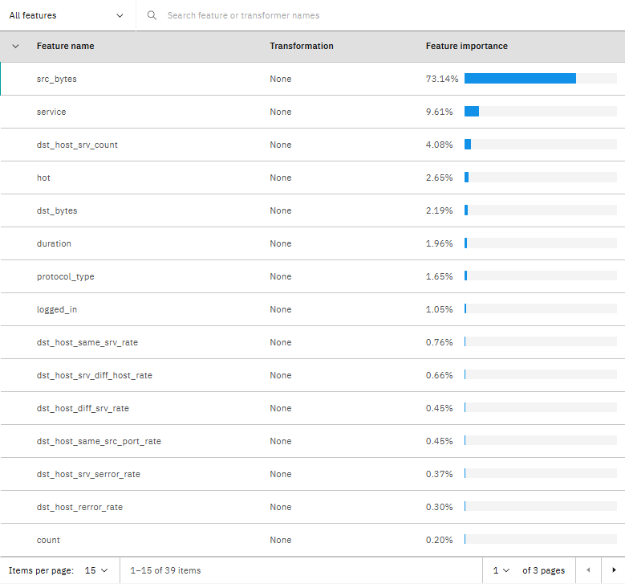
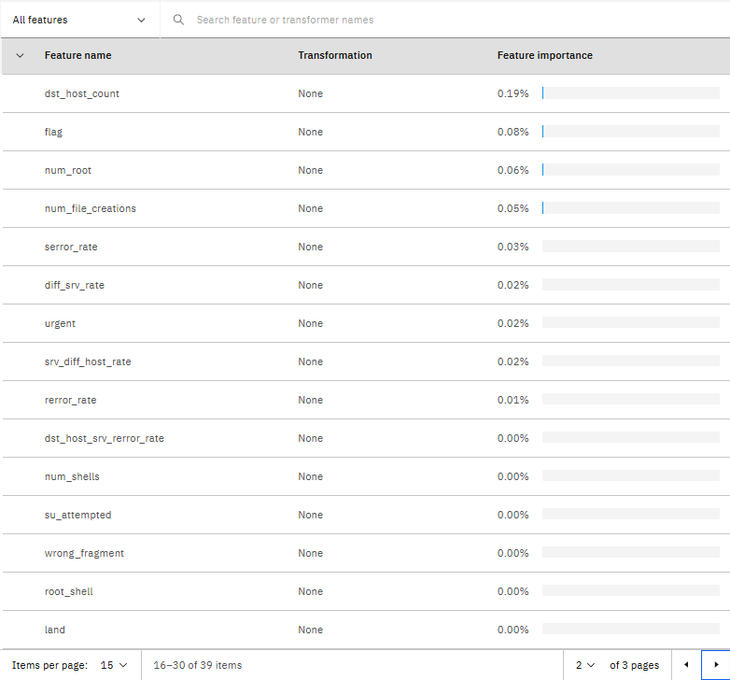
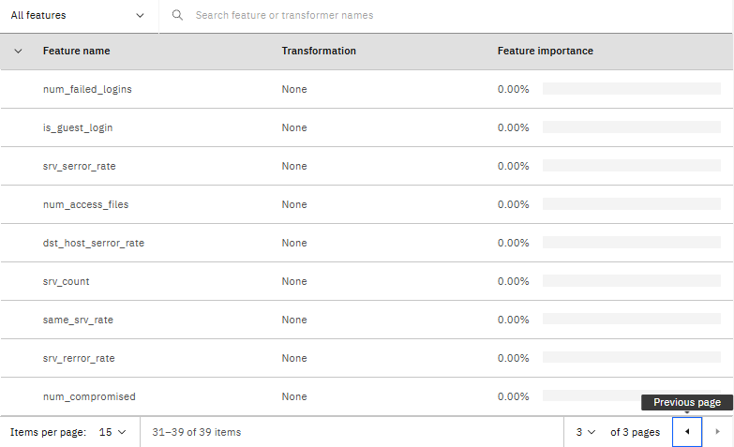
Result

Slide 12
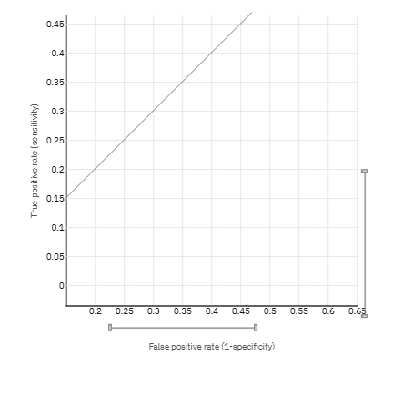
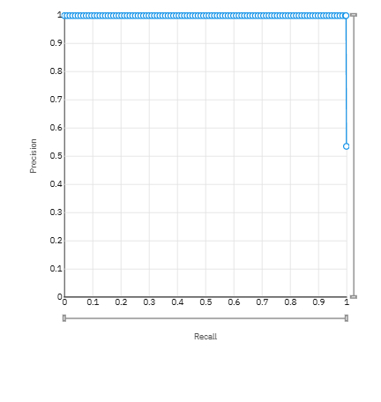
Result
ROC Curve
Precision Recall Curve

Slide 13
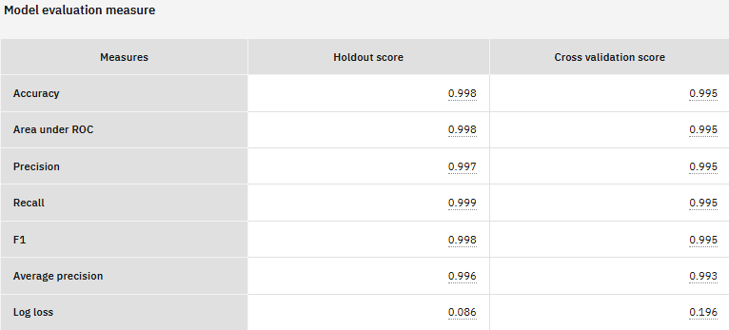
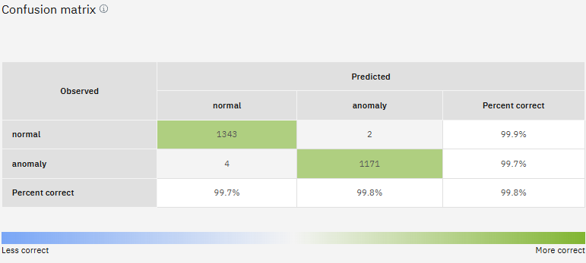
Result

Slide 14
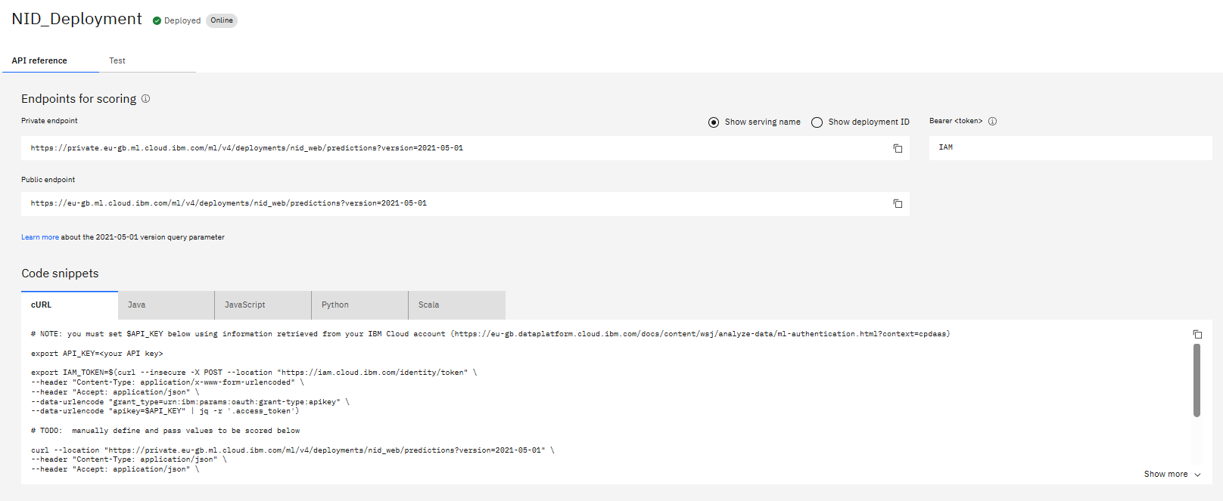
Result

Slide 15
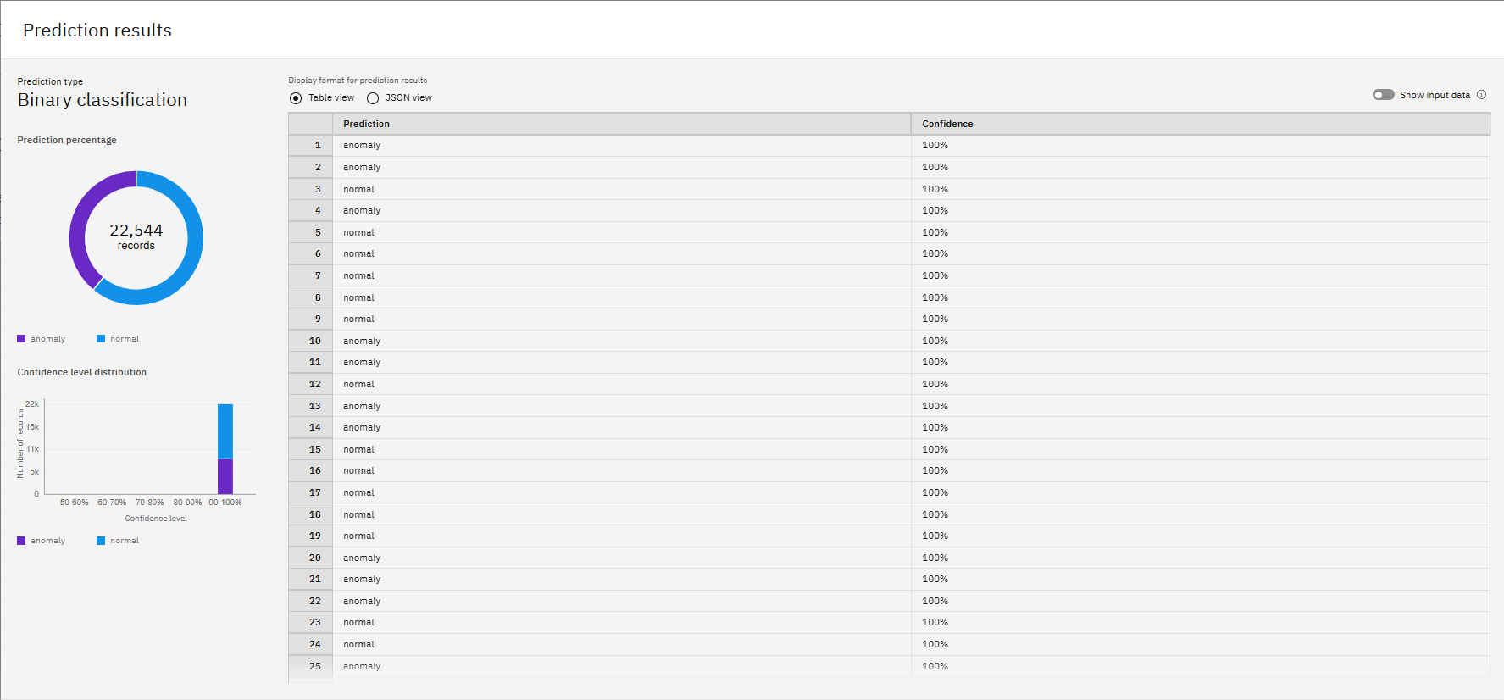
Result

Slide 16
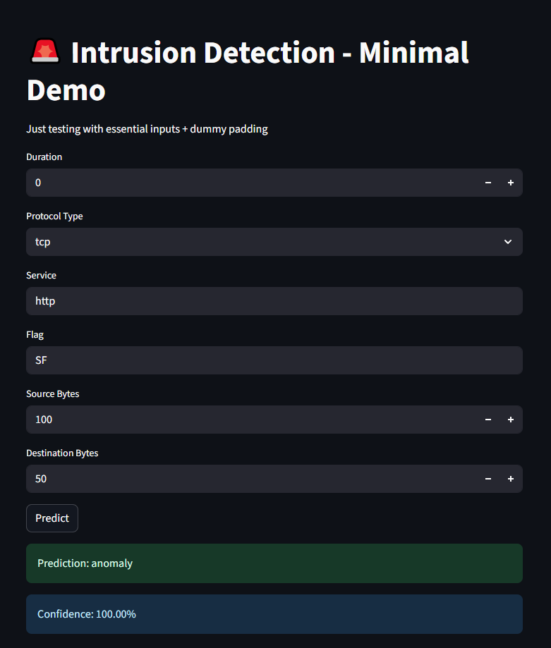
Result

Slide 17
Conclusion
In this project, a robust and intelligent Network Intrusion Detection System (NIDS) was developed using IBM’s AutoAI platform and deployed with a lightweight Streamlit frontend.
By leveraging the Snap Decision Tree Classifier, enhanced with Hyperparameter Optimization (HPO-1), the system achieved exceptional performance with a holdout accuracy of 99.8%, precision of 99.7%, and recall of 99.9%.
These results demonstrate the model’s effectiveness in detecting anomalies with high confidence and minimal error.
The successful deployment of the model on IBM Watson Machine Learning and its seamless integration with a Streamlit web app further illustrate the system’s readiness for real-time, user-interactive applications.
Overall, the solution provides a scalable and accurate approach to securing communication networks by identifying malicious activities early and reliably.

Slide 18
Future scope
While the current system performs excellently in binary classification, there is significant scope for future enhancements.
The model can be expanded to detect specific categories of cyber-attacks such as DoS, R2L, U2R, and Probe through multi-class classification.
Real-time data integration using packet capture tools like Scapy or PyShark can replace dummy inputs, making the system suitable for live network environments.
Additionally, integrating alert mechanisms such as email or SMS notifications can improve responsiveness during security incidents.
The user interface can be made more dynamic with dashboards, logs, and activity graphs.
Finally, the deployment can be extended to the public cloud using IBM Cloud Functions or Streamlit Cloud, enabling secure, scalable access for broader enterprise use.

Slide 19
References
Kaggle NIDS Dataset Sampada Basak. Network Intrusion Detection Dataset. Kaggle, 2021. https://www.kaggle.com/datasets/sampadab17/network-intrusion-detection
IBM Watson Studio Documentation IBM Cloud Docs. Using Watson Studio for model training and deployment. https://cloud.ibm.com/docs/watson-studio
IBM Watson Machine Learning API Reference IBM Cloud Docs. Deploying and scoring models with Watson Machine Learning. https://cloud.ibm.com/apidocs/machine-learning
IBM IAM Authentication for APIs IBM Cloud Docs. Getting access tokens using IAM. https://cloud.ibm.com/docs/iam?topic=iam-iamtoken-from-apikey

Slide 20
References
AutoAI Overview – IBM IBM Documentation. Automated machine learning pipelines using AutoAI. https://www.ibm.com/docs/en/cloud-paks/cp-data/4.6.x?topic=ml-autoai
Scikit-learn Documentation Pedregosa et al. Scikit-learn: Machine Learning in Python. Journal of Machine Learning Research, 12, 2011. https://scikit-learn.org/stable/
Streamlit Documentation Streamlit Inc. Building interactive web apps in Python. https://docs.streamlit.io/

Slide 21
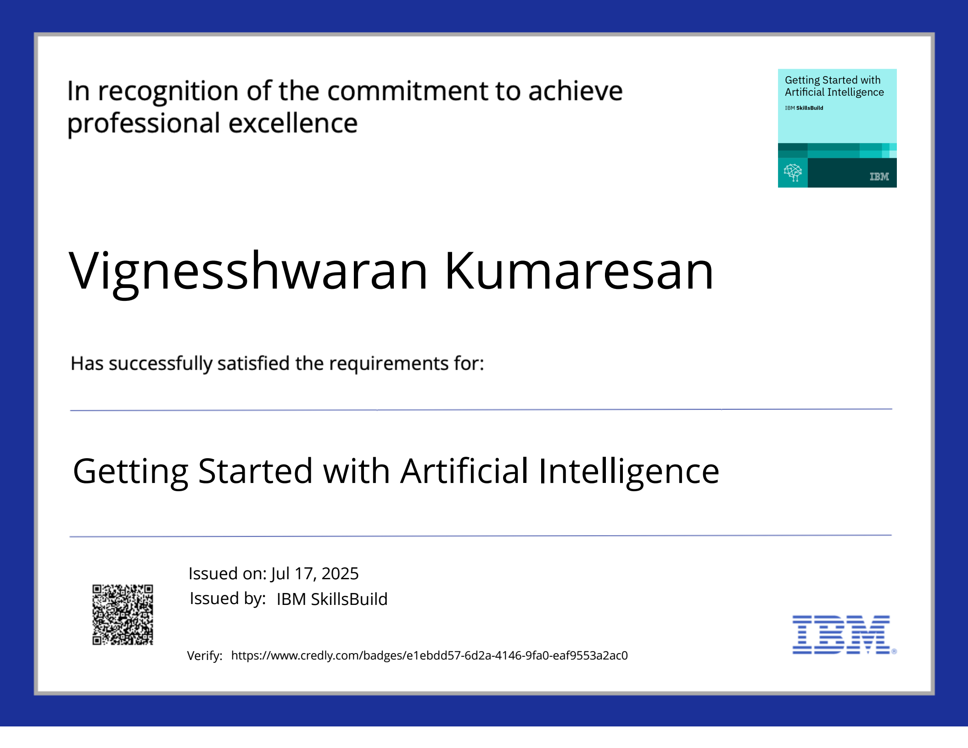
IBM Certifications

Slide 22

IBM Certifications

Slide 23
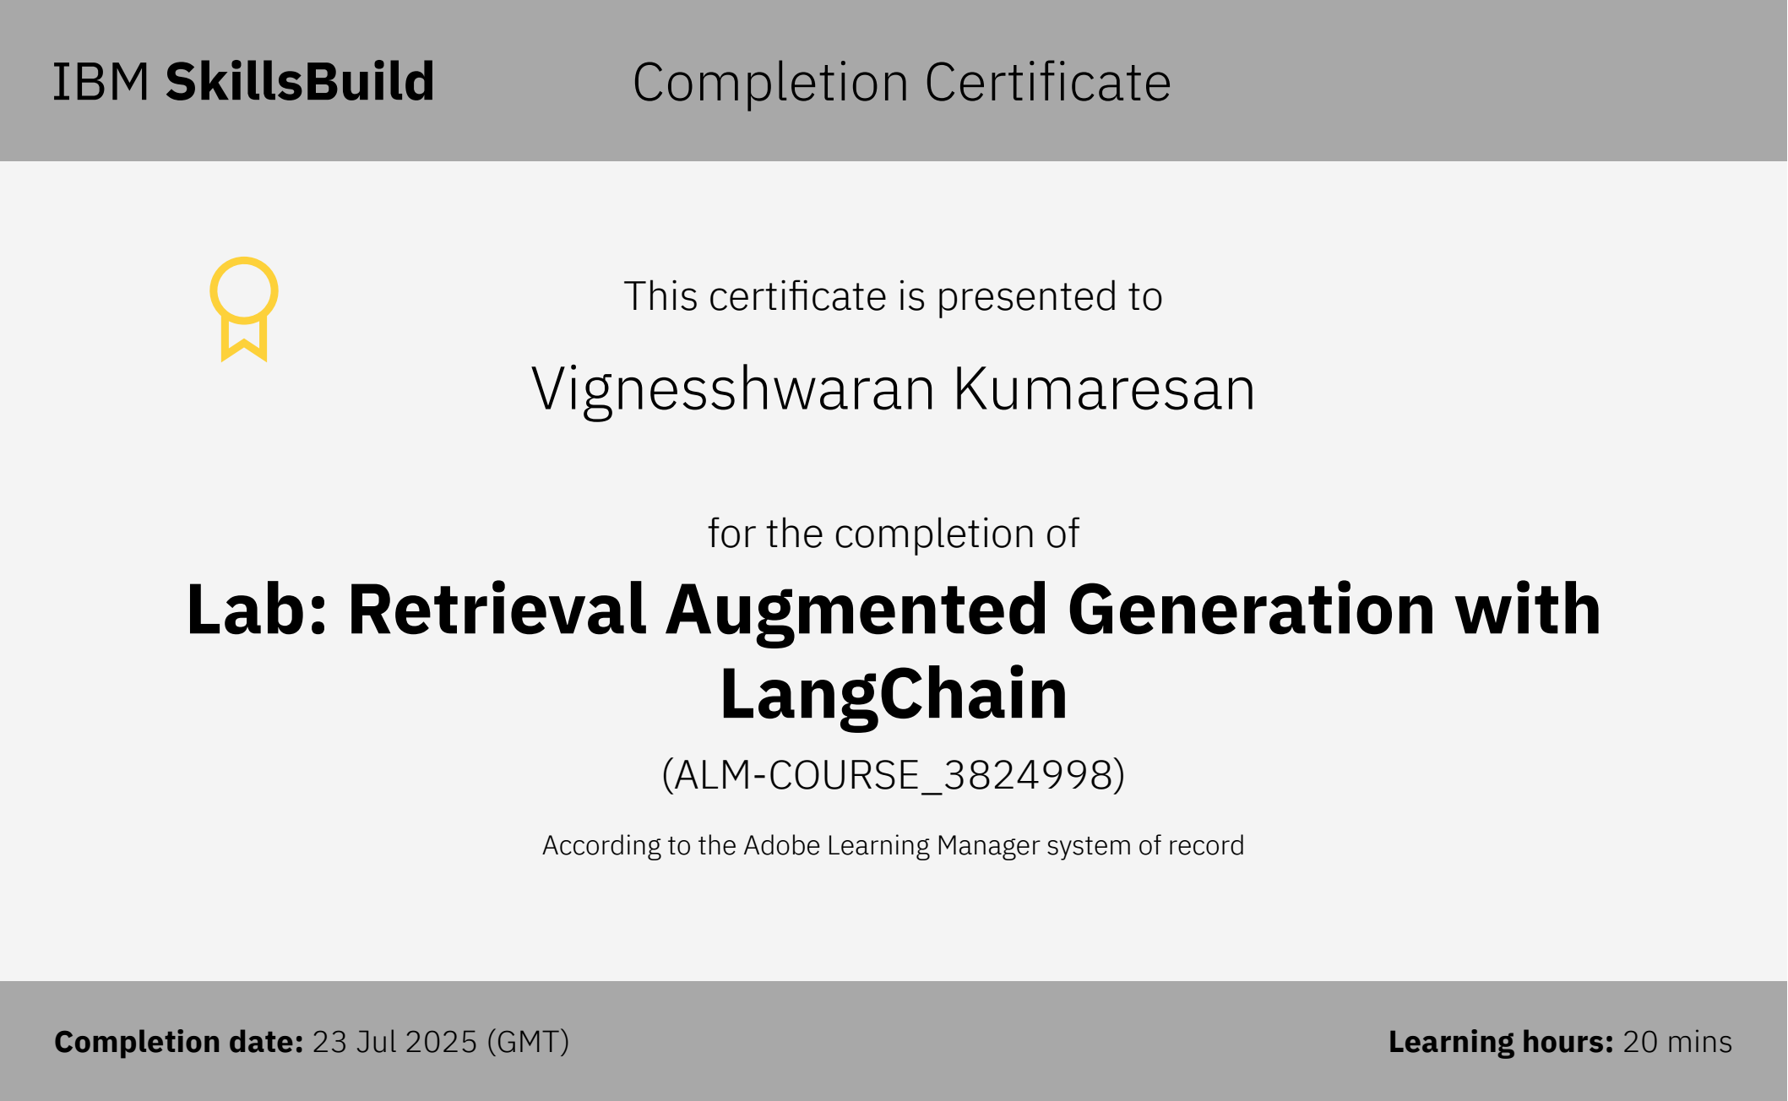
IBM Certifications

Slide 24

THANK YOU
Github Link

