Slide 1
EethalScan
This program is developed to mine data from existing Marc dat files, and work on them to extract new information.

Slide 2
Opportunity
Organizations using Marc application have numerous dat files, created for solving their industry specific problems.
Many a time, once their problem is solved, not much attention is given to these files.
There is a real opportunity to read these dat files and get new insights about industry specific model preparation using dat format, problem specific dat cards usage, to name a few.
Having access to test data from MSC Software, to see ways in which we can use different set of dat files to gain new insights, can be a nice first step.

Slide 3
Where it can be employed?
For Marc
Data patterns in dat files can be used to understand the model creation across various industries or organizations.
For Marc Customers
The knowledge acquired through this means will be a valuable feedback to solve industry or organization specific problems.

Slide 4
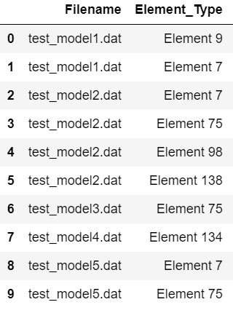
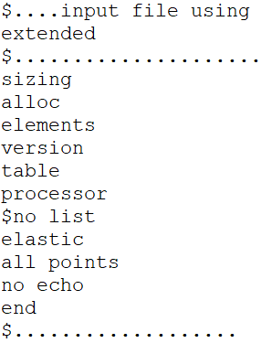
Read a card from multiple dat files
Here, “elements” card from multiple dat files are read and listed.

Slide 5
Case study
Data extracted from multiple dat files are saved as various EethalScan cards.
An EethalScan card contains an array of dat cards or any other dat information extracted from all the input dat files.
Additionally, these cards can have general information, which makes them useful by itself.
Each of these cards is stored as a csv file. Few of them are explained in later slides.
This csv file is loaded in Jupyter notebook as a Pandas dataframe, and different analytics are applied to get new insights.

Slide 6
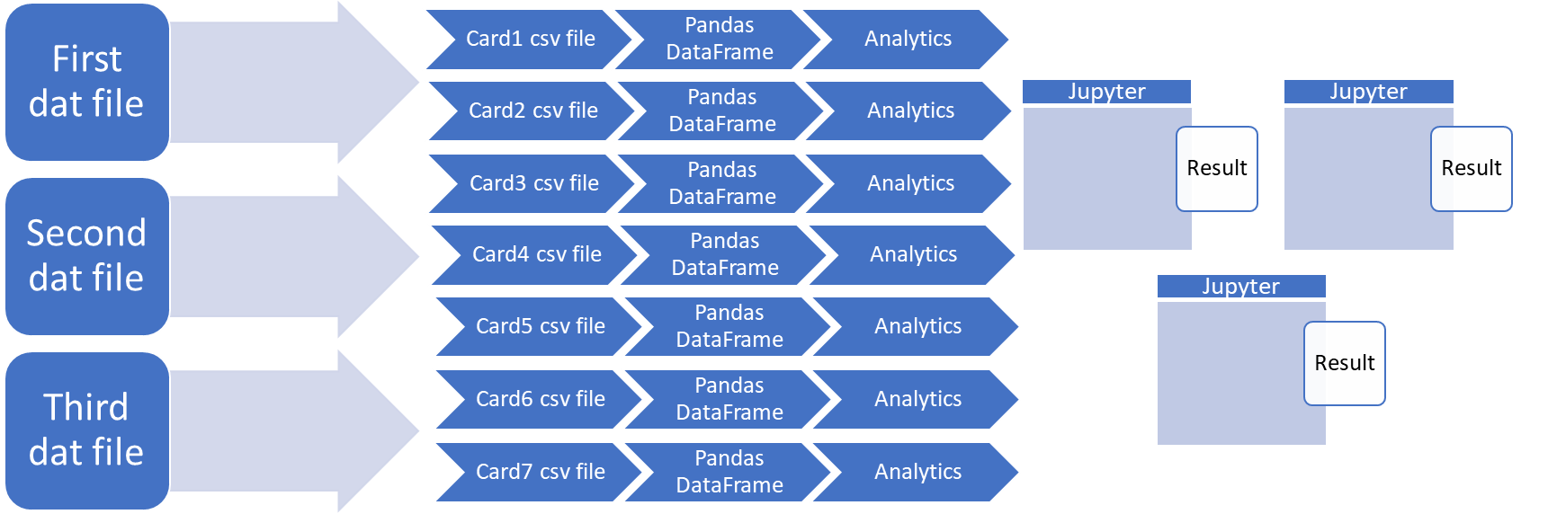
Case study (data flow)
Dataflow from multiple dat files to Jupyter notebook.

Slide 7
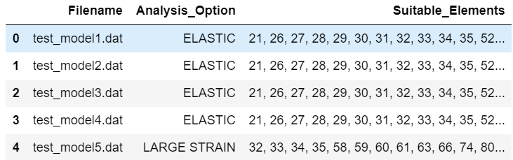
Card1
contains rows of data with filename, analysis option used, suitable elements to use for each analysis option.

Slide 8
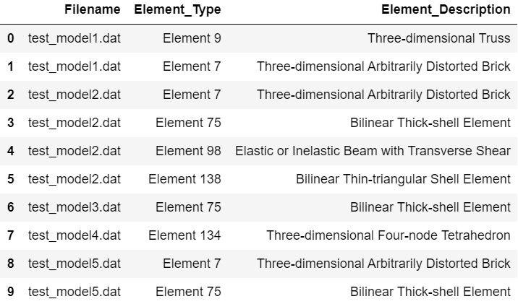
Card2
contains rows of data with filename, element type used, and element description.

Slide 9
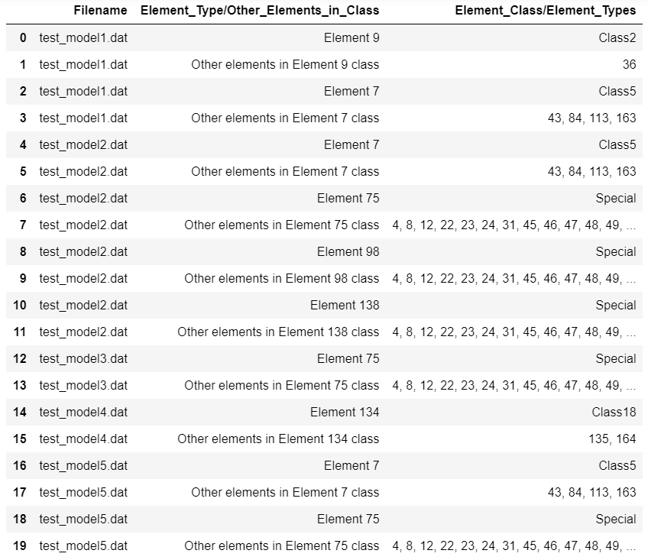
Card3
contains rows of data with filename, and element type used and class information.

Slide 10
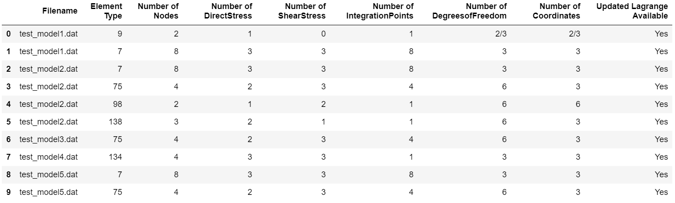
Card4
contains rows of data with filename and element properties.

Slide 11
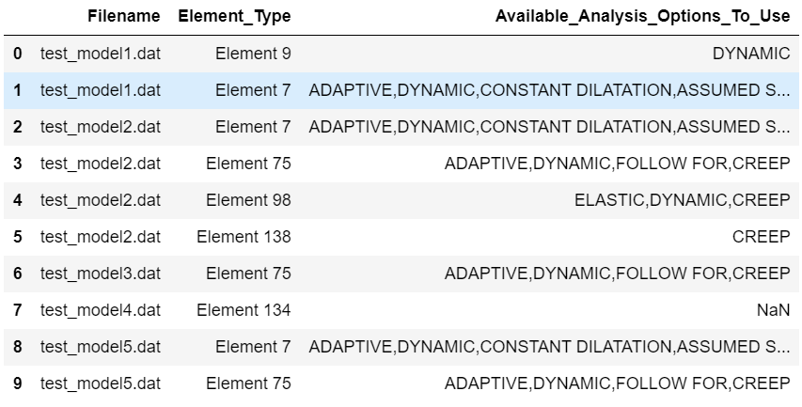
Card5
contains rows of data with filename, element type, and available analysis option for the element type.

Slide 12
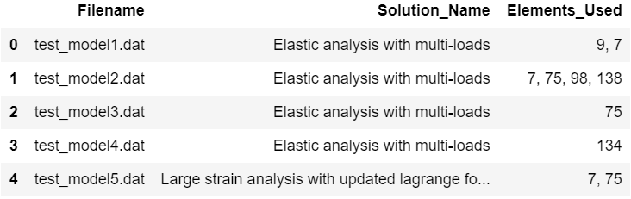
Card6
contains rows of data with filename, analysis name, and used element types.

Slide 13
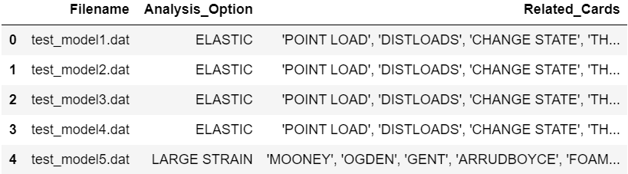
Card7
contains rows of data with filename, analysis option used, and cards which can be used with that analysis option.

Slide 14

Extract results
Get information directly from cards
Get insights from card combinations

Slide 15
Results obtained from cards
Few ways to get results directly from cards are listed below, with tabular representations in upcoming slides.
Element type count: element type repetitions in all the input files is obtained from card4.
Number of nodes count: number of nodes repetitions in all the input files is obtained from card4.

Slide 16
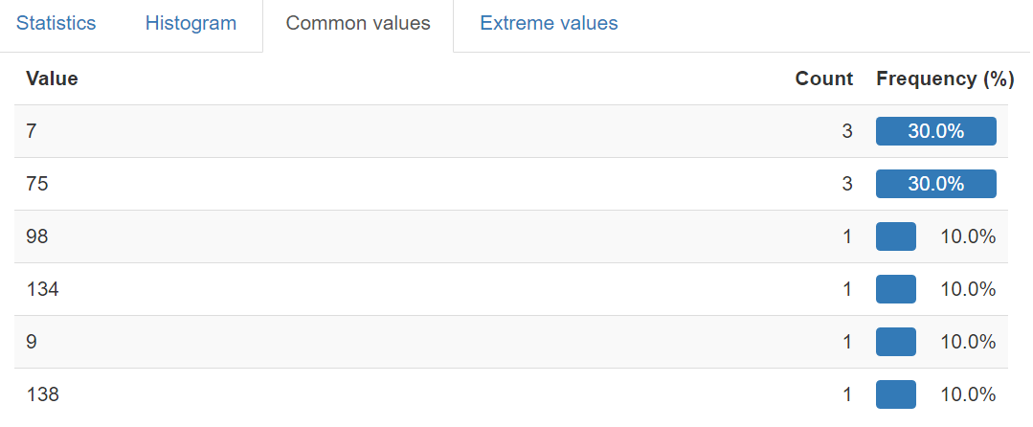
Element type count

Slide 17
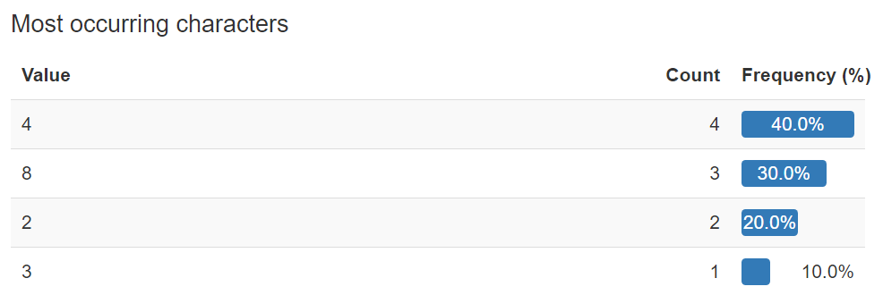
Number of nodes count

Slide 18
Results from combination of cards
Few ways to use combination of cards are listed below, with pictorial representations in upcoming slides.
First combination: combine card2, card4, and card5 to plot element number of nodes against element description.
Second combination: combine card1, card6, and card7 to plot solution name against element type(s) in file.
Third combination: combine card1 and card3 data, to get alternate elements types for the used element types. We can use number of nodes for further refinement.

Slide 19
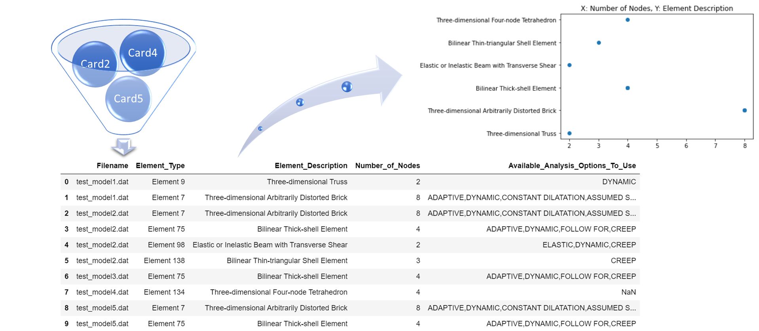
First combination

Slide 20
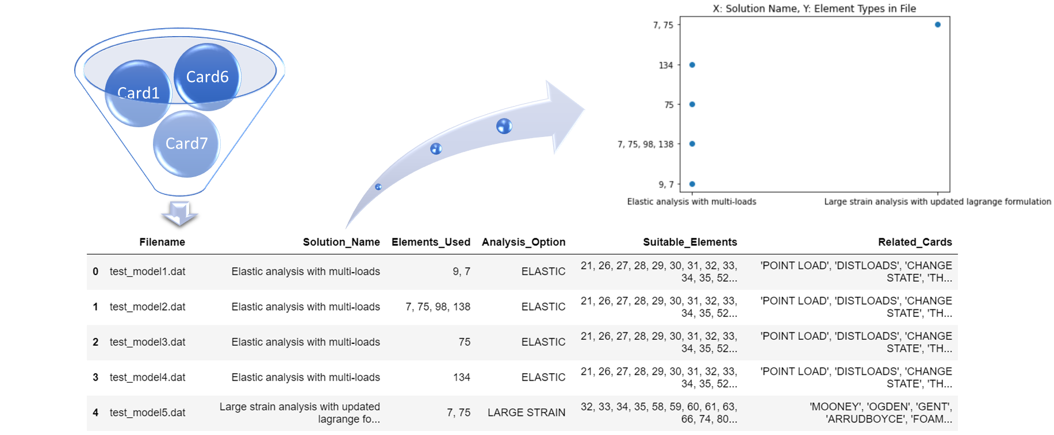
Second combination

Slide 21
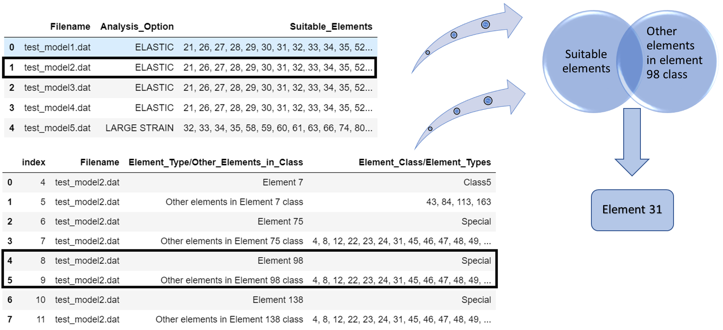
Third combination

Slide 22
Industrial application
Few ways to use the results are listed below
Scan industry models with similar functionalities or those with critical parts to get element type patterns and see if alternate elements can be used to get better results.
Understand the variation of elements used for same analysis type or similar engineering problems, in different industries.
With such information, we can provide Marc's customers with specific information like alternate elements to use for the type of parts or suggest different card combinations to more efficiently solve their problems.

Slide 23

Prospects
Incorporate Machine Learning techniques to analyze dat files.
Build data models to assist in creating a new dat file.
Add a similar program to handle Nastran bdf file.

Slide 24
Conclusion
This program is developed to
Use the advantages of data mining techniques, to add value to Marc and Mentat Application.
Incorporate Machine Learning techniques to achieve the same.
This case study, when extended to the breadth of dat cards can provide interesting insights.
Thank You!

