Slide 1
Case Study
First dat file
Second dat file
Third dat file
Card1 csv file
Pandas DataFrame
Analytics
Card2 csv file
Analytics
Pandas DataFrame
Jupyter
Result
Jupyter
Result
Jupyter
Result
Card3 csv file
Pandas DataFrame
Analytics
Card4 csv file
Pandas DataFrame
Analytics
Card5 csv file
Pandas DataFrame
Analytics
Card6 csv file
Pandas DataFrame
Analytics
Card7 csv file
Pandas DataFrame
Analytics

Slide 2
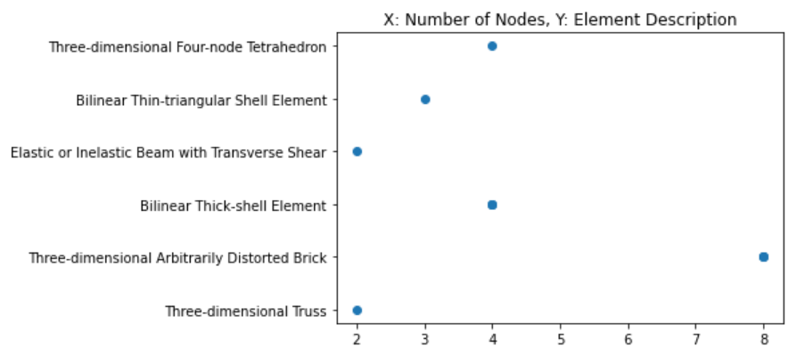
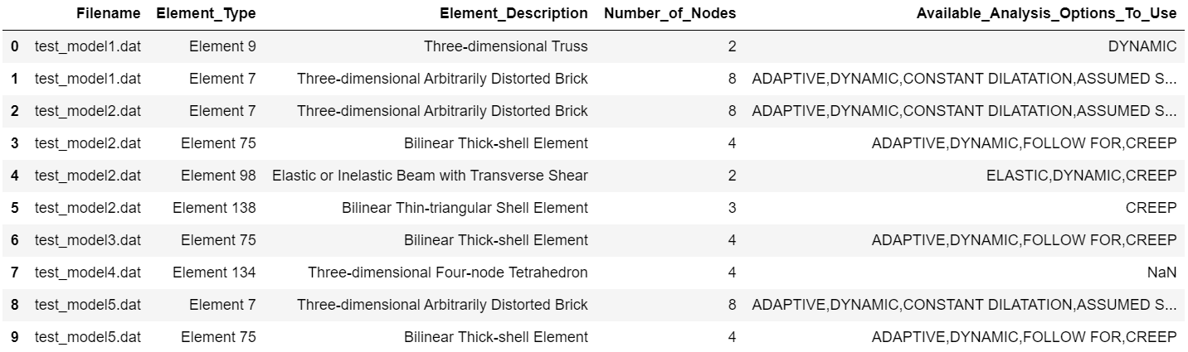
Combine Card2, Card4, and Card5 to plot element number of nodes against element description
Card4
Card2
Card5

Slide 3
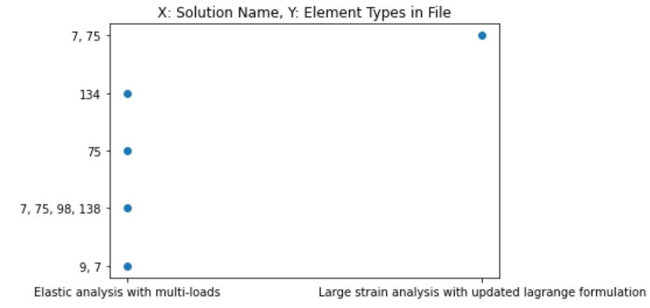
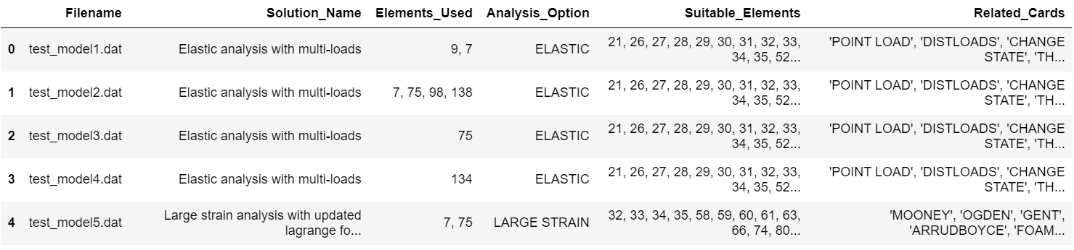
Combine Card1, Card6, and Card7 to plot solution name against element types in file
Card6
Card1
Card7

Slide 4
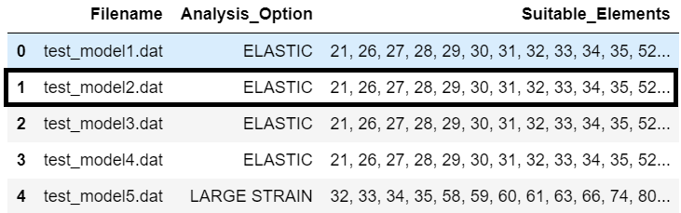
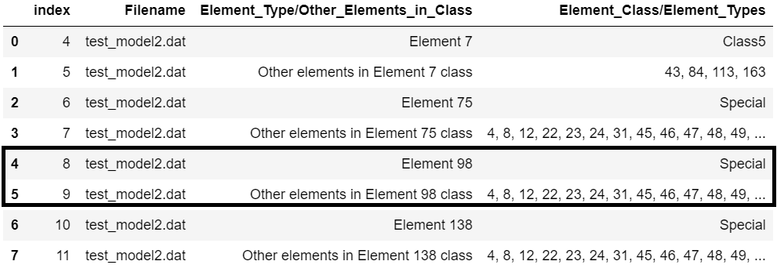
Combine test_model2.dat information from card1 and card3, to get other alternate elements to use. Other data like number of nodes, integration points can also be used to fine tune the elements list.
Suitable elements
Other elements in element 98 class
Element 31

