Slide 1
The Technology Value Stream Violet Gonzalez, module 1.2, 1.12.25

Slide 2
What is Technology Value Stream?
In DevOps there are many terms that will come which all hold a significance in their own way; however, another important term that you may hear is Technology Value Stream.
Technology Value Stream: :”The process required to convert a business hypothesis into a technology-enabled service that delivers value to the customer” – Kim, Humble, Debois, Willis, Forsgen (2021)

Slide 3
Key Concepts of Technology Value Stream
With the integration of DevOps, the delivery of the value stream is improved through the tools and practices which would help indicate any points of inefficiency.
Value Stream focuses on the process that used to deliver value (a software)
The goal is to maintain the customer value
There are three main portions in the value stream:
Value creation: Key parts required to make the final software
Value delivery: Marketing and sales
Value Capture: pricing the service

Slide 4
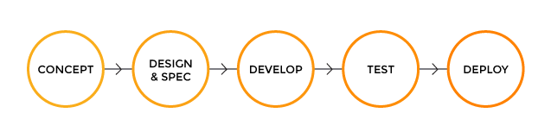
What Technology Value Stream Looks Like:

Slide 5
Lead Time vs. Processing Time
Lead Time: Starts from the beginning of request till when the product is fulfilled
A longer process
Beneficial for interacting with the customer and with planning
Allows for more responsiveness and flexibility
Better management of inventory
Processing Time: Starts when work begins for customer request and ends when the work is completed.
Shorter process
Beneficial for optimization of each step with the production process
Catches unnecessary steps
More efficient and speedy delivery time

Slide 6
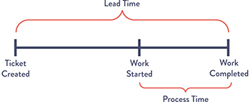
Lead Time vs. Graphic Time Example
- 6
Kim, Humble, Debois, Willis, Forsgen (2021)

Slide 7
Deployment Lead Times Requiring Months
As mentioned previously lead time isa lengthy process therefore is takes more time to deploy the application. However, that is not to say that having a lead time of several months is bad. When considering the reasons why it would be factored into the following:
Long test
Multiple approvals throughout the process
Scarce integration test environment
To investigate a problem may take a prolonged amount of time and focuses on who and how toe application become broken
- 7

Slide 8
Deployment Lead Times of Minutes
Although the later sounded uncanny, it is a true process for many organization; however, that is not necessarily and ideal scenario. Typical DevOps would encourage for Deployment lead times to be in minutes rather than months. There are many benefits to this as well such as:
Reduction of cost
Better customer service
This desired method is achieved by assessing and fixing code small snippets of the code that has made its way to the repository. Automated performances and testing without constraints always allows for a faster streamline of deployment
- 8

Slide 9
References:
Kim, G., Humble, J., Debois, P., Willis, J., Forsgren, N., & Allspaw, J. (2021). The devops handbook: How to create world-class agility, reliability, & Security in Technology Organizations. IT Revolution Press.
Blogs, P. (2019, December 27). Value streams in software: A definition and detailed guide. https://www.plutora.com/blog/value-streams-in-software-guide
WorkClout - the benefits of cycle time, lead time, and Takt Time. RSS. (n.d.). https://www.workclout.com/blog/the-benefits-of-cycle-time-lead-time-and-takt-time

