Slide 1
Mood-Based Music Player
Final Project Presentation
BCA Semester 5 – SIP-II (2025–26)

Slide 2
Introduction
Music that influences human emotion deeply
So on the basis of that we have created a music player that detects human emotion
It only detects facial emotion to play music

Slide 3
Objectives
Detects user facial emotion in real-time using a webcam.
After Detection of facial emotion it automatically plays song for respected emotion
It makes easy to select music for user
It is done through computer vision and deep learning

Slide 4
Technology Stack
Programming Language: Python 3.8+
Libraries Used:
• OpenCV: Real-time video capture
• DeepFace: Emotion recognition
• Pygame: Music playback
IDE: Visual Studio Code / PyCharm
Platform: Desktop Application

Slide 5
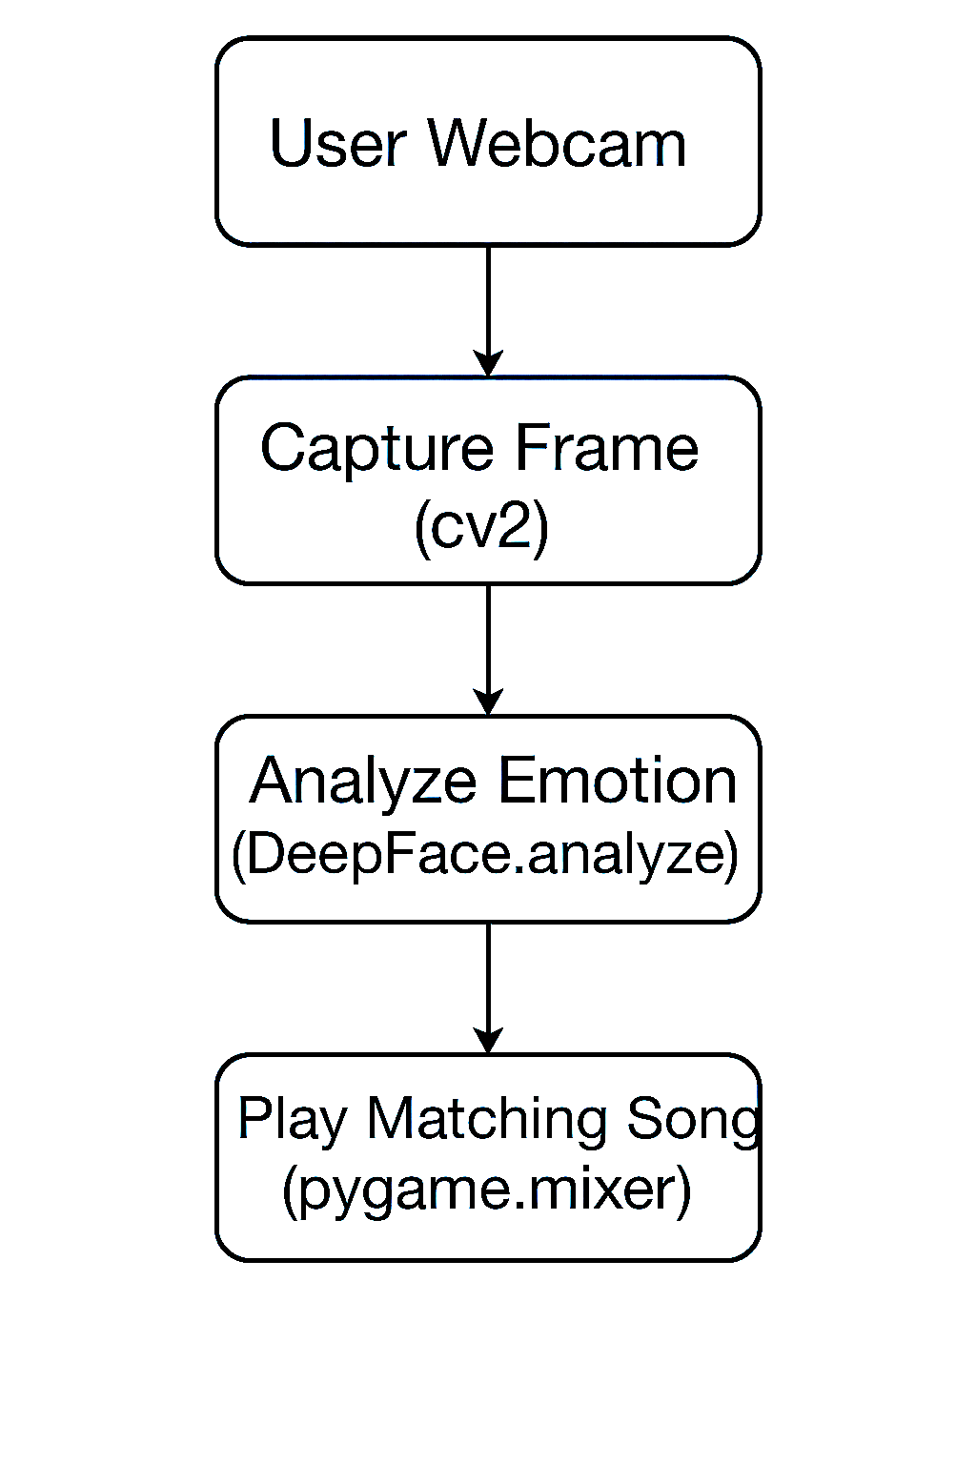
System Architecture

Slide 6
Module Description
Webcam Integration:-It Captures live video using OpenCV.
Emotion Detection Module: This Uses DeepFace to extract dominant emotion.
Music Playback Module: Loads and plays '.mp3’ files using Pygame.
User Interaction: Press 'q' to detect mood, 'e' to exit.

Slide 7
Testing and Results
We Tested with different emotional expressions like happy, sad, angry.
It has smooth and fast recognition in controlled lighting.
The song plays without any lag after detection.
The Exception handling ensures that the app don’t crash on missing files or faces.

Slide 8
Conclusion & Future Scope
Conclusion:
We have successfully built working moaod-based music player.
It combines AI and multimedia to personalize music experience.
Future Scope:
We can add GUI using Tkinter or PyQt.
It supports online streaming (Spotify API).
Can also introduce speech-based commands.
We can extend to mobile platform.

