Slide 1
AI Powered System Checker
By Tanish Goindi Vihaan Choube

Slide 2

Objective and Scope
Solution that uses AI to analyse user-reported symptoms & recommends possible conditions, along with next steps for medical consultation.
It must be a user-friendly application that allows users to input symptoms, which the AI will analyze
Initial focus on common ailments, further expanding into more complex ones

Slide 3

Feasibility
Similar systems already exist; WebMD, Babylon Health, Ada Health, and Buoy Health to name a few
Users enter their symptoms, and the AI asks follow-up questions to narrow down the possible causes
Medical professionals ensure that the AI's recommendations are safe
It is cost effective and available 24/7

Slide 4

Gathering Data
Collect a large dataset is crucial for the reliability of the model. Our sources can include:
Medical Catalogues (e.g., CDC, WHO databases)
Clinical guidelines (e.g., ICD-10, DSM-5)
User-generated data (from surveys or past patient records with consent) and user inputted data, for user reported symptoms
To obtain the following we could use:
Training Models- Natural Language Processing (NLP) Models,Transformer-based Models (e.g., GPT, BERT)

Slide 5

Symptom Analysis and Condition Recommendation
A need to implement a rule-based system using a decision tree approach to match symptoms with possible conditions
Training a machine learning model on the gathered dataset to improve accuracy(severity assessment,referral suggestions,recommended tests, specialists in your area, etc )
The system should return a ranked list of possible conditions based on the input symptoms

Slide 6
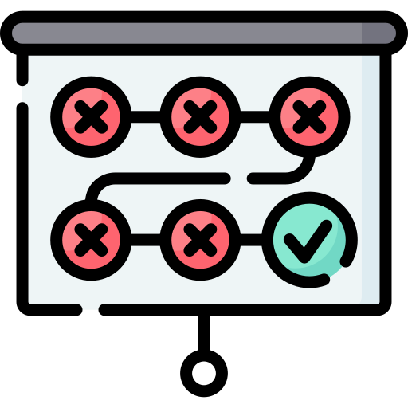
Testing and Validation
A testing sequence must commence before the model goes live so as to make sure that there are no mishaps in its analysis
Along with this it must be certified by medical professionals to provide recommendations and improve the system

Slide 7
Deployment and Maintenance
Platform Development- Decide on a platform (web, mobile, etc.) for deployment.
Continuous Improvement- Implement feedback loops for updating the AI model based on new data.
The system must not have any bias
It must be transparent and clearly communicate its limitations

Slide 8
Deployment and Maintenance
Platform Development- Decide on a platform (web, mobile, etc.) for deployment.
Continuous Improvement- Implement feedback loops for updating the AI model based on new data.
The system must not have any bias
It must be transparent and clearly communicate its limitations

Slide 9
Thank You

