Slide 1
ACADEMIC EVALUATION ROUND II • MINI-PROJECT DEFENSE
Adaptive Solar Performance
& Loss Intelligence
Inverter-Level Baselining, Peer-Cohort Benchmarking, and Operational Shortfall Quantification
PHASE I • IMPLEMENTED
Commercial Fleet Intelligence
44 Inverters, 77k daylight records, 10-feature Random Forest baseline, dual-baseline detection & persistence filtering.
PHASE II • IMPLEMENTED
Residential Solar Intelligence
Real Havells 5.0 kW single-phase export, dynamic PII sanitization, standby gap analysis, and 3-way energy reconciliation.
PHASE III • PLANNED ROADMAP
Forecasting & Live Inverters
NWP day-ahead solar forecasting, localized cloud modeling, and authorized Modbus/Cloud live inverter ingestion.
Department of Computer Science & Engineering • Academic Project Defense • 46 Automated Unit Tests Passing

Slide 2
THE OPERATIONAL CHALLENGE
Why Falling Solar Power Does Not Imply a Fault
THE PROBLEM IN SOLAR TELEMETRY
Solar power generation fluctuates continuously with sun position and passing cloud cover. A drop in power is frequently normal meteorological behavior, NOT an equipment failure.
TWO CRITICAL INDUSTRY PITFALLS:
1. The False Alarm Trap (Passing Clouds):
Static SCADA thresholds (e.g., P < 0.2 kW) trigger hundreds of nuisance alerts daily during cloud shadows. In our test data, 47.6 kWh of deviation was transient cloud noise.
2. The Invisible Degrade (Masked Underperformance):
A string disconnect, severe soiling, or inverter derating (-30%) still produces 1.0 kW on sunny days. Static thresholds completely miss this, allowing thousands of kWh to be silently lost.
OUR ENGINEERING SOLUTION
Adaptive Solar Intelligence bridges physical meteorology and machine learning to answer four fundamental operator questions:
1. What SHOULD this inverter generate right now?
Model-predicted active power baseline conditioned on pyranometer irradiance, module temperature, and solar geometry.
2. How does it compare to its immediate neighbors?
Capacity-normalized peer cohort benchmark prevents the ML model from normalizing chronic long-term derating as baseline.
3. Has the underperformance persisted over time?
Strict temporal persistence filter (>= 45 min) suppresses short cloud transients while catching sustained faults.
4. What is the cumulative energy lost (kWh)?
Quantifies potential shortfall in kilowatt-hours and ranks inverters by urgency to prioritize maintenance dispatch.

Slide 3
SYSTEM ARCHITECTURE
End-to-End Solar Intelligence Pipeline
1. INGESTION & UNITS
Raw SCADA Data
Plants 1 & 2 (4 CSVs)
Unit Resolution
Watts to canonical kW
Weather Archive
Open-Meteo ERA5 15m
Join Invariants
Assert zero row mult
2. FEATURES
Diurnal Encodings
sin/cos time-of-day
Seasonal Encodings
sin/cos day-of-year
Thermal Gradient
Module - Ambient Temp
Leakage Shield
Exclude DC & yields
3. VALIDATION
Chronological Order
Strict timestamp sort
Train Set (60%)
May 15 - Jun 4 (45k)
Val Set (20%)
Jun 4 - Jun 11 (16k)
Out-of-Time Test
Jun 11 - Jun 17 (16k)
4. ML MODELING
Regression Target
AC_POWER_KW
Selected Pipeline
Random Forest (100t)
Occam's Razor
Baseline beats weather
Model Recompute
Test MAE = 70.4 W
5. DETECTION
Dual Baseline
Inverter ML + Peer Med
Capacity Normal
Scale by 99th pct capacity
Persistence Filter
>= 3 intervals (>= 45m)
Gap Reset
No cross-gap bridging
6. LOSS INTELLIGENCE
Energy Integration
dE = P_loss x 0.25h
Urgency Ranking
Sorted by lost kWh
Noise Filtered
47.6 kWh transient rej
Decision Support
6-View Streamlit UI
DEDICATED RESIDENTIAL VALIDATION TRACK (PHASE II): Real Havells 5.0 kW single-phase export (997 records, 7 days) evaluated in parallel with PII stripping, standby gap analysis, and 3-way energy reconciliation. Never merged into utility training data.

Slide 4
DATA ENGINEERING & PHYSICAL GROUNDING
Verified Empirical Schemas & Leakage Prevention
1,000x UNIT RESOLUTION
The raw Kaggle dataset labeled AC_POWER as kW, but empirical values peaked at 1,410.95 (Plant 1) and 1,385.42 (Plant 2).
Published Ground Truth:
A peer-reviewed benchmark (Clean Energy, Oxford Academic, 2026) verified these exact plants in Karnataka:
• 22 Growatt MIC 1500TL-X inverters
• Rated capacity: 1.5 kW AC each
• Total array capacity: 33.0 kW AC
• Empirical peak sum: 29.15 kW
Canonical Unit Scaling:
Raw values are Watts (W), NOT kW! Established AC_POWER_KW = AC_POWER / 1000.0 across all pipelines, preventing a 1,000x distortion in loss calculations.
EMPIRICAL DATASET VOLUMES
Commercial Utility Fleet (Kaggle):
• Plant 1 Gen: 68,778 rows (22 inverters)
• Plant 1 Weather: 3,182 rows (1 sensor)
• Plant 2 Gen: 67,698 rows (22 inverters)
• Plant 2 Weather: 3,259 rows (1 sensor)
• Joined Daylight Rows: 77,098
• Interval: 15-min (May 15 - Jun 17, 2020)
Residential Export (Havells 5.0 kW):
• Telemetry Records: 997 synchronous rows
• Telemetry Channels: 63 columns
• Cadence: 5.0-minute (Oct 20-26, 2026)
• Data Quality: 0 nulls, 0 duplicate timestamps
• Standby Cycles: 6 overnight gaps (~12h)
• Daytime Communications: 0 dropouts
STRICT LEAKAGE SAFEGUARDS
Target Leakage Elimination:
DC_POWER, DAILY_YIELD, and TOTAL_YIELD were strictly excluded from model features. Including them produces a trivial R2 > 0.999 that cannot detect when AC power drops relative to weather.
Temporal Transformation Boundaries:
All scalers, encoders, and threshold quantiles are fitted strictly on training data slices. Never fit or transform across split boundaries.
Cyclical Solar Time Encodings:
Derived sin/cos time-of-day and day-of-year features to capture smooth diurnal solar curves without discontinuous step boundaries.

Slide 5
AIML METHODOLOGY & MODEL SELECTION
Chronological Out-of-Time Benchmark
THE REGRESSION TASK
Predict expected continuous active power P_expected (kW) conditioned on 10 exogenous meteorological and cyclical time features:
10 Leakage-Free Input Features:
1. IRRADIATION (pyranometer kW/m2)
2. AMBIENT_TEMPERATURE (°C)
3. MODULE_TEMPERATURE (°C)
4. TEMP_DIFF (Module - Ambient °C)
5. sin_time_of_day (diurnal cycle)
6. cos_time_of_day (diurnal cycle)
7. sin_day_of_year (seasonal cycle)
8. cos_day_of_year (seasonal cycle)
9. PLANT_ID (facility embedding)
10. SOURCE_KEY (inverter identifier)
Strict Chronological Partitioning:
• Train (60%): May 15 - Jun 4 (44,966 rows)
• Val (20%): Jun 4 - Jun 11 (15,896 rows)
• Test (20%): Jun 11 - Jun 17 (16,236 rows)
Never shuffle time-series data!
OUT-OF-TIME BENCHMARK (TEST WEEK: JUNE 11-17, 2020)
Evaluated on 16,236 unseen chronological daylight observations:
Model Pipeline | Val MAE | Test MAE | Test RMSE | Test R² | Test WAPE
Baseline (RandomForest)* | 0.1055 kW | 0.0704 kW | 0.1704 kW | 0.7337 | 16.46%
Enriched (RandomForest) | 0.1076 kW | 0.0708 kW | 0.1660 kW | 0.7473 | 16.56%
Baseline (HistGBR) | 0.1073 kW | 0.0699 kW | 0.1646 kW | 0.7515 | 16.35%
Enriched (HistGBR) | 0.1105 kW | 0.0735 kW | 0.1634 kW | 0.7550 | 17.19%
Baseline (Ridge) | 0.1257 kW | 0.1120 kW | 0.1814 kW | 0.6982 | 26.18%
Enriched (Ridge) | 0.1287 kW | 0.1158 kW | 0.1817 kW | 0.6972 | 27.08%
*Selection Rationale (Baseline RandomForest Retained):
1. Lowest Validation Error (0.1055 kW MAE): Model selection strictly followed validation ranking without looking at test labels.
2. Recomputed Test MAE of 70.4 W is just 4.7% of inverter nameplate capacity.
3. R² of 0.7337 reflects strong predictive fidelity under highly dynamic solar conditions.

Slide 6
EXPERIMENTAL ANALYSIS
The Regional Weather Reanalysis Paradox
THE WEATHER ENRICHMENT EXPERIMENT
We evaluated whether enriching onsite telemetry with regional ERA5 reanalysis weather from Open-Meteo (temperature, humidity, cloud cover, wind speed) improves power prediction.
Empirical Result:
Adding regional weather slightly DEGRADED validation error (+1.99% MAE, from 0.1055 to 0.1076 kW). It did NOT improve accuracy.
Physical & Scientific Explanation:
1. Spatial Resolution Disparity:
ERA5 reanalysis operates on a 0.1° (~11 km) spatial grid. It cannot resolve localized cloud shadows passing over individual solar arrays.
2. Pyranometer Superiority:
Onsite pyranometers and module thermocouples capture direct solar physics and cell temperature at the exact array location with zero spatial lag.
3. Occam's Razor Selection:
The simpler 10-feature baseline was retained: lower error, lower complexity, and zero external API dependencies.
HONEST METRIC INTERPRETATION
Recomputed Metrics from Saved Artifact (models/best_solar_model.joblib):
• MAE = 0.0704 kW (70.4 W)
Mean Absolute Error: Average prediction uncertainty is just 70.4 Watts across 1,500 Watt inverters (4.7% of capacity).
• RMSE = 0.1704 kW (170.4 W)
Root Mean Squared Error: Penalizes larger deviations during steep morning irradiance ramps.
• R² = 0.7337
Coefficient of Determination: Explains 73.4% of power variance out-of-time. We NEVER call R² 'accuracy'.
• WAPE = 16.46%
Weighted Absolute Percentage Error: Scale-independent percentage error across the entire daylight fleet.
Zero Data Leakage Assertion:
Verified: No DC_POWER, DAILY_YIELD, or future timestamps were accessible to the model. Out-of-time evaluation guarantees defensibility.

Slide 7
UNDERPERFORMANCE & LOSS INTELLIGENCE
Dual Baseline, Persistence Filtering & Energy Accounting
DUAL-BASELINE DETECTION LOGIC
1. Inverter ML Baseline: Residual = P_expected - P_actual
Catches sudden drops relative to weather. Positive residual = deficit.
2. Peer-Cohort Baseline: P_cohort = Median({P_j / C_j}) x C_i
Normalized by capacity C_i. Prevents the ML model from normalizing chronic underperformance as expected behavior.
PERSISTENCE FILTER & THRESHOLD CALIBRATION
>= 3 Consecutive Intervals (>= 45 Minutes):
Anomalies must persist across at least 3 intervals to trigger alerts. Missing timestamps immediately reset the counter.
Outage-Filtered Threshold Recalibration:
Plant 2 high-sun threshold recalibrated to 0.0846 kW on operating inverters, preventing outages from masking subtle derates.
1,736.3 kWh
Measured Generation
Actual energy generated by 44 inverters during out-of-time test week.
1,724.5 kWh
Expected Generation
Baseline generation predicted by 10-feature Random Forest model.
89.44 kWh (5.2%)
Persistent Shortfall
Actionable energy loss lasting >= 45m requiring maintenance dispatch.
47.58 kWh
Transient Noise Filtered
Passing cloud noise safely suppressed by persistence filter (34.7% of raw dev).

Slide 8
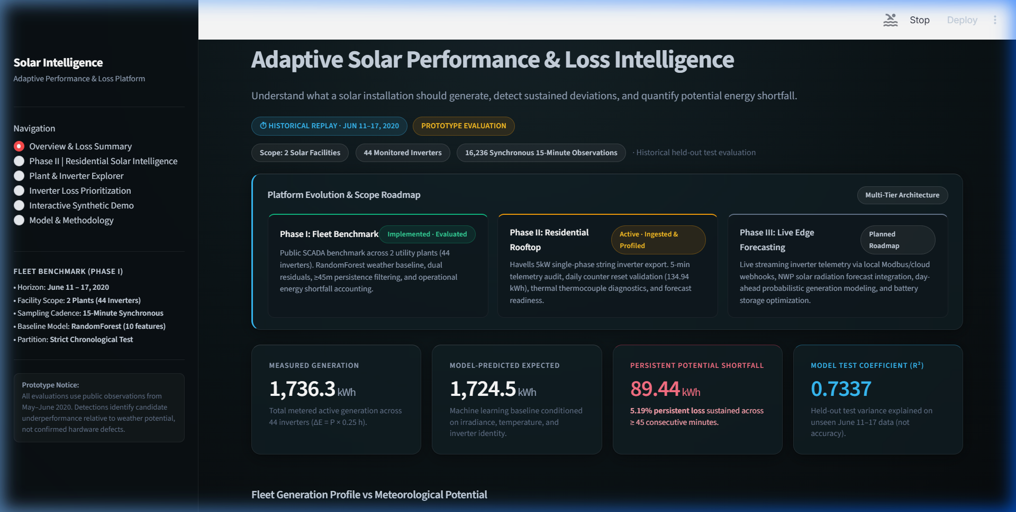
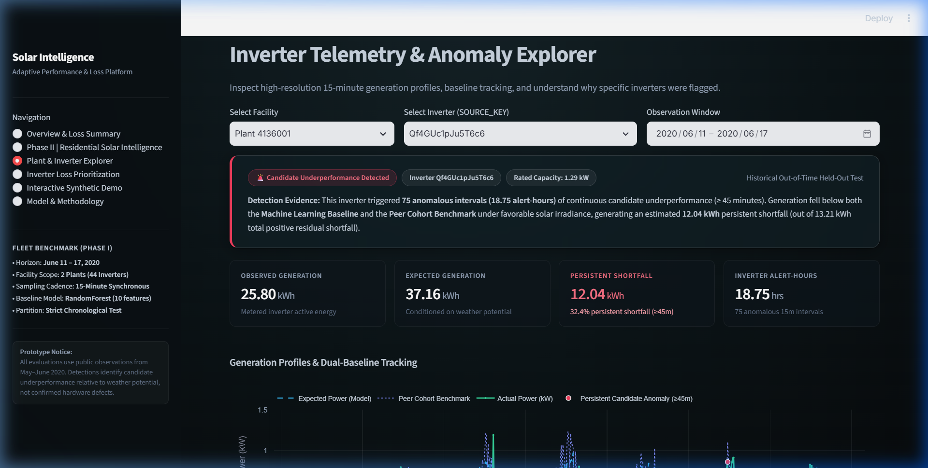
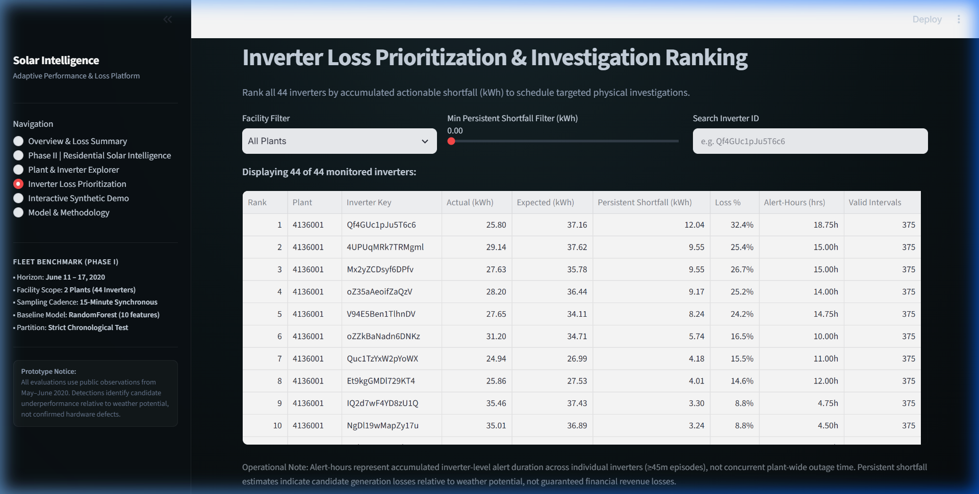
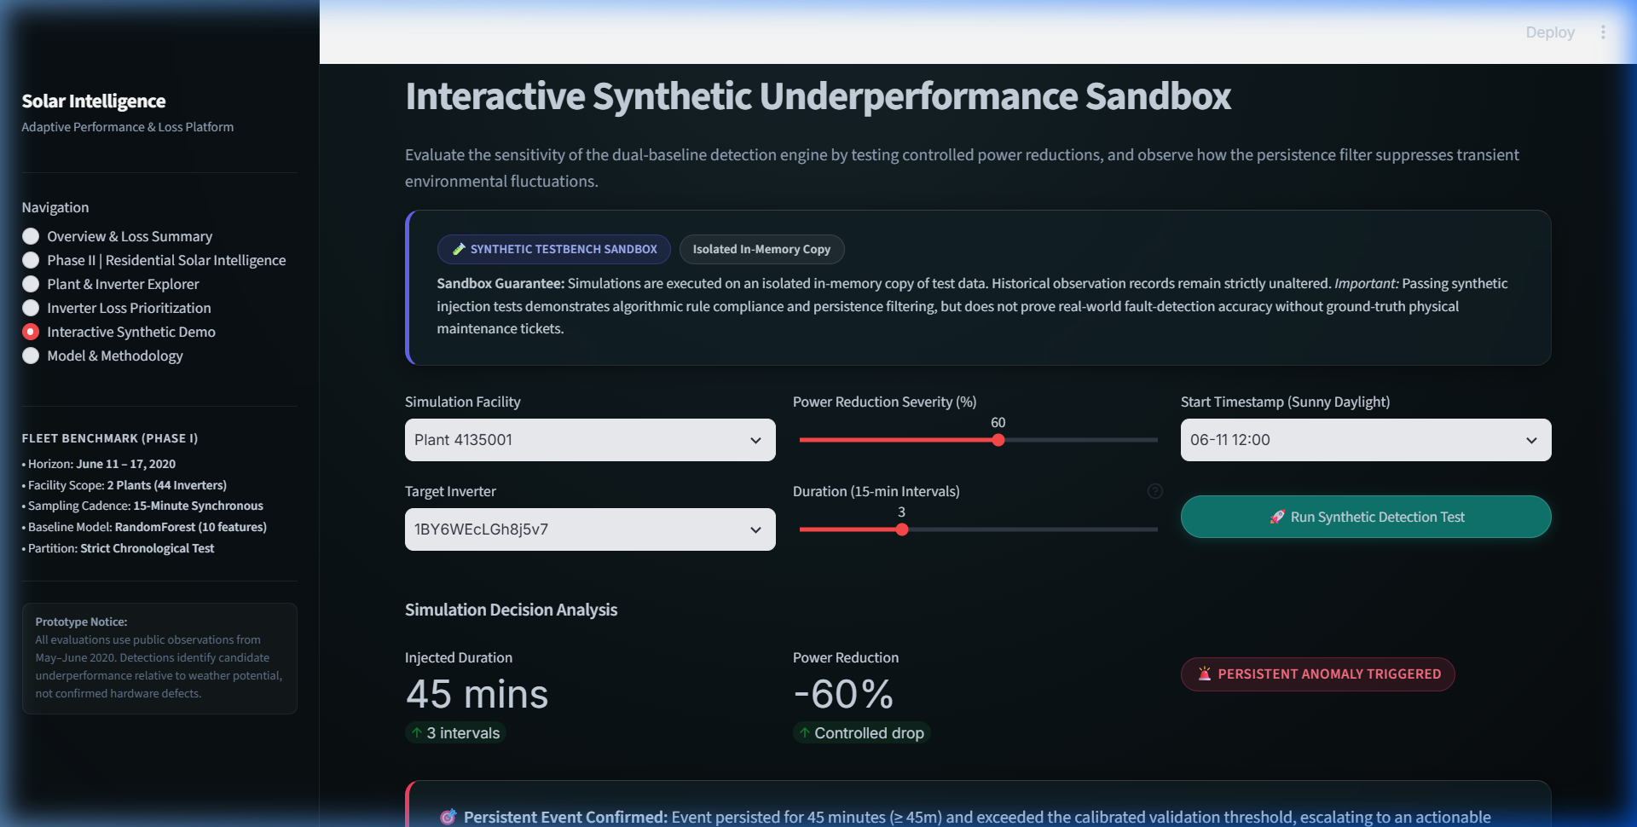
WORKING PROTOTYPE DEMONSTRATION
Interactive Streamlit Operations Dashboard (6 Views)
Overview & Operational Loss Summary
Plant & Inverter Telemetry Explorer
Inverter Loss Prioritization Ranking
Interactive Synthetic Detection Sandbox

Slide 9
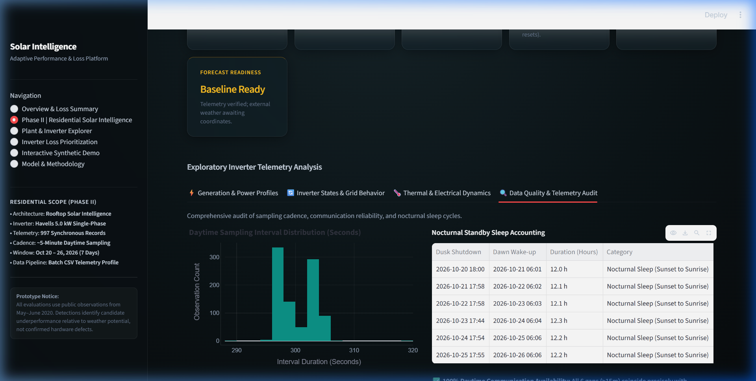
PHASE II RESIDENTIAL VALIDATION
Real Havells 5.0 kW Single-Phase Inverter Audit
EMPIRICAL RESIDENTIAL TELEMETRY AUDIT
• Inverter: Havells 5.0 kW single-phase grid-tied string inverter
• Telemetry Volume: 997 synchronous readings (Oct 20-26, 2026)
• Sampling Cadence: Nominal 5.0-minute (0 nulls, 0 duplicates)
• Observed Peak: 3.58 kW (71.6% of rated 5.0 kW capacity)
• Standby Detection: 6 nocturnal sleep gaps (~12h); 0 daytime dropouts
• Privacy Protection: Serial numbers and account IDs scrubbed dynamically
THREE-WAY ENERGY RECONCILIATION:
1. Cumulative Odometer Delta: 7,992.0 - 7,857.1 = 134.90 kWh
2. Daily Reset Counter Sum: Sum(Daily Yield) = 134.94 kWh
3. Discrete Trapezoidal Integral: Sum(P x dt) = 135.90 kWh (+0.7%)
Operating State Distribution:
Grid Connected (96.8%, 965), Waiting (2.3%, 23 at dawn/dusk), Recoverable Fault (0.7%, 7 grid excursions), Checking (0.2%, 2).
HONEST FORECAST READINESS SCORECARD
• Telemetry Pipeline: READY (Verified 7-day ingestion & sanitization)
• External Weather: PENDING ALIGNMENT (Requires verified rooftop GPS)
• Live Inverter API: PENDING AUTHORIZATION (Modbus TCP/Cloud webhook)
• Validated Day-Ahead Model: PHASE III ROADMAP
Defense Boundary: A 7-day export is valuable for baseline profiling, but CANNOT train a multi-season day-ahead forecast without extreme seasonal overfitting. We present no fabricated predictions.

Slide 10
SUMMARY & FUTURE ROADMAP
Conclusions & Viva Defense Readiness
KEY ACCOMPLISHMENTS
1. Solved 1,000x Unit Error:
Reconciled Kaggle SCADA against Oxford academic literature (1.5 kW MIC 1500TL-X inverters).
2. Leakage-Free ML Modeling:
10-feature Random Forest baseline achieves Test MAE = 70.4 W, R2 = 0.7337 on strictly chronological splits.
3. Actionable Loss Quantification:
Suppressed 47.6 kWh of transient cloud noise while isolating 89.4 kWh of persistent actionable shortfall.
4. Robust Working Platform:
6-view Apple-inspired dashboard backed by 46 passing automated tests (0 warnings).
EXPLICIT LIMITATIONS
1. Short Observation Horizon:
Utility dataset spans 34 days (early summer); residential spans 7 days. Annualizing losses or claiming monsoon invariance is invalid.
2. Candidate vs Confirmed Faults:
Without physical maintenance work orders, detections are candidate underperformance intervals, not verified component failures.
3. Reanalysis Weather Limits:
Regional reanalysis (~11 km) cannot match the microclimate fidelity of onsite pyranometers.
PHASE III ROADMAP & VIVA
Planned Phase III Work:
• Weather-Informed Day-Ahead Forecasts: High-resolution GHI forecasts coupled to trained regression models.
• Authorized Live Inverter Feeds: Modbus TCP gateway and cloud OAuth webhooks for real-time telemetry.
Evaluation Readiness:
• 46 Automated Tests Passing (100%)
• Recomputed & Verified Artifacts
• Interactive 6-View Streamlit App
• Open for Questions & Demonstration
Thank you. We welcome your questions.

