Slide 1
MINI PROJECT - 202040601
Music Genre Classification System
Chudasama Vihar (12202040501062)
Chudasama Satyapal (12202040501056)
Guided By : Krushna Pandit Sir

Slide 2
Introduction
Problem Statement
Music exists in many different genres, such as Rock, Pop, Jazz, Classical, and Hip-Hop. Each genre has its own characteristics, such as specific rhythms, instruments, and melodies.
With millions of songs available on platforms like Spotify, Apple Music, and YouTube, there is a need for an automated system that can quickly and accurately classify songs into the right genres.
2

Slide 3
Introduction
Problem Statement
Challenges in Manual Genre Classification
Subjectivity – Different people disagree on song genre
Time-consuming – For large music libraries it is impractical to classify
Feature Complexity - Music genres have multiple elements like rhythm, melody, making it hard to classify songs using fixed rules.
Data Variability - A single song can belong to multiple genres making it difficult to classify
Role of Machine Learning (ML) and Deep Learning (DL)
To overcome these challenges, we use this ML and DL models that analyze audio signals and extract features , learn pattern from datasets and automatically classify new song.
Benefits of ML & DL in Music Classification
Faster- Classify Thousands of songs in second
More Accurate- Read and capture hidden patterns which are not.
Scalable – Works for small and large music collections.

Slide 4
Introduction
Problem Objective
The goal of this project is to develop an automated music genre classification system using Machine Learning (ML) and Deep Learning (DL) techniques. The system will:
Analyze audio signals to extract key features like tempo, pitch, and frequency.
Train ML/DL models to recognize patterns and classify songs into appropriate genres (Rock, Pop, Jazz, etc.).
Improve accuracy and efficiency, making genre classification faster and more reliable than manual methods.
Enhance music streaming platforms by automatically categorizing songs for better recommendations and organization.

Slide 5
Literature Review
Related Work
1. Previous Studies on Music Classification
Earlier research focused on manual classification.
Traditional method relied on rule-based system, where specific characteristic(like beats per minute) used.
However, these methods were subjective and not scalable for large datasets.
2. Machine Learning (ML) Approaches
Support Vector Machines (SVMs): Used to classify songs based on extracted features but struggled with complex data.
Random Forest: Applied for feature selection and classification but was not as effective for deep feature extraction.
But they lacks deep feature extraction capabilities for complex music patterns.

Slide 6
Literature Review
Related Work
3. Feature Extraction approach
MFCCs- Mel-Frequency Cepstral Coefficients are widely used in music classification as they help in capturing important features of an audio signals. They extract frequency-based features, allowing models to differentiate between music genres based on sound patterns.
However, it may lose important temporal and spatial details.
4. Deep Learning (ML) Approaches
Convolutional Neural Networks (CNNs) – CNNs can be trained directly on raw audio waveforms (1D signals), offering higher accuracy in genre classification.
Studies shows that CNNs outperform traditional ML models in classifying complex genres accurately.
Combination of CNNs & RNNs-Recurrent Neural Networks (LSTMs/GRUs) – Captures both spatial and temporal dependencies, but computationally expensive and requires more training data.

Slide 7
Literature Review
Why Choose CNN and Mel-Spectrogram Instead?
CNNs efficiently extract deep features from Mel-Spectrograms, which visually represent audio signals like images.
Mel-Spectrograms preserve both frequency and time-domain information, making them superior to MFCCs in capturing musical nuances.
This combination achieves higher accuracy, reduces manual feature extraction, and scales well for large datasets.

Slide 8
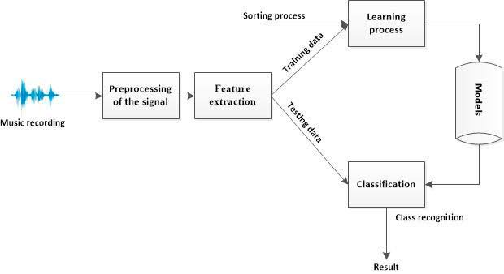
Architecture Diagram
System Design

Slide 9
Model Overview
A Mel-Spectrogram is a visual representation of audio signals, where the x-axis represents time, the y-axis represents frequency, and the color intensity shows the amplitude (energy) of frequencies. It transforms raw audio into an image-like format, making it suitable for deep learning models like CNNs.
How It Works
Convert Audio to Spectrogram – Audio signals are broken down into short frames using Short-Time Fourier Transform (STFT).
Apply Mel Scale – The frequency scale is transformed to match human hearing perception (low frequencies more detailed, high frequencies compressed).
Generate Mel-Spectrogram Image – The processed data is converted into an image, which can be fed into CNNs for classification.

Slide 10
Implementation
Technologies Used
The following technologies and libraries are used to implement the Music Genre Classification Model:
Python – Core programming language for the project.
TensorFlow / Keras – Deep learning framework for training the CNN model.
Librosa – Audio processing library for feature extraction (MelSpectrogram).
Matplotlib & Seaborn – Visualization tools for spectrograms and model performance.
Sklearn (Scikit-learn) – Used for data preprocessing, splitting, and evaluation metrics.
NumPy & Pandas – For handling numerical data and dataset operations.

Slide 11
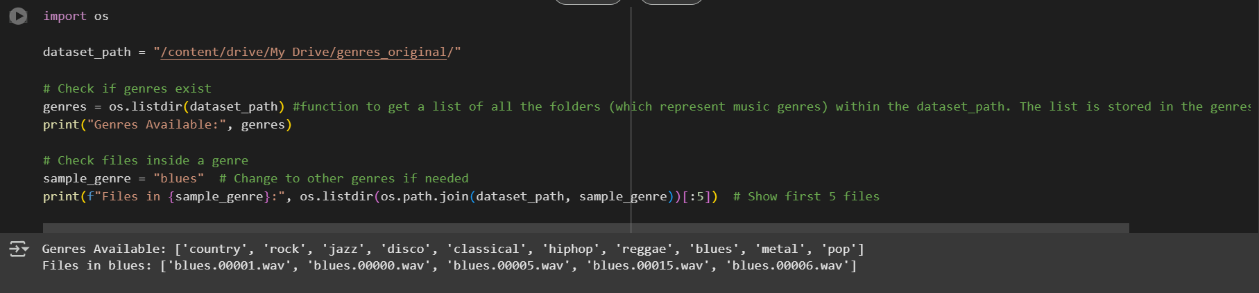

Implementation
ScreenShots

Slide 12
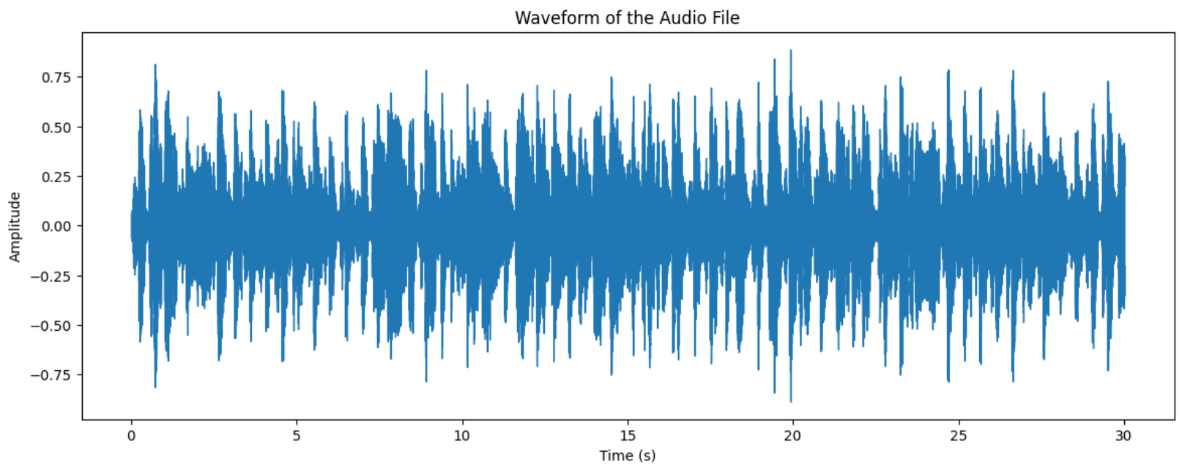
Implementation
Visualizing single audio

Slide 13
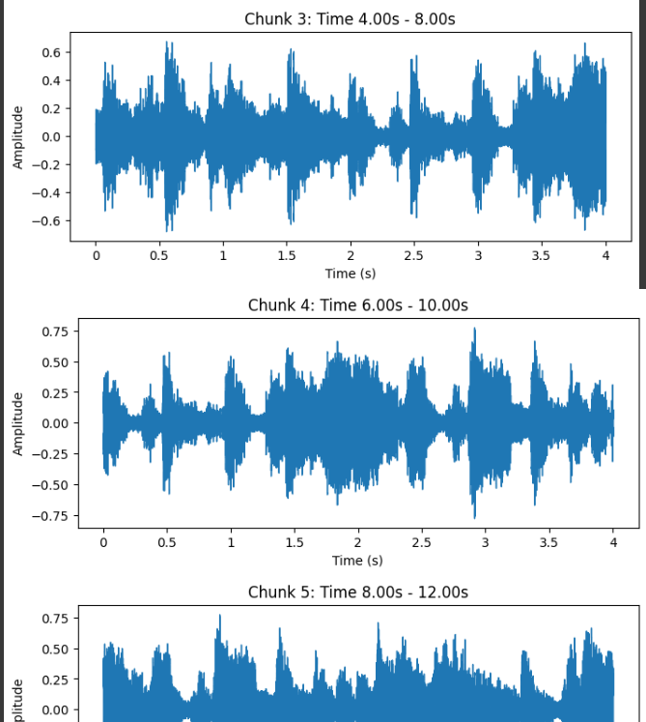
Implementation
Visualizing in chunks from 4 to 2 back seconds

Slide 14
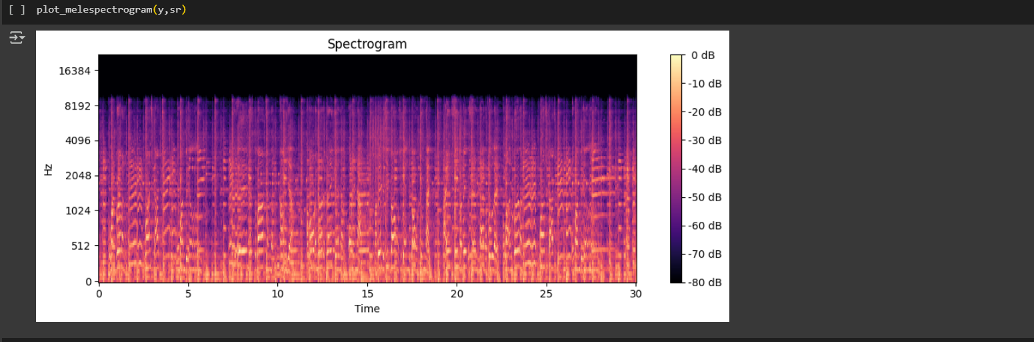
Implementation
Mel-Spectrogram Visualization

Slide 15
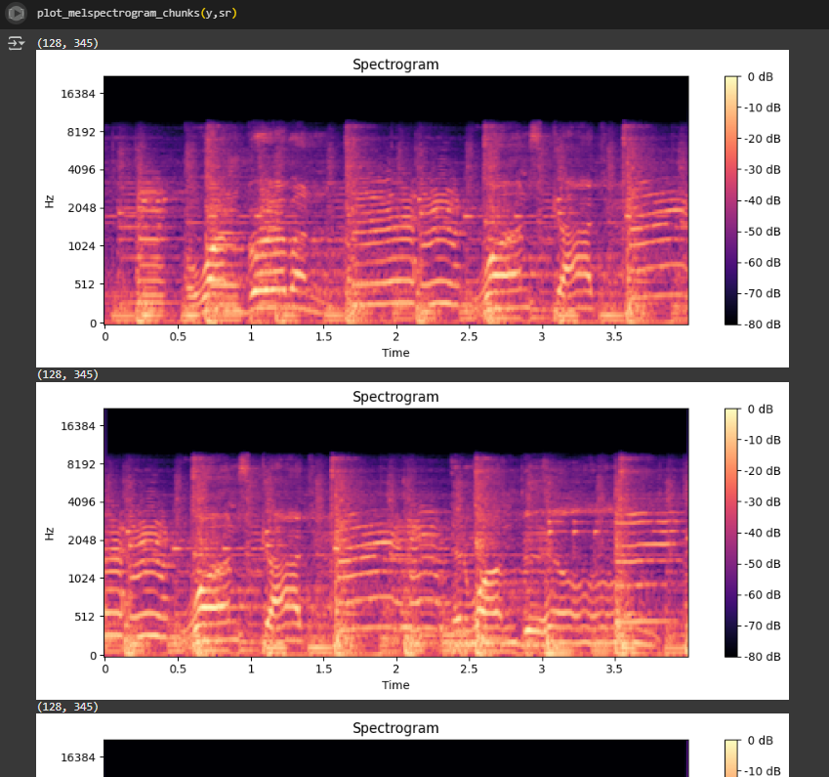
Implementation
Mel-Spectrogram chuncks Visualization

Slide 16
Testing and Results
Key Performance Metrics for Music Genre Classification
Once the model is trained, the evaluation will be done using Model Evaluation-II techniques, which include:
Precision – Measures how many predicted genres are actually correct.
Recall – Measures how well the model identifies all instances of a genre.
F1-Score – Balances Precision & Recall for a better performance measure.
Confusion Matrix – A table to analyse correct and incorrect predictions for each genre.
Current Status:
Data preprocessing & Mel-Spectrogram extraction completed
Pending: Model training & evaluation using these metrics.

Slide 17
Conclusion and Future Scope
Conclusion
Implemented a Music Genre Classification Model using CNN & Mel-Spectrograms.
Preprocessing & feature extraction completed, model training in progress.
Expected Outcome: Improved accuracy in genre classification compared to traditional models.
Future Scope
Real-time Genre Classification for streaming platforms.
Expand Dataset for better generalization.
Enhance Model with RNN/LSTM for temporal feature learning.

Slide 18
References
Research Papers & Journals
"Deep Learning for Music Genre Classification" – IEEE
"Mel-Spectrogram Features in Audio Classification" – Springer.
Libraries & Documentation
TensorFlow/Keras, Librosa, Sklearn
Kaggle Datasets & GitHub Repositories

Slide 19

Q&A

