Slide 1
WEEKLY SALES & BUSINESS ANALYSIS
Store: Lakshmi Kirana & General Store Period: 01 Jan 2020 to 02 Jan 2020

Slide 2
Executive Sales Summary
01 Jan - 02 Jan 2020
TOTAL SALES
₹ 0.00
FINALIZED BILLS
0
AVG BILL VALUE
₹ 0.00
TAXABLE SALES
₹ 0.00
TOTAL GST TAX
₹ 0.00

Slide 3
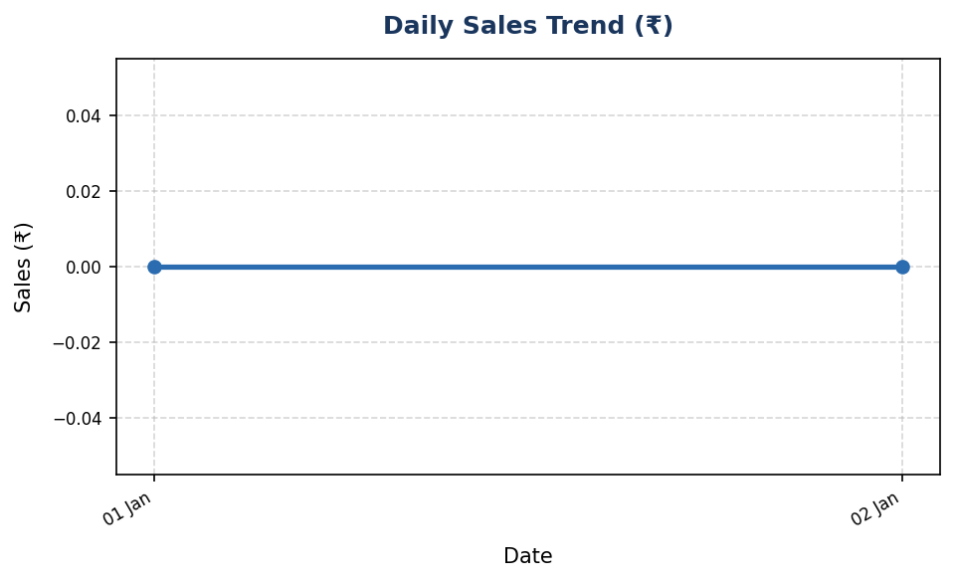
Daily Sales Performance Trend
Track daily revenue trajectory
Key Observations:
• Period Total Revenue: ₹ 0.00
• Total Finalized Orders: 0
• Highest Order Value: ₹ 0.00
• Lowest Order Value: ₹ 0.00

Slide 4
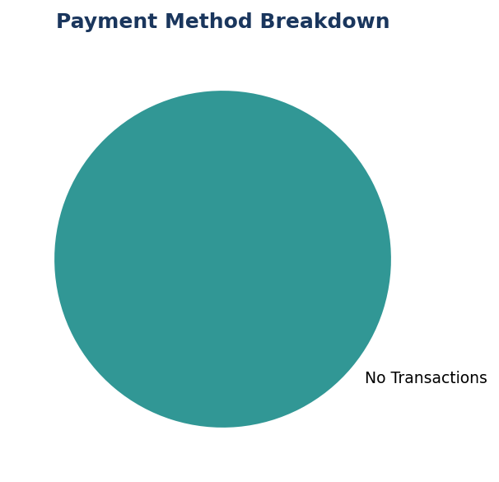
Payment Collection Channels
Breakdown by Cash, UPI, Card, and Khata Credit
Channel Breakdown:
• CASH Sales: ₹ 0.00
• UPI Digital Sales: ₹ 0.00
• CARD Sales: ₹ 0.00
• KHATA Credit Sales: ₹ 0.00

Slide 5
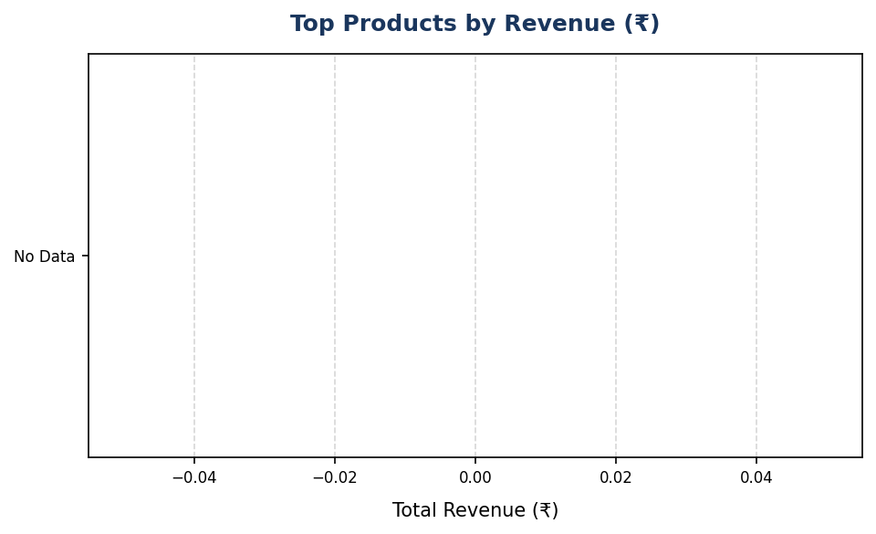
Top Selling Products
Highest revenue contributors during period
Top Revenue Items:
• No product sales recorded in period.

Slide 6
GST Tax Collection Breakdown
Deterministic CGST and SGST tax metrics
Tax Metric | Amount (₹)
Total Net Taxable Amount | ₹ 0.00
Central GST (CGST) | ₹ 0.00
State GST (SGST) | ₹ 0.00
Total GST Tax Collected | ₹ 0.00

Slide 7
Inventory Health & Reorder Alerts
Products at or below reorder threshold
Low Stock Items Identified: 1
• Sugar 1kg (SKU: SUGAR-1KG) — Current Stock: 0.00 piece (Reorder Level: 10.00)

Slide 8
Store Business Insights
Actionable operational recommendations
Operational Insights & Recommendations:
• Sales Volume: Generated ₹0.00 across 0 finalized orders (Avg: ₹0.00).
• Revenue Driver: 'Top category items' emerged as the leading revenue contributor during this period.
• Inventory Action: 1 items require immediate restocking to prevent stock-outs.
• Tax Compliance: Total GST collected ₹0.00 (CGST: ₹0.00, SGST: ₹0.00).

