Slide 1
WEEKLY SALES & BUSINESS ANALYSIS
Store: Lakshmi Kirana & General Store Period: 01 Sep 2026 to 07 Sep 2026

Slide 2
Executive Sales Summary
01 Sep - 07 Sep 2026
TOTAL SALES
₹ 664.70
FINALIZED BILLS
7
AVG BILL VALUE
₹ 94.96
TAXABLE SALES
₹ 620.00
TOTAL GST TAX
₹ 44.70

Slide 3
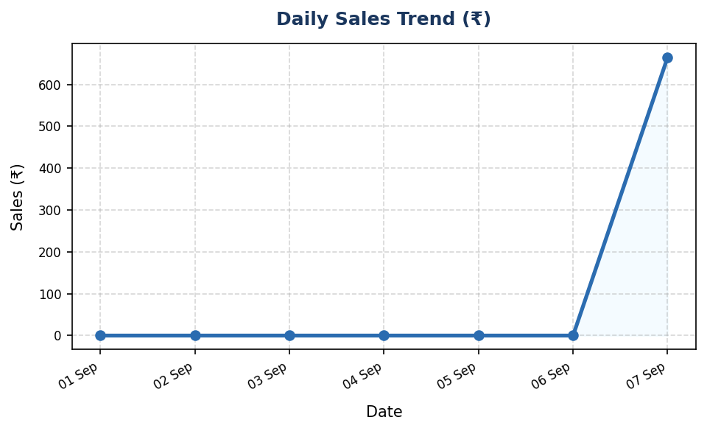
Daily Sales Performance Trend
Track daily revenue trajectory
Key Observations:
• Period Total Revenue: ₹ 664.70
• Total Finalized Orders: 7
• Highest Order Value: ₹ 147.00
• Lowest Order Value: ₹ 20.00

Slide 4
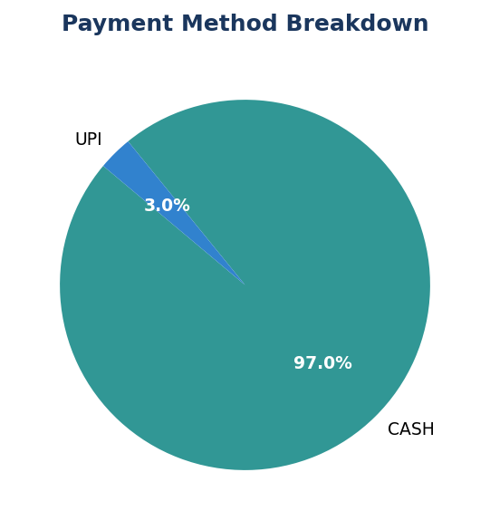
Payment Collection Channels
Breakdown by Cash, UPI, Card, and Khata Credit
Channel Breakdown:
• CASH Sales: ₹ 644.70
• UPI Digital Sales: ₹ 20.00
• CARD Sales: ₹ 0.00
• KHATA Credit Sales: ₹ 0.00

Slide 5
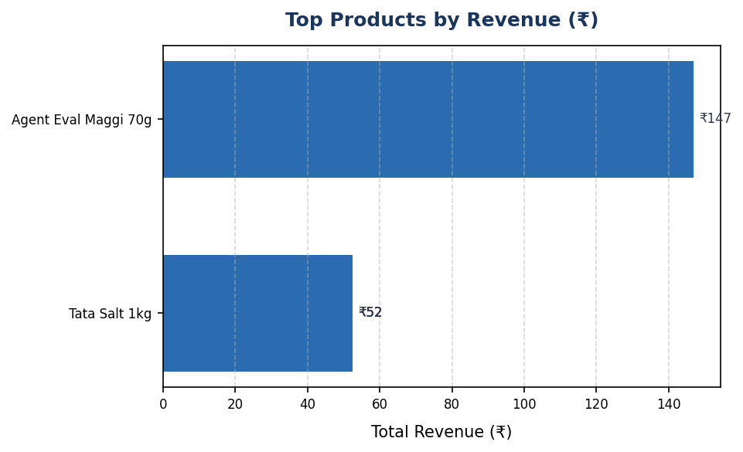
Top Selling Products
Highest revenue contributors during period
Top Revenue Items:
• Agent Eval Maggi 70g: 10 sold (₹147.00)
• Tata Salt 1kg: 2 sold (₹52.50)
• Tata Salt 1kg: 2 sold (₹52.50)
• Tata Salt 1kg: 2 sold (₹52.50)

Slide 6
GST Tax Collection Breakdown
Deterministic CGST and SGST tax metrics
Tax Metric | Amount (₹)
Total Net Taxable Amount | ₹ 620.00
Central GST (CGST) | ₹ 22.35
State GST (SGST) | ₹ 22.35
Total GST Tax Collected | ₹ 44.70

Slide 7
Inventory Health & Reorder Alerts
Products at or below reorder threshold
Low Stock Items Identified: 1
• Sugar 1kg (SKU: SUGAR-1KG) — Current Stock: 0.00 piece (Reorder Level: 10.00)

Slide 8
Store Business Insights
Actionable operational recommendations
Operational Insights & Recommendations:
• Sales Volume: Generated ₹664.70 across 7 finalized orders (Avg: ₹94.96).
• Revenue Driver: 'Agent Eval Maggi 70g' emerged as the leading revenue contributor during this period.
• Inventory Action: 1 items require immediate restocking to prevent stock-outs.
• Tax Compliance: Total GST collected ₹44.70 (CGST: ₹22.35, SGST: ₹22.35).

