Slide 1
WEEKLY SALES & BUSINESS ANALYSIS
Store: Lakshmi Kirana & General Store Period: 01 Sep 2026 to 07 Sep 2026

Slide 2
Executive Sales Summary
01 Sep - 07 Sep 2026
TOTAL SALES
₹ 99.54
FINALIZED BILLS
1
AVG BILL VALUE
₹ 99.54
TAXABLE SALES
₹ 92.00
TOTAL GST TAX
₹ 7.54

Slide 3
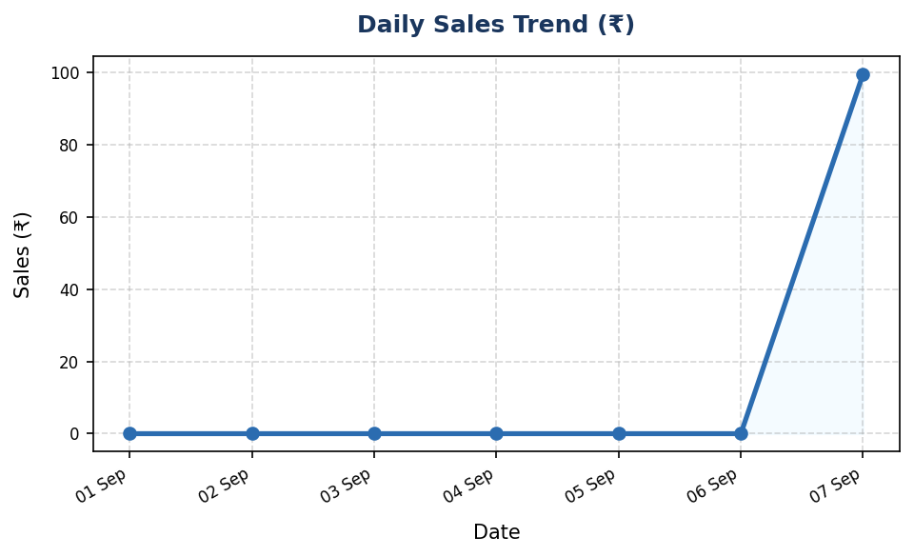
Daily Sales Performance Trend
Track daily revenue trajectory
Key Observations:
• Period Total Revenue: ₹ 99.54
• Total Finalized Orders: 1
• Highest Order Value: ₹ 99.54
• Lowest Order Value: ₹ 99.54

Slide 4
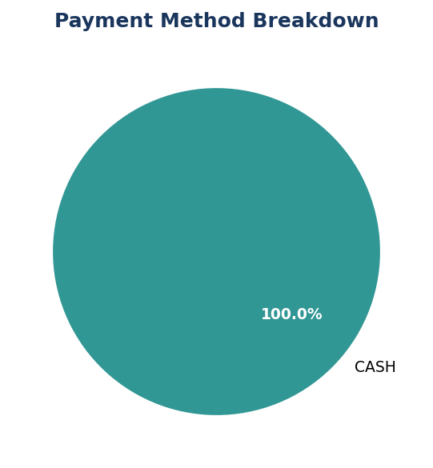
Payment Collection Channels
Breakdown by Cash, UPI, Card, and Khata Credit
Channel Breakdown:
• CASH Sales: ₹ 99.54
• UPI Digital Sales: ₹ 0.00
• CARD Sales: ₹ 0.00
• KHATA Credit Sales: ₹ 0.00

Slide 5
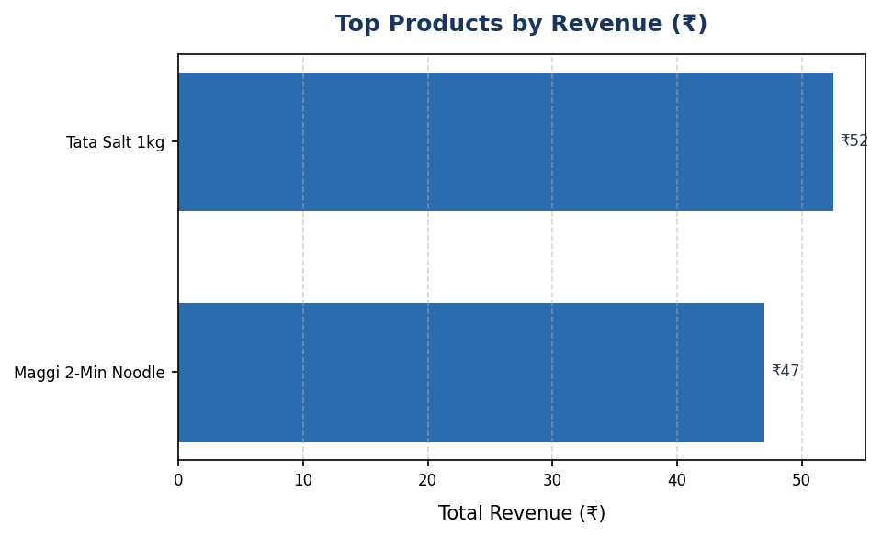
Top Selling Products
Highest revenue contributors during period
Top Revenue Items:
• Tata Salt 1kg: 2 sold (₹52.50)
• Maggi 2-Min Noodle: 3 sold (₹47.04)

Slide 6
GST Tax Collection Breakdown
Deterministic CGST and SGST tax metrics
Tax Metric | Amount (₹)
Total Net Taxable Amount | ₹ 92.00
Central GST (CGST) | ₹ 3.77
State GST (SGST) | ₹ 3.77
Total GST Tax Collected | ₹ 7.54

Slide 7
Inventory Health & Reorder Alerts
Products at or below reorder threshold
Low Stock Items Identified: 0
✅ All catalog inventory levels are healthy above reorder thresholds.

Slide 8
Store Business Insights
Actionable operational recommendations
Operational Insights & Recommendations:
• Sales Volume: Generated ₹99.54 across 1 finalized orders (Avg: ₹99.54).
• Revenue Driver: 'Tata Salt 1kg' emerged as the leading revenue contributor during this period.
• Inventory Action: 0 items require immediate restocking to prevent stock-outs.
• Tax Compliance: Total GST collected ₹7.54 (CGST: ₹3.77, SGST: ₹3.77).

