Slide 1
Secure Data Hiding in Image Using Steganography
CAPSTONE PROJECT
Presented By
Student Name : Kommula Viharika
College Name & Department : Institute of Aeronautical Engineering (Computer Science and Engineering)

Slide 2
OUTLINE
Problem Statement
Technology used
Wow factor
End users
Result
Conclusion
Git-hub Link
Future scope

Slide 3
Problem Statement
The necessity of safe data transfer is critical in today's digital environment. Despite their effectiveness, traditional encryption techniques are detectable and vulnerable to hostile actors. By encoding information into pictures, steganography provides a special remedy that prevents unwanted visitors from seeing it. In order to add an additional layer of protection, our project encrypts messages prior to embedding them using the LSB method. Users will have a smooth experience as this guarantees data integrity and supports a variety of image formats. The program offers a safe and flexible way to hide data, and it is made for a broad spectrum of users, including the general public and cybersecurity experts.

Slide 4
Technology used
Python: Core programming language.
Libraries: OpenCV, NumPy, Pillow for image processing.
Tkinter: For a user-friendly GUI.
Cryptography: Fernet for encrypting messages.
LSB Method: Steganographic technique.
Image Effects: Grayscale and blur options.
Multi-Format Support: PNG, JPG, BMP.
Execution Environment: Visual Studio Code

Slide 5
Wow factors
Encryption Layer: Adds security by encrypting messages before embedding.
Multi-Format Support: Seamless handling of various image types.
User-Friendly GUI: Easy interaction.
End Marker: Ensures accurate retrieval.
Versatile Use: Broad application range.

Slide 6
End users
Cybersecurity Professionals: Utilize the tool to discreetly transmit confidential information.
Investigative Journalists: Safeguard sensitive sources and data by embedding them in images.
Government Officials: Protect classified communications using hidden data techniques.
Educators and Trainers: Use the tool to teach steganography in an interactive manner.
Software Developers: Incorporate steganography into applications for added security.
Everyday Users: Hide personal messages and data securely within images.

Slide 7
Results
Project Directory Structure
stego_project/
│
├── main.py
├── encode_lsb_encrypted.py
├── decode_lsb_encrypted.py
├── gui.py
└── images/
├── input_image.png
└── encoded_image.png
Potential for Expansion: Capable of scaling to accommodate larger data sizes.
Swift Performance: Fast and efficient encoding and decoding operations.
Effective Encoding: Successfully embeds data within images without altering their appearance.
Reliable Decoding: Accurately retrieves and decrypts hidden messages.

Slide 8


Results
Input Image
Encoded Image

Slide 9
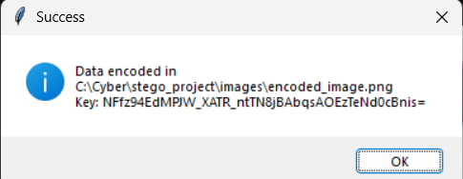
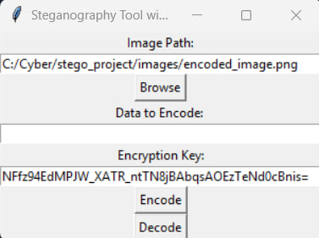
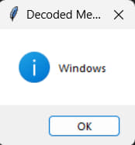
Results
Tkinter Interface

Slide 10
Conclusion
This tool offers a secure and practical method for embedding data within images, making it accessible to both novices and experts. Its versatility allows it to be applied across various fields, enhancing data protection by combining steganography with encryption and image processing. Additionally, it serves as an educational tool, illustrating key steganography concepts. Although currently limited to 128 characters, it consistently delivers reliable performance, setting the stage for future advancements in steganographic techniques.

Slide 11
GitHub Link
https://github.com/ViharikaKommula/Secure-Data-Hiding-in-Image-Using-Steganography

Slide 12
Future scope
The tool can be further developed to support larger data capacities within images. By incorporating advanced techniques like DCT or DWT, security can be enhanced. Real-time processing capabilities could be introduced, and the tool could be adapted for mobile use. AI integration could optimize encoding and improve steganalysis detection. Expanding to include video and audio files is another avenue. Additionally, blockchain technology could be used for secure data exchange, and users could customize image processing effects for a tailored experience.

Slide 13
THANK YOU

