Slide 1
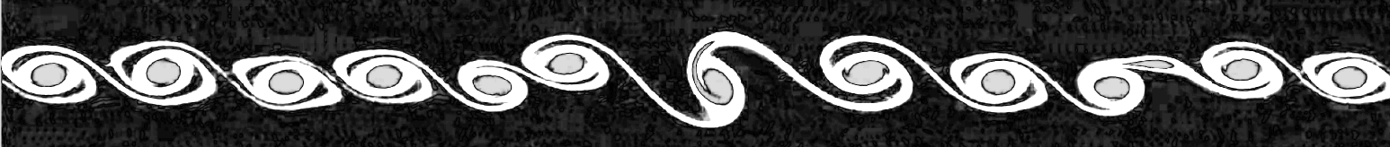
Simulation of Kelvin-Helmholtz instabilities using generalized lattice-Boltzmann methods
Thomas Rothe / Vincent Krabbenborg
19 May 2022
Computational Physics ‘22

Slide 2
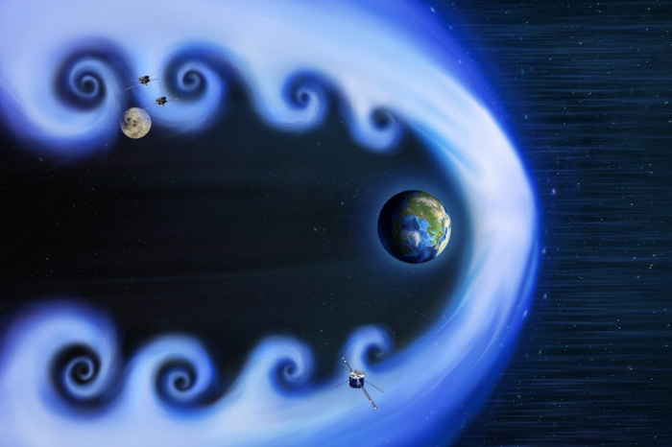
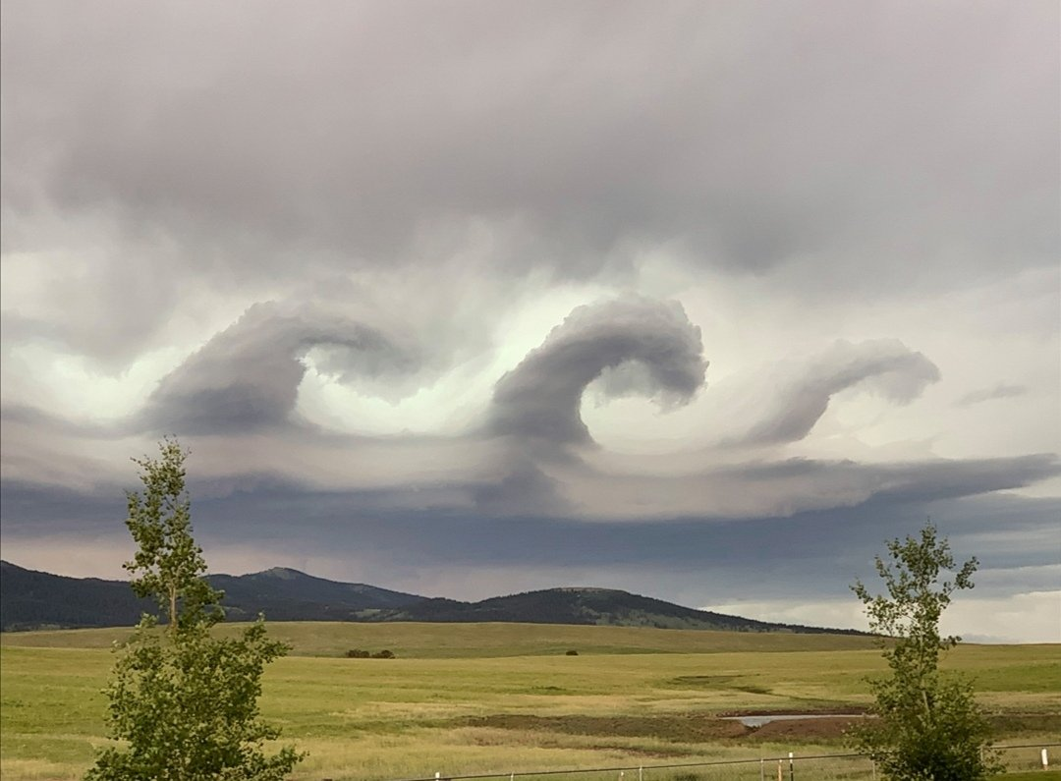

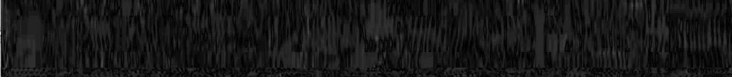
Theory: Kelvin-Helmholtz Instabilities
1

Slide 3
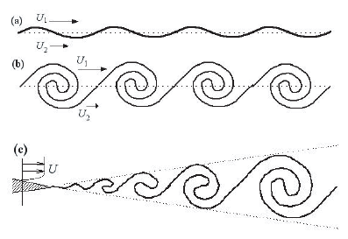
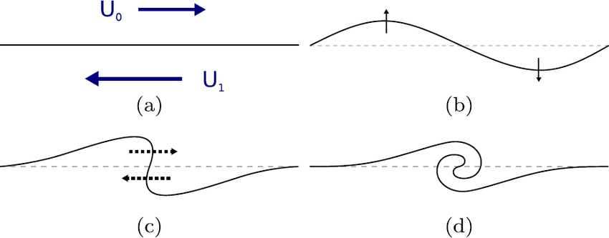
Theory: Kelvin-Helmholtz Instabilities
2

Slide 4
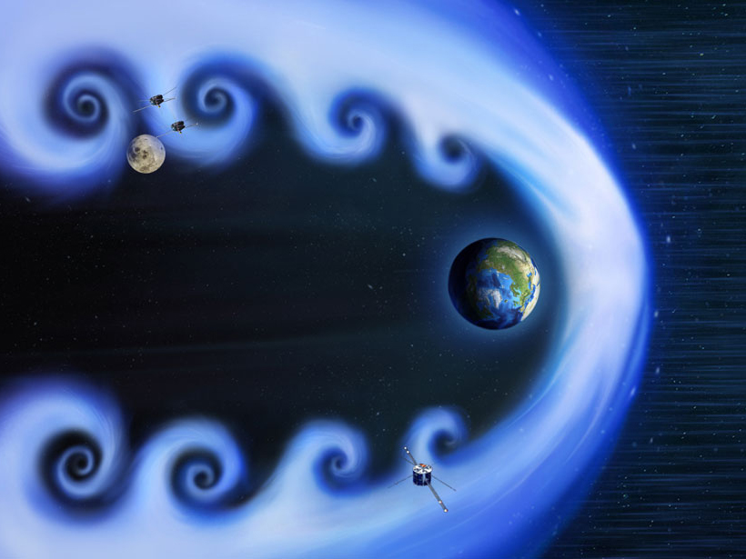
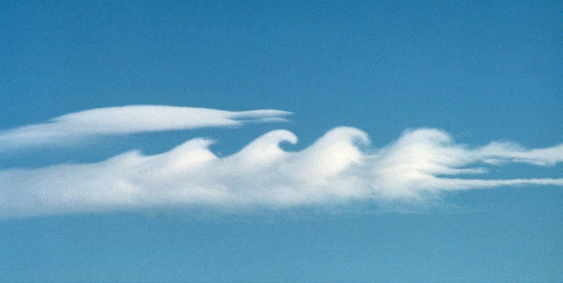
Introduction
[1]
[2]
[1]: https://www.researchgate.net/figure/The-Kelvin-Helmholtz-instability-is-visible-by-clouds-Source-Brooks-Martner-NOAA-ETL_fig9_279953803
[2]: https://eos.org/research-spotlights/measurements-of-kelvin-helmholtz-waves-in-earths-magnetic-field

Slide 5
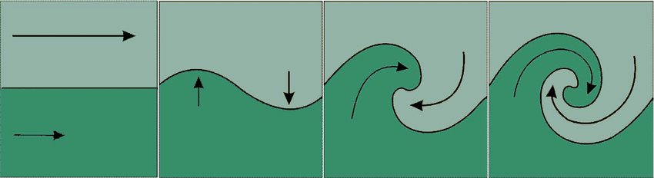
Theory: Kelvin-Helmholtz instabilities
[3]
[3]: https://www.researchgate.net/figure/Kelvin-Helmholtz-instability-in-shear-flow-A-small-velocity-perturbation-perpendicular_fig4_307173953

Slide 6

Theory: Kelvin-Helmholtz instabilities
- Shearing force VS buoyancy force:
$$R_{i}=\frac{buoyancy}{shear}=\frac{N^{2}}{U^{2}}$$
$N=\sqrt{−\frac{g}{ρ}\frac{dρ}{dz}}$ , $U= \frac{1}{2}\left(U_{2}−U_{1}\right)$

Slide 7

Theory: Kelvin-Helmholtz instabilities
- Shearing force VS buoyancy force:
Using the Taylor-Goldstein equation one can deduce:
$$R_{i}>\frac{1}{4} →laminar$$
$$R_{i}<\frac{1}{4} →turbulent$$
Why ¼ and not 1?

Slide 8
Theory: Kelvin-Helmholtz Instabilities
3

Slide 9

$$\frac{∂ }{∂t}\left(ρ u\right)+∇⋅\left(ρ u⊗u\right)= − ∇p +μ ∇^{2} u +\frac{1}{3}μ ∇ (∇⋅u) +ρg$$
Theory: Boltzmann Equation
3

Slide 10
Theory: Lattice-Boltzmann Equation (LBE)
4

Slide 11
Theory: Moment space and the LBE -> GLBE
4

Slide 12
Results: Validating dynamics
?

Slide 13
Conclusion / Summary
?

Slide 14

Simulation of Kelvin-Helmholtz instabilities using generalized lattice-Boltzmann methods
[Take-home message]
Thomas Rothe
Vincent Krabbenborg
github.com/Vinnert/Computational-Physics

Slide 15
References
[ 1 ] Chapter 14 of J.M. Thijssen (2007), Computational physics, Cambridge University Press
[ 2 ] P. Lallemand & L.S. Luo (2000), Theory of the lattice Boltzmann method: Dispersion, dissipation, isotropy, Galilean invariance, and stability, Physical Review E, 6 (61), 6546-6562,
[ ? ] M. Barbulescu & Erdélyi (2018), Magnetoacoustic Waves and the Kelvin–Helmholtz Instability in a Steady Asymmetric Slab: I: The Effects of Varying Density Ratios, Solar Physics. 293
[ ? ] L. Gramer (2007), Kelvin-Helmholtz instabilities

