Slide 1
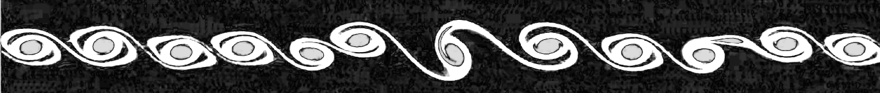
Simulation of Kelvin-Helmholtz instabilities using generalized lattice-Boltzmann methods
Thomas Rothe / Vincent Krabbenborg
19 May 2022
Computational Physics ‘22

Slide 2
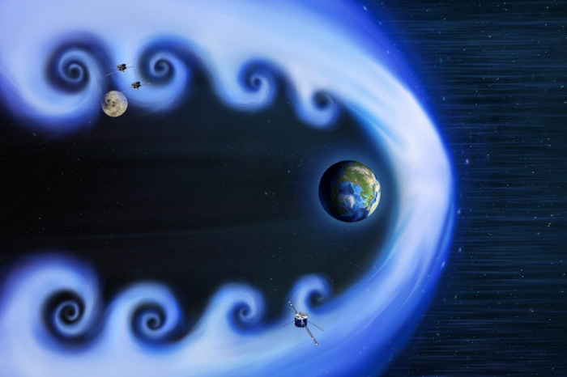
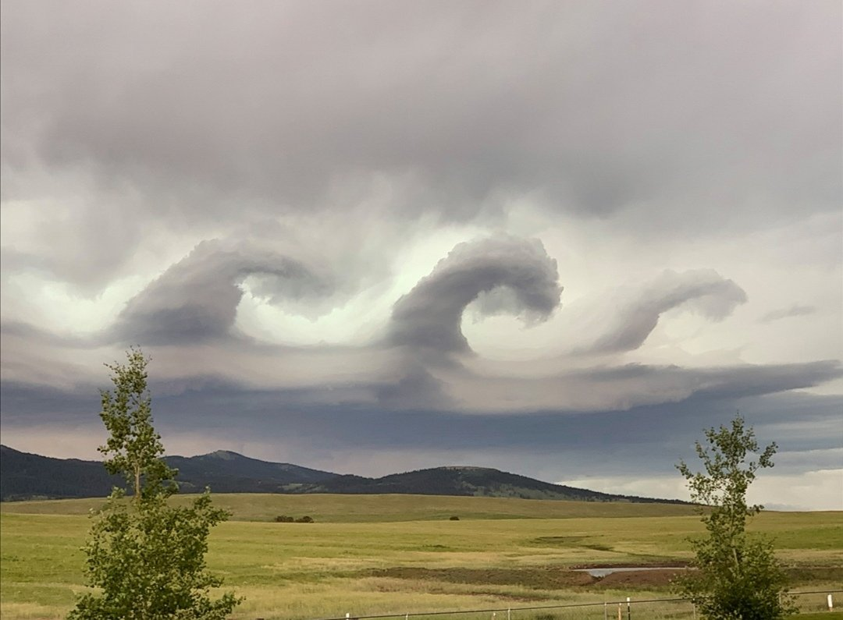

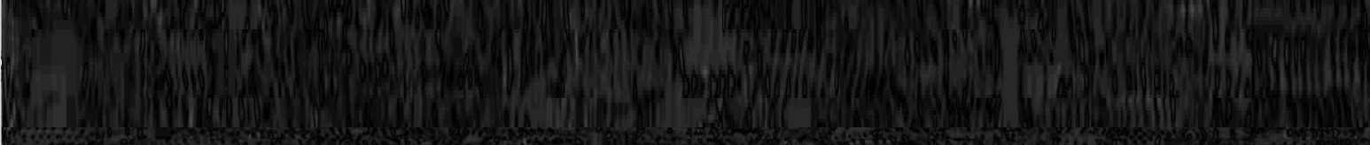
Theory: Kelvin-Helmholtz Instabilities
1

Slide 3
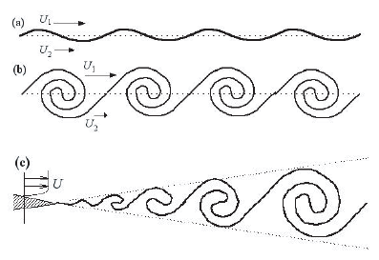
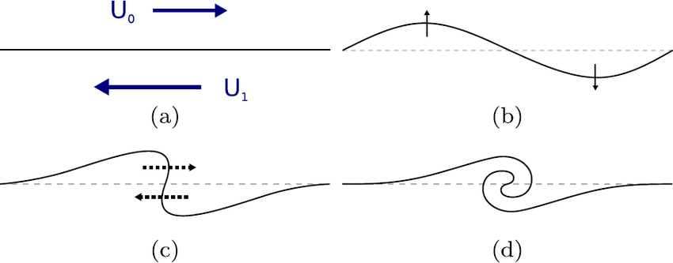
Theory: Kelvin-Helmholtz Instabilities
2

Slide 4
Theory: Kelvin-Helmholtz Instabilities
3

Slide 5

$$\frac{∂ }{∂t}\left(ρ u\right)+∇⋅\left(ρ u⊗u\right)= − ∇p +μ ∇^{2} u +\frac{1}{3}μ ∇ (∇⋅u) +ρg$$
Theory: Boltzmann Equation
3

Slide 6
Theory: Lattice-Boltzmann Equation (LBE)
4

Slide 7
Theory: Moment space and the LBE -> GLBE
4

Slide 8
Results: Validating dynamics
?

Slide 9
Conclusion / Summary
?

Slide 10

Simulation of Kelvin-Helmholtz instabilities using generalized lattice-Boltzmann methods
[Take-home message]
Thomas Rothe
Vincent Krabbenborg
github.com/Vinnert/Computational-Physics

Slide 11
References
[ 1 ] Chapter 14 of J.M. Thijssen (2007), Computational physics, Cambridge University Press
[ 2 ] P. Lallemand & L.S. Luo (2000), Theory of the lattice Boltzmann method: Dispersion, dissipation, isotropy, Galilean invariance, and stability, Physical Review E, 6 (61), 6546-6562,
[ ? ] M. Barbulescu & Erdélyi (2018), Magnetoacoustic Waves and the Kelvin–Helmholtz Instability in a Steady Asymmetric Slab: I: The Effects of Varying Density Ratios, Solar Physics. 293
[ ? ] …

