Slide 1
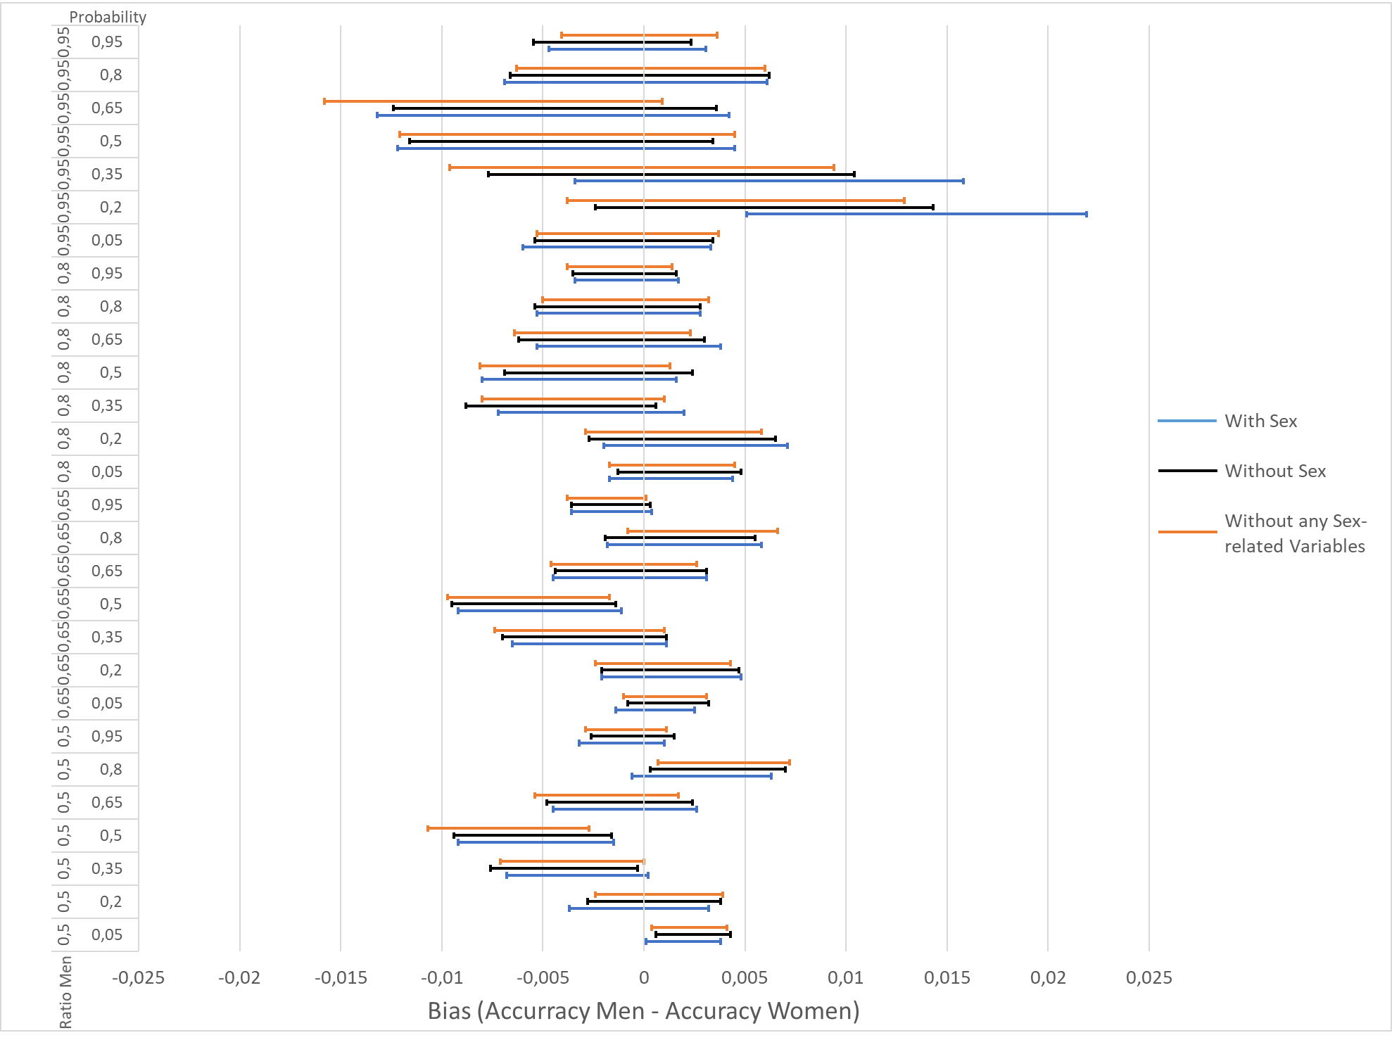
Hypothesis 1: No Bias if label distribution is the same in both populations
Hypothesis holds true up to an overrepresentation of 80% of one population
Women are favoured when probability is around 50 %
No Improvement when removing the sensible variables

Slide 2
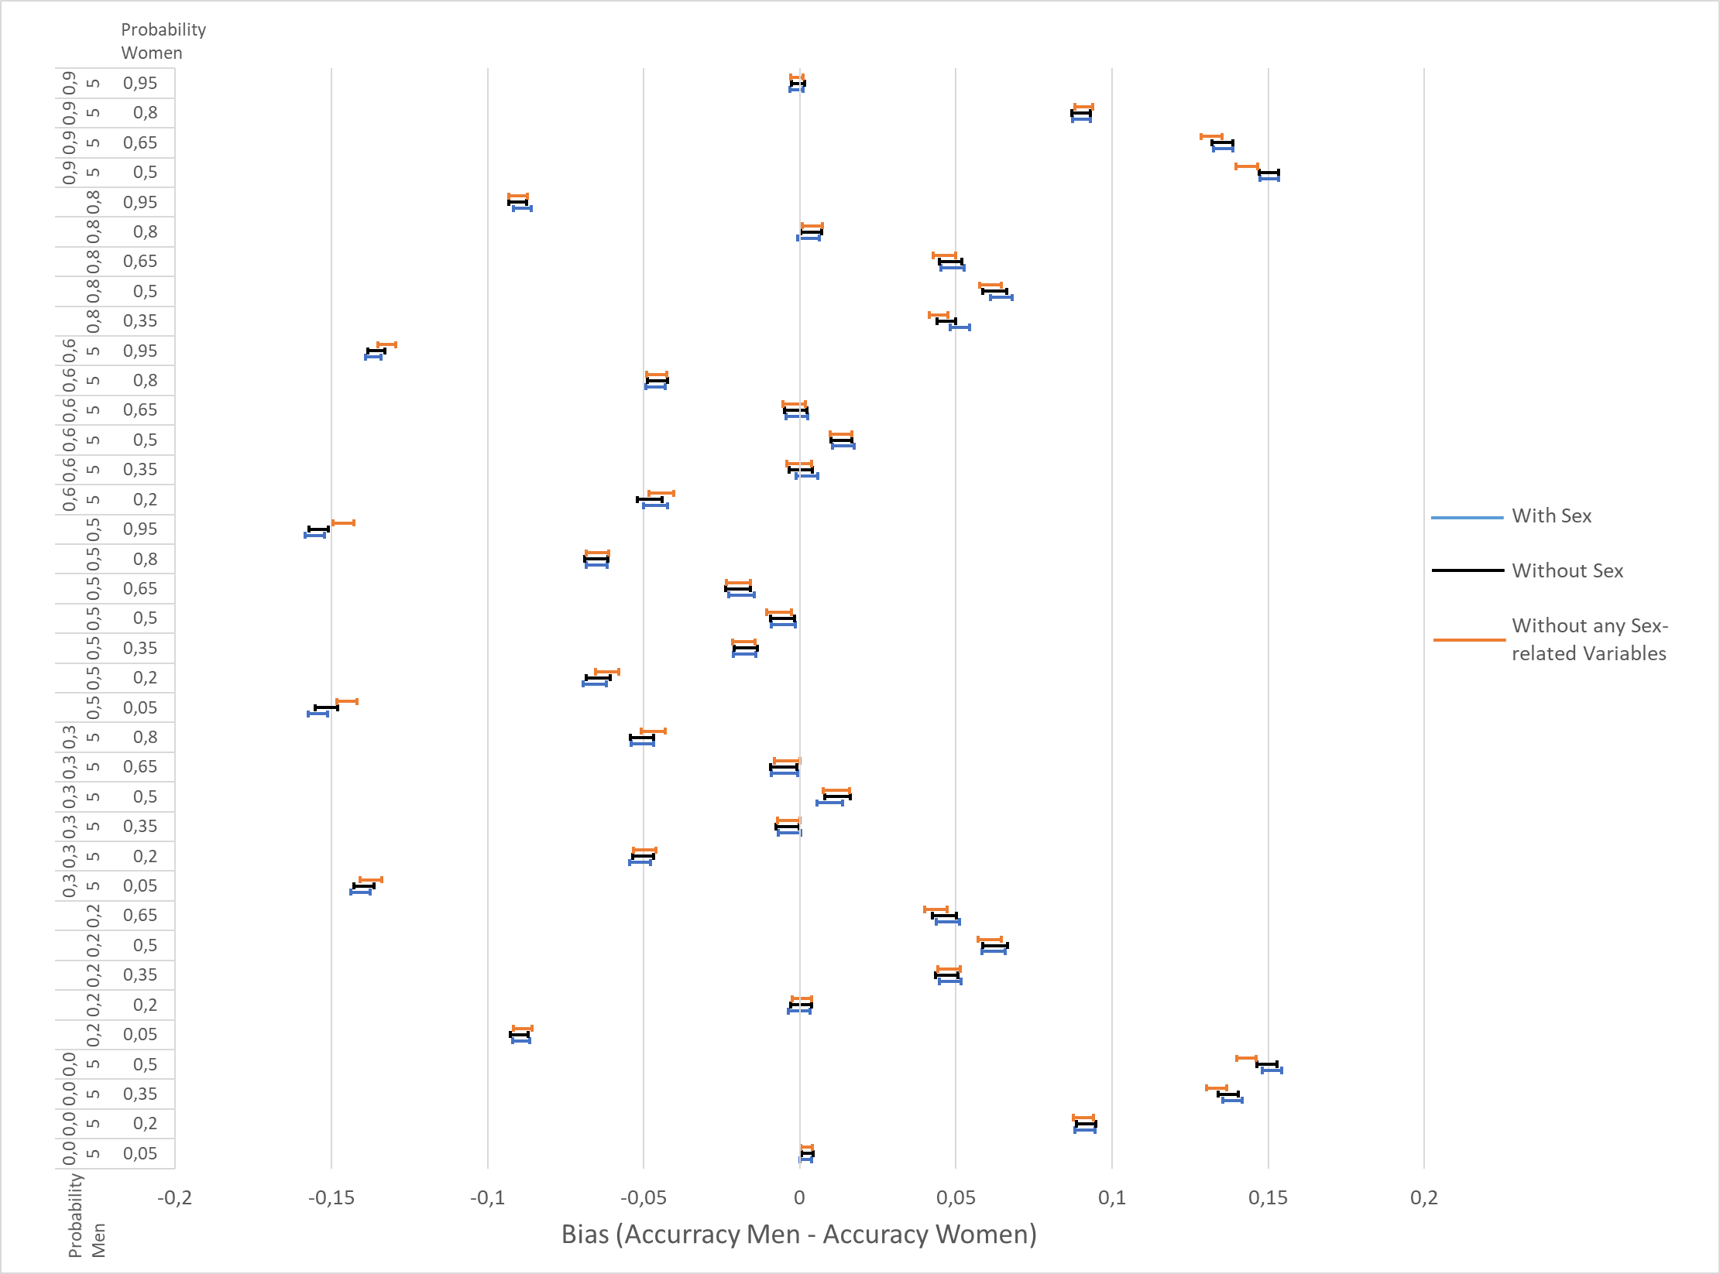
Hypothesis 2: No Bias if no population is overrepresened
Hypotheses holds not true

