Slide 1
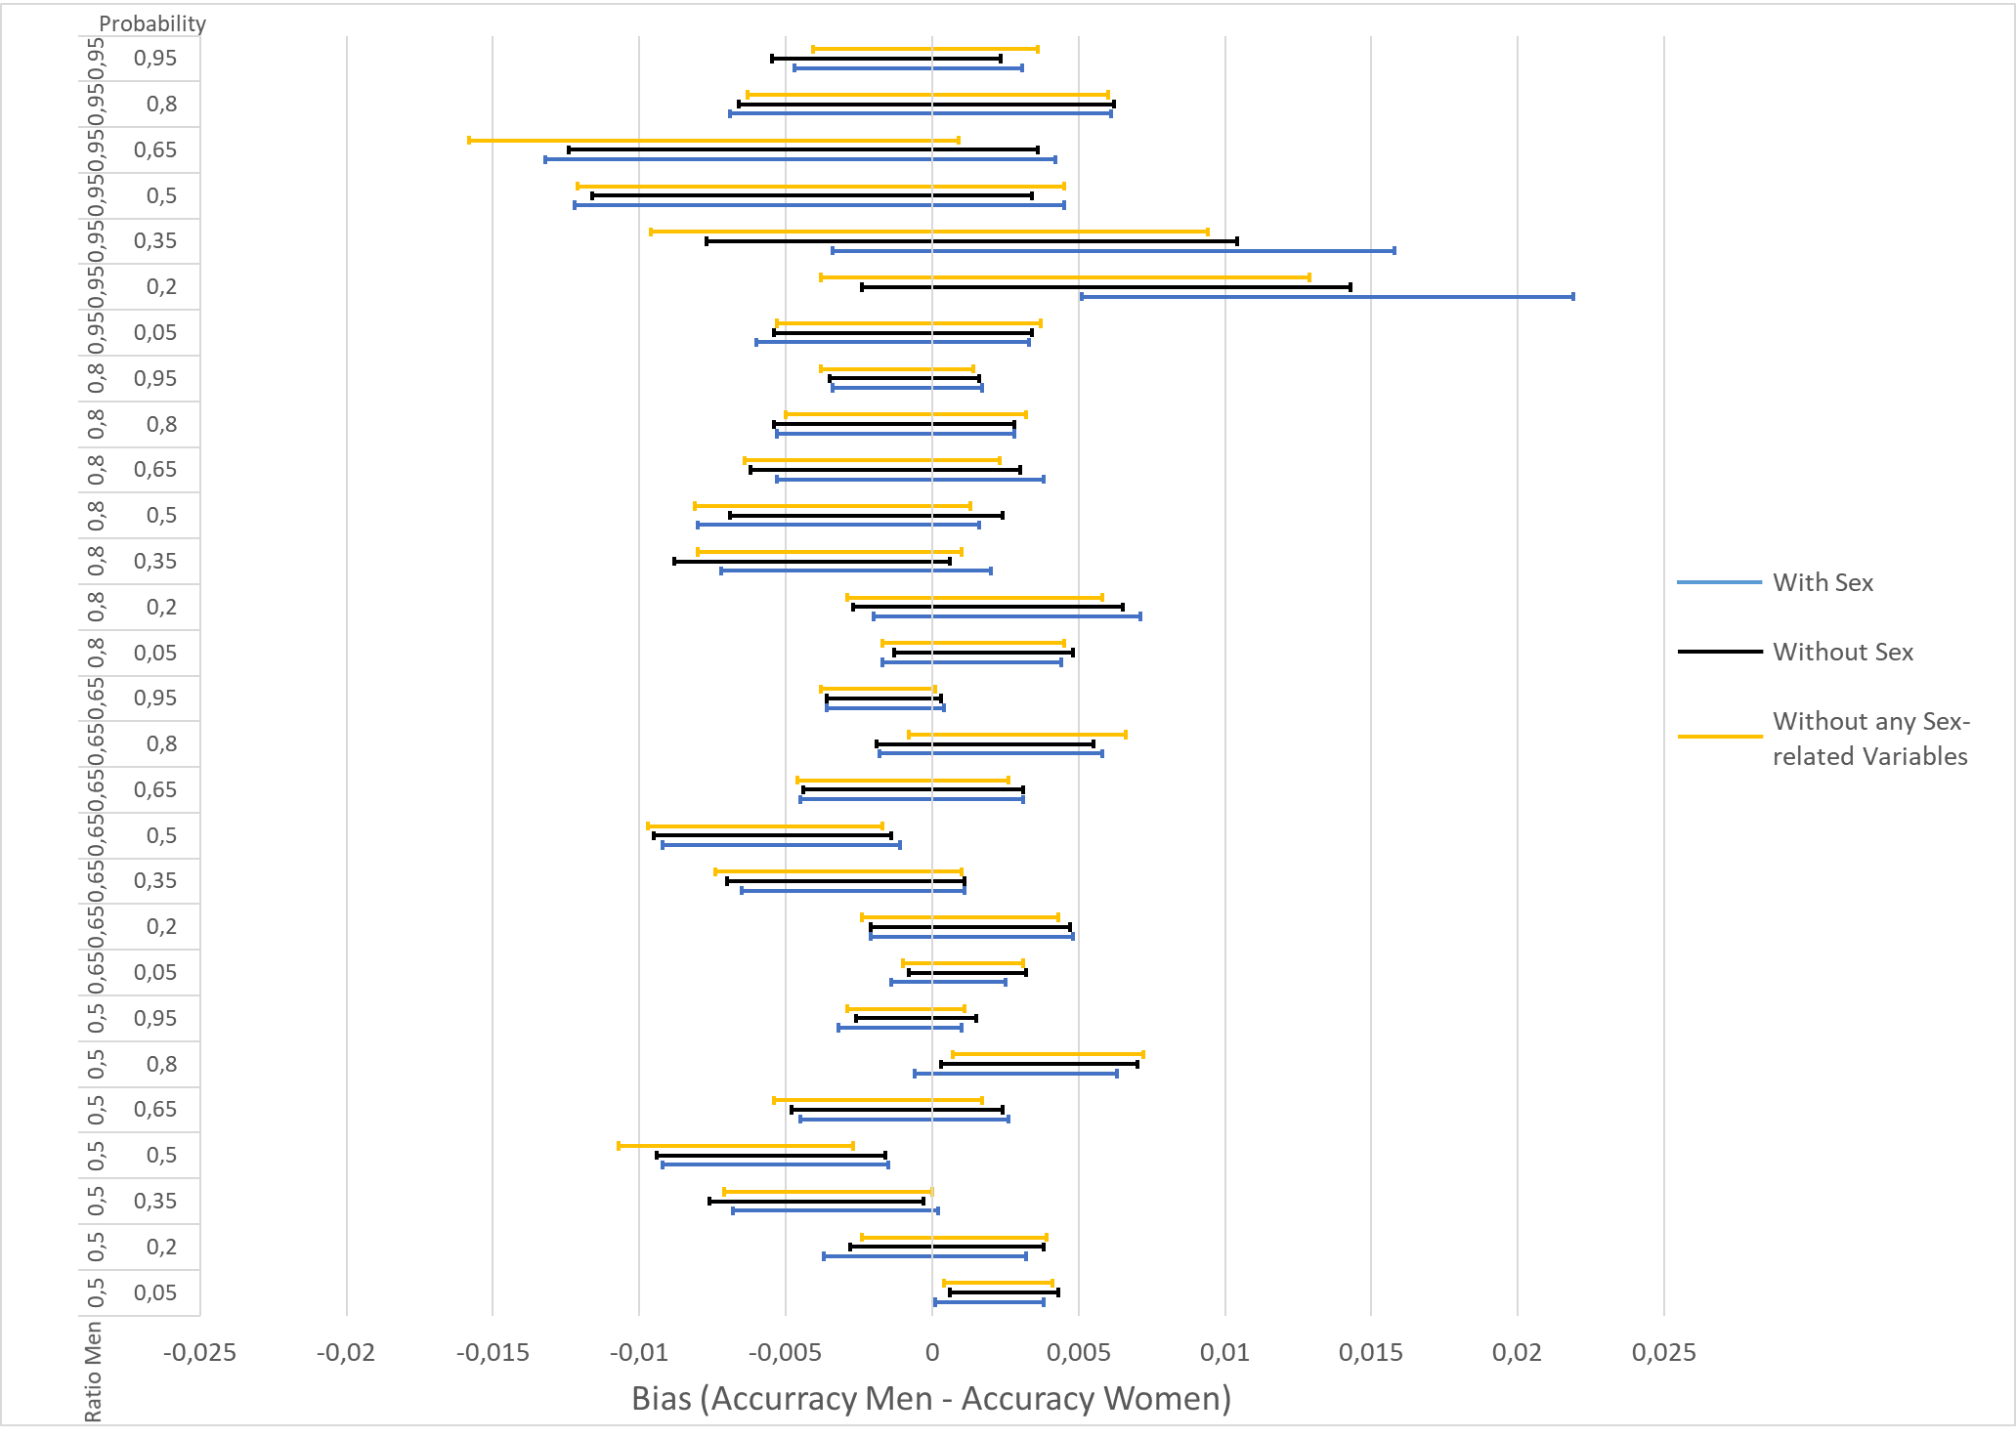
Hypothesis 1: No Bias if label distribution is the same in both populations
Hypothesis holds true up to an overrepresentation of 80% of one population
Women are favoured when probability is around 50 %
No Improvement when removing the sensible variables

