Slide 1


UG PROJECT 2025-26
EC22711 - Project Work Phase - I Viva-Voce
RISC-V Trace Verification: Block Level CoCoTb based Verification in Shakthi C-Class Processor
Supervisor
Mr. Silambarasan D
Assistant Professor
Department of ECE
Members of students: (C21)
Srinath S (No.: 2127220701138)
Vijai Saravanan R G (No.:2127220701160)

Slide 2
Problem Statement
• Traditional verification focuses only on the final output correctness of processor execution.
• A processor may still produce the correct output even when the internal instruction execution sequence is incorrect.
• Such hidden deviations can cause undetected bugs in:
1. Branch and control-flow execution
2. Privilege mode transitions (U/S/M)
3. CSR operations and system control behavior
4. Trap/exception handling
• Debugging becomes difficult without visibility into the actual execution path.
• There is a need to verify the instruction-by-instruction execution flow of Shakti C-Class to ensure strict compliance with the RISC-V ISA and Privileged Specifications.

Slide 3
Proposed Solution
• Develop a block-level trace verification methodology for Shakti C-Class RISC-V processor.
• Use CoCoTb, a Python-based verification framework, to monitor internal RTL signals during execution.
• Capture the Program Counter (PC) trace for every executed instruction.
• Compare the logged execution trace against:
1. Expected flow from disassembly
2. Reference behaviour validated using Verilator
3. RTL generated dump trace
• Detect missing, skipped, or misaligned instruction events and analyze trace visibility gaps.

Slide 4
Objectives
• To design and implement a CoCoTb-based block-level trace verification environment for Shakti C-Class RISC-V processor.
• To capture and log PC traces during RTL simulation of RISC-V assembly test programs.
• To validate instruction execution flow against the RISC-V ISA and Privileged Architecture specifications.
• To identify and analyze missing or untraced instruction patterns across multiple RISC-V test suites.
• To build a trace verification methodology that acts as a foundation for full core-level and data-trace verification.

Slide 5
Why RISC-V and Shakti C-Class?
Why RISC-V?
• Open-source Instruction Set Architecture (ISA) with no licensing cost.
• Modular and extensible design → supports custom extensions for research and industry.
• Widely adopted for academia, embedded systems, IoT, and processor R&D.
• Scalable architecture supporting standard extensions such as I, M, A, F, D, C.
• Enables transparent verification and open-source hardware development.

Slide 6
Why RISC-V and Shakti C-Class?
Why Shakti C-Class?
• Developed by IIT Madras as part of India’s open-source processor initiative.
• 64-bit RV64IM core suitable for mid-range embedded and IoT applications.
• Supports User, Supervisor, and Machine modes as per RISC-V Privileged Spec.
• Includes integrated debug and trace support required for verification and validation.
• Strengthening Shakti verification contributes to India’s indigenous semiconductor ecosystem.

Slide 7
RISC-V Execution Modes
Execution Modes:
1. Machine Mode (M-Mode):
Full-access mode used for system control and boot.
2. Supervisor Mode (S-Mode):
OS mode that manages memory and system protection.
3. User Mode (U-Mode):
Application mode with limited access for safety.
Why It Matters in Verification:
Execution modes ensures secure and correct switching between modes.

Slide 8
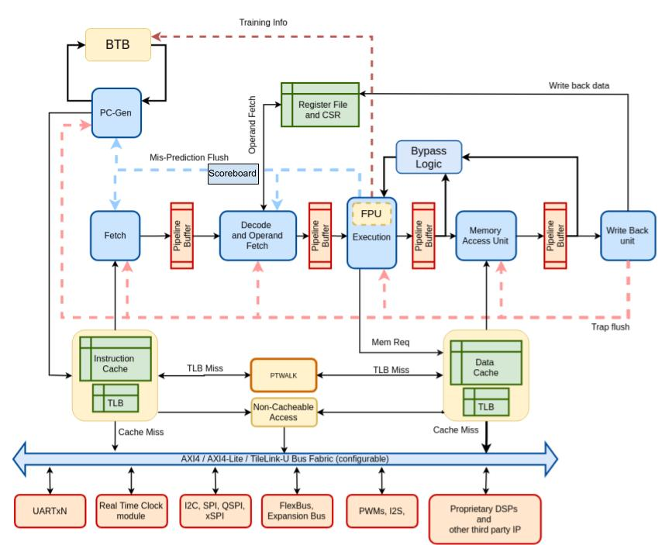
Shakti C-Class Architecture

Slide 9
What is Trace Verification
Trace Verification
• A verification technique that validates the exact sequence of instructions executed by the processor.
• Ensures that the processor follows the correct architectural flow, not just the correct final output.
• Helps detect hidden design bugs that may not reflect in output-based verification.
Why is it Important?
A processor may produce the correct final result even when internal execution steps are wrong.
Identifies issues in:
• Branch and jump execution
• Pipeline flush and control-flow handling
• CSR operations and privilege mode transitions
• Trap/exception entry and return sequences

Slide 10
Instruction Trace
• Instruction Trace ensures the processor follows the correct architectural execution flow as defined by the RISC-V ISA.
• It validates the Program Counter (PC) sequence to confirm proper control-flow throughout program execution.
• Enables detection of subtle internal design issues that may not appear in output-based verification, such as:
• Missing or untraced instructions
• Incorrect branch/jump behaviour
• Unauthorized privilege level changes
• Missed traps or CSR operations
• Traced PC values from RTL simulation are compared against the expected flow obtained from the program disassembly.

Slide 11
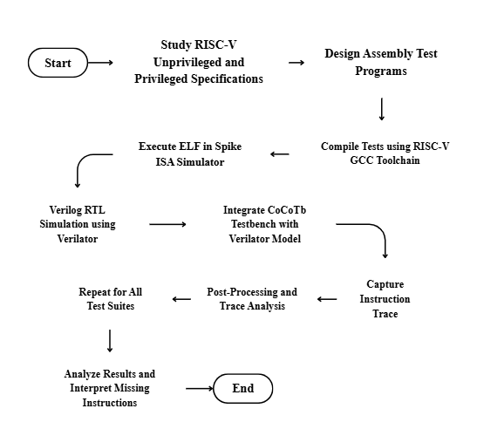
Workflow

Slide 12
Trace Components
Trace Encoder
• Hardware block that captures instruction execution information.
• Records key details like PC values for trace visibility.
Trace Packet
• Trace data is compressed into small packets for efficient storage/transfer.
• Helps in reconstructing the execution flow later.
Trace Decoder
• Software/logic that reads and interprets trace packets.
• Rebuilds the instruction sequence for verification and analysis.

Slide 13
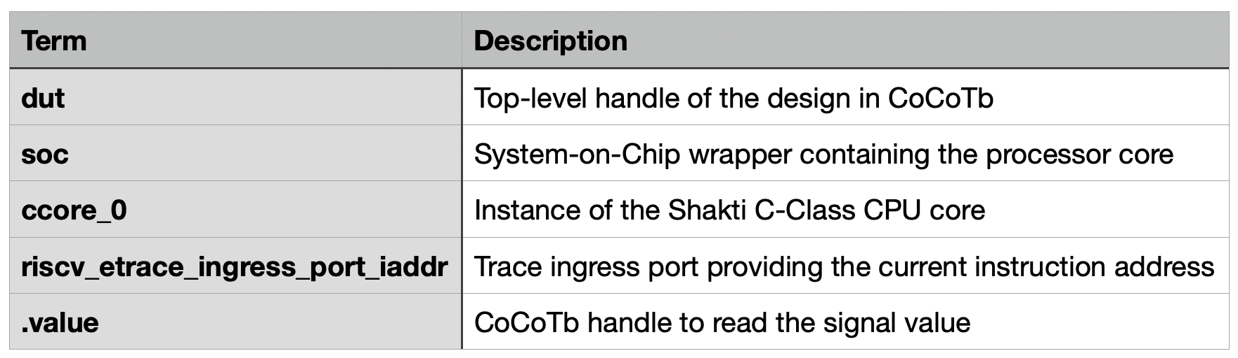
PC Trace Capture in CoCoTb
During simulation, the PC value is obtained by referencing the trace ingress signal within the RTL hierarchy using the following CoCoTb handle:
dut.soc.soc.ccore_0.riscv_etrace_ingress_port_iaddr.value
Table: Signal Hierarchy Used to Access PC:

Slide 14
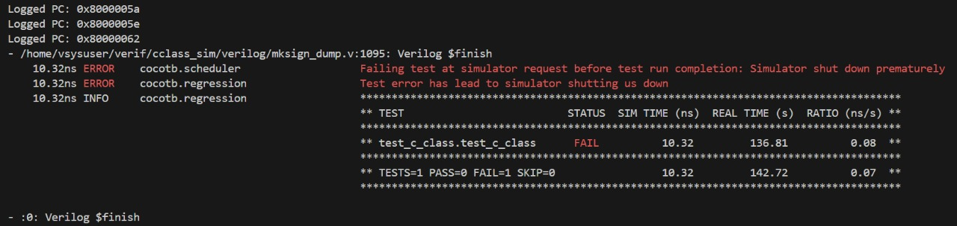
CoCoTb Result

Slide 15
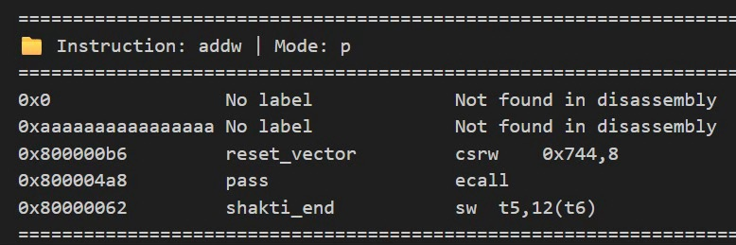
Missing Instruction
Missing Instruction Analysis – ADDW Test
• Some instruction addresses in the disassembly were not captured in the trace log.
• Missing PCs were mapped to their corresponding assembly instructions.
• These instructions executed correctly but were not traced, showing trace visibility gaps

Slide 16
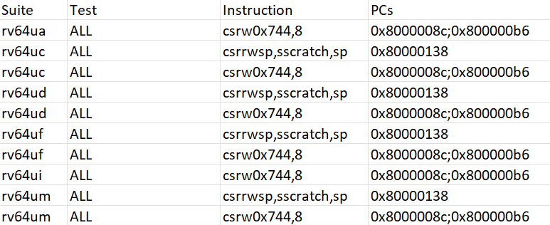
Final Analysis of I-Trace [Results]

Slide 17
References
[1] RISC-V Foundation, The RISC-V Instruction Set Manual, Volume I: Unprivileged ISA, Version 20191213, pp. 1–229, 2019.
[2] RISC-V Foundation, The RISC-V Privileged Architecture Specification, Version 1.12, pp. 1–141, 2021.
[3] Shakti Project, C-Class Core Documentation, Indian Institute of Technology Madras, India, 2024.
[4] Vyoma Systems, Industrial Verification Framework for Shakti Processors, Technical Documentation, Vyoma Systems Pvt. Ltd., Bengaluru, India, 2025.
[5] CoCoTb Developers, CoCoTb: Coroutine-based Co-Simulation Testbench, Version 1.8, pp. 1–96, 2024.
[6] GNU Project, RISC-V GCC Toolchain Documentation, Free Software Foundation, Boston, MA, USA, 2024.
[7] IEEE Standard 1800-2017, IEEE Standard for SystemVerilog – Unified Hardware Design, Specification, and Verification Language, IEEE, New York, USA, 2017.
[8] D. A. Patterson and J. L. Hennessy, Computer Organization and Design: The Hardware/Software Interface, 5th Edition, Morgan Kaufmann Publishers, San Francisco, CA, USA, 2014.
[9] D. Patterson and A. Waterman, The RISC-V Reader: An Open Architecture Atlas, 2nd Edition, Strawberry Canyon LLC, Berkeley, CA, USA, 2017.

