Slide 1
EASE – THE –ERROR 3.0
Problem Statement Title :
(5)Develop an AI-powered chatbot that can provide mental health support to users
Team Name: SOUL BUDDIES
Team Leader Name : THEERAN A
Theme Name : artificial intelligence
College Name : SRI VENKATESWARA COLLEGE OF ENGINEERING, SRIPERUMBUDUR

Slide 2
Why This Problem Statement ?
There are several reasons why developing an AI-powered chatbot for mental health support is a valuable and important problem to tackle:
Accessibility: Mental health support is often inaccessible due to barriers such as social stigma, cost, and location. By developing a chatbot, mental health support can be provided in a more accessible and convenient way for users who may not have access to traditional mental health services.
Privacy: Many people may be hesitant to seek mental health support due to concerns about privacy. With a chatbot, users can feel more comfortable opening up about their struggles in a private and anonymous setting.
Scalability: Mental health services are often limited by the number of trained professionals available to provide support. By utilizing AI-powered chatbots, mental health support can be scaled to reach more people in need.
Personalization: Chatbots can provide personalized mental health support by using algorithms to analyze a user's input and provide tailored responses and resources based on their specific needs.
Overall, an AI-powered chatbot for mental health support has the potential to address some of the major challenges in accessing and providing mental health support, making it a valuable problem to tackle.

Slide 3
Modules and Technology Stack
Openai API
Node.js library
Python3.8 or higher version
Speechrecognition library
Twilio cloud communication platform
Twilio API for whatsapp
nltk library
Random module
Datetime module
Mysql 8.0 and higher
Mysql library
Mysql connector
django web framework
Java script
Pyttx3 (text to speech conversion library)
Plyer (open source library for notifications)
SMTP library
Geopy (Navigation Library)

Slide 4
Work Flow
analysed to make user friendly response
text
or
speech
repond though text or speech
login
mysql
AI analysis
CBT based response creation
stores personal data
analyse and provide best routine
stores medical info
accessing database assigned
good
eased responses
stores data of each day
very bad
reminds to take medicine
analyse data
and classifies
access location
shares location with the close contact
data access
more specific responses
medical advisor
bad

Slide 5
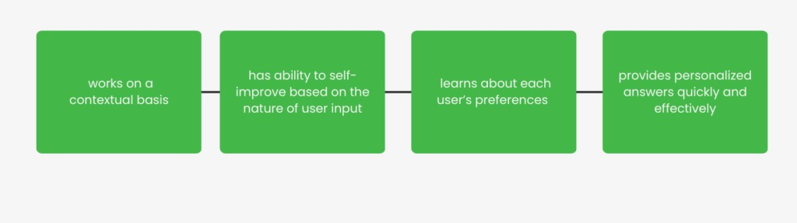




Slide 6
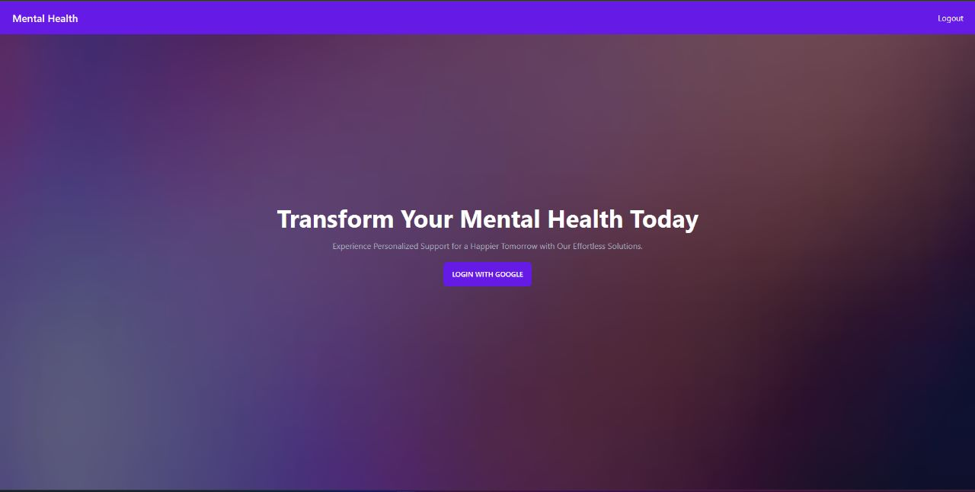

Slide 7
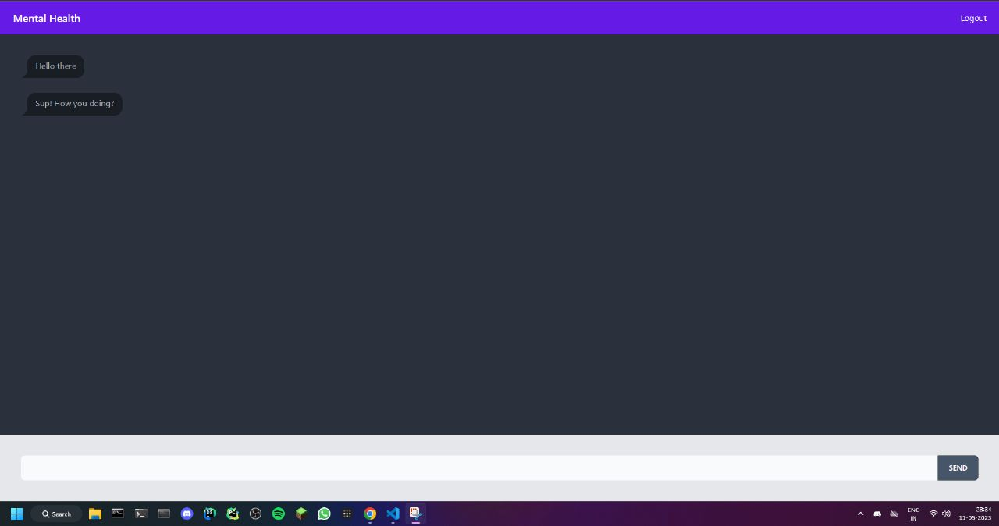

Slide 8
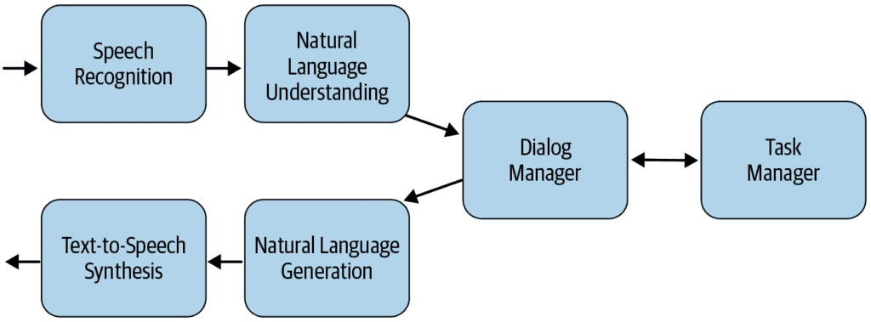

Slide 9
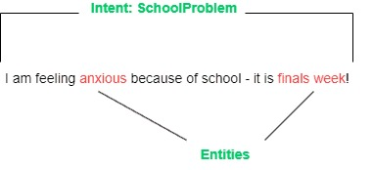

Slide 10
Use Cases and Benefits
Personalized chatbot implemented using AI takes in users inputs as text or speech to text format. The data of daily interactions are stored in the database to make the replies provided by the bot to be suited to the user. The user interactions are used in determining the condition of the user and is classified between good,bad, and very bad. The replies made by the bot varies with the classification. In case when the user’s condition is classified as very bad the location of the person is shared with the close contact through mail along with an alert stating the patient’s mental condition and the steps to be taken. Very bad classification is for severe issues and requires offline health support. The data from the database can be utilised by the medical advior.Apart from normal and simple health support the bot has been developed to provide Cognitive-Behavioral Therapy(CBT). It greets the user with positive quotes and affirmations on regular intervals to lift the person’s mood. It can also provide healthcare support if the person suffers from a disease. It provides a daily routine to follow and also reminds them about their medication. At the end of the day the bot asks few lines obout their day to have a record on their daily lifestyle.

Slide 11
FUTURE FEATURES
Symptom Tracker: The chatbot could prompt users to log any physical or emotional symptoms they are experiencing suggest potential causes.
Sleep Tracker: Poor sleep is a common issue among people with mental health concerns.
Mindfulness Exercises: The chatbot could guide users through mindfulness exercises, such as deep breathing.
Goal Setting: Setting small achievable goals is a key component of cognitive-behavioral therapy.
Community Support: Connecting users with others who are experiencing similar challenges can be helpful for building a sense of community and reducing feelings of isolation.
Music:The chatbot could also keep a playlist of the users favourite songs.

Slide 12
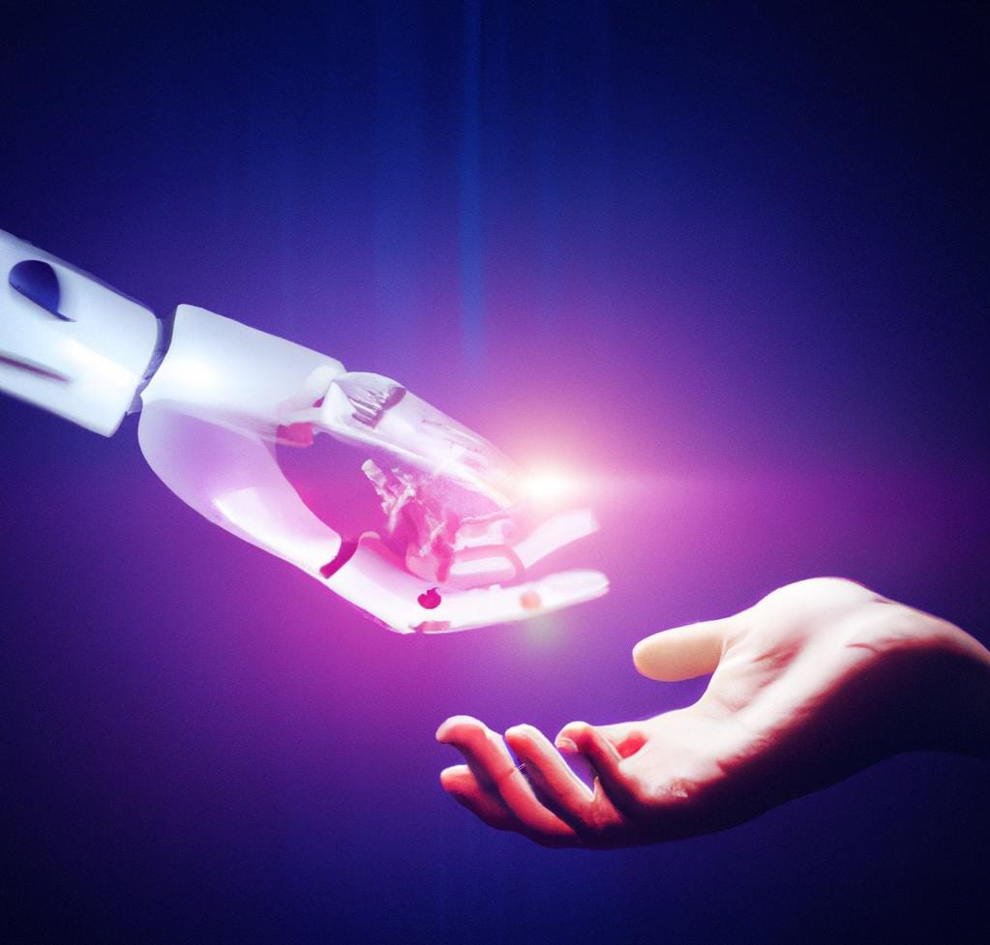
Team Member Details
Leader | Theeran A | B.Tech IT | I Year | Sri Venkateswara College of Engineering (SVCE) | 2022it0121@svce.ac.in | 8489181536
Member 2 | Roshan M | B.E ECE | I Year | Sri Venkateswara College of Engineering (SVCE) | 2022ec0448@svce.ac.in | 9841092274
Member 3 | Vijai Saravanan R G | B.E ECE | I Year | Sri Venkateswara College of Engineering (SVCE) | 2022ec0019@svce.ac.in | 9944793820
Member 4 | Praveen Chandru S | B.Tech IT | I Year | Sri Venkateswara College of Engineering (SVCE) | 2022it0109@svce.ac.in | 9442746731
Special Mention: A Mohammad AaKhil (SNU)

