Slide 1

Expense Tracker
Intern Roll No: MST03-0024
Name: Vijaiey Anand S

Slide 2
Introduction
Efficient finance management for healthier lifestyle
Instant Insight for better understanding
Visualize Your Expense
Financial Empowerment

Slide 3
Objective
Efficient expense management and visualization:
Easier input
Dynamic visualization
Empowering users for smarter financial decisions:
Financial Awareness
Data-Driven Insights
User-Friendly Tools

Slide 4
Tech Stack
Python:
Python as the programming language for the application.
Pandas:
Simplifying data handling. Demonstration of loading and saving expenses using Pandas.
Streamlit:
Streamlit for creating web applications with simple Python scripts. Streamlit components for user interaction (select boxes, buttons, etc.).
Plotly :
Plotly Express for interactive data visualization. Creation of bar charts and pie charts for visualizing expenses. Displaying total expenses and category-wise distribution.

Slide 5
Function Usage
Overview of functions such as
add_expense
load_expenses
save_expenses
display_expenses
delete_all_expenses
main

Slide 6
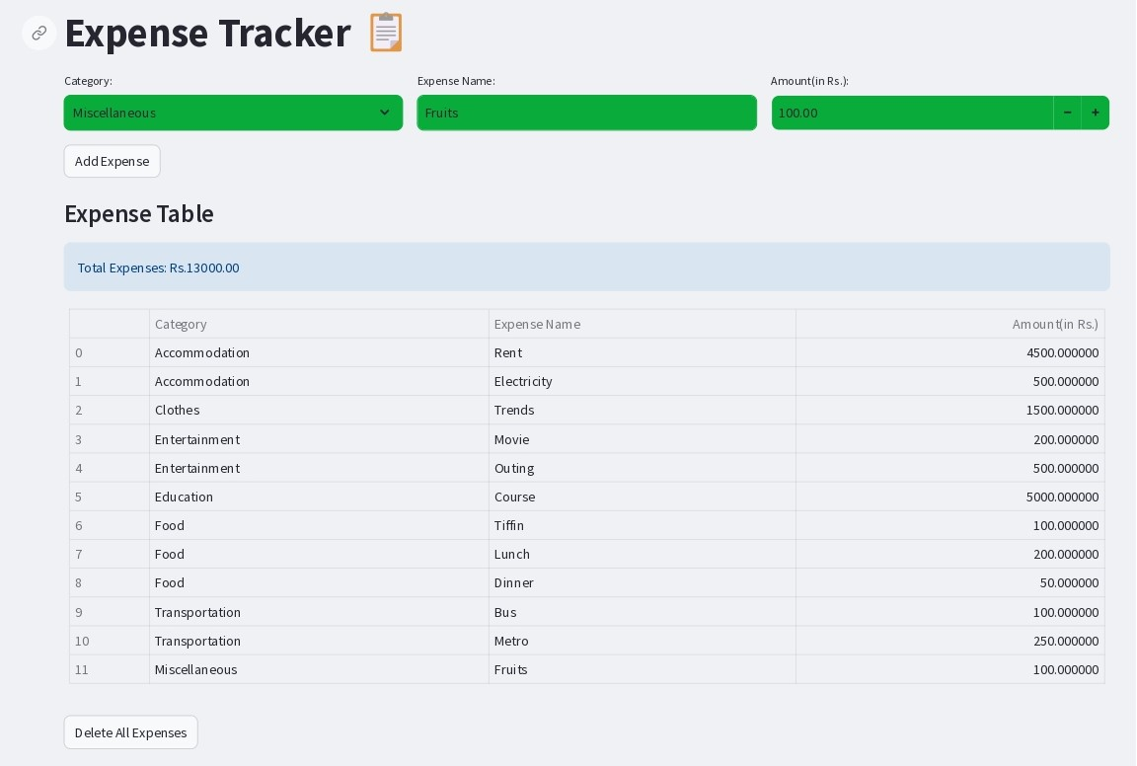

Slide 7
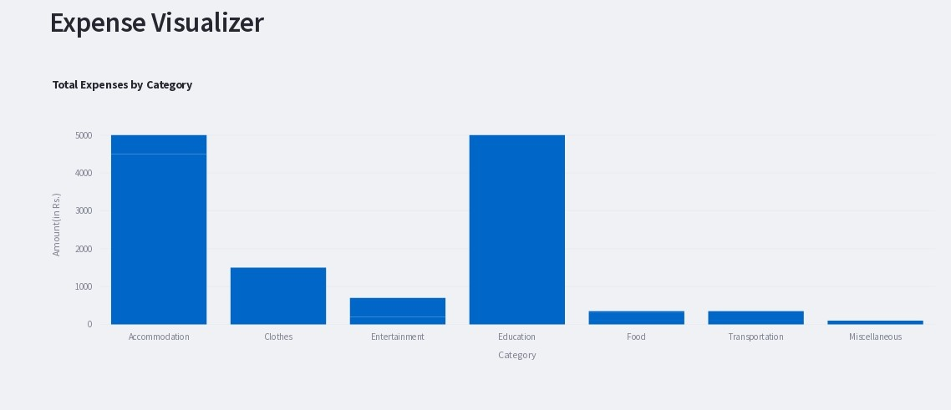
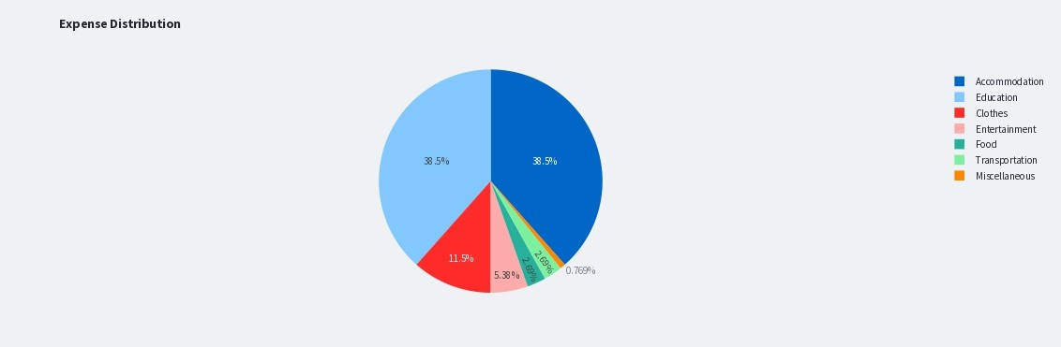
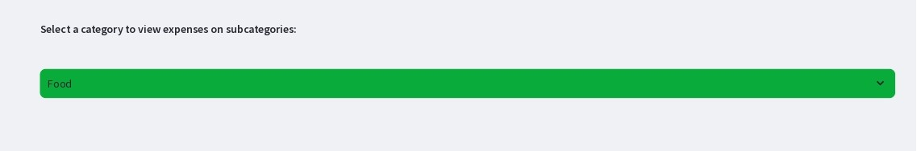
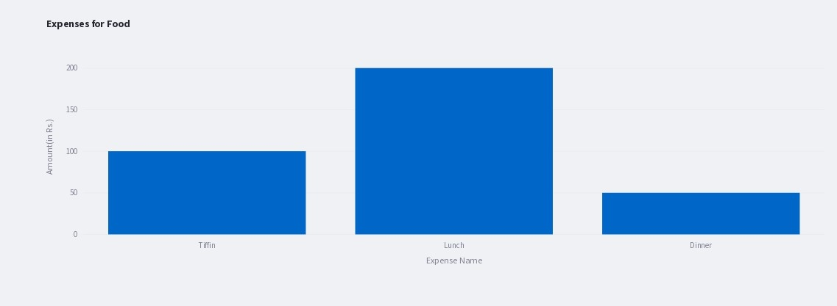

Slide 8
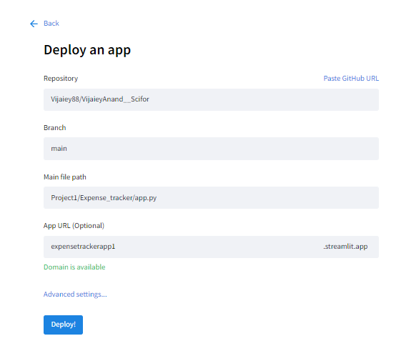
App Deployement
This app is deployed in streamlit which access github repository for the backend operations.
App Link: https://expensetrackerapp.streamlit.app/

Slide 9
Conclusion
In conclusion, this Simple Expense Tracker stands as a user-friendly solution for effective financial management.
With easier data input, dynamic visualizations, and key insights at your fingertips, it empowers you to make informed decisions about your expenses.

Slide 10
Thank You

