Slide 1

Expense Tracker
Intern Roll No: MST03-0024
Name: Vijaiey Anand S

Slide 2
Introduction
Keep your financial health in check.
This apps is a easier way of managing expenses providing a clear overview of your expenditures.
Make informed financial decisions by understanding where your money goes, empowering you to budget effectively.
Gain instant insights into your spending patterns and financial health with dynamic visualizations.
Take control of your financial journey—start using our Expense Tracker to effortlessly monitor, analyze, and optimize your expenses.

Slide 3
Objective
Efficient expense management and visualization.
Empowering users for smarter financial decisions.

Slide 4
Technology Stack
Python:
Python as the programming language for the application.
Pandas:
Simplifying data handling. Demonstration of loading and saving expenses using Pandas.
Streamlit:
Streamlit for creating web applications with simple Python scripts. Streamlit components for user interaction (select boxes, buttons, etc.).
Plotly :
Plotly Express for interactive data visualization. Creation of bar charts and pie charts for visualizing expenses. Displaying total expenses and category-wise distribution.

Slide 5
Function Usage
Overview of functions such as
add_expense
load_expenses
save_expenses
display_expenses
delete_all_expenses
main

Slide 6
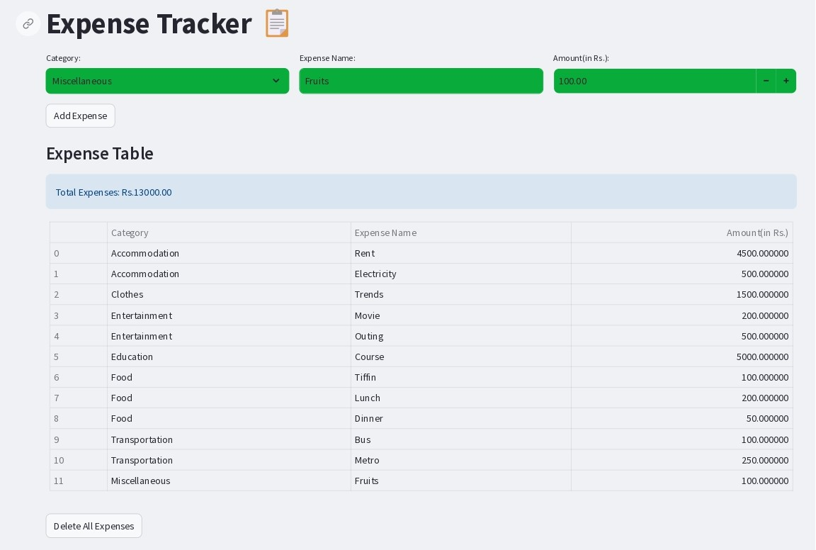

Slide 7
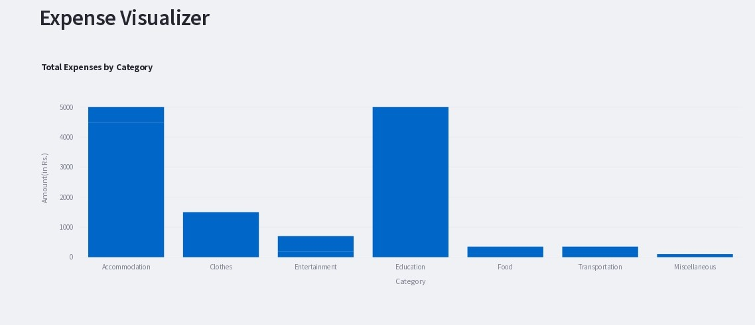
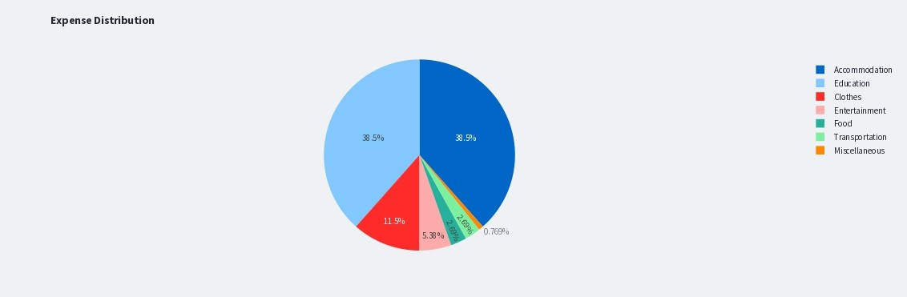
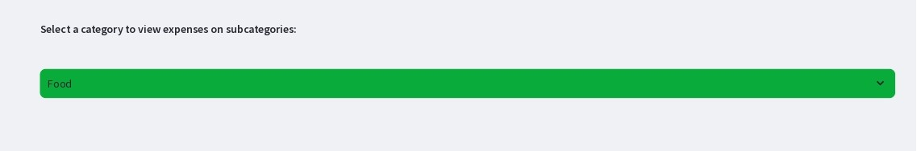
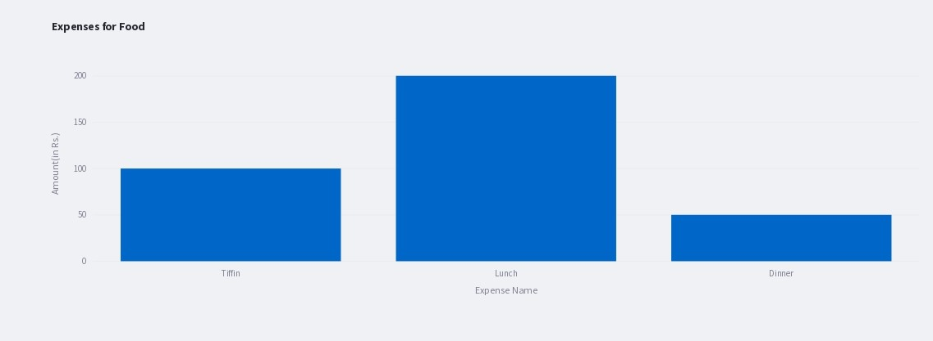

Slide 8
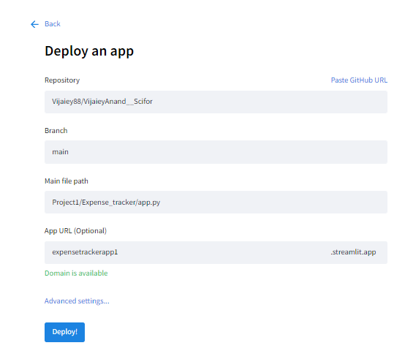
App Deployement
This app is deployed in streamlit which access github repository for the backend operations.
App Link: https://expensetrackerapp.streamlit.app/

Slide 9
Conclusion
In conclusion, this Simple Expense Tracker stands as a user-friendly solution for effective financial management.
With easier data input, dynamic visualizations, and key insights at your fingertips, it empowers you to make informed decisions about your expenses.
Start your journey towards financial wellness today – experience the ease, clarity, and control that our Expense Tracker brings to your financial life.

Slide 10
Thank You

