Slide 1
Expense Tracker
Submitted by
Intern Roll No: MST03-0024
Name: Vijaiey Anand S

Slide 2
Introduction
Efficient finance management for healthier lifestyle
Instant insights for better understanding
Visualize your expenses
Financial empowerment

Slide 3
Objective
To make simple and interactive visualization application
Empowering users for smarter financial decisions

Slide 4
Tech Stack
Python:
Python as the programming language for the application.
Helps integrating various library seamlessly.
Pandas:
Data handling such as
Load Data
Manipulate Data
Save Data
Organize Data
Facilitate Visualization

Slide 5
Streamlit:
User Interface Design
Widgets and Controls
Dynamic Updates
Integration with Python
Web Deployment
Plotly :
Data Visualization
Interactivity
Insightful Charts

Slide 6
Function Usage
Overview of functions such as
add_expense
load_expenses
save_expenses
display_expenses
delete_all_expenses
main
Github link for code

Slide 7
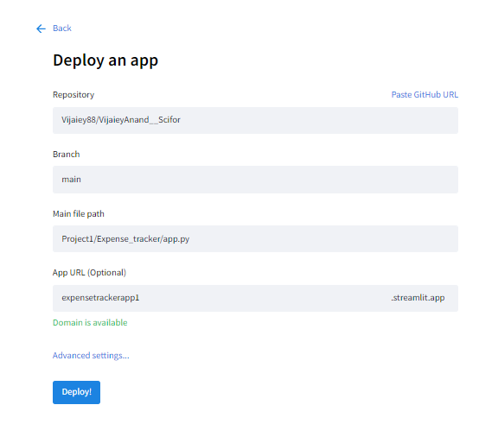
App Deployement
Deployed with Streamlit connecting backend code using Github.
App Link

Slide 8
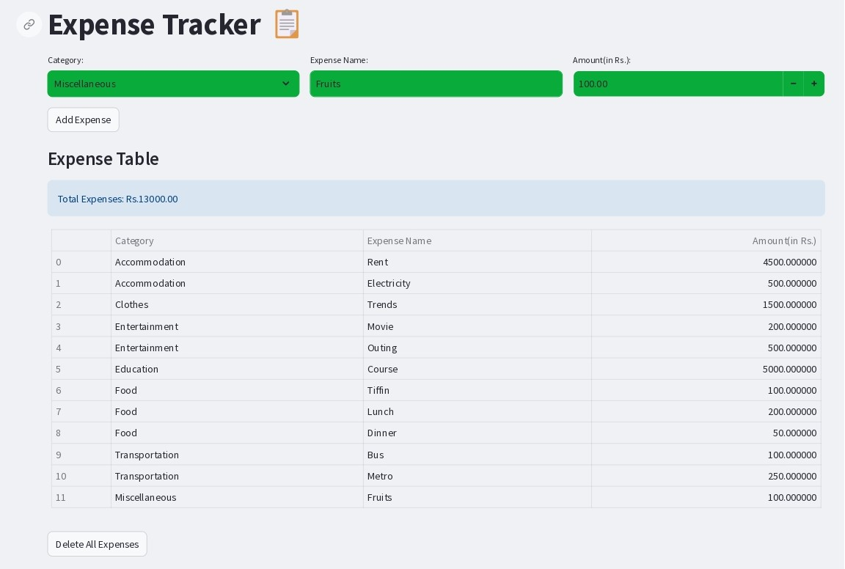

Slide 9
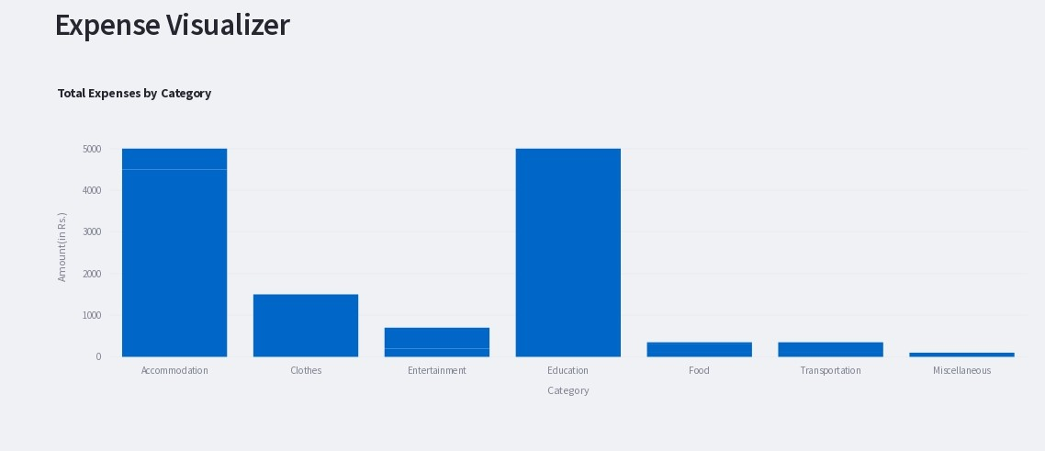
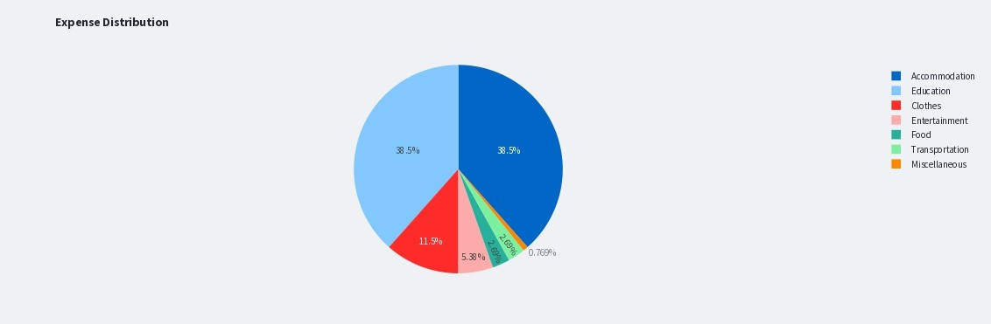
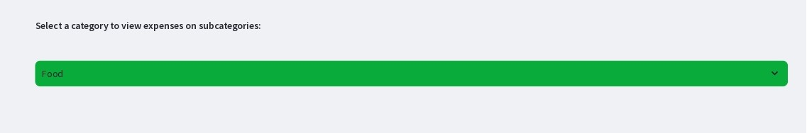
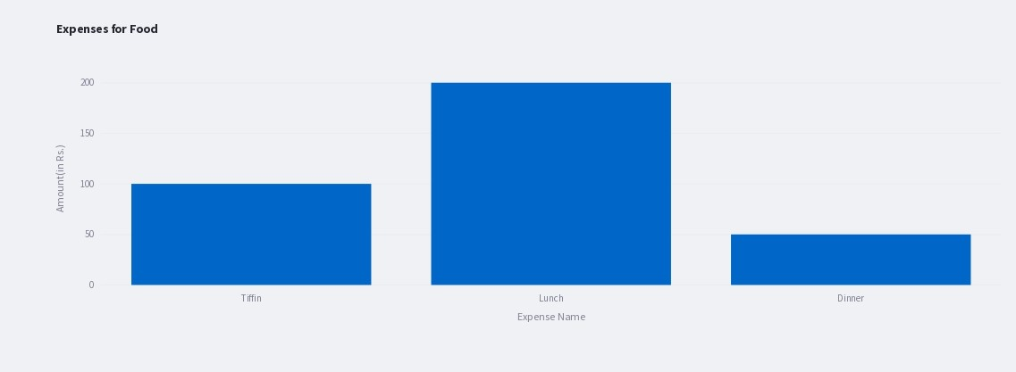

Slide 10
Conclusion
User-friendly solution for effective financial management
Dynamic visualization
Key insights at your fingertips
Informed decisions
Know where you are spending

Slide 11
Thank You

