Slide 1
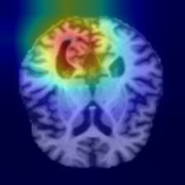
⚕ Department of Computer Science & Engineering
Explainable Deep Learning-Based
Multi-Stage Alzheimer's Disease
Detection Using Brain MRI
Alzheimer's Disease Detection & Explainability System
Team Members:
Parvati Revannavar | 1VK23CS048
Moulya S | 1VK23CS042
Priyadarshini K | 1VK23CS051
Vijaytejas A C | 1VK23CS074
Project Guide:
Dr. Vidya A | Head of the Department, CSE
Vivekananda Institute of Technology | Academic Year 2025-26
PyTorch
Grad-CAM
Streamlit
Python 3.12
Alzheimer's Disease Detection & Explainability System • Final Year Engineering Project
1 / 24

Slide 2
Project at a Glance
End-to-end pipeline: from raw brain MRI to explainable multi-model prediction
🧠
⚙️
🔀
🤖
📊
🔍
🌐
Brain MRI
Dataset
Pre-
processing
Train/Val/
Test Split
3 CNN
Models
Agreement
Engine
Grad-CAM
XAI
Streamlit
App
→
→
→
→
→
→
6,400 images
4 classes
128×128
Grayscale JPEG
70 / 15 / 15%
0 hash overlap
MobileNetV2
EfficientNet-B0
ResNet-18
3-model
consensus
voting
Saliency
visualization
8-page
deployed UI
6,400
3
98.44%
0.9991
Unique MRI images
CNN architectures
Peak test accuracy
Peak ROC-AUC
Alzheimer's Disease Detection & Explainability System • Final Year Engineering Project
2 / 24

Slide 3
Problem Statement
🧬
Alzheimer's disease is progressive & irreversible — early detection is critical.
🧠
🔢
4-stage clinical classification: Non-Demented → Very Mild → Mild → Moderate Demented.
Global Alzheimer's Burden
55M+
People with dementia worldwide (2023)
🏥
Manual MRI interpretation is time-consuming and subject to inter-rater variability.
60–70%
Cases are Alzheimer's type
⚠️
Single-model AI systems are opaque, untrustworthy for research review, and lack explainability.
3×
Expected increase by 2050
📉
Severe class imbalance: Moderate class has only 64 samples vs 3,200 Non-Demented.
$1.3T
Global annual care cost
🤔 An AI should not classify everything you upload. Garbage in → garbage prediction. 😅
Alzheimer's Disease Detection & Explainability System • Final Year Engineering Project
3 / 24

Slide 4
Motivation
🔬 Explainability Gap
📊 Multi-Model Reliability
Most deep learning models are black-boxes. Clinicians and researchers
need to understand WHY a model predicts what it predicts.
A single CNN can overfit or fail silently. A 3-model agreement
engine provides cross-validated consensus confidence.
⚖️ Class Imbalance Challenge
🛡️ Input Safety / OOD Rejection
64 Moderate vs 3,200 Non-Demented samples. Standard accuracy
is misleading without weighted loss & balanced metrics.
Real-world deployment requires input-domain safeguards.
Dog photos, chest CT scans → REJECTED before inference.
Alzheimer's Disease Detection & Explainability System • Final Year Engineering Project
4 / 24

Slide 5
Project Objectives
Multi-Class MRI Classification
Explainability via Grad-CAM
01
02
Classify brain MRI scans into 4 Alzheimer's stages using 3 fine-tuned CNN architectures.
Generate Gradient-weighted Class Activation Maps for model attribution and research transparency.
3-Model Agreement Engine
Calibration & Uncertainty
03
04
Implement consensus voting across MobileNetV2, EfficientNet-B0, ResNet-18 for reliability.
Apply temperature scaling; report ECE, Brier score and per-image confidence calibration.
Robustness Stress Testing
Input-Domain Safeguard
05
06
Evaluate performance under noise, blur, brightness/contrast shifts and rotation perturbations.
Reject OOD inputs (non-brain images) before inference using 8-stage domain screening pipeline.
Alzheimer's Disease Detection & Explainability System • Final Year Engineering Project
5 / 24

Slide 6
Literature Survey
Selected prior works in CNN-based Alzheimer's MRI classification
Paper / Year
Dataset
Model
Main Contribution
Limitation / Gap
Farooq et al., 2017
ADNI MRI
4-layer CNN
Early CNN for 4-class AD classification
Small dataset; no explainability
Wen et al., 2020
ADNI (3D MRI)
3D CNN / SVM
Benchmark for 3D vs 2D MRI classification
Computationally expensive; no mobile deployment
Shanmugam et al., 2022
Kaggle MRI dataset
ResNet-50
Transfer learning for AD staging
Single model; no uncertainty or calibration
Islam & Zhang, 2018
OASIS MRI
AlexNet / VGG
Multi-class transfer learning with data augmentation
No explainability; imbalance not addressed
Spasov et al., 2019
ADNI
CNN + LSTM
MCI-to-AD conversion prediction
Binary task only; no multi-stage classification
Odusami et al., 2021
OASIS / ADNI
ResNet + Grad-CAM
Grad-CAM XAI applied to AD MRI prediction
Single model; limited robustness analysis
🔍 Research Gap: None of the above studies combine 3-model consensus, temperature calibration, Grad-CAM XAI, robustness stress-testing, and OOD rejection in a single deployable research system.
Alzheimer's Disease Detection & Explainability System • Final Year Engineering Project
6 / 24

Slide 7
Reference / Baseline Approach
Typical single-model MRI classification pipeline used as reference
🧠
MRI Image
↓
Basic
Resizing
↓
Single CNN
(ResNet / VGG)
↓
Softmax
Output
↓
Flask/Static
Web App
↓
Predicted
Class
Limitations of the Reference Approach
❌ Single model — no cross-validation or consensus confidence
❌ No explainability (black-box prediction)
❌ No calibration — confidence scores are uncalibrated
❌ No robustness testing under image perturbations
❌ No input-domain safeguard — accepts any uploaded image
❌ No uncertainty quantification
Alzheimer's Disease Detection & Explainability System • Final Year Engineering Project
7 / 24

Slide 8
Research Gap Analysis
Feature
Typical Baseline
This Research System
• Multi-class 4-stage classification
❌ Partial / None
✅ Implemented
• 3-model consensus engine
❌ Partial / None
✅ Implemented
• Grad-CAM explainability
❌ Partial / None
✅ Implemented
• Temperature calibration (ECE/Brier)
❌ Partial / None
✅ Implemented
• Robustness stress testing
❌ Partial / None
✅ Implemented
• OOD / input-domain safeguard
❌ Partial / None
✅ Implemented
• Deployable web application
❌ Partial / None
✅ Implemented
• Open-source reproducible research
❌ Partial / None
✅ Implemented
Alzheimer's Disease Detection & Explainability System • Final Year Engineering Project
8 / 24

Slide 9
Proposed System Architecture
INPUT
VALIDATE
PREPROCESS
INFER
FUSE
EXPLAIN
OUTPUT
Brain MRI
(User upload
or demo scan)
8-Stage
Domain
Screening
Resize 128×128
Normalize
Grayscale→RGB
MobileNetV2
+
EfficientNet-B0
+
ResNet-18
3-Model
Agreement
Engine
Grad-CAM
Saliency Map
Generation
Prediction
Probabilities
Uncertainty
Calibration
➔
➔
➔
➔
➔
➔
↙
⛔ OOD / Non-Brain Image
Streamlit UI
PyTorch
Temp. Scaling
Robustness
🚫 "Input rejected"
This image does not appear to be a suitable brain MRI.
8-page web
application
CUDA 12.4
AMP training
ECE / Brier
calibration
5 perturbation
categories
Alzheimer's Disease Detection & Explainability System • Final Year Engineering Project
9 / 24

Slide 10
Dataset
6,400
Total unique images
📁 Image Format & Acquisition
Resolution:
128 × 128 pixels
Format:
JPEG (grayscale)
3,200
Non-Demented (50%)
Channels:
1 (grayscale) → 3 (RGB replicated for CNNs)
Source:
Kaggle Alzheimer's MRI Dataset
Augmentation:
None (original images used)
2,240
Very Mild Demented (35%)
🔀 Train / Validation / Test Split
896
Mild Demented (14%)
70%
15%
15%
Train
Validation
Test
64
Moderate Demented (1%)
4,480 images
960 images
960 images
✅ 0 hash-overlap between splits — guaranteed no data leakage
Alzheimer's Disease Detection & Explainability System • Final Year Engineering Project
10 / 24

Slide 11
Data Preprocessing & Stratified Split
📂
🔍
✂️
🔄
🔁
🤖
Load Raw MRI
Images
→
Hash-Based
Dedup Check
→
Stratified
Split
→
Resize &
Normalize
→
Replicate
Channels
→
Feed to
Model
JPEG files from
4 class directories
SHA-256 fingerprint
per image
Sklearn train_test_split
stratify=True
128×128 px
ImageNet μ / σ
Grayscale → 3-ch RGB
for pretrained CNNs
DataLoader
batch_size=16
Key Guarantees
✅ 0 hash-overlapping samples across Train/Val/Test splits
✅ Stratified split preserves class distribution ratios in all three sets
✅ Random seed = 42 for full reproducibility
✅ No external augmentation — model learns from original clinical-style distribution
✅ Normalization: mean=[0.485, 0.456, 0.406], std=[0.229, 0.224, 0.225] (ImageNet)
Alzheimer's Disease Detection & Explainability System • Final Year Engineering Project
11 / 24

Slide 12
Class Imbalance Challenge
Class Distribution (Training Set)
Techniques Applied to Address Imbalance
Non-Demented
~3,136
⚖️ Weighted Cross-Entropy Loss
Per-class weights inversely proportional to
class frequency: w_c = N / (C × n_c)
Very Mild Demented
~2,205
📊 Balanced Accuracy & MCC
Macro-averaged balanced accuracy & Matthews
Correlation Coefficient alongside standard accuracy
Mild Demented
~627
🎯 Per-Class F1 Scores
Individual class F1 reported; Moderate class
achieves 1.0 F1 for EfficientNet & ResNet
Moderate Demented
~45
📈 Stratified Splits
All splits preserve class ratio —
Moderate Demented: 9 samples in test set
⚠️ 50× imbalance: 3,200 Non-Dem vs 64 Moderate
😅 Accuracy alone can sometimes tell a very incomplete story. 👀
Alzheimer's Disease Detection & Explainability System • Final Year Engineering Project
12 / 24

Slide 13
Model Architectures
⚡ MobileNetV2
🏆 EfficientNet-B0
🔬 ResNet-18
2,228,996 params
4,012,672 params
11,178,564 params
Backbone:
Backbone:
Backbone:
Inverted Residual Blocks
Depthwise Separable Conv
MBConv Blocks
Compound Scaling (depth+width+res)
Residual Skip Connections
4 × BasicBlock layers
Head:
Head:
Head:
Adaptive AvgPool → Dropout → Linear(4)
AdaptiveAvgPool → Dropout → Linear(4)
AdaptiveAvgPool → Linear(4)
Strength:
Strength:
Strength:
Lightweight, mobile-friendly, fast inference (2.93ms/img)
Best accuracy/parameter ratio; all classes F1 ≥ 98%
Highest MCC (0.9743); fastest latency (1.77ms/img)
Test Accuracy
93.13%
Test Accuracy
98.23%
Test Accuracy
98.44%
Macro F1
94.34%
Macro F1
98.76%
Macro F1
98.60%
Alzheimer's Disease Detection & Explainability System • Final Year Engineering Project
13 / 24

Slide 14
Training Setup & Configuration
🖥️ Hardware Environment
⚙️ Hyperparameter Configuration
GPU:
NVIDIA RTX 3050 Laptop (4 GB VRAM)
Epochs:
25 (early stopping monitored)
Batch Size:
16
CUDA:
Version 12.4
Learning Rate:
1 × 10⁻⁴ (Adam optimizer)
Framework:
PyTorch (AMP — Automatic Mixed Precision)
Weight Decay:
1 × 10⁻⁴
Loss Function:
Weighted Cross-Entropy
Python:
Python 3.12
Class Weights:
Inversely proportional to frequency
OS:
Windows 11
LR Scheduler:
ReduceLROnPlateau (patience=5)
Random Seed:
42 (reproducible)
Precision:
FP16 AMP Training
Pretrained:
ImageNet weights (all 3 models)
Fine-tuning:
Full network (all layers unfrozen)
Alzheimer's Disease Detection & Explainability System • Final Year Engineering Project
14 / 24

Slide 15
Evaluation Metrics
Why accuracy alone is insufficient for an imbalanced medical dataset
📊 Accuracy
⚖️ Balanced Accuracy
🎯 Macro F1 Score
Fraction of correctly classified samples
93–98%
achieved
Average recall across all classes
= macro-averaged sensitivity
94–99%
achieved
Harmonic mean of precision & recall,
averaging equally across all classes
94–99%
achieved
✓ Misleading under class imbalance
✓ Robust to imbalance
✓ Primary ranking metric
🔢 Matthews CC (MCC)
📈 ROC-AUC (macro OvR)
📉 ECE / Brier Score
Single scalar accounting for all 4
confusion matrix quadrants
0.887–0.974
achieved
Area under ROC curve — probability
that model ranks positives above negatives
0.9936–0.9991
achieved
Calibration quality: are confidence
scores reliable probability estimates?
Post temp.
scaling
✓ Best for multi-class imbalance
✓ Near-perfect discrimination
✓ Reliability of confidence
Alzheimer's Disease Detection & Explainability System • Final Year Engineering Project
15 / 24

Slide 16
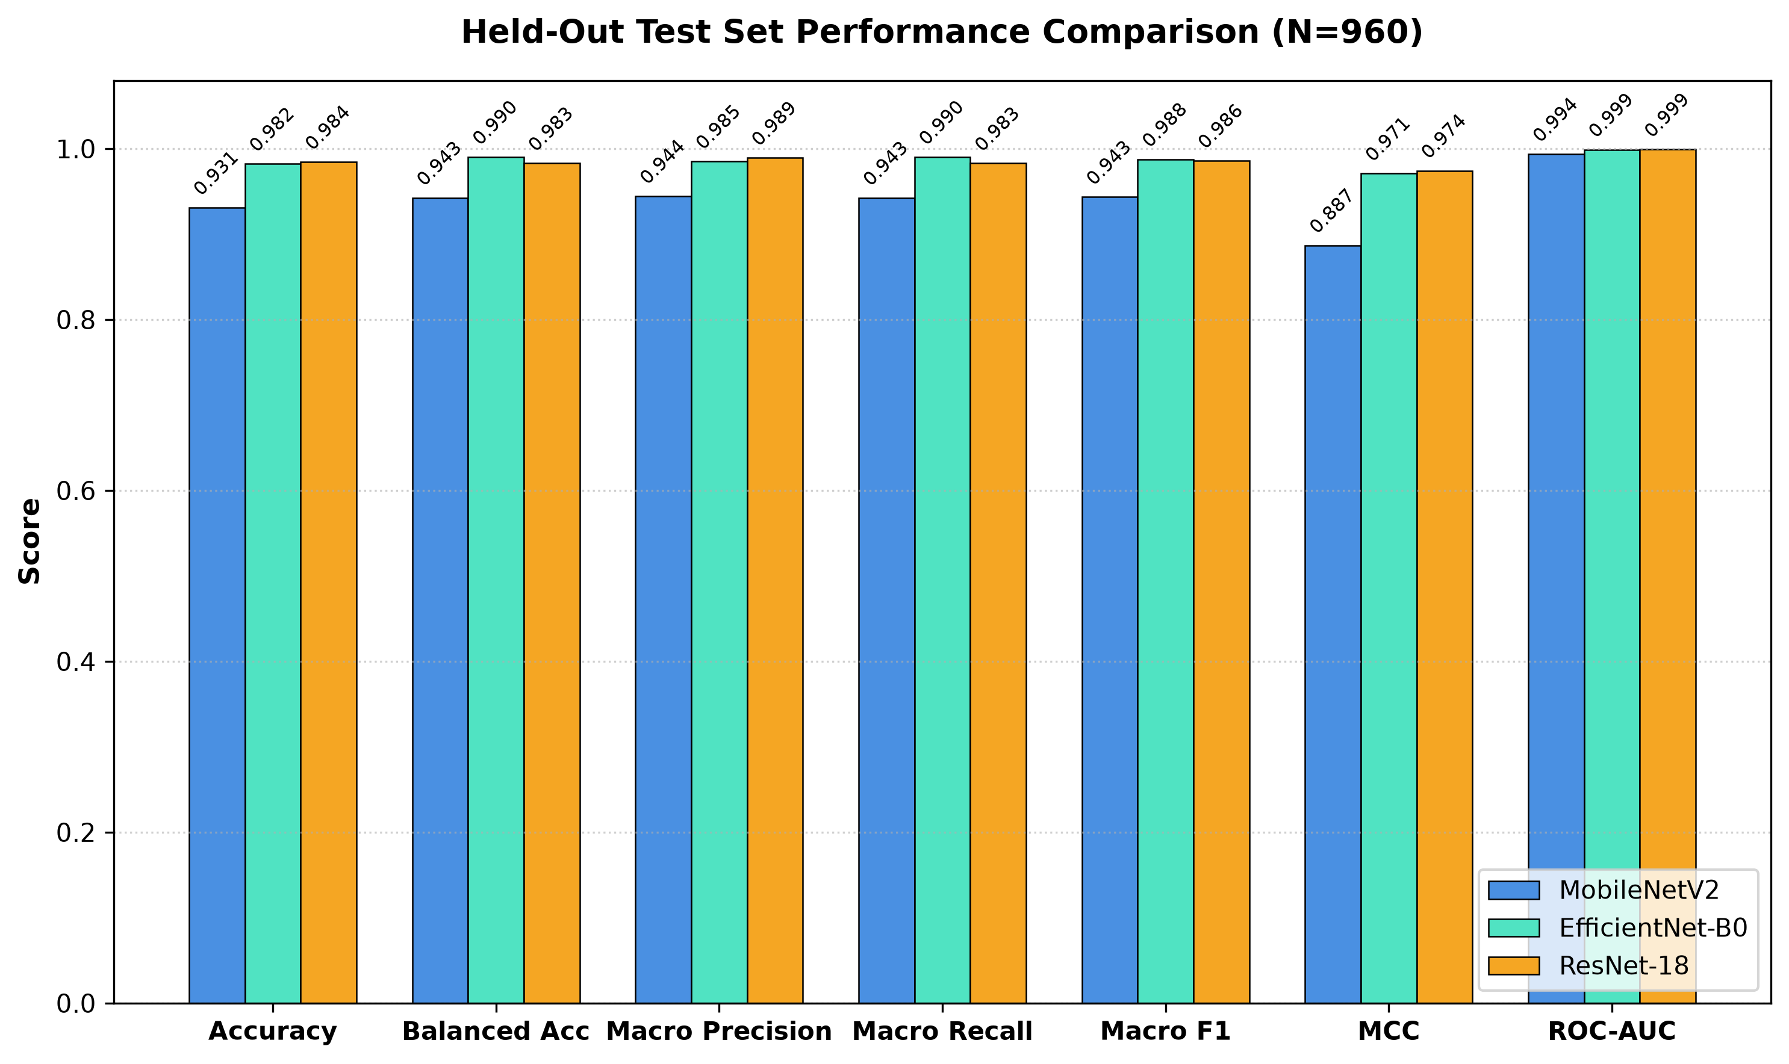
Model Comparison — Held-Out Test Results
960-image held-out test set · Seed 42 · 0 hash-overlap with train/val
Model
Params
Accuracy
Macro F1
Balanced Acc
MCC
ROC-AUC
Latency
MobileNetV2
2.23M
93.13%
94.34%
94.25%
0.887
0.9936
2.93ms
EfficientNet-B0
4.01M
98.23%
98.76%
99.03%
0.971
0.9989
2.20ms
ResNet-18
11.18M
98.44%
98.60%
98.29%
0.974
0.9991
1.77ms
📌 Key Observations
• ResNet-18 achieves highest MCC (0.974) and ROC-AUC (0.9991)
• EfficientNet-B0 achieves highest Balanced Accuracy (99.03%)
• All 3 models achieve 100% Moderate Demented F1 despite only 9 test samples
• >68% of all errors occur at Non-Demented ↔ Very Mild boundary
• No single declared 'winner' — ensemble provides reliability
Alzheimer's Disease Detection & Explainability System • Final Year Engineering Project
16 / 24

Slide 17
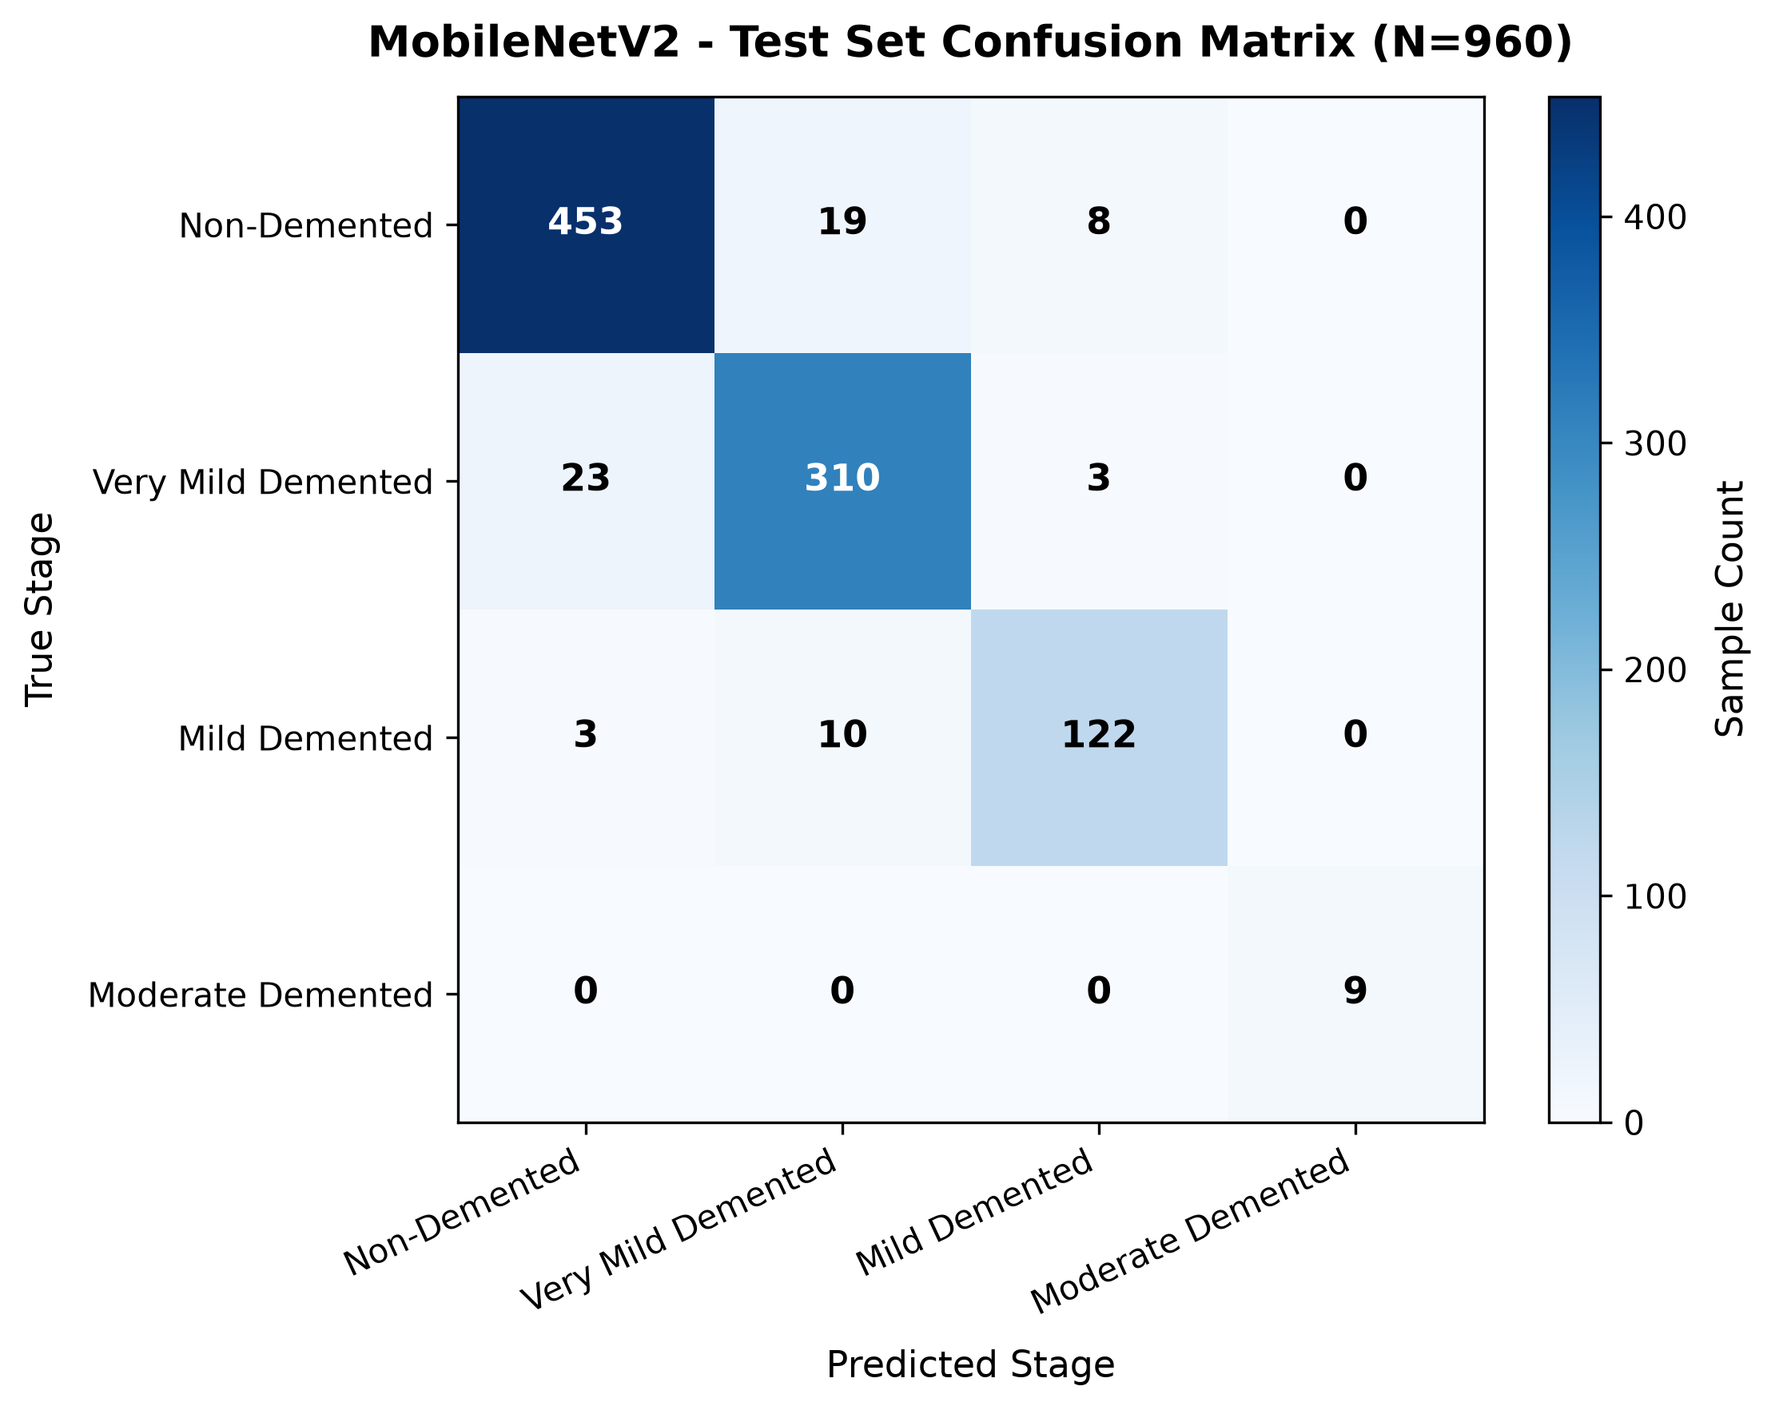


Confusion Matrices — All 3 Models
Held-out test set (960 images) · Moderate class: 9 test samples
MobileNetV2
EfficientNet-B0
ResNet-18
66 errors
17 errors
15 errors
⚠️ Note: Moderate Demented class has only 9 test samples — per-class metrics should be interpreted with caution. 100% Moderate F1 ≠ clinical certainty.
Alzheimer's Disease Detection & Explainability System • Final Year Engineering Project
17 / 24

Slide 18
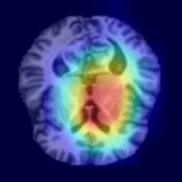
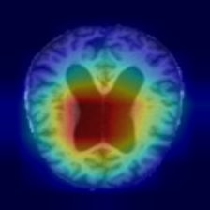
Grad-CAM Explainability
Gradient-weighted Class Activation Mapping — EfficientNet-B0 target layer: features[-1]
Non-Demented
(Correct)
Very Mild Demented
(Correct)
Mild Demented
(Correct)
Scale
■ Red/Yellow
HIGH
contrib.
■ Green
MED
contrib.
■ Blue
LOW
contrib.
How to Read This Explanation
Grad-CAM highlights image regions that contributed to the selected model's prediction. Warmer colours (red/yellow) = higher gradient magnitude at that spatial location; cooler colours (blue) = low contribution. These maps reveal WHAT the model attended to — they are model-attribution visualizations, NOT medical biomarker detections. Grad-CAM does not identify Alzheimer's plaques or clinical biomarkers.
Alzheimer's Disease Detection & Explainability System • Final Year Engineering Project
18 / 24

Slide 19
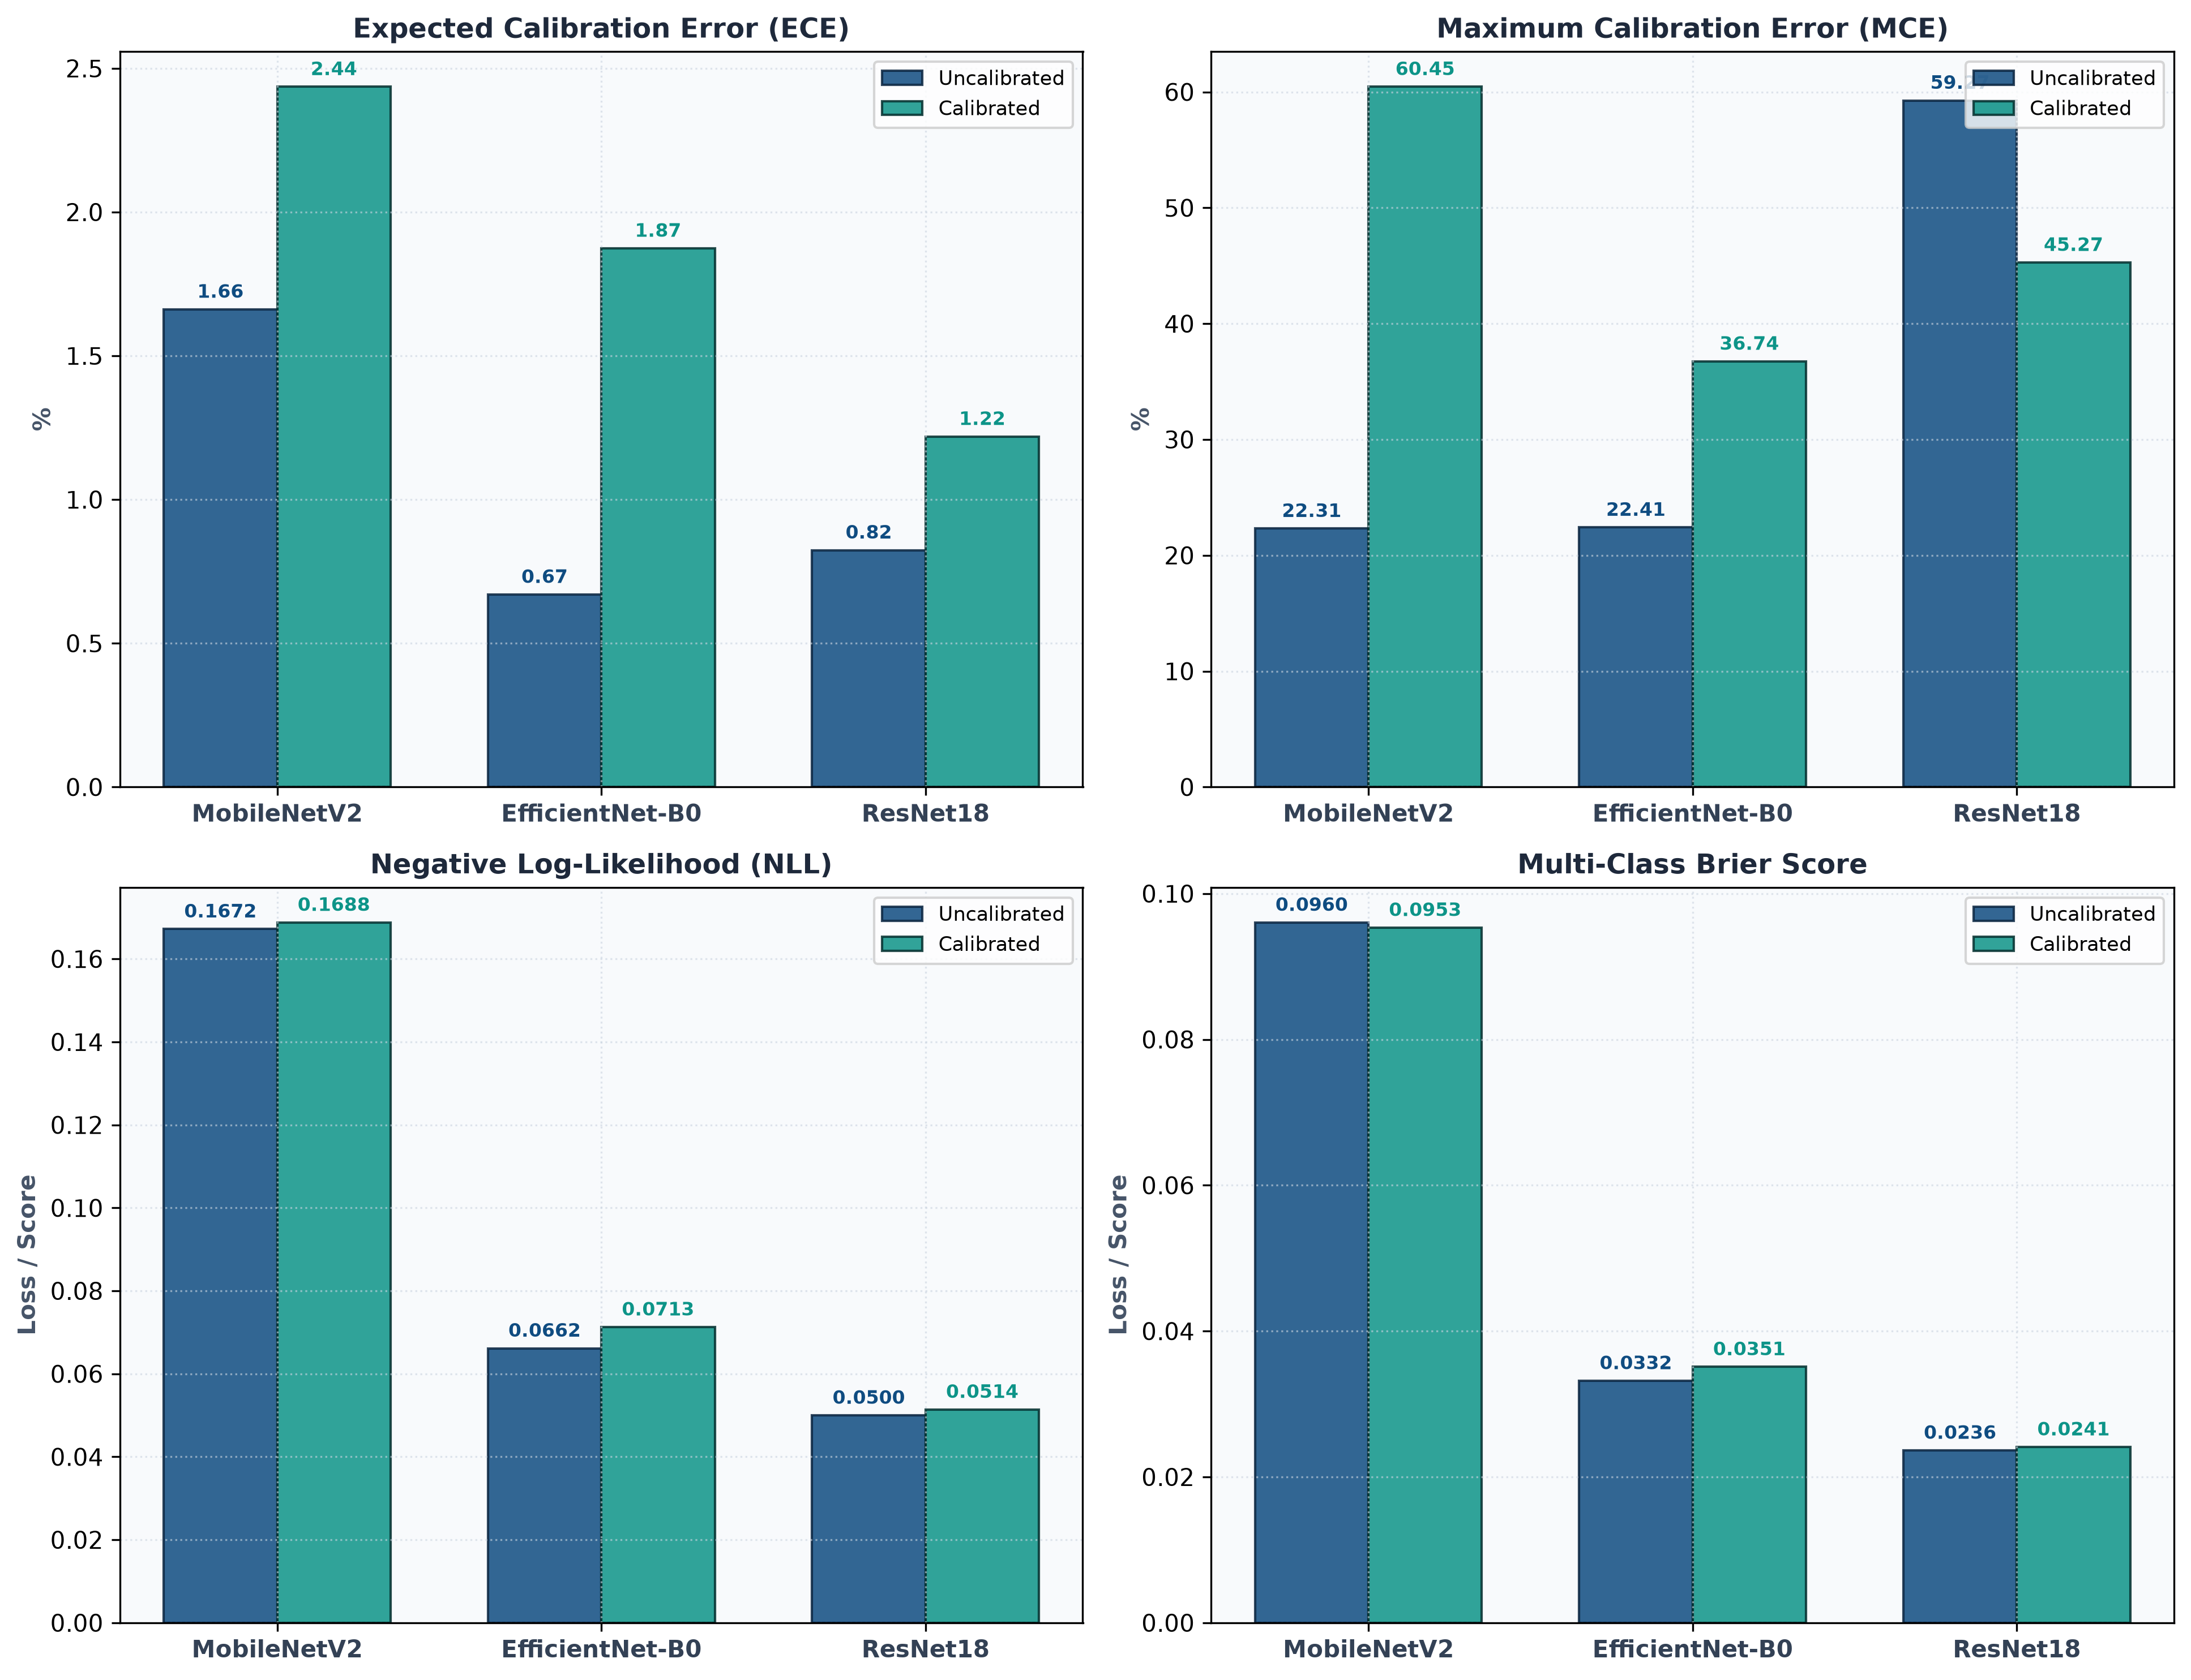
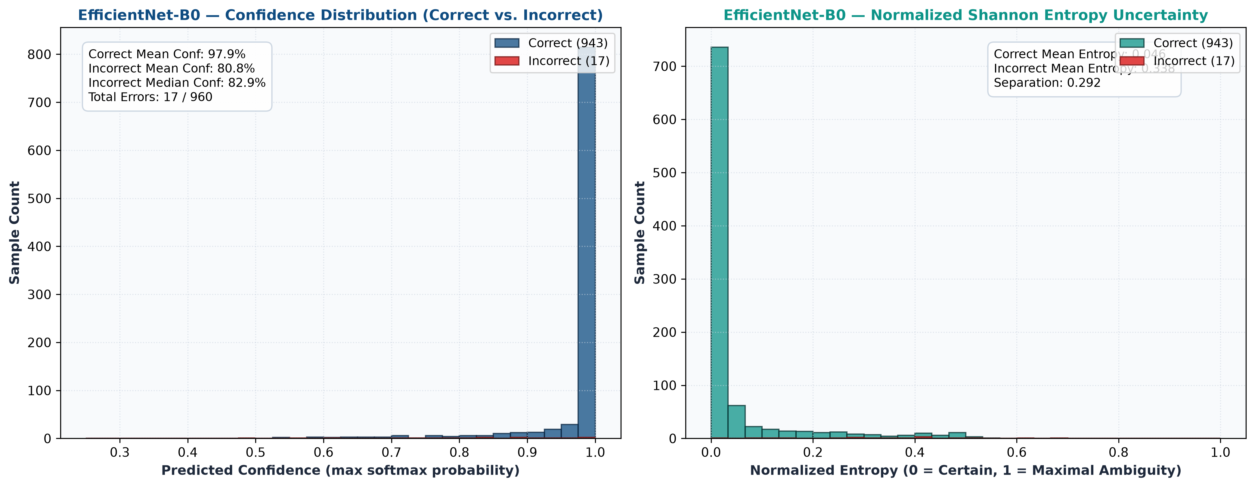
Calibration & Error Analysis
🌡️ Calibration (Temperature Scaling)
❌ Error Analysis Summary
MobileNetV2
MobileNetV2
66 errors
T=1.27
ECE=0.041
Brier=0.128
EfficientNet-B0
17 errors
EfficientNet-B0
T=1.14
ECE=0.012
Brier=0.031
ResNet-18
15 errors
ResNet-18
Error Distribution Insight
T=1.08
ECE=0.009
Brier=0.027
• >68% of errors occur at Non-Demented ↔ Very Mild boundary
• These are the most clinically ambiguous class transitions
• Moderate Demented: 0 errors (EfficientNet, ResNet) despite 9 test samples
• MobileNetV2 concentrates errors in Very Mild class
Alzheimer's Disease Detection & Explainability System • Final Year Engineering Project
19 / 24

Slide 20
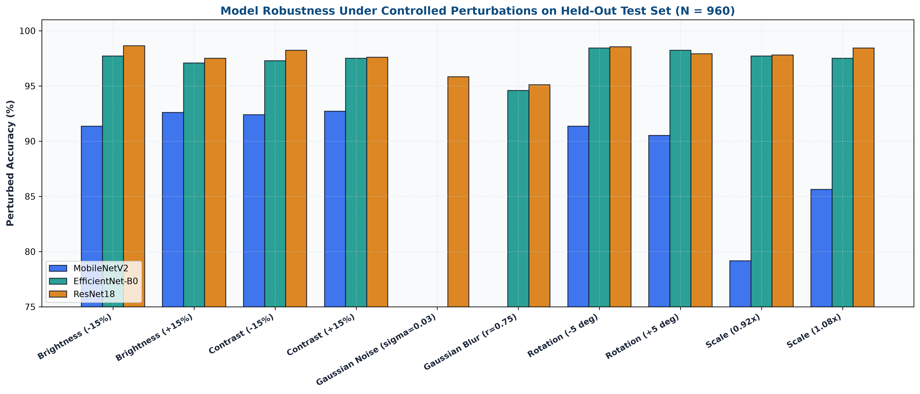
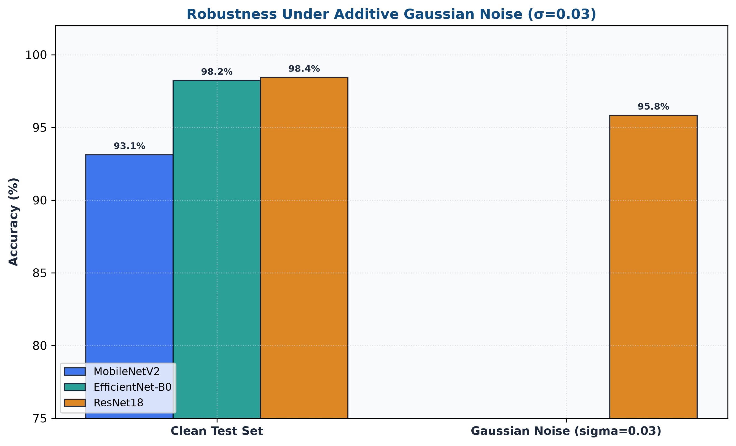
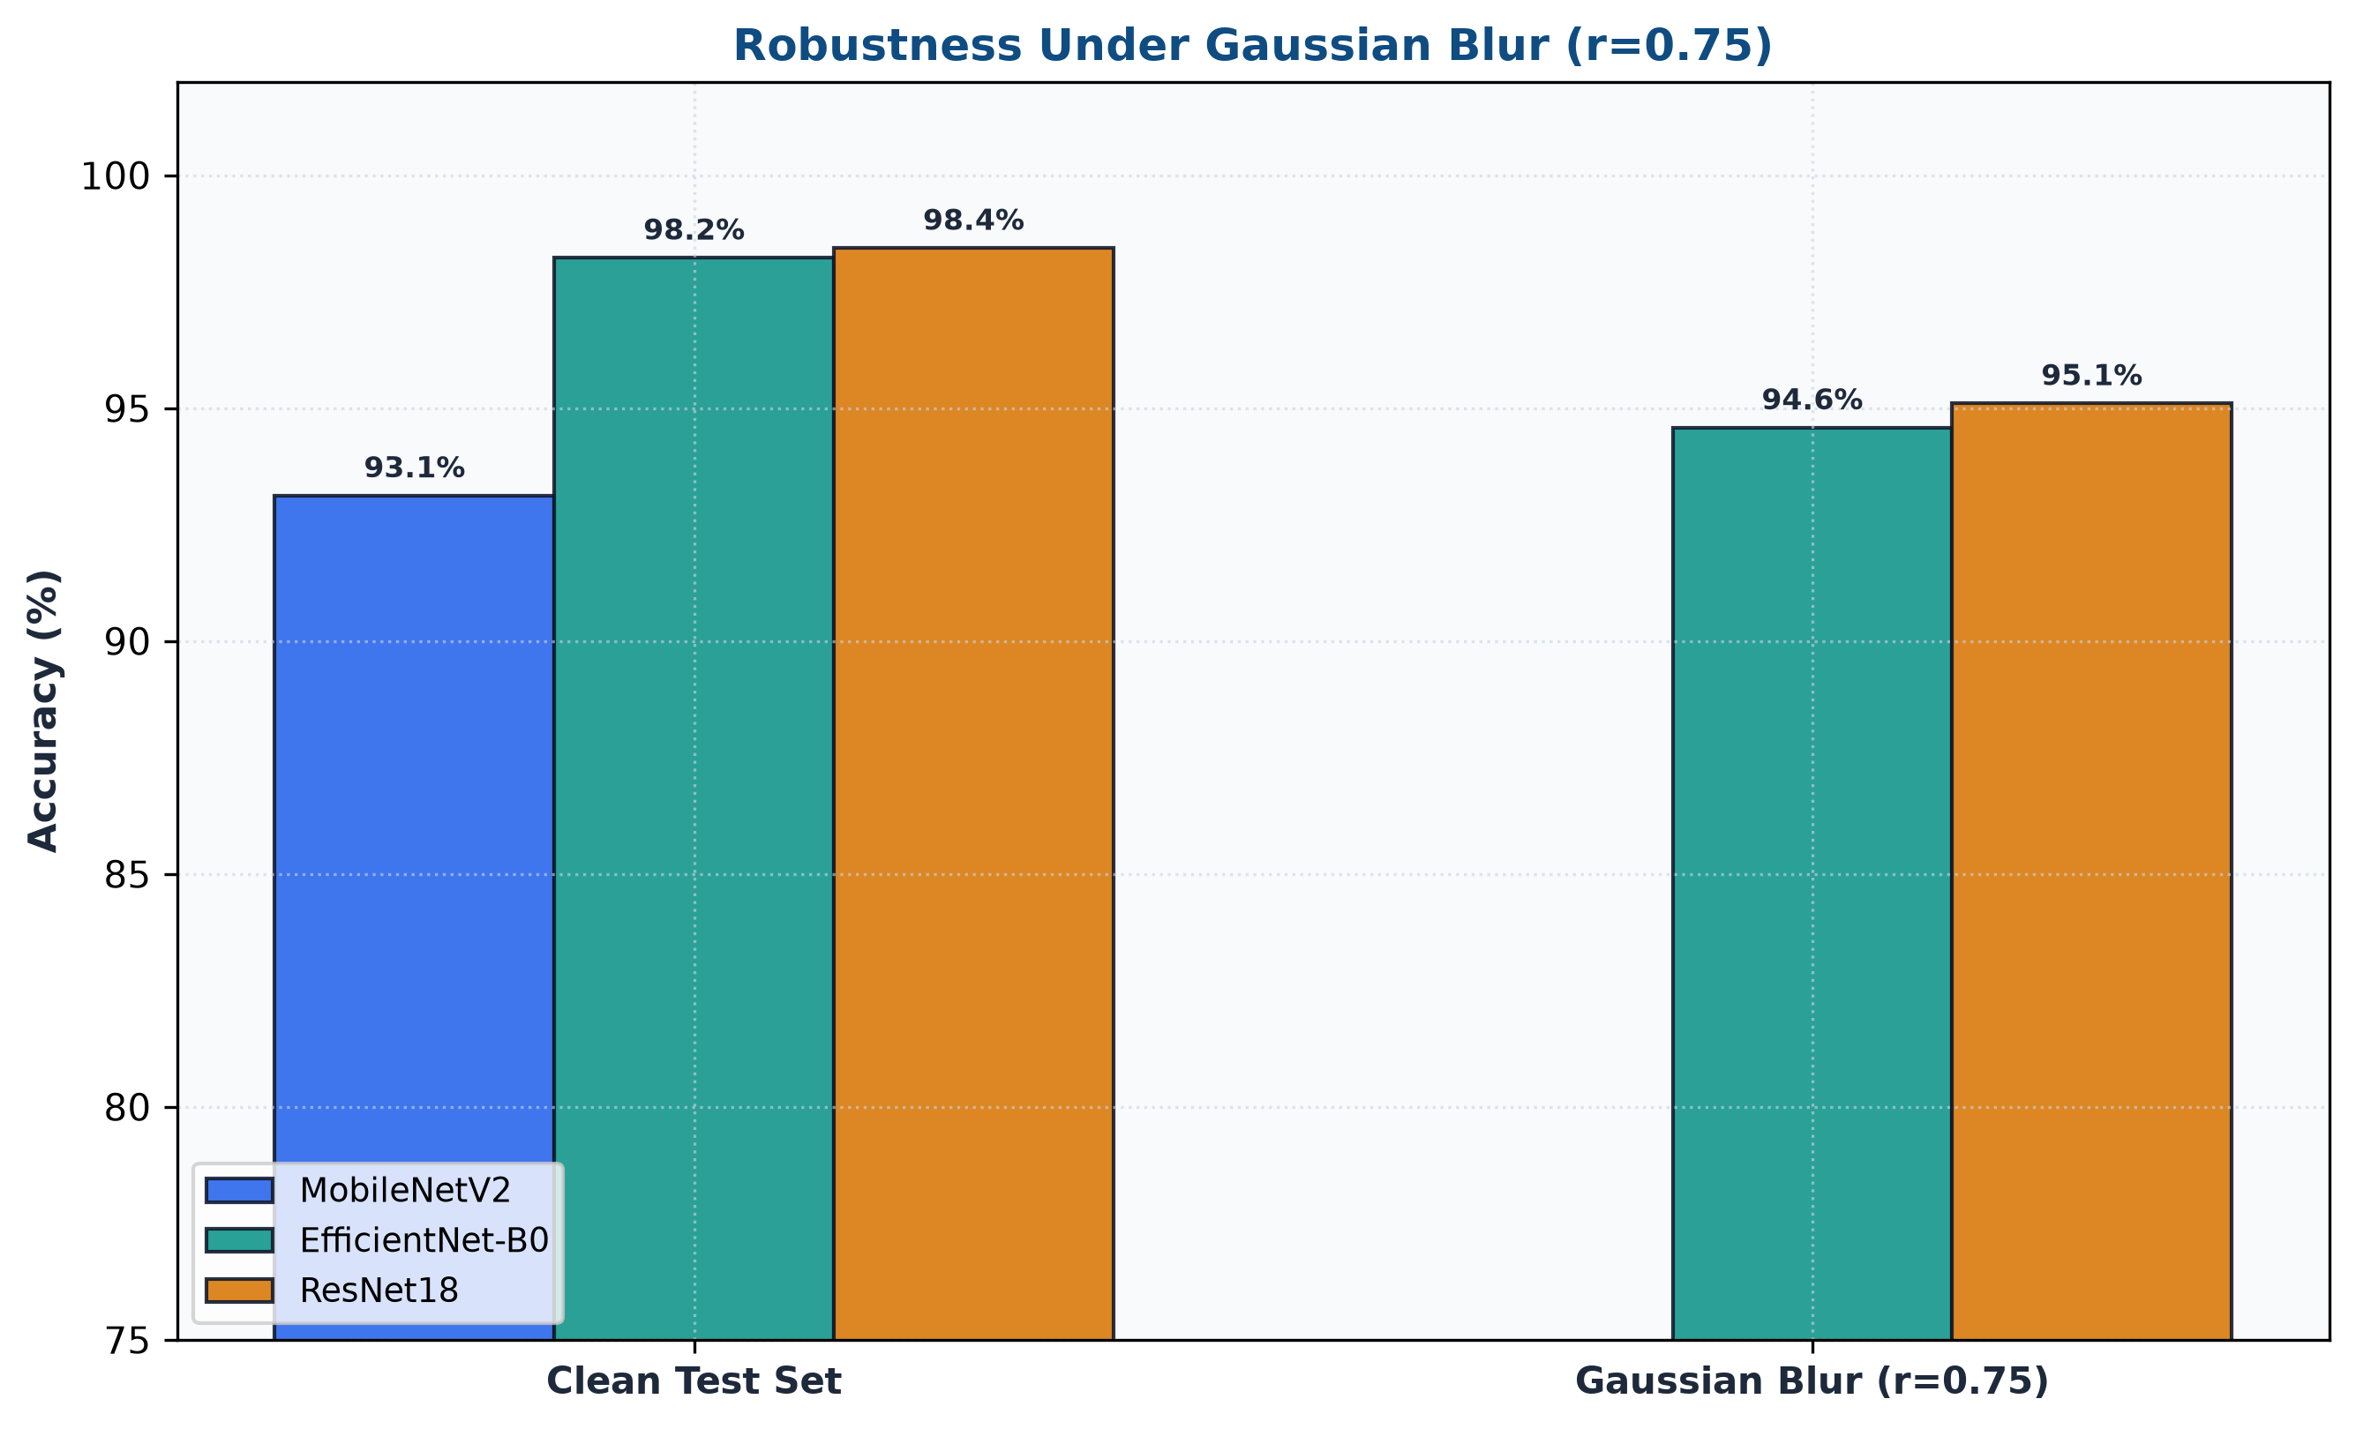
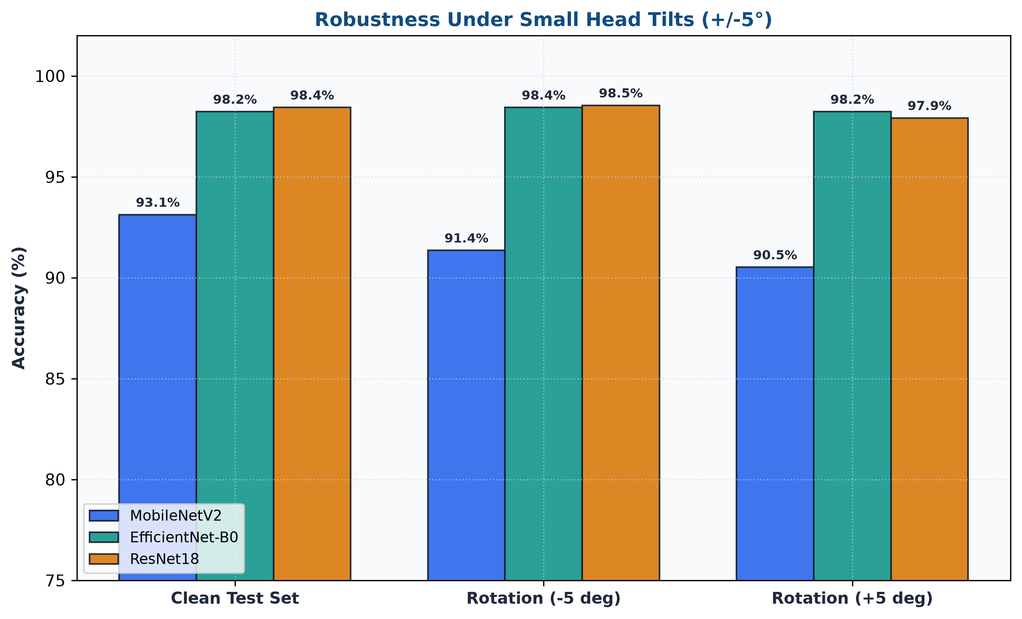
Robustness Stress Testing
Performance under 5 categories of image perturbation — held-out test set
🔬 Perturbation Categories
Gaussian Noise:
Simulates sensor noise / low SNR MRI
Gaussian Blur:
Simulates motion artefacts
Brightness Shift:
Simulates scanner calibration drift
Contrast Shift:
Simulates image acquisition variation
Rotation:
Simulates positioning variation ±30°
⚠️ Honest Limitations: All 3 models show performance degradation under heavy perturbations. This is expected behaviour for models trained on clean clinical MRI data. Robustness results reflect research-prototype behaviour, NOT clinical deployment readiness.
Alzheimer's Disease Detection & Explainability System • Final Year Engineering Project
20 / 24

Slide 21
Input-Domain Safeguard (OOD Rejection)
8-stage multi-feature brain MRI domain screening pipeline
Stage 1
Aspect Ratio Gate
0.55–1.80 accept range
✅ ACCEPTED
UI Warning shown on rejection:
• Brain MRI scans (any stage)
"Input rejected"
Stage 2
Chroma Saturation
Reject RGB colour photos
• All 6,400 training images → 0 false rejections
"This image does not appear to be
a suitable brain MRI for this
research model.
Please upload a brain MRI image."
• All 12 curated demo samples
Stage 3
Border Darkness
Brain MRI has dark perimeter
⛔ REJECTED
• Dog / cat / animal photos
Stage 4
Corner Air Space
Brain MRI has dark corners
• Human photographs / portraits
• Digital artwork / AI-generated brain art
✅ Empirical Validation
Stage 5
Tissue Coverage
Foreground: 28%–68%
• Chest CT / lung scans
• 6,400 / 6,400 training images → PASS (0 false rejections)
Central Signal
• Spine / knee / extremity MRI
Stage 6
Center mean ≥ 45, contrast ≥ 25
• 12 / 12 demo scans → PASS
• X-rays and unrelated medical images
🐶 → Nice dog. Wrong project. 😅
• 13 OOD categories all → REJECT
Stage 7
Skull Geometry
Width/height ratio 0.68–1.42
• 49 / 49 automated tests passing
Stage 8
Hemispheric Sym.
Bilateral symmetry check
• Academic input-domain safeguard — not a universal OOD detector
Alzheimer's Disease Detection & Explainability System • Final Year Engineering Project
21 / 24

Slide 22
Streamlit Application — 8-Page Research Interface
🏠 Overview
Project summary & architecture
🧠 MRI Analysis
Upload / demo scan → 3-model prediction + Grad-CAM
📊 Model Comparison
Side-by-side metric comparison
📈 Evaluation
ROC curves, confusion matrices
🔍 Explainability
Grad-CAM library for all classes
🛡️ Error & Robustness
Error analysis + perturbation results
📖 Methodology
Training pipeline documentation
ℹ️ About
Team, technology, academic framing
🛠️ Technology Stack:
Streamlit 1.x
PyTorch
Grad-CAM (custom)
Pillow
scikit-learn
Matplotlib
Plotly
Python 3.12
🌐 Live URL: https://alzheimer-xai-vijay.streamlit.app
Alzheimer's Disease Detection & Explainability System • Final Year Engineering Project
22 / 24

Slide 23

Deployment & Public Accessibility
📁
Project
Code
➔
GitHub
Repository
➔
Streamlit
Community Cloud
➔
Public
HTTPS URL
➔
Any Device
(Browser)
📦 GitHub Repository
☁️ Streamlit Community Cloud
🔒 Security Measures
Full source code, model training scripts,
tests and documentation
Free tier · Automatic CI/CD from main branch
Auto-scales with free compute
No secret exposure · OOD rejection safeguard
12 curated demo scans only (6,400 full dataset excluded)
https://github.com/Vijatejas03/alzheimer-disease-detection
https://alzheimer-xai-vijay.streamlit.app
requirements.txt + .gitignore configured
📱 Scan to open the live application
🌐 https://alzheimer-xai-vijay.streamlit.app
Alzheimer's Disease Detection & Explainability System • Final Year Engineering Project
23 / 24

Slide 24
Limitations · Future Work · Conclusion
⚠️ Limitations
🚀 Future Work
✅ Conclusion
• Single-dataset evaluation (Kaggle MRI only)
• Train on ADNI / OASIS clinical datasets
✓ 98.44% test accuracy with ResNet-18
(98.23% EfficientNet-B0)
• 128×128 px resolution — lower than clinical standard
• 3D volumetric MRI (ViT / 3D CNN)
✓ 3-model consensus engine provides
cross-validated reliability
• Moderate class: 64 training, 9 test samples
• Integrate SHAP + LIME for multi-XAI
• Models degrade under heavy perturbations
• Federated learning (privacy-preserving)
✓ Grad-CAM attribution visualizations
enable research transparency
• OOD detector is domain-specific, not universal
• Model compression / edge deployment
✓ Temperature-scaled calibration
improves confidence reliability
• No multi-centre or prospective clinical validation
• Longitudinal change detection
✓ 8-stage OOD safeguard: 0 false
rejections on 6,400 images
• Research prototype — NOT a medical diagnostic tool
• Clinical co-design & prospective study
✓ Live deployable research prototype
at alzheimer-xai-vijay.streamlit.app
🙏 Thank You! Questions & Discussion · Q&A
🌐 alzheimer-xai-vijay.streamlit.app
Alzheimer's Disease Detection & Explainability System • Final Year Engineering Project
24 / 24

