Slide 1
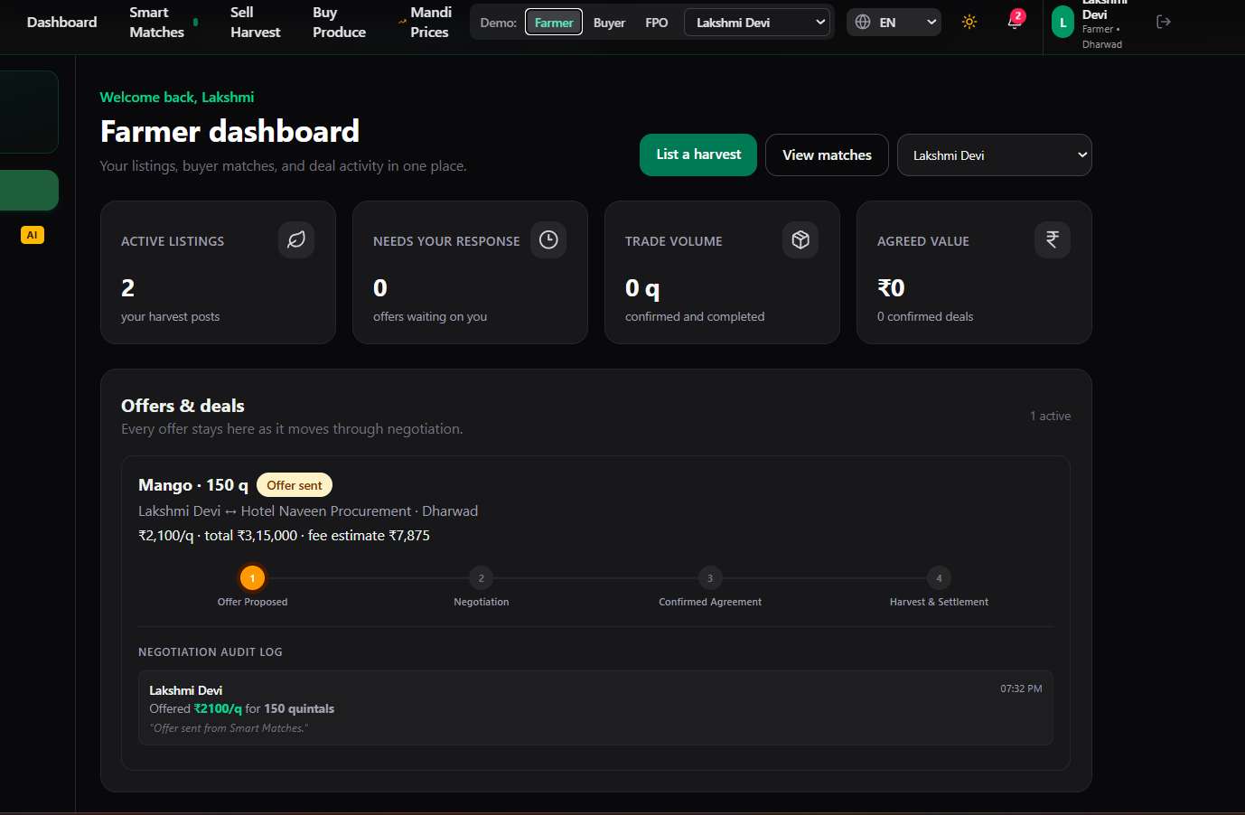
MandiMatch
Know your buyer and price
before harvest.
A pre-harvest marketplace connecting farmers, FPOs, and produce buyers.
Interface shown with sample demo data
Mentor presentation · Hackathon prototype
Notes:
Introduce MandiMatch as a hackathon prototype for planning crop sales before harvest.
The dashboard screenshot is a user-provided screenshot from the project. Sample values shown in the interface are demonstration data, not measured project outcomes.
Sources: project README.md; supplied MandiMatch dashboard screenshot.

Slide 2
PROBLEM UNDERSTANDING
The marketplace problem
Farmers and buyers need a clearer way to find one another and agree on a deal.
01
Supply is hard to discover
A buyer may not know which nearby farms have the crop and quantity they need.
02
Price and timing are uncertain
Harvest dates, delivery windows, and price expectations can miss one another.
03
Agreement takes coordination
Offers, counteroffers, and order status need a shared, understandable flow.
MandiMatch focuses on discovery and deal coordination; it does not guarantee a sale or a market price.
MANDIMATCH · 02
Notes:
Frame these as the problem this prototype is designed to address, not as quantified research findings.
Sources: project README.md, Product Overview; problem framing for the MandiMatch prototype.

Slide 3
HOW IT WORKS
One workflow from crop plan to agreement
Both sides describe what they can offer or need. MandiMatch helps them move toward a confirmed deal.
01
02
03
04
05
Farmer / FPO
→
Buyer
→
Match
→
Negotiate
→
Confirm
Post crop, quantity, grade, price, location, harvest date
Post crop, quantity, budget, location, delivery date
Compare crop, quantity, price, dates, and district
Send an offer, respond, or counteroffer
Confirm the deal; contact details become available
A contact number is shared only after the offer is accepted and a deal is confirmed.
MANDIMATCH · 03
Notes:
Walk through the flow: farmers and FPOs list upcoming produce, buyers post demand, the matching engine surfaces compatible pairs, and users negotiate.
Phone contacts are displayed after confirmation in the deal flow.
Sources: src/pages/BuyPage.tsx; src/pages/SellPage.tsx; src/pages/MatchesPage.tsx; src/pages/DashboardPage.tsx; server/src/modules/offers/offers.controller.ts.

Slide 4
TECHNICAL IMPLEMENTATION
Matching weighs fit, not just crop name
A match score combines four practical signals:
40%
Quantity fit
Can the available lot cover the buyer’s need?
25%
Price fit
Does the ask fit within the buyer’s budget?
20%
Date fit
Do harvest and delivery dates line up?
15%
District fit
How close are the listed locations?
Eligible crop pairs score from 0–100; the prototype displays matches from 35 upward.
MANDIMATCH · 04
Notes:
Explain the score as a weighted compatibility heuristic. A higher score means the listed quantities, budgets, dates, and districts fit better; it is not a prediction of deal success.
Sources: src/utils/matching.ts; server/src/utils/matching.ts; README.md, How the Matching Engine Works.

Slide 5
INNOVATION AND PRACTICAL VALUE
Clearer terms and a safer handoff
Before confirmation
After confirmation
OTP-verified mobile sign-up
Crop, quantity, grade, dates, and location
Offers and counteroffers stay in a visible history
Mandi price references are labelled as simulated
Both participants can see a call button for the other party. The contact is released only after the deal is accepted.
Illustrative example from the project README
25 q × ₹2,200/q = ₹55,000
Estimated 2.5% fee = ₹1,375
The example is simulated; it is not a live quote or a charged fee.
MANDIMATCH · 05
Notes:
Describe OTP verification and the marketplace fields that make terms more explicit.
Phone numbers are hidden until deal confirmation. Mandi price data and example commissions in the prototype are simulated; the product is not a payment or legal-contract system.
Sources: README.md, OTP setup and prototype disclaimer; src/pages/SignupPage.tsx; src/pages/DashboardPage.tsx; server/src/modules/offers/offers.controller.ts; README.md, Sample Commission Calculation.

Slide 6
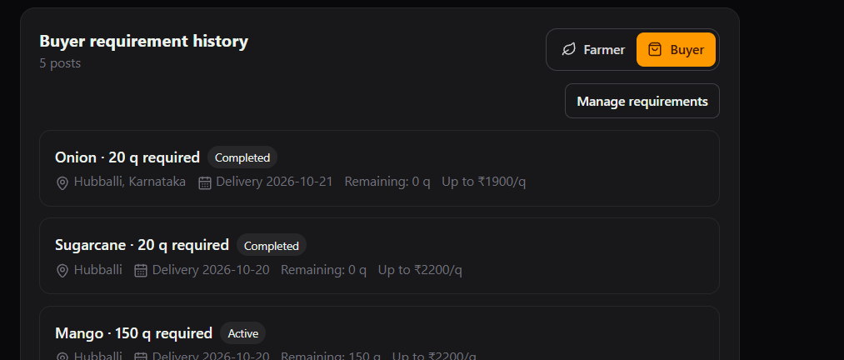
PRODUCT WALKTHROUGH
The product in the user’s flow
Deal progress
The dashboard brings listings, response needs, volume, and offers together.
Profile history
Active and completed posts remain visible to the account owner.
Screenshots show prototype UI; displayed account and deal values are sample data.
MANDIMATCH · 06
Notes:
Use the screenshots to show the dashboard’s offer status flow and the profile history filters.
The screenshots are supplied project screenshots. Any figures visible in them are sample/demo data and must not be presented as actual outcomes.
Sources: supplied MandiMatch dashboard and buyer-history screenshots; src/pages/DashboardPage.tsx; src/pages/ProfilePage.tsx.

Slide 7
OUTCOMES TO MEASURE
KPIs for a real pilot
Track outcomes after real farmers and buyers use the marketplace. No live pilot results are claimed yet.
DISCOVERY
CONVERSION
Active listings and buyer needs
Offers sent and deals confirmed
Eligible posts that receive a relevant match
Offer acceptance rate; median time to confirmation
TRADE VALUE
TRUST
Confirmed quintals traded
Verified contact coverage
Agreed deal value, reported in ₹
Review completion and post-deal feedback
Baseline → pilot → compare by role, crop, and district
MANDIMATCH · 07
Notes:
These are proposed KPIs, not reported results. Explain how each one connects to discovery, deal completion, value, or user trust.
Sources: project feature set in src/pages/DashboardPage.tsx; src/pages/MatchesPage.tsx; src/pages/ProfilePage.tsx. KPI definitions are proposed for a future pilot.

Slide 8
LEARNING AND RESPONSE
Feedback shaped the next version
Changes made from user feedback
What I want to learn next
Active and completed profile history
Clearer “waiting for your response” offer links
Contact buttons after deal confirmation
Crop grade and dated listing details
• Can nearby users find a useful match?
• Which part of negotiation causes delay?
• What price and transport details are missing?
• Do users trust the confirmation and contact flow?
Next step: run a small farmer–buyer pilot, record the KPIs, and use feedback to prioritize live data and production needs.
MANDIMATCH · 08
Notes:
Share the concrete improvements added in response to feedback, then invite your mentor to challenge the pilot plan.
Be clear that live mandi feeds, payments, and a production deployment are not claimed as complete.
Sources: project history in src/pages/ProfilePage.tsx; src/pages/DashboardPage.tsx; README.md, Prototype Disclaimer and Features Requiring Additional Services for Production.

