Slide 1
Hackathon Project Final Presentation
January 24th, 2025
ML Newbies
Dinghan Wang, Yining Huang, Deena Elhossary, Manav Patel, and Vijay Avala
Department of Petroleum and Geosystems Engineering
Department of Statistics and Data Science

Slide 2
Executive Summary
1. What is the problem?
Develop a data analytics and machine learning workflow in Python to predict Grid, Diesel, and Compressed Natural Gas energy usage during hydraulic fracturing operation.
2. What did your team do to address the problem?
We combined petroleum domain knowledge with geostatistics and machine learning work to address this problem.
3. What did your team learn?
We realized the importance of domain knowledge when making use of machine learning technique.
4. What does your team recommend going forward?
Future work could be using this model to apply to other larger datasets in oil & gas.

Slide 4
Workflow
Overview with Steps / Flow Chart
Start
Data Analysis
Univariate Analysis
Bivariate Analysis
Feature Ranking and Selection
Mutual Info Approach
Feature Programming
Fix Missing Data
Outlier detection
Scaling
Machine Learning Model and Evaluation
Basic Model Training
Hyperparameter Tuning & Model Comparison
Model Comparison
Deployment and Uncertainty
Run Model on Test Data
Bagging Regressor
End

Slide 5
Workflow (Multiple Slides)
Showcase Interesting and Innovative Aspects of Your Workflow.
State and Defend Modeling Decisions
Discuss Critical Results and Learnings for Workflow Steps
Captions for all Figures
Concise Text on Slides to Explain the Main Points

Slide 6
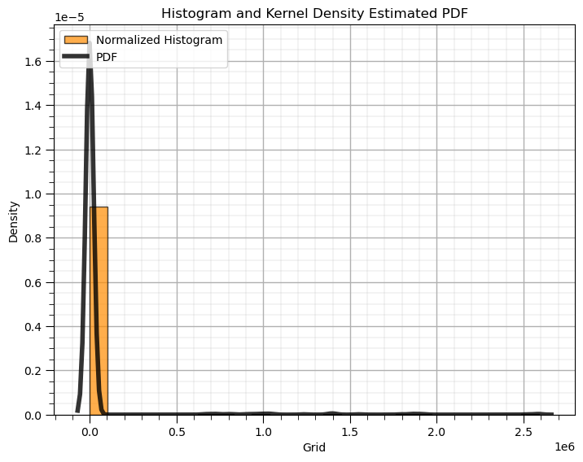
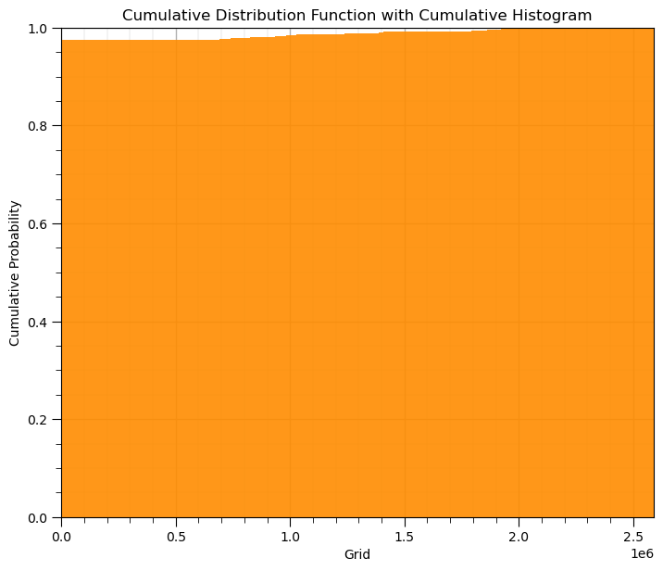
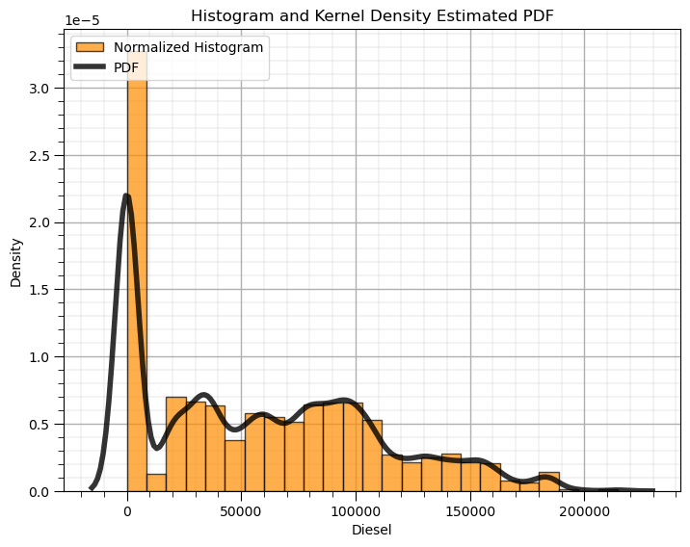
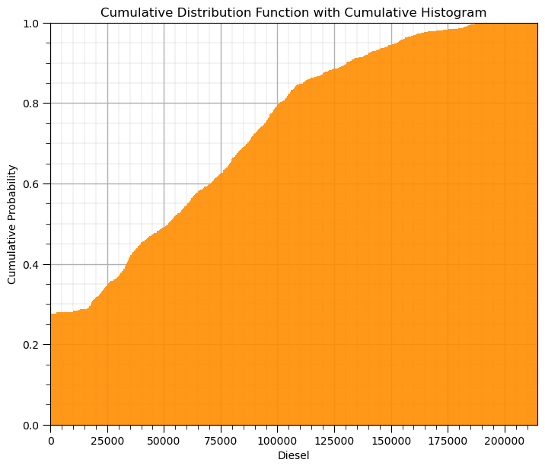
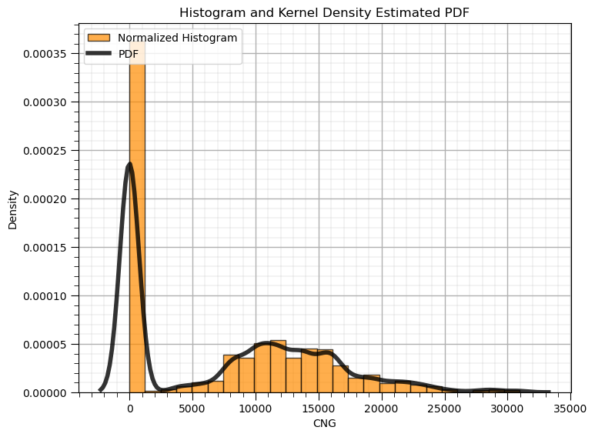
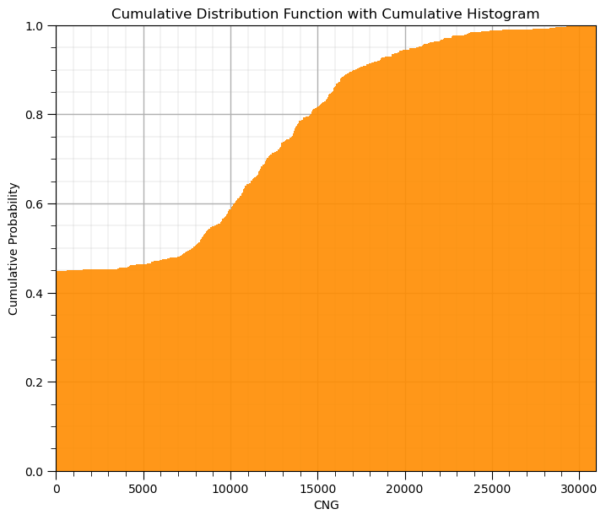
Univariate Data Analysis

Slide 7
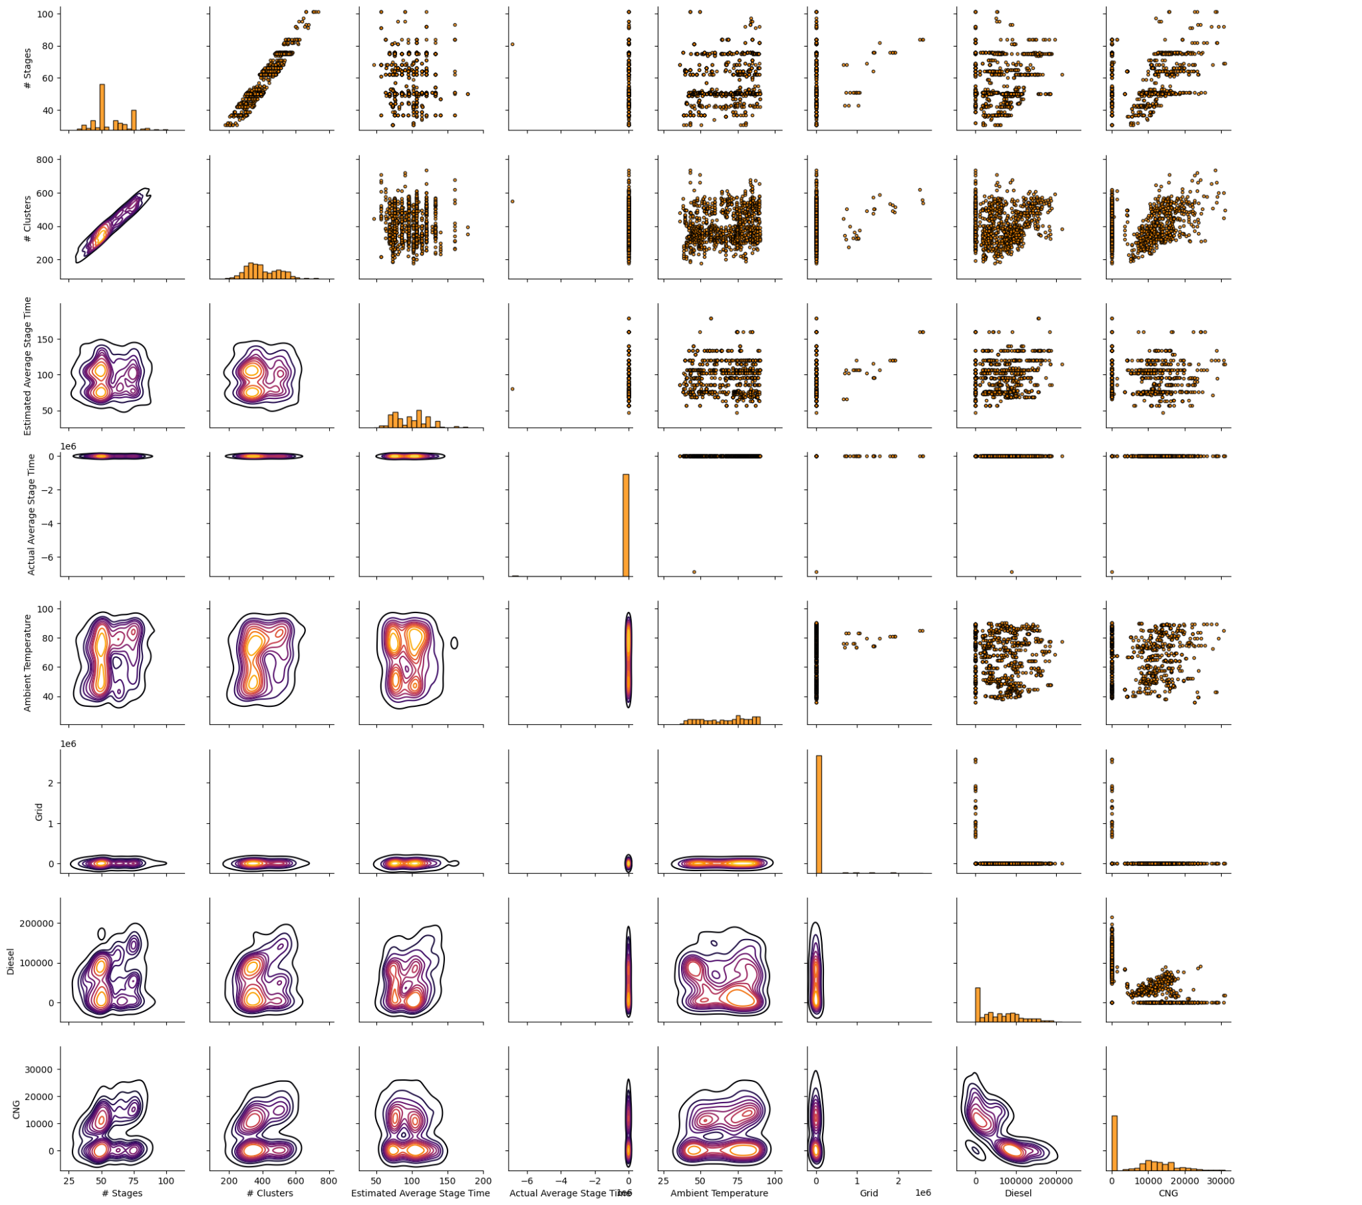
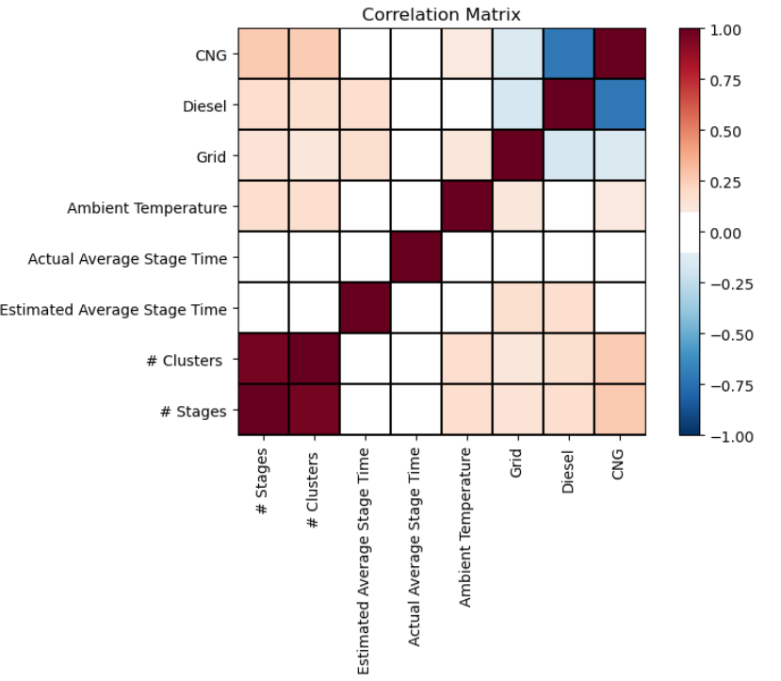
Bivariate Data Analysis

Slide 8
Feature Ranking and Selection
Mutual Information Approach
Placeholder
Place for Images

Slide 9
Feature Programming
Fix Missing Data
Placeholder
Outlier Detection
Placeholder
Scaling
Placeholder
Place for Images

Slide 10
ML Model and Evaluation
Basic model
deleting all missing data rows
apply Linear, random forest and XGBoost
Best model selection
Go through all datasets and model with hyperparameter tuning
apply R2 and K fold evaluation
Place for Images
Notes:
Our idea is to compare all possible options, including data cleaning options, impute methods, model selection and hyperparameter tuning. We apply R^2 and Kfold evaluation to evaluate the model performance. As showing in the slides is the best performaning model.

Slide 11
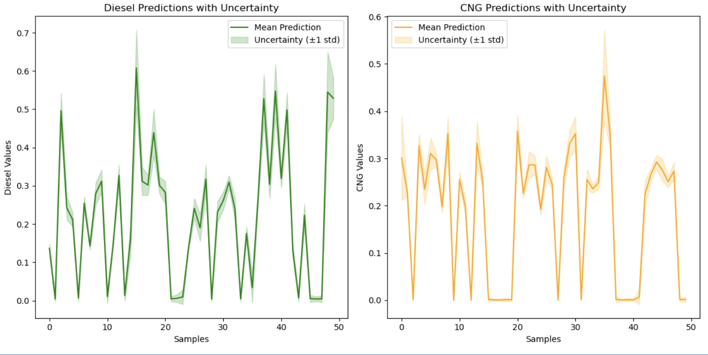
Deployment and Uncertainty
Deployment
Ran the model on the testing data
Uncertainty
Used bagging regressor for the uncertainty analysis (Bootstrapping with aggregation; reduces variance thus strong beneficial effect on high variance classifiers)

Slide 12
Results and Discussions
Present your predictions and uncertainty models for the average pump difference for the 15 withheld wells.
Recall the withheld wells are listed in data/solution.csv
Use table, graphs to communicate the model predictions and uncertainty models, modeling tuning, feature engineering and importance, etc.
You will be judged on the quality and the novelty of the figures and the ways of looking at data

Slide 13
Feedback
What did your team learn?
We learned that domain experience is critical for efficient and useful machine learning implementation and analysis
What did your team like?
We liked the collaborative and problem solving aspects of the Hackathon
What could we do to improve next year?
Perhaps have better vegetarian food

