Slide 1



ATM FRAUD DETECTION SYSTEM
Presented By
VIJAY S
Reg No: 210419205059
DHINAKARAN V
Reg No: 210419205010

Slide 2
What is ATM?
Automated Teller Machine is a computerized machine that provides the customers of banks the facility of accessing their accounts for dispensing cash and to carry out other financial transactions without the need of actually visiting a bank branch.
Objectives
ATM is widely used to make transaction in modern world.
ATM system is not secured enough today.
Several Attacks are regularly occurring in ATM system.
Our goal is to prevent these threats.

Slide 3
ATM FRAUDS
ATM fraud refers to fraud with the use of an ATM card whereby the offender of the crime uses the card to immediately withdraw funds from a consumer account using PIN based transactions at the ATM.
Types of ATM Frauds
Card skimming
Salisi gang
Cash Trapping
Fake assistance
Card Trapping
Fake PIN Pad Overlay
Shoulder surfing
Physical Attack

Slide 4
Proposed Fraud Prevention method
Card activation/deactivation method prevents card skimming, Salisi gang and card trapping ATM frauds.
Face detection method prevents fake pin pad overlay, shoulder surfing, fake assistance ATM frauds.
Client confirmation method increases the security of the system.

Slide 5
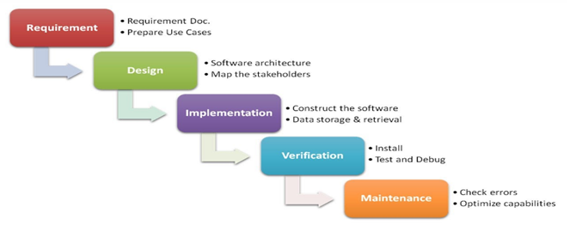
Process Model
The waterfall Model illustrates the software development process in a linear sequential flow. This means that any phase in the development process begins only if the previous phase is complete.

Slide 6
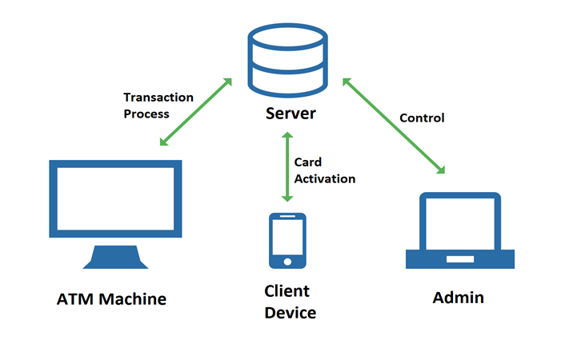
System Model

Slide 7
System Flow chart

Slide 8
E-R diagram

Slide 9
IMPLEMENTATION

Slide 10
Features
Prevent most of the threats
Multiple authentication methods

Slide 11
Development Tools
Editor – Pycharm, Sublime text 3
Productivity Management Tool – Trello Board, Slack
Platform/Operating System – Cross Platform

Slide 12
Future Works
Iris recognition method
High accuracy
Possible to recognize dead human eye
Costly to implement

Slide 13
THANK YOU

