Slide 1
Lecture Software Process Definition and Management Chapter 2: Prescriptive Process Models
Dr. Jürgen Münch
Fall 2012
Notes:
1

Slide 2

Prescriptive versus Descriptive Modeling
27. Integration Test (Host)
Customer Data
Tools
APS
TSPA (from P3)
30. Customer Data Upgrade/ Tool-Upgrade
Test
Specification
Protocol
28. Integration Test (Target)
Customer Data
Data
Delta
Conformance
Test Cases
Regression
Test Cases

Slide 3
Introduction
The development of computer systems became more complex than one person could achieve in a short time.
Many methodologies have been employed to formalise the process, ensure quality and manage the production of a commercial product.
In traditional system development methodologies, the requirements for the system are determined at the beginning of the development project and often fixed from that point on.
This means that the cost of changing the requirements at a later stage will be high.
Agile approach of developing software appeared.
Agile approach is a lot less rigorous than the traditional system development methodologies.

Slide 4
Software Development Lifecycle Models and Methodologies
Families of Software development lifecycle models
Waterfall model
Prototyping
Spiral model
Incremental model
Requirements specification
Customer Requirements
Use specification
Design Team
Incremental development plan
Documentation
Incremental design
Testing
for each increment
Team
Team
User/system documentation
Test
-
Correctness verification
case generation
No
Correct?
Yes
Statistical testing
Certification model
Incremental
No
Certified?
Yes
certified system

Slide 5
Lifecycle Models – Waterfall Model (1/3)
System Requirements
Software Requirements
Analysis
Program Design
Coding
Testing
Operations

Slide 6
Iterative Enhancement: Overview
Origin: Basili und Turner, 1975
Idea:
Develop each increment (i.e., a product part that fulfills a subset of requirements) in a Waterfall style; integrate increment by increment into the product until delivery
The focus of the development of an increment might be on the completion of functionality or structure, but it can also be on refinement and improvement
Strictly sequential control flow can be weakened by controlled iterations
Prerequisites:
Structure of the problem permits incremental development

Slide 7
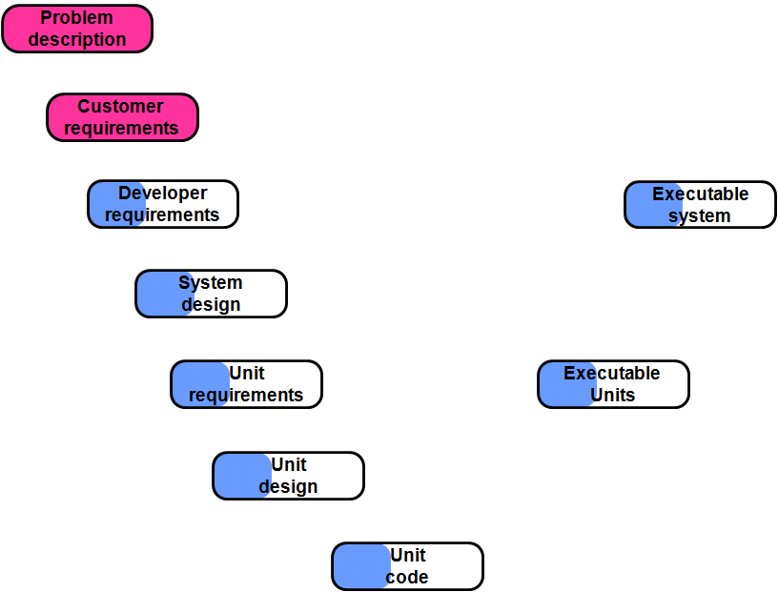
Iterative Enhancement Model (1/4)
Ref.: Rombach

Slide 8
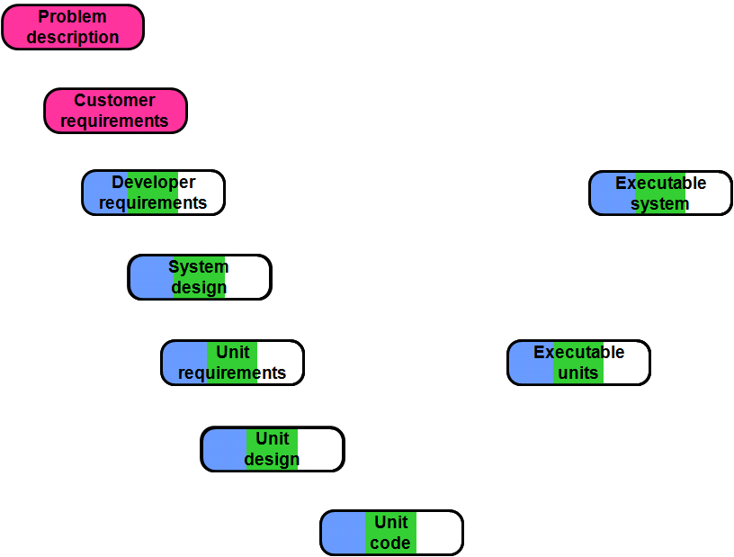
Iterative Enhancement Model (2/4)
Ref.: Rombach

Slide 9
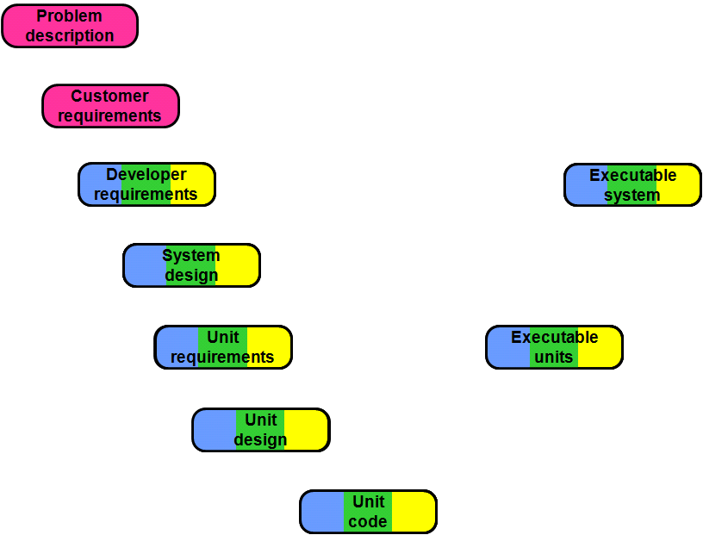
Iterative Enhancement Model (3/4)
Ref.: Rombach

Slide 10
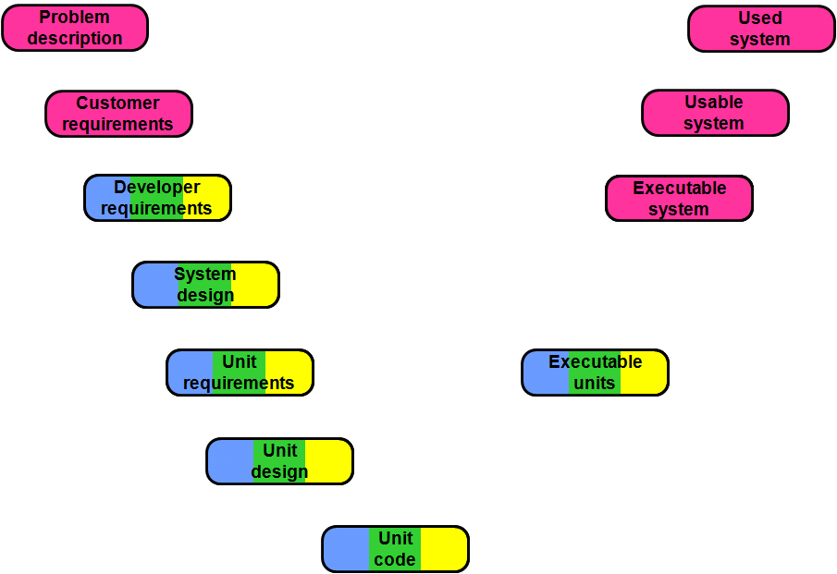
Iterative Enhancement Model (4/4)
Ref.: Rombach

Slide 11
Lifecycle Models – Prototyping Model (1/3)
Problem Description
Customer Requirements
Developer Requirements
Executable System
Executable Units
Unit Code

Slide 12
Lifecycle Models – Spiral Model (1/3)
cumulative cost
Progress through steps
Determine objectives, alternatives, constraints
Evaluate alternatives, identify, resolve risks
Risk analysis
Risk analysis
Risk analysis
Commitment
R. a.
Prototype 2
Prototype 3
Operational
Prototype
Review
partition
Requirements plan lifecycle plan
P.1
Concept of operation
Simulations, models, benchmarks
Software requirements
Software product design
Detailed design
Development plan
Requirements validation
Code
Unit test
Integration and test plan
Design validation and verification
Integration and test
Acceptance test
Develop, verify next-level product
Plan next phases
Implementation

Slide 13
Rational Unified Process (RUP) (1/4)
Phases
Inception
Elaboration
Construction
Transition
Requirements
one iteration in
the elaboration
Analysis
phase
Design
Core Workflows
Implementation
Test
Iteration
Iteration
…
Iteration
Iteration
1
2
n-1
n

Slide 14
Agility in Software Development
Agility in software development is not a methodology; it is an approach.
A number of different Agile methodologies have been developed that have embraced the Agile approach, such as Extreme Programming (XP), Dynamic Systems Development Method, Feature-Driven Design, Crystal, Agile Modelling and SCRUM.
Agile principles (Beck et al., 2001):
Welcome changing requirements.
The highest priority is to satisfy the customer through early and continuous delivery of valuable software.
Deliver working software frequently, from a couple of weeks to a couple of months, with a preference to the shorter timescale.
Business people and developers must work together daily throughout the project.
Working software is the primary measure of progress.

Slide 15
Extreme Programming (XP): Overview
Like other agile methodologies, XP differs from traditional methodologies mainly in placing a higher value on adaptability than on predictability.
Adapt to changing requirements at any point during the project life instead of defining all requirements at the beginning of a project.
XP uses Agile principles.
XP lowers the cost of change.
XP helps to achieve a high degree of customer satisfaction because customers notice that it creates a working software faster, and that software tends to have very few defects.

Slide 16
Extreme Programming: Overview
Planning
Collect user stories
Create prototype architecture
Create release plan
Develop test scenarios
Develop Increment
Develop test cases
Plan & implement the increment
Revise architecture
Test current increment
Collect data
Iteration 1
Iteration 2
…
Perform Acceptance Test
(Ref: Bunse / von Knethen: Vorgehensmodelle kompakt)

Slide 17
Extreme Programming: Planning
Planning
Collect user stories
→ Text documents
→ Use cases
Create release plan
→ Increment planning
→ Day tasks
→ Data recording
Create prototype architecture
→ Class diagrams
Develop test scenarios
→ Scenarios
(Ref: Bunse / von Knethen: Vorgehensmodelle kompakt)

Slide 18
Extreme Programming: Iterative Phase
Iteration 1
Develop test cases
→ Test cases
→ Test environment
Iteration 2
…
Revise architecture
→ Class diagram
Plan & implement the increment
→ Source code
Collect data
→Measurement data
Test current increment
→ Test results
Perform Acceptance Test
→ Test results
(Ref: Bunse / von Knethen: Vorgehensmodelle kompakt)

Slide 19
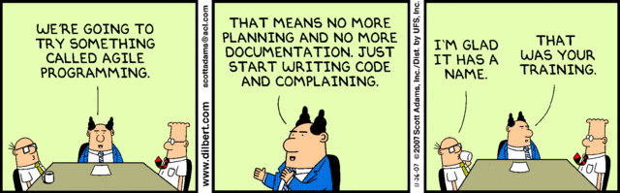
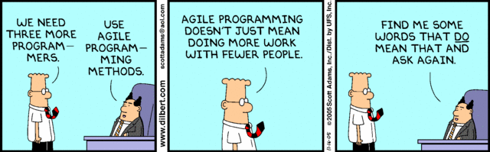
What is Scrum?
Agile Management Framework for SW development projects

Slide 20
What is Scrum? (2)
Agile Management Framework for SW development projects
Few clear rules
Roles: Product Owner, Team, Scrum Master
Product Backlog, Sprint Backlog, few compact reports
Short work cycles (so called “Sprints”) for incremental development
Based on the agile manifest by Kent Beck et al.
Human-centered
Technology and tools have secondary role
Close cooperation with customer

Slide 21
What is Scrum? (3)
Empirical learning process
Learning in each iteration (Sprint): „inspect and adapt“
Development speed/productivity
Obtained results
Team work
Usage of Scrum process
→ Scrum does not define a development methodology, QA strategy, or risk management approach, but asks the team to take care of these issues appropriately

Slide 22
Scrum – An Overview
Product Owner
Product Backlog
Sprint Backlog
Shippable
Product Increment
Sprint
ScrumMaster
Team

Slide 23
Scrum – An Overview (2)
Product Backlog
Includes requirements for the product - at the start of the project a few, less detailed requirements, which are refined and detailed incrementally
Managed by the product owner
Sprint Backlog
Includes the requirements for the product that have to be implemented as part of the next sprint
Managed by the team
Sprint
Period (max. 30 calendar days) in which a shippable product increment (executable, tested, and documented) is created by the team
Time Boxed, i.e. ends exactly at the scheduled time
At the end of the Sprint, the product owner has to accept the final results
Partially completed or incorrect results will not be shipped (no compromise on quality) and go back to the product backlog for the next Sprint

Slide 24
Scrum – The Three Roles
Product Owner
Decides which requirements are implemented for a product version
Decides about when product increments will be shipped
Team
Implements requirements
Decides how many requirements are implemented in a Sprint
Organizes its activities independently
Scrum Master
Takes care of the proper implementation of Scrum
Supports the team

Slide 25
Summary
Prescriptive process models prescribe a certain process
They are defined on different levels of abstraction and may be standardized
Challenges and shortcomings of process standards
Most standards tell you ‘what to’ do but not ‘how to’; i.e., they must be interpreted for organizational application
Often only weak/generic definitions so many implementations can fit in
A standard does not necessarily fit all organizational contexts
Adapting a standard does not automatically mean improvement
Some standards (ISO etc.) are expensive and not publicly available
NO one size fits all!!
We have
learned about several basic software development models
learned about important process standards with their implications
learned about the benefits of adapting to a standard
learned about alternative approaches

