Slide 1
difference between sinlge page application and multi page application
------------
SPA
--
- only one html page, content is (re)rendered on client.
- typically only one ReactDOM.render() call
MPA
--
- multiple html pages, content is rendered on server
- one ReactDOM.render() call per "widget"

Slide 2
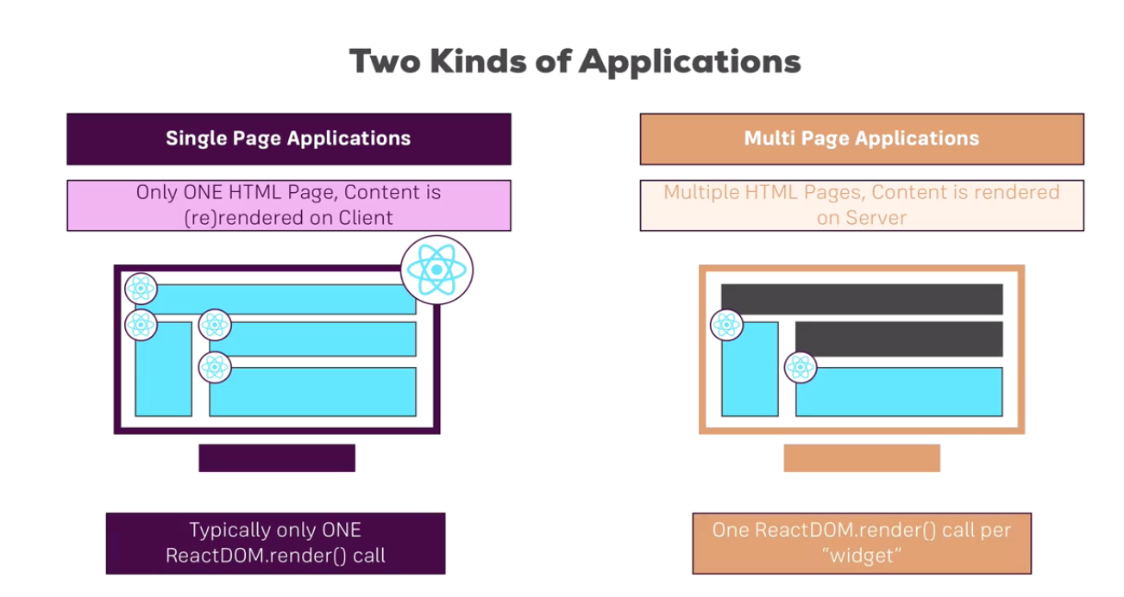

Slide 3
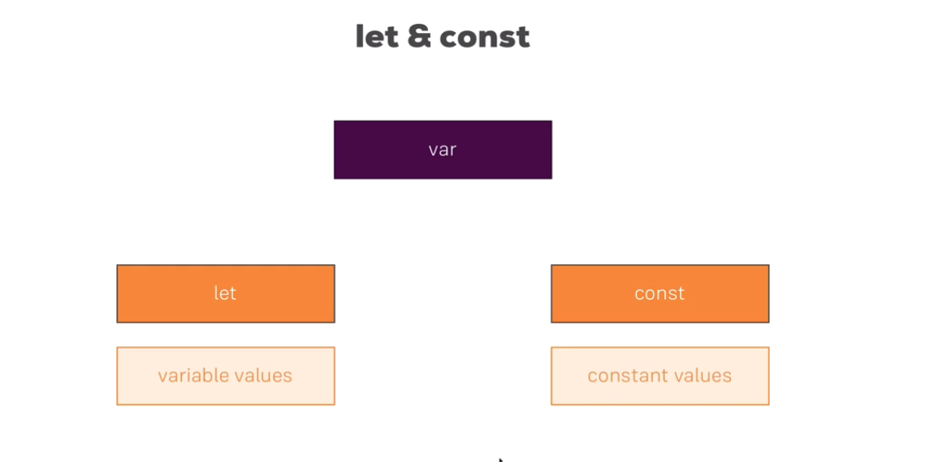

Slide 4
http://jsbin.com/?html,output - For online compiler
Next Generation Javascript Introduction
var creates a variable in javascript.
- Some variables never change they are called constants technically these are also variables. Something assigning only once and never change.
With ES6 they have introduced let and const
Highly encouraged to use let and const
let is the new var
let and const are different ways of creating variables.

Slide 5
var myname = 'vijay';
console.log(myname);
myname = 'kate';
console.log(myname);
let myname = 'vijay';
console.log(myname);
myname = 'kate';
console.log(myname);

Slide 6
const myname = 'vijay';
console.log(myname);
myname = 'kate';
console.log(myname);

Slide 7
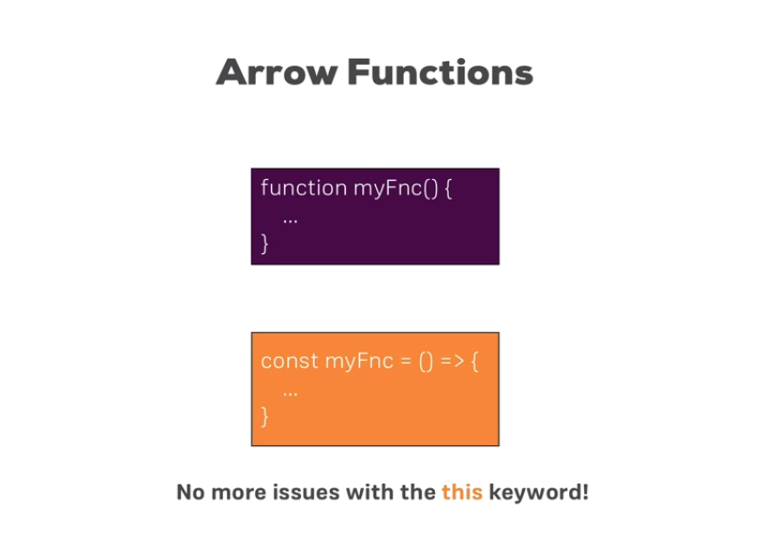
Arrow Functions

Slide 8
Normal function
function printMyname(name)
{
console.log(name);
}
printMyname();
o/p
undefined
function printMyname(name)
{
console.log(name);
}
printMyname('vijay');
o/p
"vijay"

Slide 9
Using Arrow function
const printMyname = (name) =>
{
console.log(name);
}
printMyname('vijay');
"vijay”
Important:
When having no arguments, you have to use empty parentheses in the function declaration:
const callMe = () => {
console.log('Vijay!');
}

Slide 10
When having exactly one argument, you may omit the parentheses:
const callMe = name => {
console.log(name);
}
When just returning a value, you can use the following shortcut:
const returnMe = name => name
That's equal to:
const returnMe = name => {
return name;
}

Slide 11
const returnMe = name => name;
console.log(returnMe('vijay'));
If multiple arguments are there compulsory you should use parenthesis:
const printMyname = (name, age) =>
{
console.log(name, age);
}
printMyname('vijay', 28);

Slide 12
const multiply = (number) =>
{
return number * 2;
}
console.log(multiply(2));
Shorter version of the above code while returning something
const multiply = (number) => number * 2;
console.log(multiply(2));

Slide 13
Exports and Imports(Modules)
in React projects (and actually in all modern JavaScript projects), you split your code across multiple JavaScript files - so-called modules. You do this, to keep each file/ module focused and manageable.
To still access functionality in another file, you need export (to make it available) and import (to get access) statements.
Another feature of modern javascript is writing modular code.
Spliting javascript code into multiple files.
We just have to import them in the correct order in our html files.
Inside javascript file we can import the content from another file so javascript files themselves know their dependencies.

Slide 14
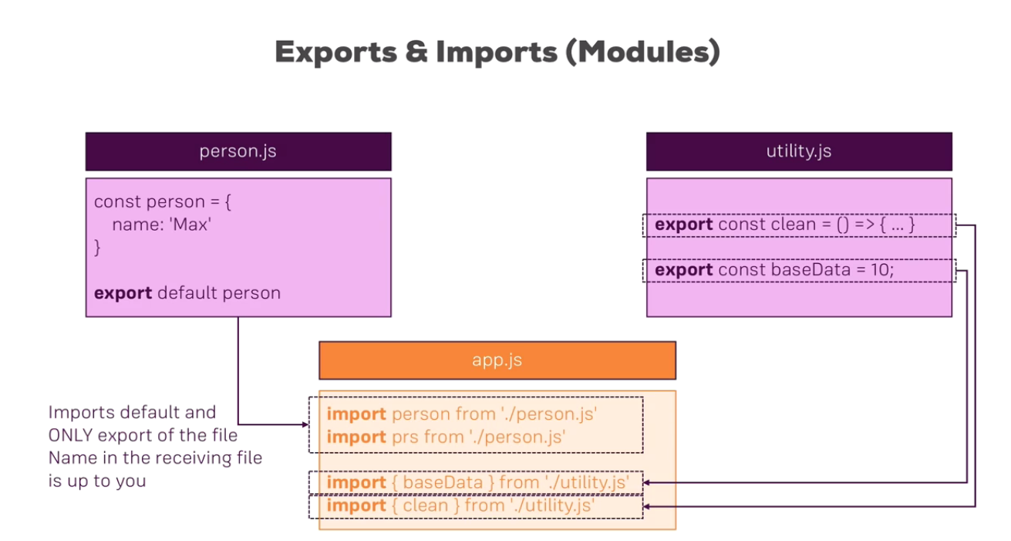
You got two different types of exports: default (unnamed) and named exports:

Slide 15
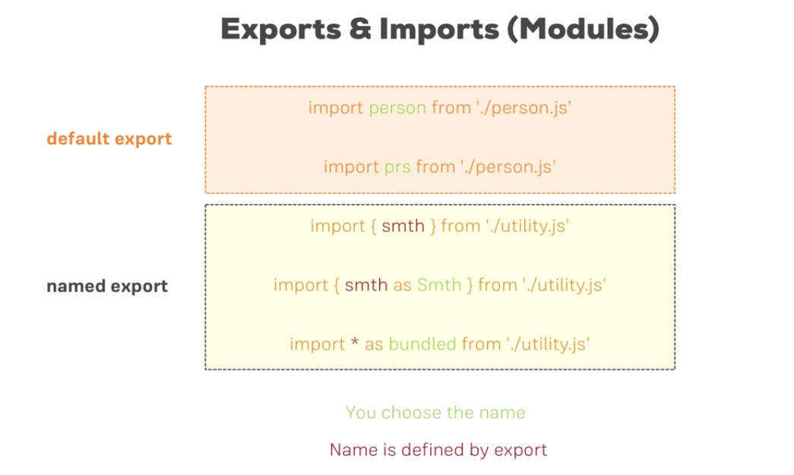

Slide 16
default => export default ...;
named => export const someData = ...;
You can import default exports like this:
import someNameOfYourChoice from './path/to/file.js';
Surprisingly, someNameOfYourChoice is totally up to you.
Named exports have to be imported by their name:

Slide 17
import { someData } from './path/to/file.js';
A file can only contain one default and an unlimited amount of named exports. You can also mix the one default with any amount of named exports in one and the same file.
When importing named exports, you can also import all named exports at once with the following syntax:
import * as upToYou from './path/to/file.js';
upToYou is - well - up to you and simply bundles all exported variables/functions in one JavaScript object. For example, if you export const someData = ... (/path/to/file.js ) you can access it on upToYou like this: upToYou.someData .

Slide 18
What are constructors?
A constructor is a function that creates an instance of a class which is typically called an “object”. In JavaScript, a constructor gets called when you declare an object using the new keyword.
The purpose of a constructor is to create an object and set values if there are any object properties present. It’s a neat way to create an object because you do not need to explicitly state what to return as the constructor function, by default, returns the object that gets created within it.

Slide 19
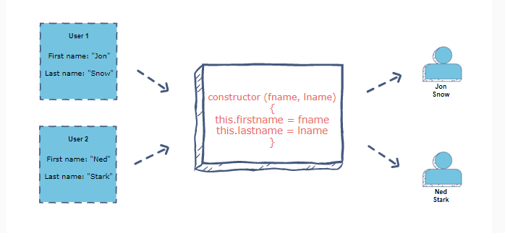
Example
Let’s say there is an object, User, which has two properties: firstname and lastname.
To initialize two instances with different names, you will use the same constructor function, as shown in the figure below:

Slide 20
What happens when a constructor gets called?
In JavaScript, here’s what happens when a constructor is invoked:
A new empty object is created
this keyword starts referring to that newly created object and hence it becomes the current instance object
The newly created object is then returned as the constructor’s returned value

Slide 21
Given below is the code to initialize two user instances just as shown in the above illustration:
function User(first, last) {
this.firstName = first
this.lastName = last
}
var user1 = new User("Jon", "Snow")
console.log(user1)
var user2 = new User("Ned", "Stark")
console.log(user2)

Slide 22
Default constructors
In JavaScript, if you don’t specify any constructor, a default constructor is automatically created which has no parameters:
constructor(){
}
Note: Constructors have the same name as that of the object which is being created. As a convention, the first alphabet is kept capital in the constructor function.

Slide 23
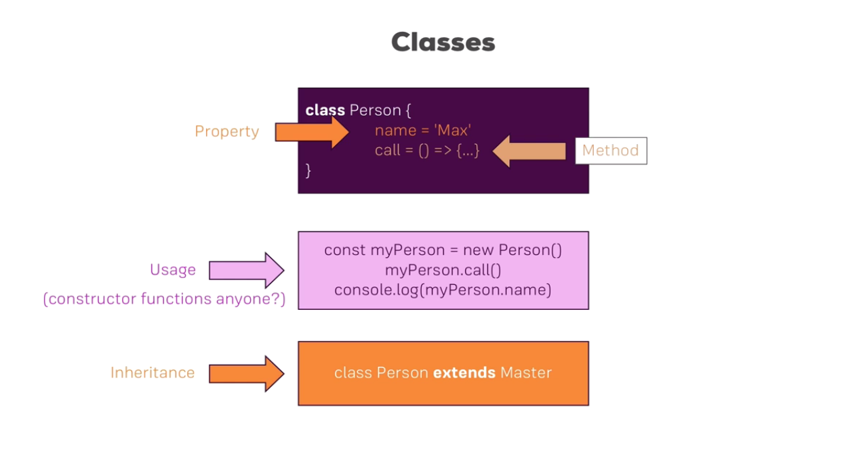
classes

Slide 24
Classes are a feature which basically replace constructor functions and prototypes. You can define blueprints for JavaScript objects with them.
Like this:
class Person {
constructor () {
this.name = 'Max';
}
}
const person = new Person();
console.log(person.name); // prints 'Max'

Slide 25
In the above example, not only the class but also a property of that class (=> name ) is defined. The syntax you see there, is the "old" syntax for defining properties. In modern JavaScript projects (as the one used in this course), you can use the following, more convenient way of defining class properties:
class Person {
name = 'Max';
}
const person = new Person();
console.log(person.name); // prints 'Max'

Slide 26
You can also define methods. Either like this:
class Person {
name = 'Max';
printMyName () {
console.log(this.name); // this is required to refer to the class!
}
}
const person = new Person();
person.printMyName();

Slide 27
Or like this:
class Person {
name = 'Max';
printMyName = () => {
console.log(this.name);
}
}
const person = new Person();
person.printMyName();
The second approach has the same advantage as all arrow functions have: The this keyword doesn't change its reference.

Slide 28
You can also use inheritance when using classes:
class Human {
species = 'human';
}
class Person extends Human {
name = 'Max';
printMyName = () => {
console.log(this.name);
}
}
const person = new Person();
person.printMyName();
console.log(person.species); // prints 'human'

Slide 29
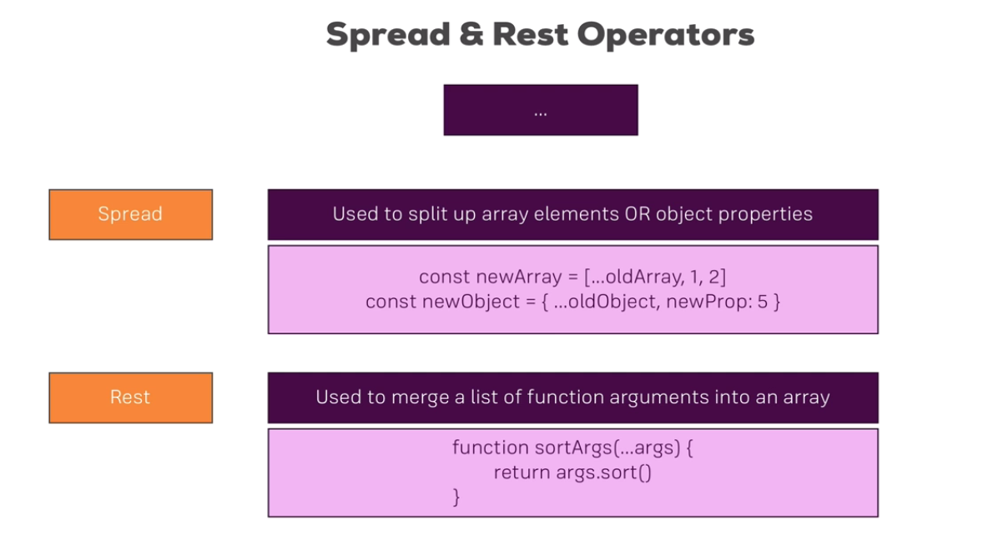

Slide 30
Spread & Rest Operator
The spread and rest operators actually use the same syntax: ...
Yes, that is the operator - just three dots. It's usage determines whether you're using it as the spread or rest operator.
Using the Spread Operator:
The spread operator allows you to pull elements out of an array (=> split the array into a list of its elements) or pull the properties out of an object. Here are two examples:
const oldArray = [1, 2, 3];
const newArray = [...oldArray, 4, 5]; // This now is [1, 2, 3, 4, 5];

Slide 31
Here's the spread operator used on an object:
const oldObject = {
name: 'Max'
};
const newObject = {
...oldObject,
age: 28
};
newObject would then be
{
name: 'Max',
age: 28
}

Slide 32
The spread operator is extremely useful for cloning arrays and objects. Since both are reference types (and not primitives), copying them safely (i.e. preventing future mutation of the copied original) can be tricky. With the spread operator you have an easy way of creating a (shallow!) clone of the object or array.

Slide 33
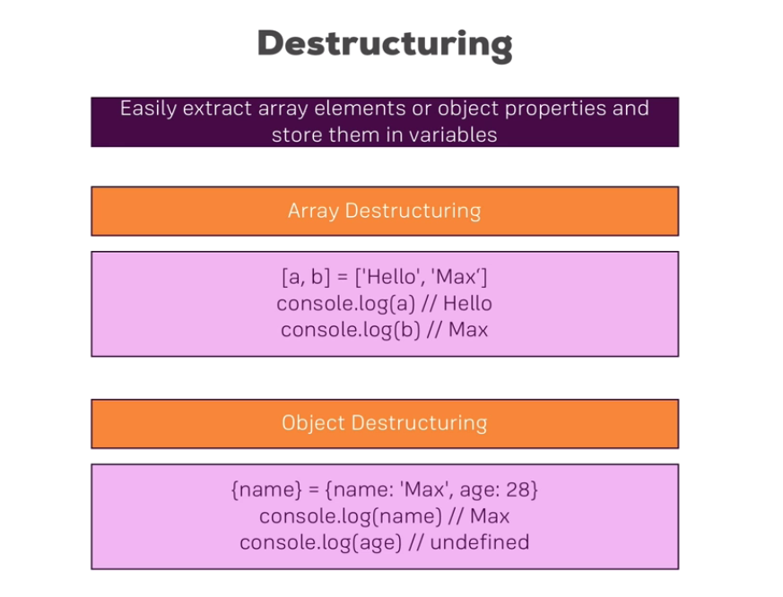

Slide 34
Destructuring
Destructuring allows you to easily access the values of arrays or objects and assign them to variables.
Here's an example for an array:
const array = [1, 2, 3];
const [a, b] = array;
console.log(a); // prints 1
console.log(b); // prints 2
console.log(array); // prints [1, 2, 3]
And here for an object:
const myObj = {
name: 'Max',
age: 28
}

Slide 35
const {name} = myObj;
console.log(name); // prints 'Max'
console.log(age); // prints undefined
console.log(myObj); // prints {name: 'Max', age: 28}
Destructuring is very useful when working with function arguments. Consider this example:
const printName = (personObj) => {
console.log(personObj.name);
}
printName({name: 'Max', age: 28}); // prints 'Max'

Slide 36
Here, we only want to print the name in the function but we pass a complete person object to the function. Of course this is no issue but it forces us to call personObj.name inside of our function. We can condense this code with destructuring:
const printName = ({name}) => {
console.log(name);
}
printName({name: 'Max', age: 28}); // prints 'Max')
We get the same result as above but we save some code. By destructuring, we simply pull out the name property and store it in a variable/ argument named name which we then can use in the function body.

Slide 37
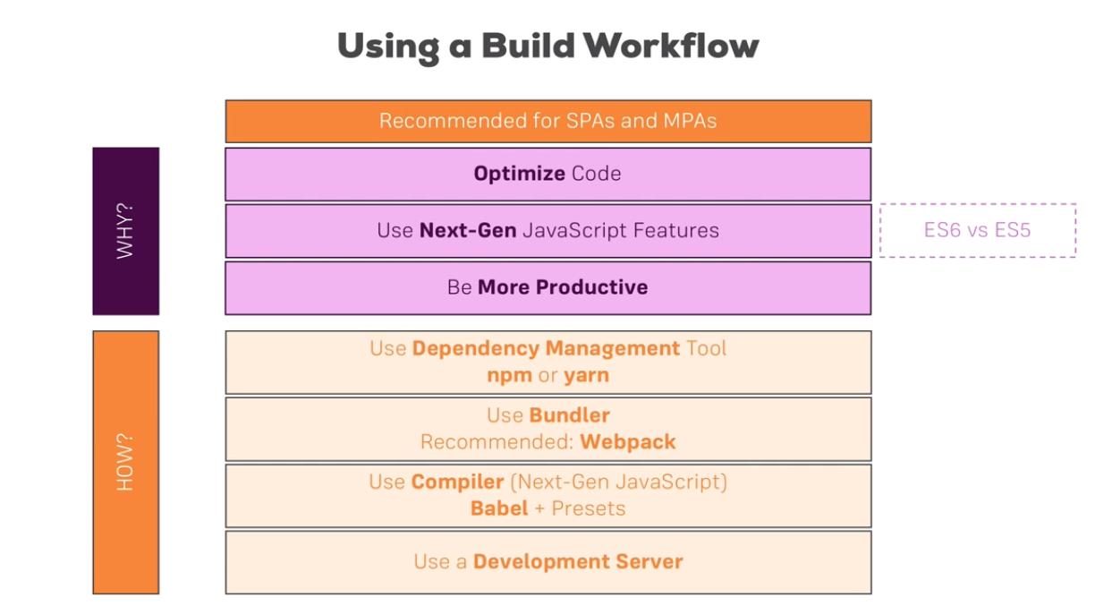

Slide 38
To create the new app
-First install nodejs
-Then in the new folder trigger to install create react app F:\IDE_Projects\DSU_WebDev\React>npm install create-react-app –g
-to create the project trigger
create-react-app react-complete-guide --scripts-version 1.1.5
create-react-app react-complete-tutorial

Slide 39
Understanding the folder structure
let's know walk through all the files and folders we have here. On the root level, we get a couple of configuration files. The package-lock.json is the lock file we can ignore this file. It is just locking in the versions of the dependencies we're using.
the general dependencies our project has are defined in the package.json files.
"dependencies": {
"react": "^17.0.2",
"react-dom": "^17.0.2",
"react-scripts": "1.1.5"
},

Slide 40
"scripts": {
"start": "react-scripts start",
"build": "react-scripts build",
"test": "react-scripts test --env=jsdom",
"eject": "react-scripts eject"
}
- In the package.json file, there was a couple of scripts defined, you can run these scripts with npm run and then the script name.
- it uses this react scripts package to then also execute some start command there, this command happens to start this development server, watch all our code, compile our code, optimize the code and do all these things

Slide 41
Once you're ready for deploying your app, you would run npm run build to optimize it even more, not launch the development server but instead get your optimized code stored in a folder because right now you won't see your compiled code anywhere here, everything happens in memory.
The node modules folder holds all the dependencies and sub-dependencies of our project this is why we have that many. We only had react, react dom and react scripts but react scripts has a lot of other dependencies, You shouldn't edit anything into node modules folder, it's generated automatically if you run npm install in your project folder and this was automatically done by create react scripts.

Slide 42
The public folder is more interesting, it's basically the root folder which gets served by the web server in the end, though here it only holds the files we can edit the script files are added in the source folder.
in src folder Here we got one important file index.html this is a normal html page and it is the single page, We will never add more html pages in this project.
if you are creating a multi page project you would create multiple such projects here with create react app, you wouldn't add more html files here or you need your own workflow if you want to do that. So this is the single page, where in the end our script files will get injected by that build workflow. which is why you don't see a script import here and you can edit this file but we won't write any html code here. this will become important because this will be where we actually mount our react application later.

Slide 43
But if you need to add any imports to let's say other libraries, CSS libraries or want to add some meta tags, you can do that here in the html file.
this manifest.json file where we can define some meta data about our application.
Interesting for us is this source folder, here we get a couple of files and these are actually the files we will work in, this is actually our react application.
Most important for us right now, the index.js file gets access to this root element in our dom, in our html file, so the element with the ID root which of course is this div we saw in the index.html file, this one, and there as you can see it, it renders our react application with the render method.
<App /> is a reference of some app object or element which we import from an app file, the extension

Slide 44
- import App from './App';
.js is left out because it's automatically added by our build workflow
This is the jsx syntax
return (
<div className="App">
<header className="App-header">
<img src={logo} className="App-logo" alt="logo" />
<h1 className="App-title">Welcome to React</h1>
</header>
<p className="App-intro">
To get started, edit <code>src/App.js</code> and save to reload.
</p>
</div>
);

Slide 45
Remove everything and just add
render() {
return (
<div className='App'>
<h1>Hi, I'am a React App</h1>
</div>
)
}
don't forget to save your files.
since you have npm start running, this will automatically trigger a recompilation and it should automatically reload your page too which is why you should now see Hi I'm a react app. instead of the old content.

Slide 46
With that we can also removed this logo.svg file because we no longer use it in our project,
app.css file which basically defines some stylings we use in this app.js file, though I will say that these are not scoped to this file. will actually remove everything but this first app class definition.
The registerServiceWorker.js file is as the name implies important for registering a service worker which is generated automatically, that's related to this progressive web app we get out of the box. It will basically pre-cache our script files, we don't need to configure anything there.
-The test file, it basically allows us to create unit tests for the different units, for example components in our application.

Slide 47
This is the general setup and for the majority of this course, we'll work in app.js or other new components we create.

Slide 48
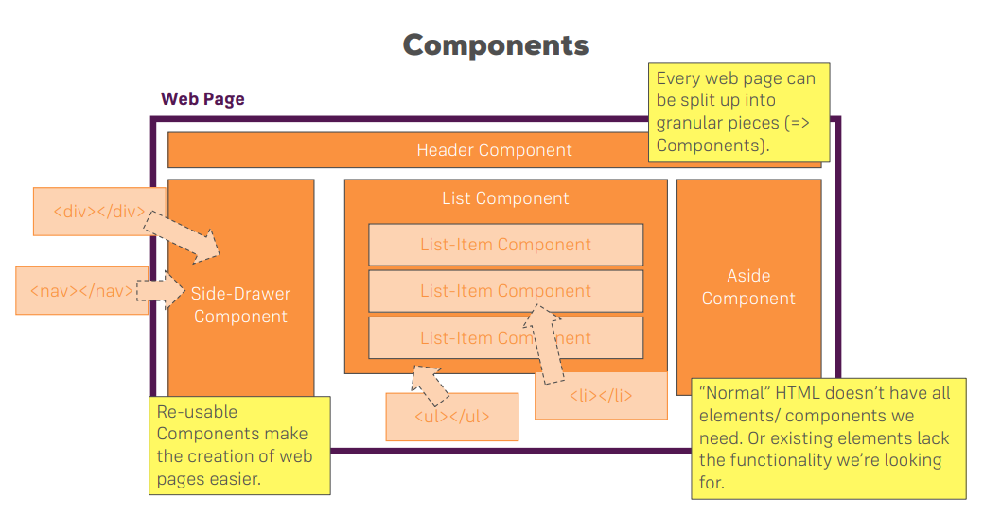
Understanding Components Basics
react is all about creating components, basically custom html. elements you could say, which you can then use to construct your application.

Slide 49
Creating our first react component
First delete the files in the src all the files except index.js
index.js is the javascript entry point

