Slide 1
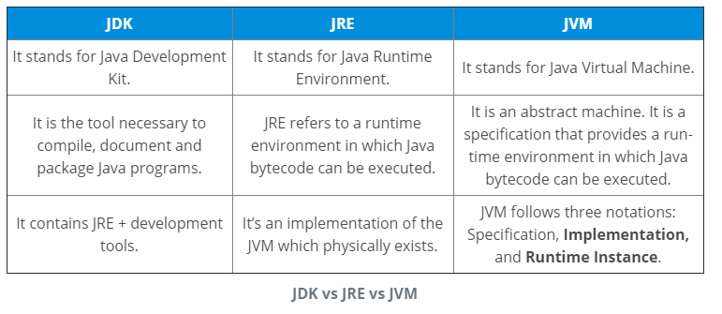
Exercise 1:
Explain JDK, JRE and JVM?
Why Java is platform independent?
Java is called platform independent because of its byte codes which can run on any system irrespective of its underlying operating system.

Slide 2
3. Why pointers are not used in Java?
Java doesn’t use pointers because they are unsafe and increases the complexity of the program. Since, Java is known for its simplicity of code, adding the concept of pointers will be contradicting. Moreover, since JVM is responsible for implicit memory allocation, thus in order to avoid direct access to memory by the user, pointers are discouraged in Java.
4. What is JIT compiler in Java?
JIT stands for Just-In-Time compiler in Java. It is a program that helps in converting the Java bytecode into instructions that are sent directly to the processor. By default, the JIT compiler is enabled in Java and is activated whenever a Java method is invoked. The JIT compiler then compiles the bytecode of the invoked method into native machine code, compiling it “just in time” to execute. Once the method has been compiled, the JVM summons the compiled code of that method directly rather than interpreting it. This is why it is often responsible for the performance optimization of Java applications at the run time.

Slide 3
What do you know about Java?
Java is a high-level programming language originally developed by Sun
Microsystems and released in 1995. Java runs on a variety of platforms, such as
Windows, Mac OS, and the various versions of UNIX.
What are the supported platforms by Java Programming Language?
Java runs on a variety of platforms, such as Windows, Mac OS, and the various
versions of UNIX/Linux like HP-Unix, Sun Solaris, Redhat Linux, Ubuntu, CentOS, etc.

Slide 4
How Java enabled High Performance?
A: Java uses Just-In-Time compilerto enable high performance. Just-In-Time compiler
is a program that turns Java bytecode, which is a program that contains instructions
that must be interpreted into instructions that can be sent directly to the processor
What is Java Virtual Machine and how it is considered in context of Java’s platform independent feature?
A: When Java is compiled, it is not compiled into platform specific machine, rather
into platform independent byte code. This byte code is distributed over the web and
interpreted by virtual Machine (JVM) on whichever platform it is being run.

Slide 5
List two Java IDE’s?
A: Netbeans, Eclipse, etc.
What is the Difference between JDK and JRE ?
The Java Runtime Environment (JRE) is basically the Java Virtual Machine (JVM) where your Java programs are being executed.
It also includes browser plugins for applet execution. The Java Development Kit (JDK) is the full featured Software Development
Kit for Java, including the JRE, the compilers and tools (like JavaDoc, and Java Debugger), in order for a user to develop, compile
and execute Java applications.

Slide 6
Why people say that Java is 'write
once and run anywhere' language?
You can write Java code on Windows and compile it in Windows
platform. The class and jar files that you get from Windows
platform can run as it is on Unix environment. So it is a truly
platform independent language.
Behind all this portability is Java byte code. Byte code generated by
Java compiler can be interpreted by any JVM. So it becomes much
easier to write programs in Java and expect those to run on any
platform.
Java compiler javac compiles java code and JVM java runs that
code.

